Slide 1
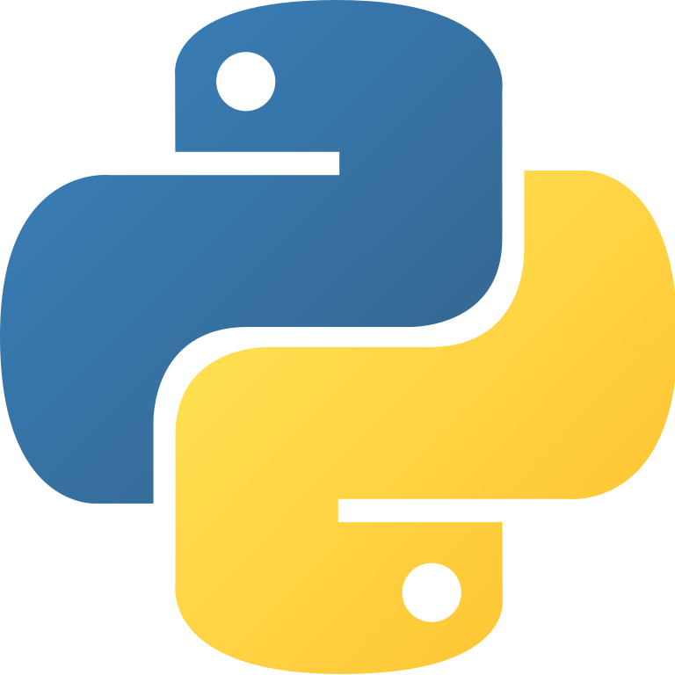
Python here, there, and everywhere

Slide 2
Where should you run Python
It’s best to install it on your own computer
You’ll have more control, can run Jupyter notebooks and learn more about it
You can also run it on UMBC’s gl unix system
Installing new packages and modules as needed
You can also use remote notebook servers
At UMBC, Google Colab, Binder, …
And use other remote options
Like Repl.it
We’ll give some details here

Slide 3
Installing Python 3
Assuming you have a computer running Unix, OS X, or Windows install the newest version of Python (e.g., 3.8) from python.org
You can install it on iOS and Android, too
Here’s a tutorial if you need help
Running it on your own computer makes it easier to install packages, IDEs, and use notebooks
And will give you more experience

Slide 4
IDE or not?
Python’s an interpreted language so it comes with a read-eval-print-loop environment
I’ll admit to mostly using emacs to edit code in one window and the Python REPL in another
Emacs comes with a python-mode that’s invoked when you edit a file ending in .py
But you may prefer a Python IDE
Python comes with a simple one, IDLE
PyCharm is very popular and good
Here’s a guide to Python editors and IDEs

Slide 5
Loading code into Python
Load file foo.py from the current directory
>>> import foo
Each expression in the file is evaluated, but the value is not printed (i.e., it’s a read-eval loop)
Python will also search directories in the environment variable PYTHONPATH
~> echo $PYTHONPATH
/afs/umbc.edu/users/f/i/finin/pub/ai/aima-python: /afs/umbc.edu/users/f/i/finin/pub/ai/:
And load installed packages, which can be simple or complex with sub-packages
>>> import tensorflow

Slide 6
Import variations
File: example.py
name = "Bob"
def hello():
print("hello, I'm", name)
def bye():
print("goodbye")
How you import effects how you access its named functions and variables
import example example.hello()
import example as ex ex.hello()
from example import hello hello()
from foo import * hello()
Python only imports a file once, subsequent imports do nothing

Slide 7
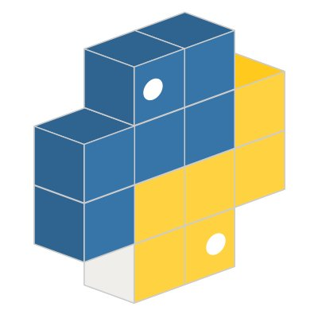
Installing software packages
Python’s got a huge user base and is the most popular language for AI today
So there are many great SW packages to install
Your Python probably came with pip, the standard python package install program
Search for packages on pypi.org and install/update them with the pip command

Slide 8
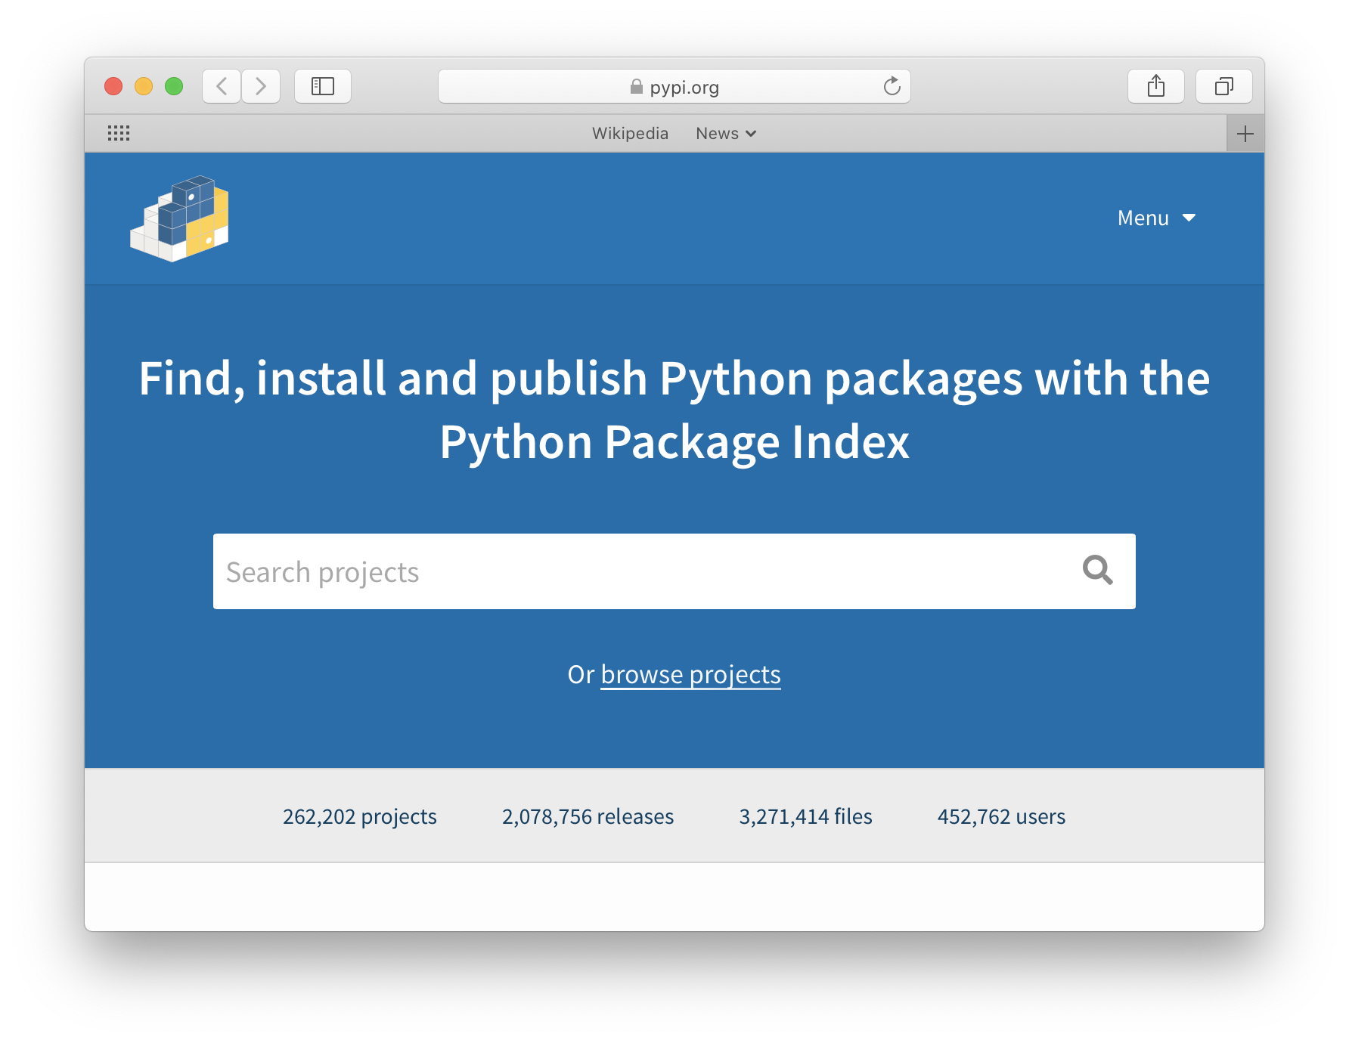

Slide 9
Using pip
For HW3 you’ll need the python package python-constraint
Install it on your own Linux or Mac system
pip install python-constraint
If your acct is not an admin:
sudo pip install python-constraint
Install without sudo privileges (e.g., on gl)
pip install python-constraint --user

Slide 10
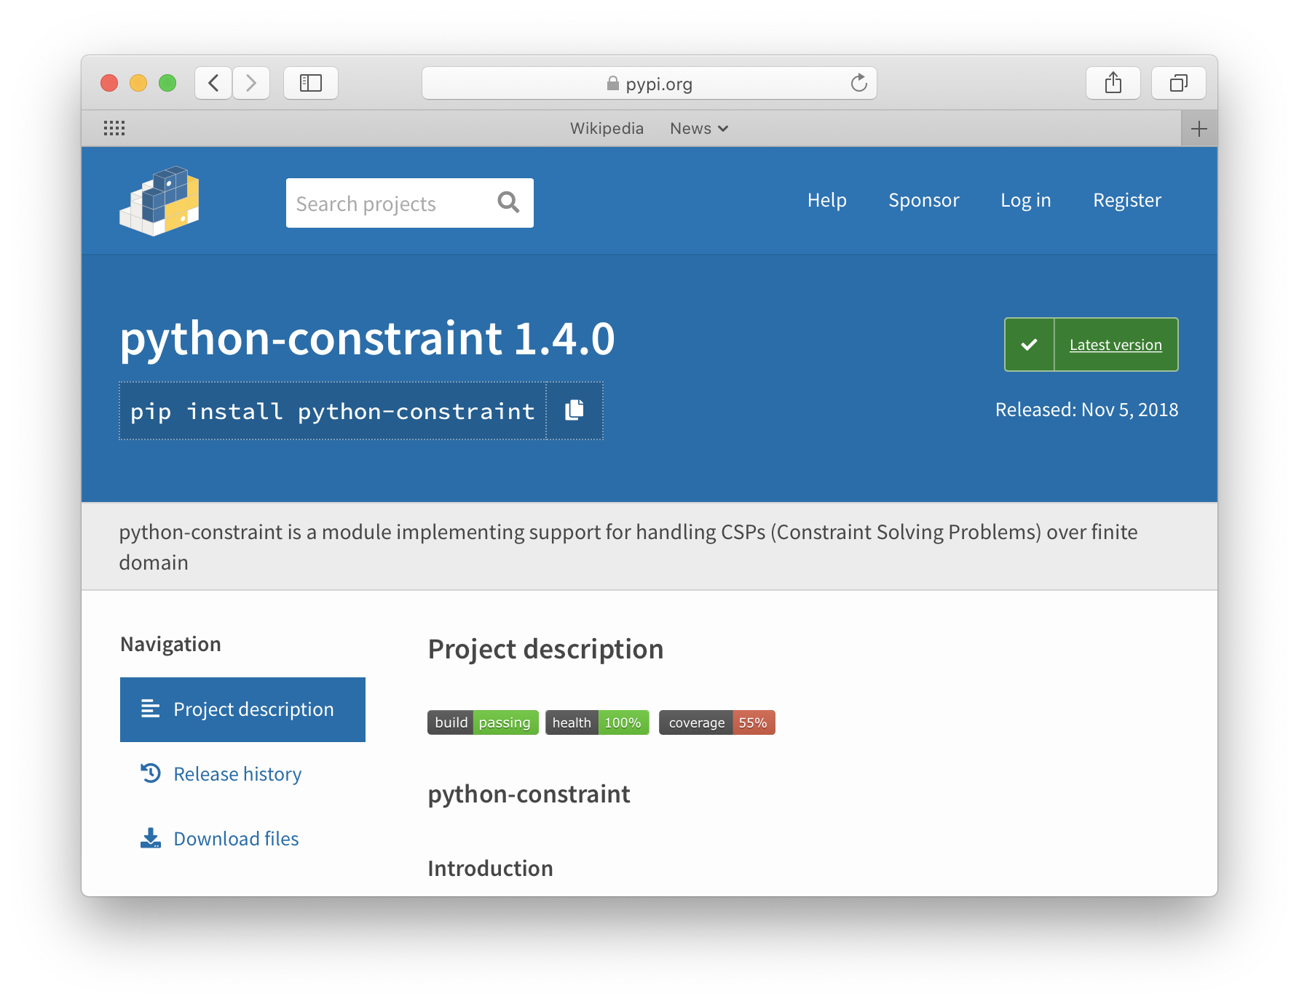
Type this to install
Scroll down to see more info & documentation

Slide 11
Working on gl
On gl, you tell Python to look in the directory we’ve set up for AIMA python code
Or set up your own directory (e.g., ~/mypy) in which you install new packages
For either, you must first add appropriate directories to your PYTHONPATH environment variable
Do this by modifying your shell initialization file (e.g., ~/.cshrc or ~/.bashrc)

Slide 12
Python and PYTHONPATH
Python’s import command looks for modules to load in a list of places
sys.path is the list, with ‘‘ as the current directory
>>> import sys
>>> sys.path
[‘ ‘, '/usr/lib64/python26.zip', …]
On Unix, when python starts, it prepends directories on your PYTHONPATH environment variable
Add new directories for python to search by setting PYTHONPATH in the init file used by your shell
The Unix command echo $SHELL shows what shell you are using

Slide 13
virtualenv

Slide 14
Notebooks

Slide 15
On your own computer

Slide 16
Using a notebook server

Slide 17
Using Binder

Slide 18
Using Google Colab

Slide 19
Using repl.it

Slide 20
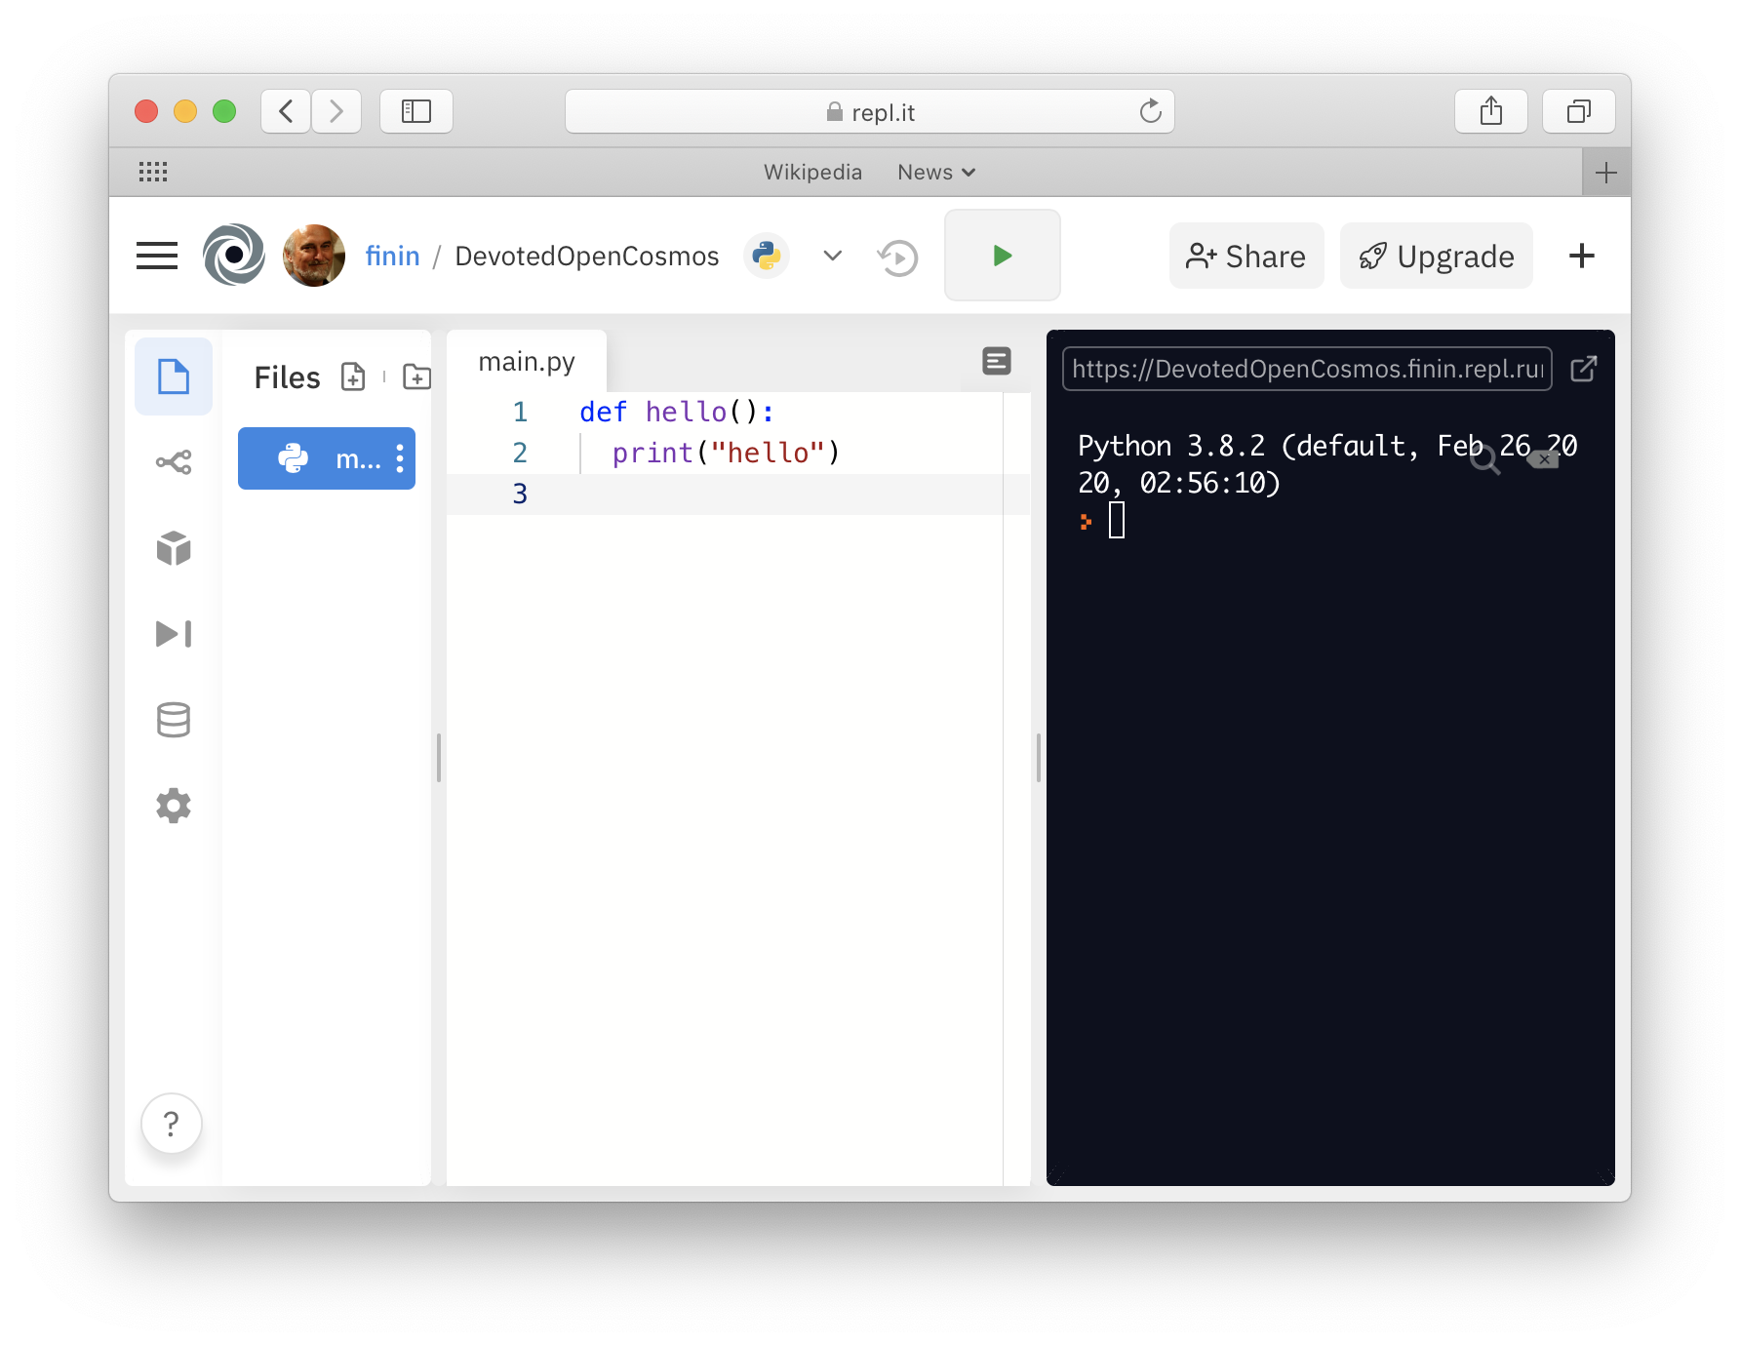
Using repl.it
I’m unfamiliar with this, but it looks interesting
Web-based IDE startup for 60+ languages
Including Python
Free for public and limited use
Good for trying new languages?
Supports teams

