Slide 1

Machine Learning: Decision Trees
14.2_dt
Chapter 19.3
Some material adopted from notes by Chuck Dyer

Slide 2
Decision Trees (DTs)
A supervised learning method used for classification and regression
Given a set of training tuples, learn model to predict one value from the others
  Learned value typically a class (e.g., goodRisk)
Resulting model is simple to understand, interpret, visualize, and apply

Slide 3
Learning a Concept
The red groups are negative examples, blue positive
Attributes
Size: large, small
Color: red, green, blue
Shape: square, circle
Task
Classify new object with a size, color & shape as positive or negative

Slide 4
Training data
Size | Color | Shape | class
Large | Green | Square | Negative
Large | Green | Circle | Negative
Small | Green | Square | Positive
Small | Green | Circle | positive
Large | Red | Square | Positive
Large | Red | Circle | Positive
Small | Red | Square | Positive
Small | Red | Circle | Positive
Large | Blue | Square | Negative
Small | Blue | Square | Positive
Large | Blue | Circle | Positive
Small | Blue | Circle | Positive

Slide 5
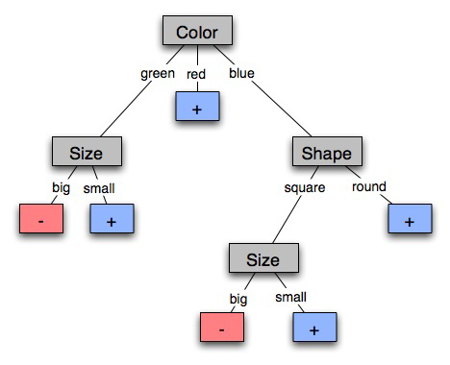
A decision tree-induced partition
The red groups are negative examples, blue positive
Negative things are big, green shapes and big, blue squares

Slide 6
Learning decision trees
Goal: Build decision tree to classify examples as positive or negative instances of concept using supervised learning from training data
A decision tree is a tree where
  non-leaf nodes have an
  attribute (feature)
  leaf nodes have a classification
  (+ or -)
  each arc has a possible value of
  its attribute
Generalization: allow for >2 classes
  e.g., classify stocks as {sell, hold, buy}
Color
green
red
blue
Size
+
Shape
big
small
square
round
-
+
Size
+
big
small
-
+

Slide 7
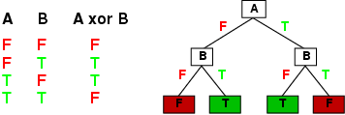
Expressiveness of Decision Trees
Can express any function of input attributes, e.g., for Boolean functions, truth table row → path to leaf:
There’s a consistent decision tree for any training set with one path to leaf for each example, but it probably won't generalize to new examples
Prefer more compact decision trees

Slide 8
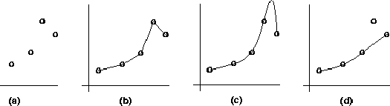
Inductive learning and bias
Suppose that we want to learn a function f(x) = y and we’re given sample (x,y) pairs, as in figure (a)
Can make several hypotheses about f, e.g.: (b), (c) & (d)
Preference reveals learning technique bias, e.g.:
  prefer piece-wise functions (b)
  prefer a smooth function (c)
  prefer a simple function and treat outliers as noise (d)

Slide 9

Preference bias: Occam’s Razor
William of Ockham (1285-1347)
  “non sunt multiplicanda entia praeter necessitatem”
  entities are not to be multiplied beyond necessity
Simplest consistent explanation is the best
Smaller decision trees correctly classifying training examples preferred over larger ones
Finding the smallest decision tree is NP-hard, so we use algorithms that find reasonably small ones

Slide 10
Hypothesis spaces
How many distinct decision trees with n Boolean attributes?
  = number of Boolean functions
  = number of distinct truth tables with 2^{n} rows = 2^{2n}
  e.g., with 6 Boolean attributes, 18,446,744,073,709,551,616 trees
How many conjunctive hypotheses (e.g., Hungry ∧ ¬Rain)?
  Each attribute can be in (positive), in (negative), or out
    3^{n} distinct conjunctive hypotheses
  e.g., with 6 Boolean attributes, 729 trees
A more expressive hypothesis space
  increases chance that target function can be expressed
  increases number of hypotheses consistent with training set
  ⇒ may get worse predictions in practice

Slide 11
R&N’s restaurant domain
Develop decision tree that customers make when deciding whether to wait for a table or leave
Two classes: wait, leave
Ten attributes: Alternative available? Bar in restaurant? Is it Friday? Are we hungry? How full is restaurant? How expensive? Is it raining? Do we have reservation? What type of restaurant is it? Estimated waiting time?
Set of 12 training examples
~7000 possible cases

Slide 12
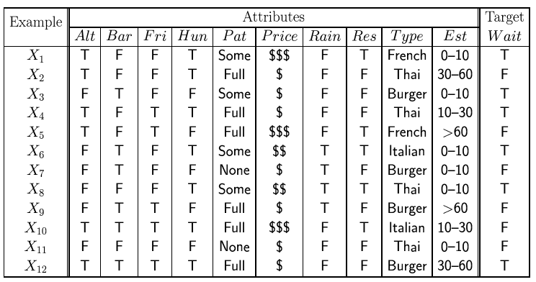
Attribute-based representations
Examples described by attribute values (Boolean, discrete, continuous), e.g., situations where will/won't wait for a table
Classification of examples is positive (T) or negative (F)
Serves as a training set

Slide 13
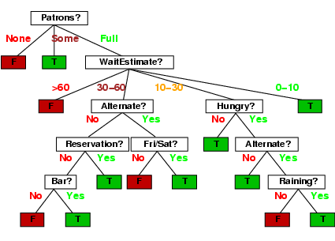
Decision tree from introspection

Slide 14

Issues
It’s like 20 questions
We can generate many decision trees depending on what attributes we ask about and in what order
How do we decide?
What makes one decision tree better than another: number of nodes? number of leaves? maximum depth?

Slide 15
ID3 / C4.5 / J48 Algorithm
Greedy algorithm for decision tree construction developed by Ross Quinlan circa 1987
Top-down construction of tree by recursively selecting best attribute to use at current node
  Once attribute selected for current node, generate child nodes, one for each possible attribute value
  Partition examples using values of attribute, & assign these subsets of examples to the child nodes
  Repeat for each child node until examples associated with a node are all positive or negative

Slide 16
Choosing best attribute
Key problem: choose attribute to split given set of examples
Possibilities for choosing attribute:
  Random: Select one at random
  Least-values: one with smallest # of possible values
  Most-values: one with largest # of possible values
  Max-gain: one with largest expected information gain
  Gini impurity: one with smallest gini impurity value
The last two measure the homogeneity of the target variable within the subsets
The ID3 algorithm uses max-gain

Slide 17
Restaurant: type vs patrons?
Random: Patrons or Wait-time; Least-values: Patrons; Most-values: Type; Max-gain: ???
French
Y
N
Y
N
Type variable
Italian
Thai
N
Y
N
Y
N
Y
N
Y
Burger
Empty
Some
Full
Patrons variable

Slide 18
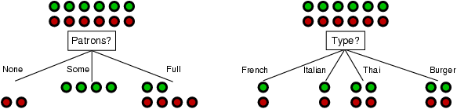
Choosing an attribute
stay
leave
Idea: good attribute splits examples into subsets that are (ideally) all positive or all negative
Which is better: Patrons? or Type?

Slide 19
Choosing an attribute
stay
leave
Idea: good attribute splits examples into subsets that are (ideally) all positive or all negative
Patrons: for six examples we know the answer and for six we can predict with prob. 0.67
Type: our prediction is no better than chance (0.50)

Slide 20
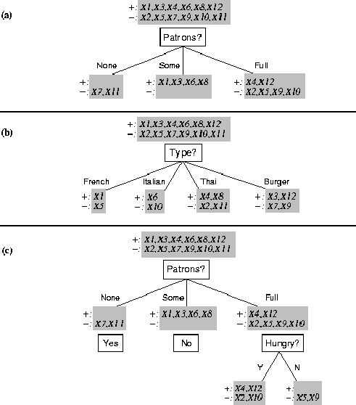
Splitting examples by testing attributes

Slide 21
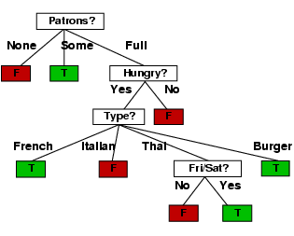
ID3-induced decision tree

Slide 22
Compare the two Decision Trees
Human-generated decision tree
ID3-generated decision tree

Slide 23
Information theory 101
Sprang fully formed from Claude Shannon’s seminal work: Mathematical Theory of
Communication in 1948
Intuitions
  Common words (a, the, dog) shorter than less common ones (parlimentarian, foreshadowing)
  Morse code: common letters have shorter encodings
Information inherent in data/message (inform-
ation entropy) measured in minimum number of bits needed to store/send using a good encoding

Slide 24
Information theory 101
Information entropy ... tells how much information there is in an event. More uncertain an event is, more information it contains
Receiving a message is an event
How much information is in these messages
  The sun rose today!
  It’s sunny today in Honolulu!
  The coin toss is heads!
  It’s sunny today in Seattle!
  Life discovered on Mars!
None
A lot

Slide 25
Information theory 101
For n equally probable possible messages or data values, each has probability 1/n
Information of a message is -log(p) = log(n)
  e.g., with 16 messages, then log(16) = 4 and we need 4 bits to identify/send each message
For probability distribution P (p₁,p₂ … p_{n}) for n messages, its information (aka H or entropy) is:
  I(P) = -(p₁*log(p₁) + p₂*log(p₂) + .. + p_{n}*log(p_{n}))

Slide 26
Entropy of a distribution
  I(P) = -(p₁*log(p₁) + p₂*log(p₂) + .. + p_{n}*log(p_{n}))
Examples:
  If P is (0.5, 0.5) then I(P) = 0.5*1 + 0.5*1 = 1
  If P is (0.67, 0.33) then I(P) = -(2/3*log(2/3) + 1/3*log(1/3)) = 0.92
  If P is (1, 0) then I(P) = 1*1 + 0*log(0) = 0
More uniform probability distribution, greater its information: more information is conveyed by a message telling you which event actually occurred
Entropy is the average number of bits/message needed to represent a stream of messages

Slide 27
Example: Huffman code
In 1952, MIT student David Huffman devised (for a homework assignment!) a coding scheme that’s optimal when all data probabilities are powers of 1/2
A Huffman code can be built as followings:
  Rank symbols in order of probability of occurrence
  Successively combine 2 symbols of lowest probability to form new symbol; eventually we get binary tree where each node is probability of nodes below
  Trace path to each leaf, noting direction at each node

Slide 28
Huffman code example
M P
A .125
B .125
C .25
D .5

Slide 29
Huffman code example
M P
A .125
B .125
C .25
D .5
1
0
1
.5
.5
D
0
1
.25
If we use this code to many messages (A,B,C or D) with this probability distribution, then, over time, the average bits/message should approach 1.75
.25
C
0
1
.125
.125
A
B

Slide 30
Information for classification
To divide T records is into disjoint “answer” classes (C₁..C_{k}), the information needed to identify class of element of T is:
Info(T) = I(P)
where P is the probability distribution of partition (C₁,C₂,..,C_{k}):
  Info(T) = (|C₁|/|T|, |C₂|/|T|, ..., |C_{k}|/|T|)
C1
C2
C3
C1
C2
C3
C1
C2
C3
High information
Lower information
Still lower

Slide 31
Information for classification II
If we further divide T w.r.t. attribute X into sets {T₁,T₂, ..,T_{n}}, the information needed to identify class of an element of T is weighted average of information needed to identify class of an element of T_{i}, i.e., weighted average of Info(T_{i}):
  Info(X,T) = Σ|T_{i}|/|T| * Info(T_{i})
C1
C2
C3
C1
C2
C3
High information
Low information

Slide 32
Information gain
Gain(X,T) = Info(T) - Info(X,T) is difference of
  info needed to identify element of T and
  info needed to identify element of T after value of attribute X known
This is gain in information due to attribute X
Used to rank attributes and build DT where each node uses attribute with greatest gain of those not yet considered in path from root
goal: create small DTs to minimize questions

Slide 33
Computing Information Gain
French
Y
N
Should we ask about restaurant type or how many patrons there are?
I(T) = ?
I (Pat, T) = ?
I (Type, T) = ?
Italian
Y
N
Thai
N
Y
N
Y
Burger
N
Y
N
Y
Empty
Some
Full
Gain (Patrons, T) = ?
Gain (Type, T) = ?
  I(P) = -(p₁*log(p₁) + p₂*log(p₂) + .. + p_{n}*log(p_{n}))

Slide 34
Computing information gain
I(T) =
- (.5 log .5 + .5 log .5)
= .5 + .5 = 1
I (Pat, T) =
2/12 (0) + 4/12 (0) +
6/12 (- (4/6 log 4/6 +
2/6 log 2/6))
= 1/2 (2/3*.6 +
1/3*1.6)
= .47
I (Type, T) =
2/12 (1) + 2/12 (1) +
4/12 (1) + 4/12 (1) = 1
French
Y
N
Italian
Y
N
Thai
N
Y
N
Y
Burger
N
Y
N
Y
Empty
Some
Full
Gain (Patrons, T) = 1 - .47 = .53
Gain (Type, T) = 1 – 1 = 0
  I(P) = -(p₁*log(p₁) + p₂*log(p₂) + .. + p_{n}*log(p_{n}))

Slide 35
Computing information gain
I(T) =
- (.5 log .5 + .5 log .5)
= .5 + .5 = 1
I (Pat, T) =
2/12 (0) + 4/12 (0) +
6/12 (- (4/6 log 4/6 +
2/6 log 2/6))
= 1/2 (2/3*.6 +
1/3*1.6)
= .47
I (Type, T) =
2/12 (1) + 2/12 (1) +
4/12 (1) + 4/12 (1) = 1
French
Y
N
Italian
Y
N
Thai
N
Y
N
Y
Burger
N
Y
N
Y
Empty
Some
Full
Gain (Patrons, T) = 1 - .47 = .53
Gain (Type, T) = 1 – 1 = 0
  I(P) = -(p₁*log(p₁) + p₂*log(p₂) + .. + p_{n}*log(p_{n}))

Slide 36
How well does it work?
Case studies show that decision trees often at least as accurate as human experts
  Study for diagnosing breast cancer had humans correctly classifying examples 65% of the time; DT classified 72% correct
  British Petroleum designed DT for gas-oil separation for offshore oil platforms that replaced an earlier rule-based expert system
  Cessna designed an airplane flight controller using 90,000 examples and 20 attributes per example

Slide 37
Extensions of ID3
Using alternate selection metric gain ratios, …
Real-valued data
Noisy data and overfitting
Generation of rules
Setting parameters
Cross-validation for experimental validation of performance
C4.5: extension of ID3 accounting for unavailable values, continuous attribute value ranges, pruning of decision trees, rule derivation, etc.

Slide 38
Using gain ratios
Information gain criterion favors attributes that have a large number of values
  An attribute D with a distinct value for each record has Info(D,T) 0, thus Gain(D,T) is maximal
To compensate, use GainRatio instead of Gain:
  GainRatio(D,T) = Gain(D,T) / SplitInfo(D,T)
SplitInfo(D,T) is information due to split of T on basis of value of categorical attribute D
  SplitInfo(D,T) = I(|T1|/|T|, |T2|/|T|, .., |Tm|/|T|)
where {T1, … Tm} is partition of T induced by value of D

Slide 39
Computing gain ratio
French
Y
N
I(T) = 1
I (Pat, T) = .47
I (Type, T) = 1
Italian
Y
N
Thai
N
Y
N
Y
Gain (Pat, T) =.53
Gain (Type, T) = 0
Burger
N
Y
N
Y
Empty
Some
Full
SplitInfo (Pat, T) = - (1/6 log 1/6 + 1/3 log 1/3 + 1/2 log 1/2) = 1/6*2.6 + 1/3*1.6 + 1/2*1
= 1.47
SplitInfo (Type, T) = 1/6 log 1/6 + 1/6 log 1/6 + 1/3 log 1/3 + 1/3 log 1/3
= 1/6*2.6 + 1/6*2.6 + 1/3*1.6 + 1/3*1.6 = 1.93
GainRatio (Pat, T) = Gain (Pat, T) / SplitInfo(Pat, T) = .53 / 1.47 = .36
GainRatio (Type, T) = Gain (Type, T) / SplitInfo (Type, T) = 0 / 1.93 = 0

Slide 40
Real-valued data?
Many ML systems work only on nominal data
Select thresholds defining intervals so each becomes a discrete value of attribute
Use heuristics: e.g., always divide into quartiles
Use domain knowledge: e.g., divide age into infant (0-2), toddler (3-5), school-aged (5-8)
Or treat this as another learning problem
  Try different ways to discretize continuous variable; see which yield better results w.r.t. some metric
  E.g., try midpoint between every pair of values

Slide 41
Noisy data?
ML systems must deal with noise in training data
Two examples have same attribute/value pairs, but different classifications
Some attribute values wrong due to errors in the data acquisition or preprocessing phase
Classification is wrong (e.g., + instead of -) because of some error
Some attributes irrelevant to decision-making, e.g., color of a die is irrelevant to its outcome
Bias in the training data is a related problem

Slide 42

If it’s cloudy, that’s a tank
You may hear the story of a machine learning system designed to classify images as those with camouflaged tanks and those without
It was trained on N images with tanks and M images with no tanks
But the positive examples were all taken on a cloudy day; the negative on a sunny one
System worked well, but had learned to detect the weather ☹
The story is too good to be true; see Neural Net Tank Urban Legend

Slide 43
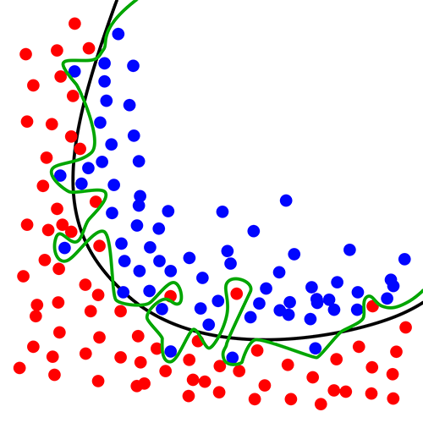
Overfitting ☹
Overfitting occurs when a statistical
model describes random error or noise instead of underlying relationship
If hypothesis space has many dimensions (many attributes) we may find meaningless regularity in data irrelevant to true distinguishing features
  Students with an m in first name, born in July, & whose SSN digits sum to a prime number get better grades in AI
If we have too little training data, even a reasonable hypothesis space can overfit

Slide 44
Avoiding Overfitting
Remove obviously irrelevant features
  E.g., remove ‘year observed’, ‘month observed’, ‘day observed’, ‘observer name’ from feature vector
Getting more training data
Pruning lower nodes in a decision tree
  E.g., if gain of best attribute at a node is below a threshold, stop and make this node a leaf rather than generating children nodes

Slide 45
Pruning decision trees
Pruning a decision tree is done by replacing a whole subtree by a leaf node
Replacement takes place if the expected error rate in the subtree is greater than in the single leaf, e.g.,
  Training: 1 training red success and 2 training blue failures
  Test: 3 red failures and one blue success
  Consider replacing this subtree by a single Failure node.
After replacement, only 2 errors instead of 5
Training
Test
Pruned
Color
Color
FAILURE
red
blue
red
blue
2 success
4 failure
1 success
0 failure
0 success
2 failures
1 success
3 failure
1 success
1 failure

Slide 46
Converting decision trees to rules
Easy to get rules from decision tree: write rule for each path from the root to leaf
Rule’s left-hand side built from the label of the nodes & labels of arcs
Resulting rules set can be simplified:
  Let LHS be the left hand side of a rule
  LHS’ obtained from LHS by eliminating some conditions
  Replace LHS by LHS' in this rule if the subsets of the training set satisfying LHS and LHS' are equal
  A rule may be eliminated by using meta-conditions such as “if no other rule applies”

Slide 47
Summary: decision tree learning
Widely used learning methods in practice for problems with relatively few features
Strengths
  Fast and simple to implement
  Can convert result to a set of easily interpretable rules
  Empirically valid in many commercial products
  Handles noisy data
  Easy for people to understand
Weaknesses
  Large decision trees may be hard to understand
  Requires fixed-length feature vectors
  Non-incremental (i.e., batch method)
  Univariate splits/partitioning using only one attribute at a time so limits types of possible trees

