Slide 1
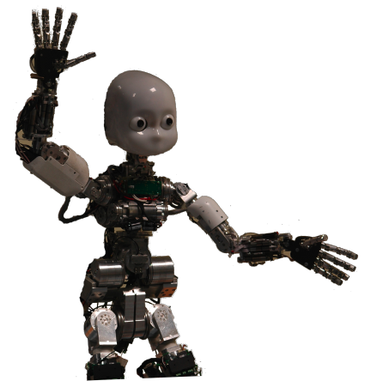
Machine Learning
Chapter 18, 21
Some material adopted from notes by Chuck Dyer

Slide 2
What is learning?
“Learning denotes changes in a system that ... enable a system to do the same task more efficiently the next time” – Herbert Simon
“Learning is constructing or modifying representations of what is being experienced” – Ryszard Michalski
“Learning is making useful changes in our minds” – Marvin Minsky

Slide 3
Why study learning?
Understand and improve efficiency of human learning
Use to improve methods for teaching and tutoring people (e.g., better computer-aided instruction)
Discover new things or structure previously unknown
Examples: data mining, scientific discovery
Fill in skeletal or incomplete specifications in a domain
Large, complex systems can’t be completely built by hand & require dynamic updating to incorporate new information
Learning new characteristics expands the domain or expertise and lessens the “brittleness” of the system
Build agents that can adapt to users, other agents, and their environment

Slide 4
AI & Learning Today
Neural network learning was popular in the 60s
In the 70s and 80s it was replaced with a paradigm based on manually encoding and using knowledge
In the 90s, more data and the Web drove interest in new statistical machine learning (ML) techniques and new data mining applications
Today, ML techniques and big data are behind almost all successful intelligent systems
http://bit.ly/U2ZAC8

Slide 5
Machine Leaning Successes
Sentiment analysis
Spam detection
Machine translation
Spoken language understanding
Named entity detection
Self driving cars
Motion recognition (Microsoft X-Box)
Identifying paces in digital images
Recommender systems (Netflix, Amazon)
Credit card fraud detection

Slide 6
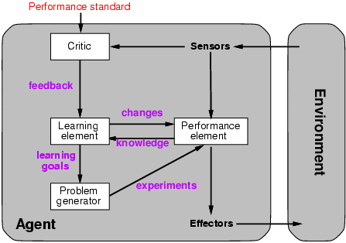
A general model of learning agents

Slide 7
Major paradigms of machine learning
Rote learning: 1-1 mapping from inputs to stored representation, learning by memorization, association-based storage and retrieval
Induction: Use specific examples to reach general conclusions
Clustering: Unsupervised identification of natural groups in data
Analogy: Determine correspondence between two different representations
Discovery: Unsupervised, specific goal not given
Genetic algorithms: Evolutionary search techniques, based on an analogy to survival of the fittest
Reinforcement – Feedback (positive or negative reward) given at the end of a sequence of steps

Slide 8
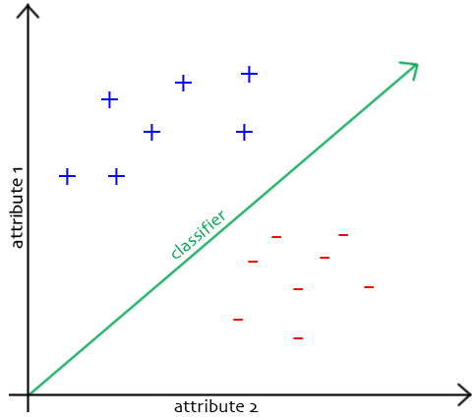
The Classification Problem
Extrapolate from set of examples to make accurate predictions about future ones
Supervised versus unsupervised learning
Learn unknown function f(X)=Y, where X is an input example and Y is desired output
Supervised learning implies we’re given a training set of (X, Y) pairs by a “teacher”
Unsupervised learning means we are only given the Xs and some (ultimate) feedback function on our performance.
Concept learning or classification (aka “induction”)
Given a set of examples of some concept/class/category, determine if a given example is an instance of the concept or not
If it is an instance, we call it a positive example
If it is not, it is called a negative example
Or we can make a probabilistic prediction (e.g., using a Bayes net)

Slide 9
Supervised Concept Learning
Given a training set of positive and negative examples of a concept
Construct a description that will accurately classify whether future examples are positive or negative
That is, learn some good estimate of function f given a training set {(x₁, y₁), (x₂, y₂), ..., (x_{n}, y_{n})}, where each y_{i} is either + (positive) or - (negative), or a probability distribution over +/-

Slide 10
Inductive Learning Framework
Raw input data from sensors are typically preprocessed to obtain a feature vector, X, that adequately describes all of the relevant features for classifying examples
Each x is a list of (attribute, value) pairs. For example,
X = [Person:Sue, EyeColor:Brown, Age:Young, Sex:Female]
The number of attributes (a.k.a. features) is fixed (positive, finite)
Each attribute has a fixed, finite number of possible values (or could be continuous)
Each example can be interpreted as a point in an n-dimensional feature space, where n is the number of attributes

Slide 11
Measuring Model Quality
How good is a model?
Predictive accuracy
False positives / false negatives for a given cutoff threshold
Loss function (accounts for cost of different types of errors)
Area under the (ROC) curve
Minimizing loss can lead to problems with overfitting
Training error
Train on all data; measure error on all data
Subject to overfitting (of course we’ll make good predictions on the data on which we trained!)
Regularization
Attempt to avoid overfitting
Explicitly minimize the complexity of the function while minimizing loss. Tradeoff is modeled with a regularization parameter

Slide 12
Cross-Validation
Divide data into training set and test set
Train on training set; measure error on test set
Better than training error, since we are measuring generalization to new data
To get a good estimate, we need a reasonably large test set
But this gives less data to train on, reducing our model quality!

Slide 13
Cross-Validation, cont.
k-fold cross-validation:
Divide data into k folds
Train on k-1 folds, use kth fold to measure error
Repeat k times; use average error to measure generalization accuracy
Statistically valid; gives good accuracy estimates
Leave-one-out cross-validation (LOOCV)
k-fold where k=N (test data = 1 instance!)
Accurate but expensive; requires building N models

Slide 14
Inductive learning as search
Instance space I defines the language for the training and test instances
Typically, but not always, each instance i∈I is a feature vector
Features are sometimes called attributes or variables
I: V₁ x V₂ x … x V_{k}, i = (v₁, v₂, …, v_{k})
Class variable C gives an instance’s class (to be predicted)
Model space M defines the possible classifiers
M: I → C, M = {m1, … mn} (possibly infinite)
Model space is sometimes, but not always, defined in terms of the same features as the instance space
Training data can be used to direct the search for a good (consistent, complete, simple) hypothesis in the model space

Slide 15
Model spaces
Decision trees
Partition the instance space into axis-parallel regions, labeled with class value
Version spaces
Search for necessary (lower-bound) and sufficient (upper-bound) partial instance descriptions for an instance to be in the class
Nearest-neighbor classifiers
Partition the instance space into regions defined by the centroid instances (or cluster of k instances)
Associative rules (feature values → class)
First-order logical rules
Bayesian networks (probabilistic dependencies of class on attributes)
Neural networks

Slide 16
Model spaces
I
I
-
-
-
-
+
+
+
+
I
Nearest
neighbor
-
Decision
tree
-
+
+
Version space

