Slide 1
Change-Link: A Digital Forensic Tool for Visualizing Changes to Directory Trees
Timothy R. Leschke, M.S.
Doctoral Student
tleschk1@umbc.edu
Alan T. Sherman, Ph.D.
Associate Professor
sherman@umbc.edu
Notes:
Tim Leschke
Doctoral Student in Computer Science at the University of Maryland Baltimore County.
My research involves using data visualization techniques to support digital forensics. Digital forensics involves extracting and analyzing data from digital artifacts (such as computers and cell phones) in support of law enforcement investigations.
I am conducting my research under the supervision of my advisor, Dr. Alan Sherman.
Presenting a paper titled “Change-Link: A Digital Forensic Tool for Visualizing Changes to Directory Trees”
This paper is about a prototype tool which I developed called Change-Link, which supports a user’s ability to see visual representations of an operating system directory structure that has changed over time.
This paper represents a starting point for my research in which I am investigating technology that supports the browsing of digital forensic data, including large dataset and data that has changed over time.

Slide 2
Motivation
Visualizing Change
Digital Forensics
Data Explosion
Shadow Volume Data
http://www.smeadvisor.com/wp-content/uploads/2011/07/Data-explosion.jpg, http://datastoragelongbeach.com/wp-content/uploads/2012/02/data-backup-Long-Beach.jpg
Notes:
I am interested in visualizing change because it is an interesting academic exercise that is ripe with opportunities to conduct interesting research.
I am also interested in visualizing change because I believe the technology can be used to address two issues within digital forensics. These issues are:
Dealing with the “data explosion” that we are currently seeing in digital forensics and
Dealing with Shadow Volume Data, which can be a significant issue for digital forensic examinations.
The issue of the “data explosion” is the result of personal cell phones/smart phones, GPS navigation aides, portable computers, and other digital devices have become ubiquitous within modern society. Furthermore, with digital storage devices surpassing the terrabyte level, the amount of personal data that is associated with each of these devices has grown significantly. Because there is more data, there is more work to be done by digital forensic examiners.
The issue of “shadow volume data” is an issue of both quantity and complexity of the data. As I will explain in greater detail later, certain computer systems contain “shadow volume data” which record multiple versions of file, application, and operating system data. The multiple versions of data makes analyzing this data more complex. Plus, because there can be many very large sets of shadow volume data, this extra quantity of data adds to the data explosion that forensic examiners are trying to keep pace with.

Slide 3
Benefits of Visualizing Change
“…direct their efforts toward more important data.”
“…digital forensic examiners are better able to understand what happened.”
http://techmehigh.com/wp-content/uploads/2011/06/How-to-restore-3.jpg, http://sharetv.org/images/what_happened-show.jpg
Notes:
There are several benefits to visualizing change:
Because there is too much data that can be subject to a digital forensic investigation, examiners cannot look at all of the data. A better approach might be to look at the most important data first. I believe data that has changed within a computer system is the most import data. For example, the fresh installation of an operating system is generally not as interesting as how that operating system data may have been changed by alleged criminal activity. Thus, by using data visualization techniques to identify data that has changed, digital forensic examiners might be able to complete there examinations with a smaller sub-set of the evidence and thereby keep pace with the recent “data explosion.”
A second benefit of visualizing change is it will help the digital forensic examiner understand how the data was used and changed to support criminal activity. This supports a better understanding of “what happened.”

Slide 4
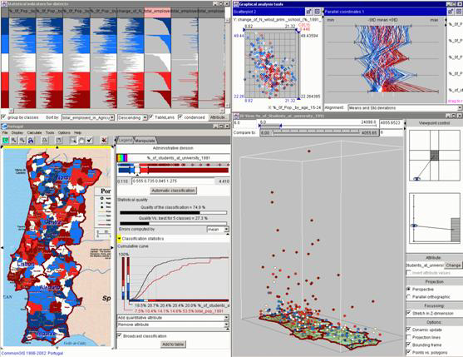
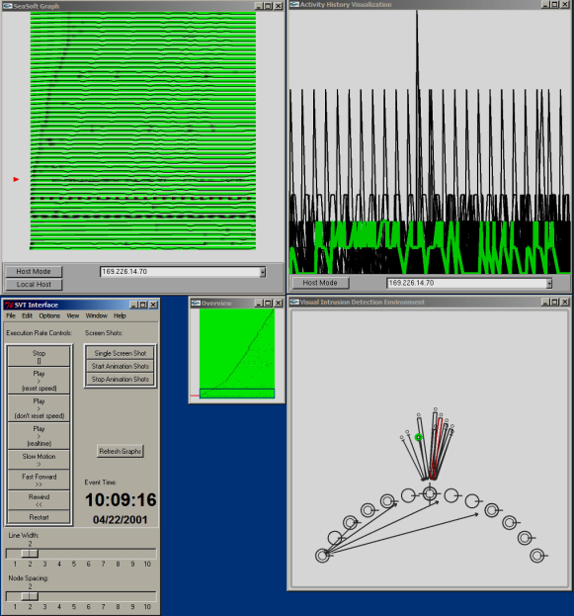
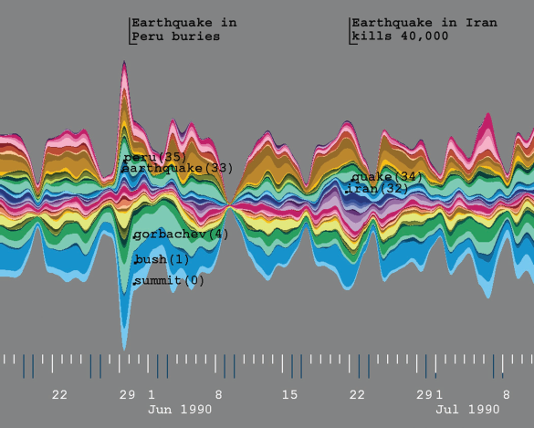
Related Work
Shadow Volume Tools
Coordinated and Multiple Views
Visual Analytics
Linked Views
Overview+Detail
TreeJuxtaposer & Mizbee
Visualization of Change
Few address coming into and going out of existence.
http://www.prlog.org/10766636-shadow-analyser-computer-forensics-tool-for-digital-forensic-investigators.jpg, State of the Art: Coordinated & Multiple Views in Exploratory Visualization by Jonathan C. Roberts, Hierarchical Linked Views by Erbacher and Frincke, Themeriver: Visualizing thematic changes in large document collections, by Havre, Hetzler, Whitney and Nowell.
Notes:
There is significant related work to this research.
First, within digital forensics, there are many tools that support the accessing of shadow volume data. These tools include
Shadow Scanner
Shadow Explorer
Shadow Analyzer
Time Traveler, and others
Non e of these tools provide an overview of change, and none support an adequate understanding of change over more than two shadow volumes at a time.
Within the data visualization community, the previous research that has influenced this research includes:
Coordinated and multiple views – using several windows to show multiple levels of detail
Visual analytics – attempts to make large dataset tractable through visualization
Linked views – which allows the manipulation of one view to be reflected in another view.
Overview+Detail – which helps the user retain the context and browsing position within a large dataset.
TreeJuxtaposer – which provides a nice visualization of how a tree structure (similar to our directory tree) has changed from one time period to the next.
MizBee – which inspires us to explore relationship among data points.

Slide 5
Shadow Volume Data
Volume Shadow Copy Service
Windows Vista, Windows 7, and others
When data is archived
Backup utility
Prior to installation
Restore point
Why data is archived
Rollback data to restore stability and recover lost data.
http://home.comcast.net/~SupportCD/Images/Windows_Vista_Ultimate_Box_HiRes.jpg
Notes:
The data set that Change-Link works with is derived from shadow volume data, which is a product of the Volume Shadow Copy Service. This is a service that is found in several Microsoft Operating Systems, but perhaps most notably in Windows Vista and Windows 7.
Intended to prevent accidental data loss (due to user error)
The Volume Shadow Copy Service archives data
When configured to do so (nightly, or weekly)
Prior to new software installation
At the creation of a restore point
This archiving of data allows a system to be rolled back to a previous state
To recover lost data
To put the system back into a stable state if a virus or the incorrect installation of software has made the system unstable.

Slide 6
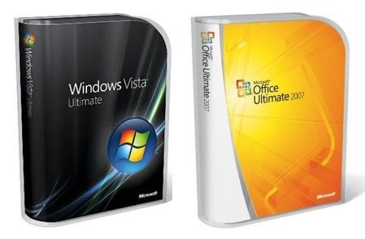
Test Data
Eight shadow volumes
After installing Vista
After activating Vista
During installation of SP1
After installing SP1
After installing Office
After activation of Office
After creating directories
After deleting directories
11,000 directories x 8 shadow volumes = 88,000 data points.
700,000 directories x 8 ≈ 5 million data points!
http://laptoping.com/wp-content/vista_and_office2007.jpg
Notes:
I am working with law enforcement to test future tools with real evidence/case data, but for the Change-Link prototype tool, I created a simple test dataset to work with.
On a Windows Vista machine, I created a shadow volume (my manually creating a restore point)
After installing Vista
After activating Vista
During the installation of Service Pack 1
After the installation of Service Pack 1
After the installation of Microsoft Office
After the activation of Microsoft Office
After creating some user directories
After deleting some user directories
By including just user-level directories in my dataset, my dataset had 11,000 directories, in each of the 8 shadow volumes, for a total of about 88,000 data points.
When I included all directories (including system level directories), my dataset had 700,000 directories in each of the 8 shadow volumes, or about 5.6 million data points.
For simplicity, I conducted my research with the smaller (88,000 data point) data set.

Slide 7
Design and Implementation
Notes:
As I explain the Design and Implementation of Change-Link, I will be showing the user interface (which is seen at the bottom center of this slide), and also zooming into each of the left-side and right-side windows to show the details of those visualizations as shown by the pictures at the top left and top right of this slide.
Lets first look at the user interface as a whole.

Slide 8
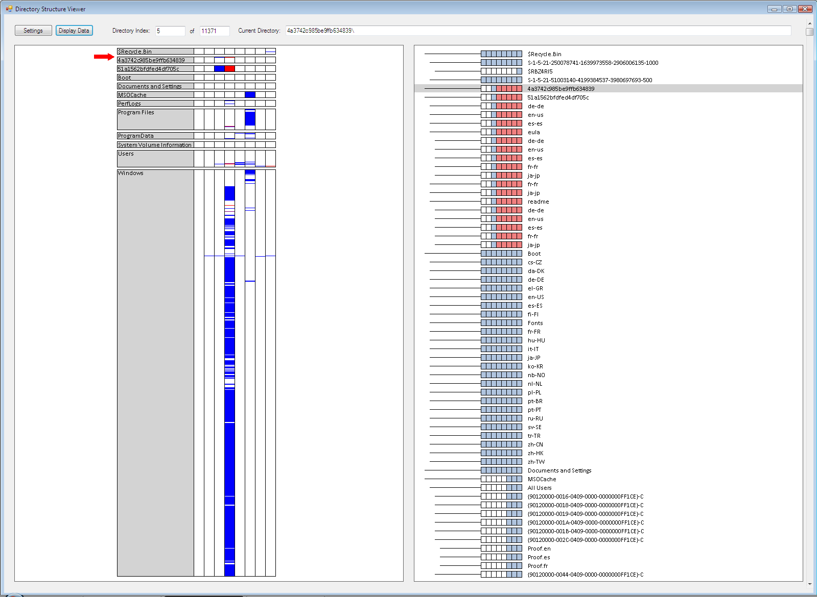
OVERVIEW
DETAIL
Notes:
This is the Change-Link user interface.
There are two main windows:
The left window provides an overview and the right window provides the detail.
As the user clicks with a pointer in the left overview window, a red arrow moves to mark that point in the overview visualization, and the right side windows scrolls the data to reflect the details of the part of the dataset that has been chosen.
Lets zoom into the left side window first to get a better understanding of the overview visualization.

Slide 9
Overview Window
Notes:
The picture on the right of this screen is the overview visualization. What this shows is a visual representation of the operating system directories that are located at the root of the directory. Thus, we see directories with names like $Recycle.Bin, Boot, program Files, User, and Windows (among others).
To the left is an enlarged view of the Users directory.
Each directory is colored grey, has its name on it, and contains eight (8) white partitions – one for each of the eight time periods that correspond to the eight (8) shadow volumes.
The blue and red lines that appear in these segments represent the approximate location within the sub-directory of that directory where a directory was either created (blue) or deleted (red).
The height of each directory reflects the number of sub-directories within that directory.
Thus, the overview shows the Windows directory has the most sub-directories, and also had the most created (blue lines) directories in time period 4. Time period 4 is also when the most directories where deleted as seen in the third directory from the top. Areas of concentrated creation and deletion of directories are easily identifies, as are single creation and deletions of directories.

Slide 10
Design and Implementation
Notes:
If we zoom into the right visualization window, we see a glyph we developed called a segmented box and whisker. This glyph is used to show the change history of an individual directory.

Slide 11
Segmented Box and Whisker
Notes:
In this example, there are three segmented box and whisker glyphs.
The thin black line that extends to the left of each glyph is the “whisker.” and it is used to represent the nesting of a child directory under a parent directory. In this example, the MyJazzMusic directory is a child directory of the MyMusic directory, which is a child directory of the MyDocuments directory.
The segmented box and whisker glyph contains eight (8) boxes or segments – one for each of the eight time periods of the eight shadow volumes. They are by decreasing age from left to right. Thus, the oldest time period is represented by the left most box and the most recent time period is represented by the rightmost box.
The boxes are colored blue for when the directory does exist, red for when the directory does no longer exist, and white if the directory doe not yet exist. For example, the MyJazzMusic directory did not exist for the first three time periods, existed for the next two time periods, and then did not exist for the last three time periods.
My ordering the glyphs so that the time periods are aligned with each other, it is easy to compare the existence of the directories for any time period. For example, in the last time period, only the MyDocuments directory existed.
The name of each directory is provided to its right.

Slide 12
Notes:
Next, I am going to flip forward and back with the next six (6) slides to simulate how both the right and left side pictures change with user interaction. You can assume the user is clicking on specific change lines found in the overview window and the right side is scrolling to that data points location.
As the user clicks on a change line, the red arrow in the left overview window moves to point to the general location of the change line that was selected.
The right side will appear to change by scrolling to the selected data point.
A grey focus bar highlights the exact directory that has been selected. The visualization is configured so that this grey focus bar stays in the center of the visualization, whenever possible.

Slide 13
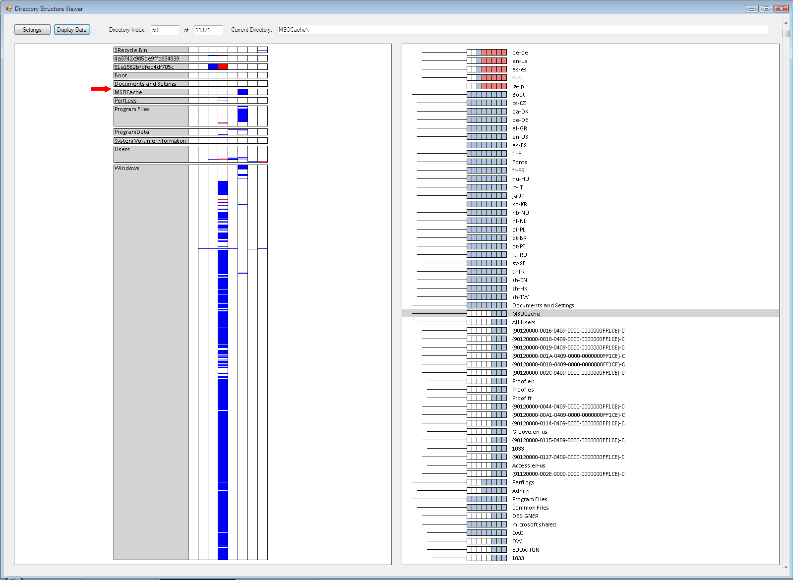

Slide 14
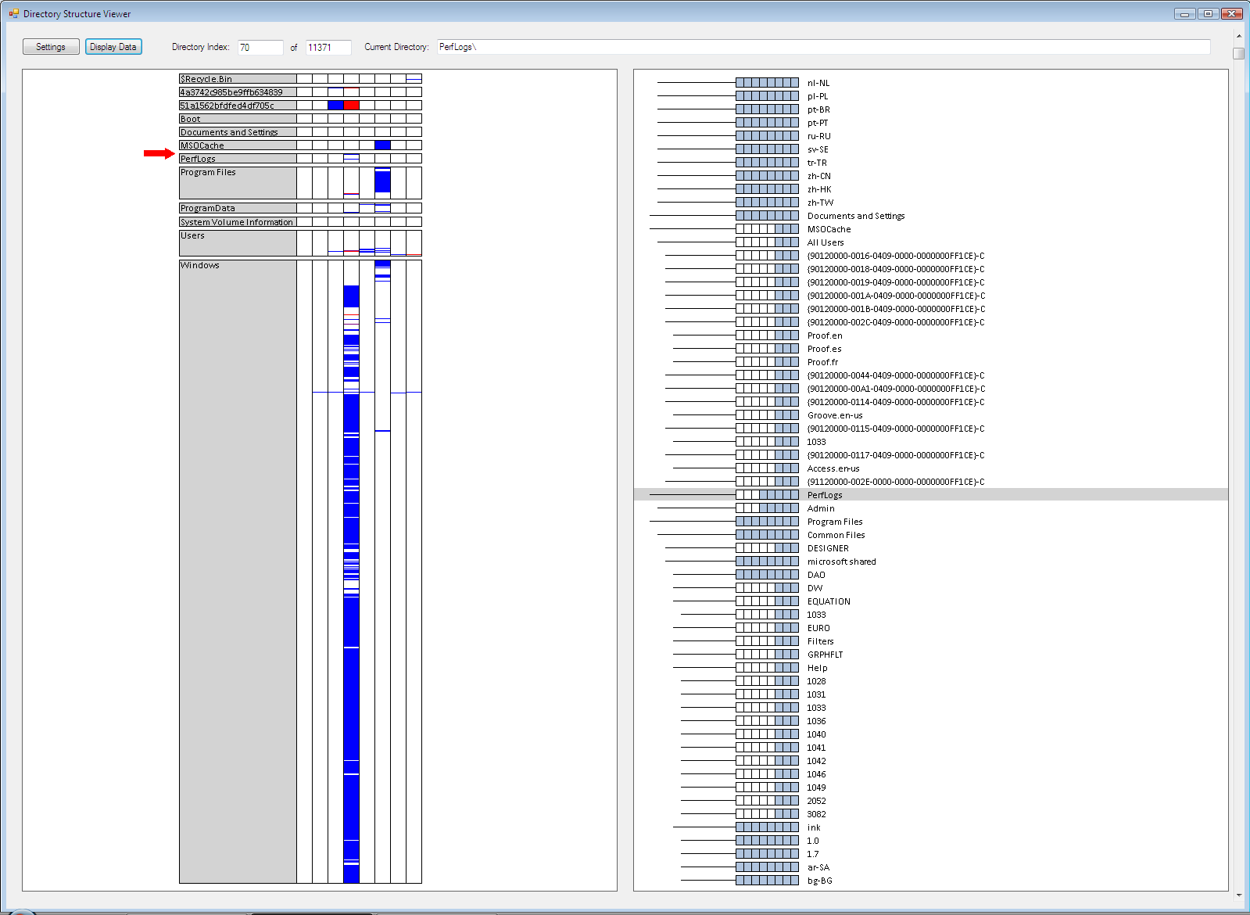

Slide 15
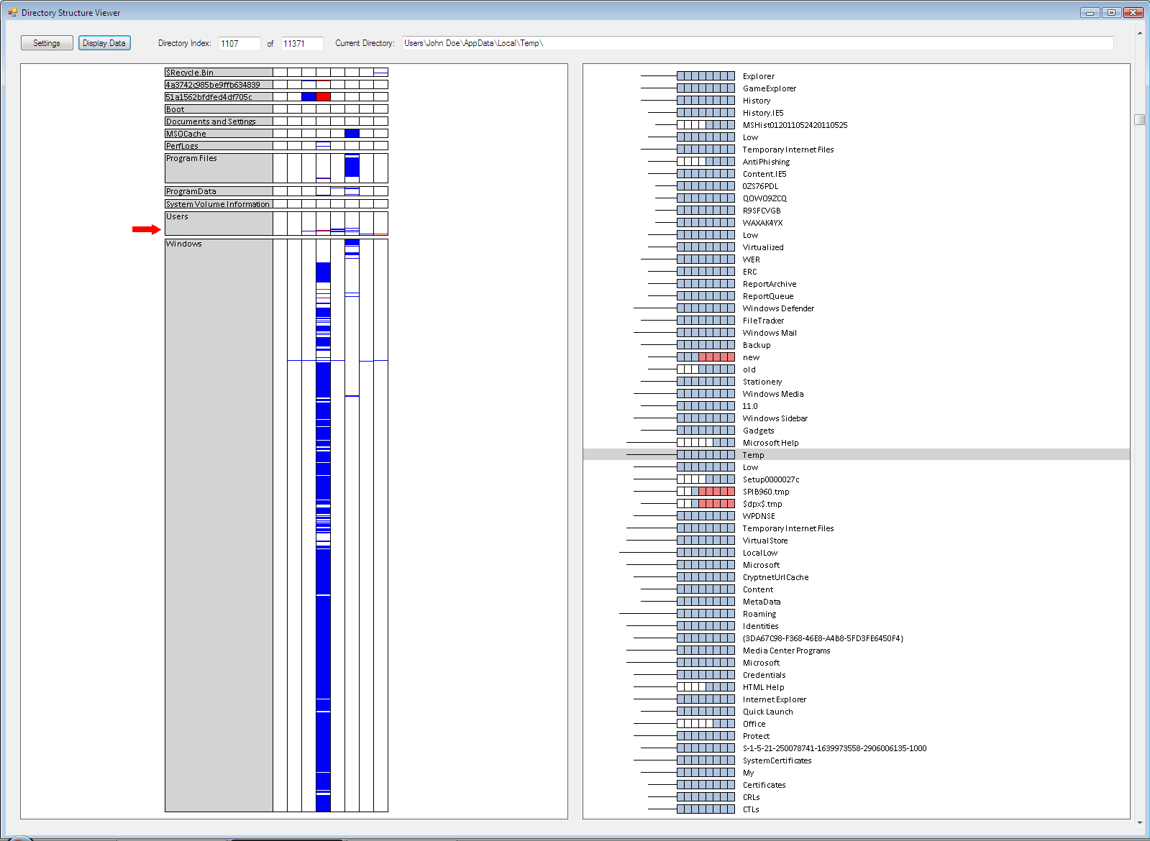

Slide 16
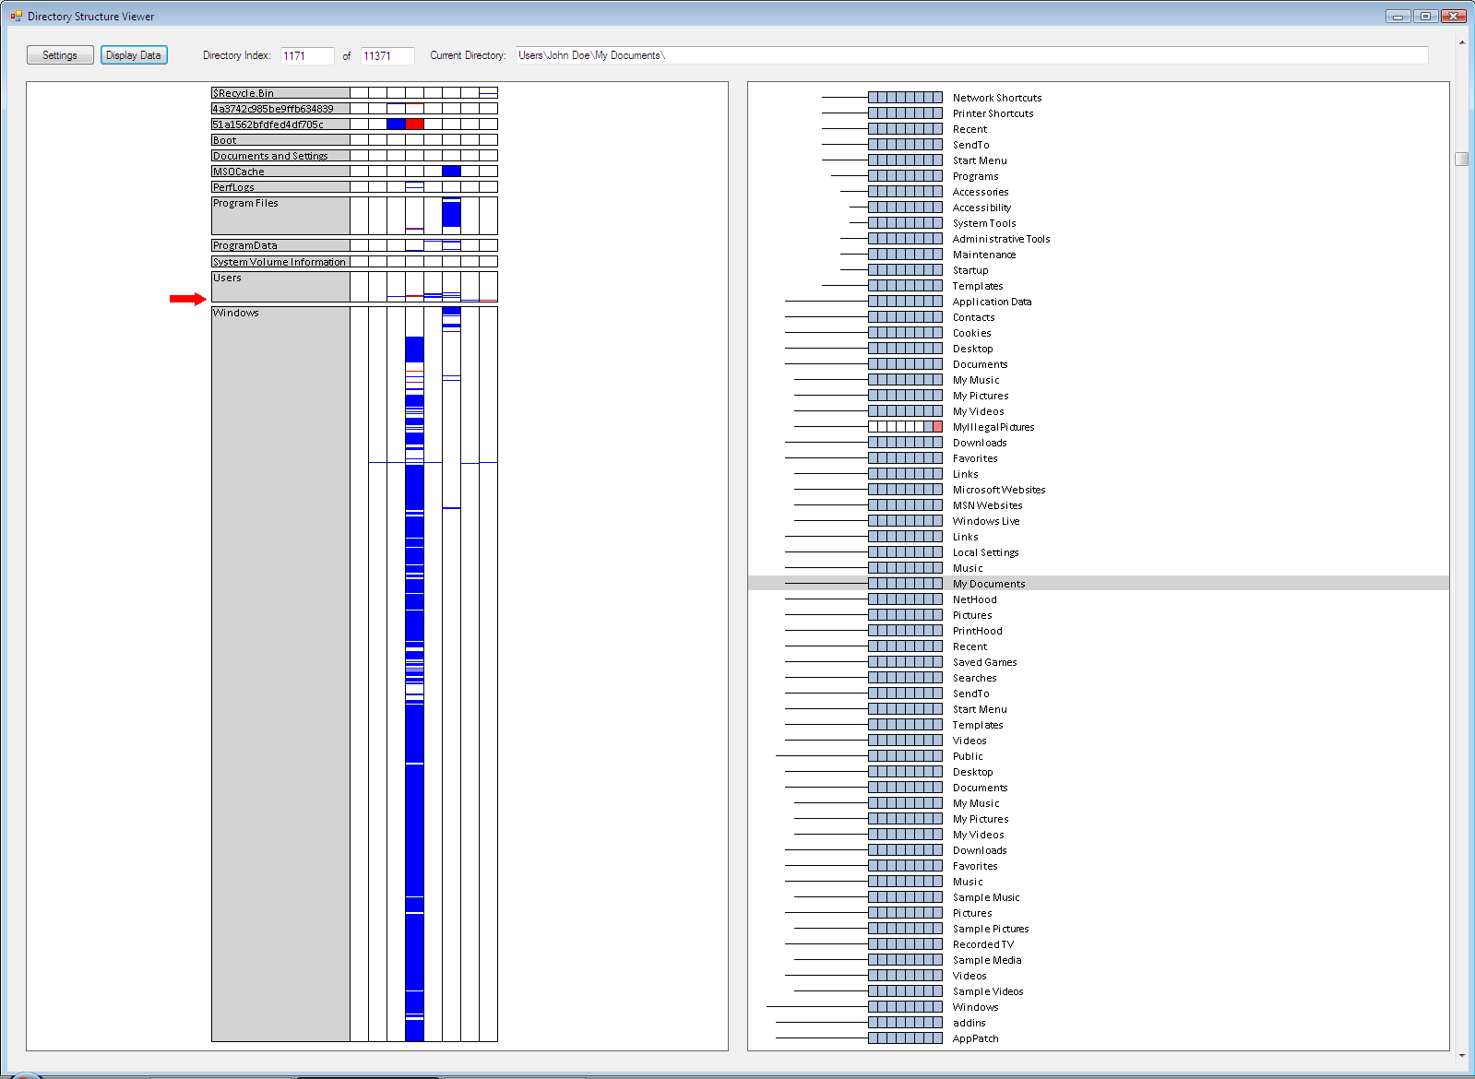

Slide 17
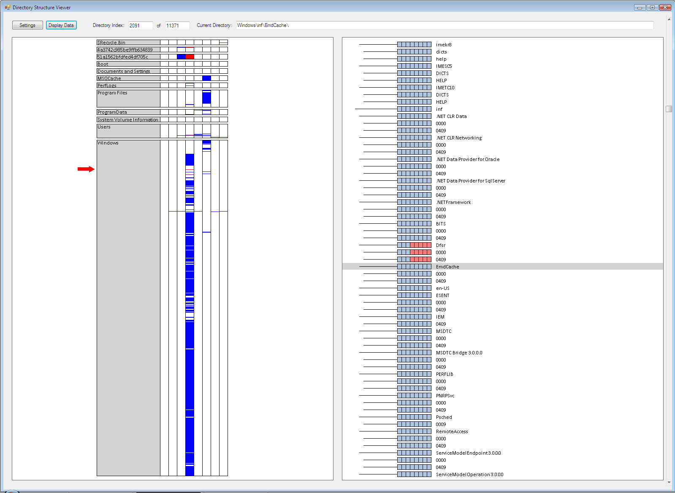

Slide 18
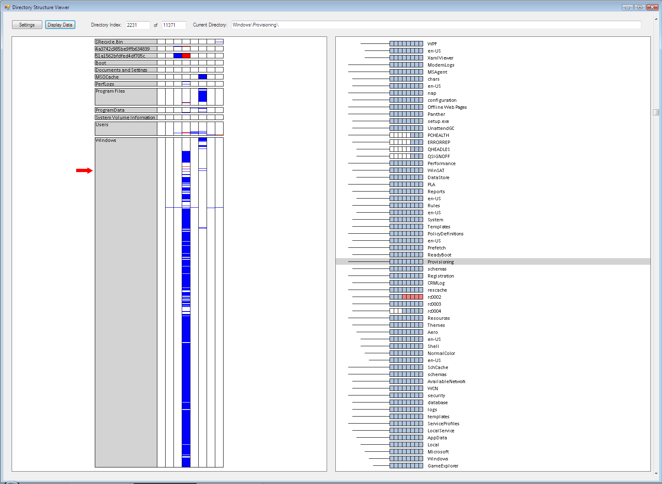

Slide 19
Results
Overview of all Directory Change
Notes:
This picture shows an overview of our dataset.
Time period 4 has the most change (both blue and red lines).
Time period one has no change (and never will, since there is no time period before it that it can be compared to)
The Windows directory appears to have about half or two thirds of all of the sub-directories.
The most deleted directories are in time period 4, in the third directory from the top.
Etc.

Slide 20
Results (2)
Installation of Service Pack 1
Notes:
These pictures show changes that occurred during the Installation of Service Pack 1. This event occurred in time period 3 and time period 4.
Looking at the picture on the left, we see in time period three, about 19 directories were created in this part of the directory structure. Then in time period 4, the boxes are red which means the directories were deleted. View as a single event, the left picture shows Service Pack 1 creating backup folders to store data temporarily, to be used in case the installation is not successful and the installation has to be rolled-back.
The picture on the right shows an interesting event. Near the top, the fourth directory from the top, there is a directory named “Backup”. Below it is a directory named “new” which existed for the first three time periods and is then deleted. Below that directory is a directory named “old”, which is created in time period 4 and continues to exist for the duration of the next five time periods.
Viewing this part of the picture on the right side as a single event, we hypothesize that Service Pack 1 is simply renaming the Backup sub-directory from “new” to “old.” After all, it seems to make more sense that the backup directory should have a sub directory for storing “old” data rather than “new” data.

Slide 21
Renaming of a Sub-Directory
Notes:
I redrew the visualization to make it easier to see.
This shows a directory named “Backup” that has a sub-directory named “New” for the first three (3) time periods and a sub-directory named “Old” for the last five (5) time periods. This seems to show that the “New” directory was renamed to “Old” at the transition from time period three (3) to time period four (4). This seems to mean that Service Pack 1 simply renamed the directory.
It makes more sense to have a sub-directory within the Backup directory named “Old” for perhaps old data rather than a sub-directory named “New.”

Slide 22
Results (3)
Activation of Vista
Notes:
This shows a surprising event. The change reflected in this picture occurred during the period in which the Vista Operating System was activated. (the surrounding directories were whited-out so you can focus just on the four directories in the picture.)
This picture implies that the four directories shown above were created when Vista was activated. We expected the activation to maybe update a file. We are surprised to see that it may have created several directories.
Although this visualization cannot confirm a cause and effect relationship between the activation of Vista and the creation of the directories, like every good data visualization, this picture makes the user ask “why is the data like this.” this picture helps direct one’s attention toward an interesting change in the data that might require further examination.

Slide 23
Results (4)
User Created and Deleted Directory
Notes:
This is a simple example of a user creating a directory named “MyIllegalPictures” and then deleting it (after a record of it was archived into a shadow volume).
This example simulates what is commonly seen in a child pornography investigation. The person might create a directory to store their illicit images, and then delete that directory as a way hide their activity. However, if the information is archived by the volume shadow copy service, a record of that illegal activity is retained.

Slide 24
User Reactions
Users identified periods of…
Most change
Most created directories
Most deleted directories
Root directory with the most sub-directories
Effectiveness of segmented box and whisker glyph
Navigation support
Comprehension
Color
Whisker
“helps understand…”
“discover information…”
http://www.experiment-resources.com/images/survey-research-design.jpg
Notes:
I conducted an informal usability study with about seven (7) co-workers. I sat them in from of a computer that was running Change-Link, asked them to interact with it and become familiar with how it works, and the asked them a few test questions to verify if they understood the visualizations that they were seeing. Once they understood the visualization and how to use the tool, I asked them to identify certain patterns in the data. They were able to;
Identify the time period of most created directories
Identify time period of most deleted directories.
Identify time period of most change (which is most deleted and most created directories)
Identify directory located at the root that has the most sub-directories (done by comparing the height of the glyphs)
The users stated the segmented box and whisker glyph was effective for showing the child-parent relationship among directories, and also showing how the existence of the directory changes over time.
Change-Link was found to provide strong navigation support and support good comprehension of the data.
The colors that were used were good, with the exception that some users though blue and red in one window mean the same thing in the next window.

Slide 25
Conclusion
Change-Link helps
“focus on anomalies”
“find meaningful data more quickly”
Explore data more efficiently and effectively
Companion to existing technology
Future Goals
Add two additional views:
Overview
Tree View
Directory View
File View
http://datascientistjob.com/wp-content/uploads/2011/10/data-science.jpg
Notes:
Change-Link does help the user understand how the directory structure has changed over time.
Anomalies were easy to spot and understand. Could better focus on anomalies.
Users could explore data more efficiently and effectively. Could find meaningful data more quickly.
Our initial results suggest
1. Visualizing data in this way might provide a better understanding.
2. Being able to see the most important data first (that being changed data) might help the digital forensic community deal with the data explosion.
Change-Link is a prototype of a more robust tool which is currently under development. The next generation tool will provide a linked-view approach to browsing an evidence hard drive. The next tool will include an Overview and Treeview (like Change-Link), but also include a Directory View and a File View. This will allow the user to see an overview of change over the entire data set, see how the directory structure has changed in a specific area, see how the contents of a specific directory has changed over time, and see the change history of a specific file. This all supports a better understanding of “what happened.”

Slide 26
Thank You
http://www.turnbacktogod.com/wp-content/uploads/2008/12/questions.jpg

