Slide 1

Machine Learning: Decision Trees
14.2_dt
Chapter 19.3
Some material adopted from notes by Chuck Dyer

Slide 2
Decision Trees (DTs)
A supervised learning method used for classification and regression
Given a set of training tuples, learn model to predict one value from the others
  Learned value typically a class (e.g., goodRisk)
Resulting model is simple to understand, interpret, visualize, and apply

Slide 3
Learning a Concept
The red groups are negative examples, blue positive
Attributes
Size: large, small
Color: red, green, blue
Shape: square, circle
Task
Classify new object with a size, color & shape as positive or negative

Slide 4
Training data
Size | Color | Shape | class
Large | Green | Square | Negative
Large | Green | Circle | Negative
Small | Green | Square | Positive
Small | Green | Circle | positive
Large | Red | Square | Positive
Large | Red | Circle | Positive
Small | Red | Square | Positive
Small | Red | Circle | Positive
Large | Blue | Square | Negative
Small | Blue | Square | Positive
Large | Blue | Circle | Positive
Small | Blue | Circle | Positive

Slide 5
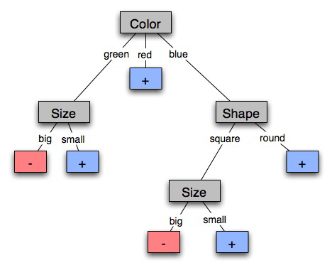
A decision tree-induced partition
The red groups are negative examples, blue positive
Negative things are big, green shapes and big, blue squares

Slide 6
Learning decision trees
Goal: Build decision tree to classify examples as positive or negative instances of concept using supervised learning from training data
A decision tree is a tree in which
  non-leaf nodes have an
  attribute (feature)
  leaf nodes have a classification
  (+ or -)
  arcs have a possible value of
  its attribute
Generalization: allow for >2 classes
  e.g., classify stocks as {sell, hold, buy}
Color
green
red
blue
Size
+
Shape
big
small
square
round
-
+
Size
+
big
small
-
+

Slide 7
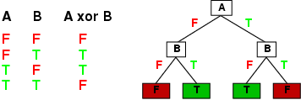
Expressiveness of Decision Trees
Can express any function of input attributes, e.g., for Boolean functions, truth table row → path to leaf:
There’s a consistent decision tree for any training set with one path to leaf for each example, but it probably won't generalize to new examples
Prefer more compact decision trees

Slide 8
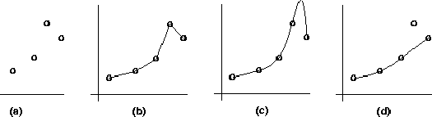
Inductive learning and bias
Suppose that we want to learn a function f(x) = y and we’re given sample (x,y) pairs, as in figure (a)
Can make several hypotheses about f, e.g.: (b), (c) & (d)
Preference reveals learning technique bias, e.g.:
  prefer piece-wise functions (b)
  prefer a smooth function (c)
  prefer a simple function and treat outliers as noise (d)

Slide 9

Preference bias: Occam’s Razor
William of Ockham (1285-1347)
  non sunt multiplicanda entia praeter necessitatem
  entities are not to be multiplied beyond necessity
Simplest consistent explanation is the best
Smaller decision trees correctly classifying training examples preferred over larger ones
Finding the smallest decision tree is NP-hard, so we use algorithms that find reasonably small ones

Slide 10
R&N’s restaurant domain
Develop decision tree that customers make when deciding whether to wait for a table or leave
Two classes: wait, leave
Ten attributes: Alternative available? Bar in restaurant? Is it Friday? Are we hungry? How full
is restaurant? How expensive? Is it raining? Do
we have reservation? What type of restaurant is it? Estimated waiting time?
Set of 12 training examples
~7,000 possible cases (i.e., combinations of values)

Slide 11
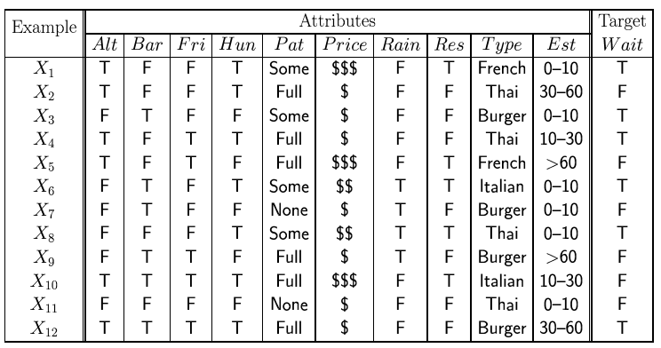
Attribute-based representations
Examples described by attribute values (Boolean, discrete, continuous), e.g., situations where will/won't wait for a table
Classification of examples is positive (T) or negative (F)
Serves as a training set

Slide 12
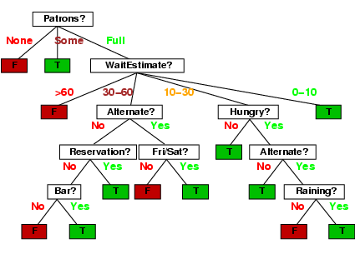
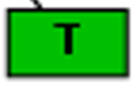

A decision tree from introspection
= wait
= leave

Slide 13

Issues
It’s like 20 questions
We can generate many decision trees depending on what attributes we ask about and in what order
How do we decide?
What makes one decision tree better than another: number of nodes? number of leaves? maximum depth?

Slide 14
ID3 / C4.5 / J48 Algorithm
Greedy algorithm for decision tree construction developed by Ross Quinlan 1987-1993
Top-down construction of tree by recursively selecting best attribute to use at current node
  Once attribute selected for current node, generate child nodes, one for each possible attribute value
  Partition examples using values of attribute, & assign these subsets of examples to the child nodes
  Repeat for each child node until examples associated with a node are all positive or negative

Slide 15
Choosing best attribute
Key problem: choose attribute to split given set of examples
Possibilities for choosing attribute:
  Random: Select one at random
  Least-values: one with smallest # of possible values
  Most-values: one with largest # of possible values
  Max-gain: one with largest expected information gain
  Gini impurity: one with smallest gini impurity value
The last two measure the homogeneity of the target variable within the subsets
The ID3 and C4.5 algorithms uses max-gain

Slide 16
A Simple Example
For this data, is it better to start the tree by asking about the restaurant type or its current number of patrons?

Slide 17
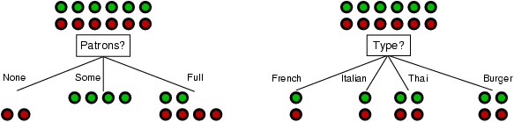
Choosing an attribute
stay
leave
Idea: good attribute choice splits examples into subsets that are as close to all of one type as possible, e.g., for binary attributes, all T or all F
Which is better: asking about Patrons or Type?
Initially half T and half F
After asking Type, 4 sets

Slide 18
Choosing an attribute
stay
leave
Idea: good attribute choice splits examples into subsets that are as close to all of one type as possible, e.g., for binary attributes, all T or all F
Patrons: for six examples we know the answer and for six we can predict with probability 0.67
Type: our prediction is no better than chance (0.50)
Initially half T and half F
After asking Type, 4 sets

Slide 19
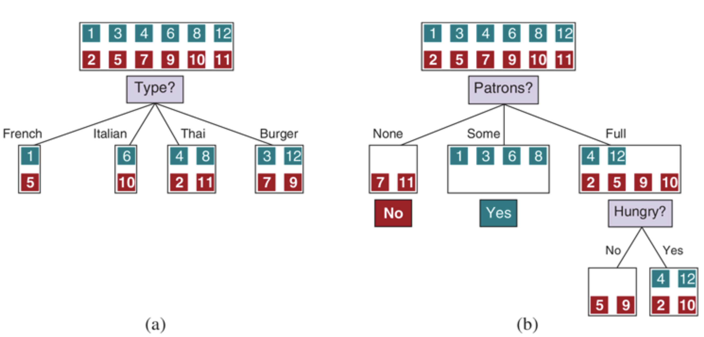
Choosing Patrons yields more information
The ID3 algorithm used this to decide what attribute to ask bout next when building a decision tree

Slide 20
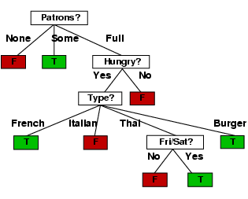
ID3-induced decision tree

Slide 21
Compare the two Decision Trees
Human-generated decision tree
ID3-generated decision tree
Intuitively, ID3 tree looks better: it’s shallower and has fewer nodes
ID3 uses information theory to decide which question is best to ask next

Slide 22
Information theory 101
Sprang fully formed from Claude Shannon’s seminal work: Mathematical Theory of
Communication in 1948
Intuitions
  Common words (a, the, dog) shorter than less common ones (parlimentarian, foreshadowing)
  Morse code: common letters have shorter encodings
Information inherent in data/message (inform-
ation entropy) measured in the number of bits needed to store/send using an optimal encoding

Slide 23
Information theory 101
Information entropy ... tells how much information there is in a message
More uncertain it is, more information it contains
How much information is in these messages
  The sun rose today!
  It’s sunny today in Honolulu!
  The coin toss is heads!
  It’s sunny today in Seattle!
  Life discovered on Mars!
None
A lot

Slide 24
Information theory 101
For n equally probable possible messages or data values, each has probability 1/n
Def: Information of a message is –log₂(p) = log₂(n)
  e.g., with 16 messages, then log(16) = 4 and we need 4 bits to identify/send each message
What if the messages are not equally likely?
For probability distribution P (p₁,p₂…p_{n}) for n mes-sages, its information (H or information entropy) is:
  I(P) = -(p₁*log(p₁) + p₂*log(p₂) + .. + p_{n}*log(p_{n}))

Slide 25
Information entropy of a distribution
  I(P) = -(p₁*log(p₁) + p₂*log(p₂) + .. + p_{n}*log(p_{n}))
Examples:
  If P is (0.5, 0.5) then I(P) = 0.5*1 + 0.5*1 = 1
  If P is (0.67, 0.33) then I(P) = -(2/3*log(2/3) + 1/3*log(1/3)) = 0.92
  If P is (1, 0) then I(P) = 1*1 + 0*log(0) = 0
More uniform probability distribution, greater its information: more information is conveyed by a message telling you which event actually occurred
Entropy is the average number of bits/message needed to represent a stream of messages

Slide 26
Example: Huffman code
In 1952, MIT student David Huffman devised (for a homework assignment!) a coding scheme that’s optimal when all data probabilities are powers of 1/2
A Huffman code can be built as followings:
  Rank symbols in order of probability of occurrence
  Successively combine 2 symbols of lowest probability to form new symbol; eventually we get binary tree where each node is probability of nodes below
  Trace path to each leaf, noting direction at each node

Slide 27
Huffman code example
Four possible messages (A, B, C, D) each with a probability of being sent
We could encode them using 2 bits per message: A=00, B=01, C=10, D=11
Sending 1,000 messages will require 2,000 bits
We can do better with a Huffman code!
M P
A .125
B .125
C .25
D .5
.125
.125
.25
.5
A
B
C
D

Slide 28
Huffman code example
M P
A .125
B .125
C .25
D .5
1
0
1
.5
.5
D
0
1
.25
Using this code for many messages (A,B,C or D), average bits/message should approach 1.75
Sending 1000 messages will need ~1750 bits not 2000 bits
.25
C
0
1
.125
.125
A
B

Slide 29
Information for classification
To divide T records is into disjoint “answer” classes (C₁..C_{k}), the information needed to identify class of element of T is:
Info(T) = I(P)
where P is the probability distribution of partition (C₁,C₂,..,C_{k}):
  Info(T) = (|C₁|/|T|, |C₂|/|T|, ..., |C_{k}|/|T|)
C1
C2
C3
C1
C2
C3
C1
C2
C3
High information
Lower information
Still lower

Slide 30
Information for classification II
If we further divide T w.r.t. attribute X into sets {T₁,T₂, ..,T_{n}}, the information needed to identify class of an element of T is weighted average of information needed to identify class of an element of T_{i}, i.e., weighted average of Info(T_{i}):
  Info(X,T) = Σ|T_{i}|/|T| * Info(T_{i})
C1
C2
C3
C1
C2
C3
High information
Low information

Slide 31
Information gain
Gain(X,T) = Info(T) - Info(X,T) is difference of
  info needed to identify element of T and
  info needed to identify element of T after value of attribute X known
This is gain in information due to attribute X
Used to rank attributes and build DT where each node uses attribute with greatest gain of those not yet considered in path from root
goal: create small DTs to minimize questions

Slide 32
Information Gain
stay
leave
I = .5*log₂(.5) + .5*log₂(.5) = 0.5+0.5 = 1
I=0; P=1/3
I=0; P=1/6
I=1;P=1/6
I=1; P=1/6
I=1; P=2/6
I=1; P=2/6
I=(1/3*log₂(1/3)+2/3*log₂(2/3); P=1/2 = 0.46
I = 6/6*1 = 1
Information gain = 1 - 0.46 = 0.54
Information gain = 1 - 1 = 0
Information gain for asking Patrons = 0.56, for asking Type = 0
Note: If only one of the N categories has any instances, the information entropy is always 0

Slide 33
Computing Information Gain
French
Y
N
Should we ask about restaurant type or how many patrons there are?
I(T) = ?
I (Pat, T) = ?
I (Type, T) = ?
Italian
Y
N
Thai
N
Y
N
Y
Burger
N
Y
N
Y
Empty
Some
Full
Gain (Patrons, T) = ?
Gain (Type, T) = ?
  I(P) = -(p₁*log(p₁) + p₂*log(p₂) + .. + p_{n}*log(p_{n}))

Slide 34
Computing information gain
I(T) =
- (.5 log .5 + .5 log .5)
= .5 + .5 = 1
I (Pat, T) =
2/12 (0) + 4/12 (0) +
6/12 (- (4/6 log 4/6 +
2/6 log 2/6))
= 1/2 (2/3*.6 +
1/3*1.6)
= .47
I (Type, T) =
2/12 (1) + 2/12 (1) +
4/12 (1) + 4/12 (1) = 1
French
Y
N
Italian
Y
N
Thai
N
Y
N
Y
Burger
N
Y
N
Y
Empty
Some
Full
Gain (Patrons, T) = 1 - .47 = .53
Gain (Type, T) = 1 – 1 = 0
  I(P) = -(p₁*log(p₁) + p₂*log(p₂) + .. + p_{n}*log(p_{n}))

Slide 35
Computing information gain
I(T) =
- (.5 log .5 + .5 log .5)
= .5 + .5 = 1
I (Pat, T) =
2/12 (0) + 4/12 (0) +
6/12 (- (4/6 log 4/6 +
2/6 log 2/6))
= 1/2 (2/3*.6 +
1/3*1.6)
= .47
I (Type, T) =
2/12 (1) + 2/12 (1) +
4/12 (1) + 4/12 (1) = 1
French
Y
N
Italian
Y
N
Thai
N
Y
N
Y
Burger
N
Y
N
Y
Empty
Some
Full
Gain (Patrons, T) = 1 - .47 = .53
Gain (Type, T) = 1 – 1 = 0
  I(P) = -(p₁*log(p₁) + p₂*log(p₂) + .. + p_{n}*log(p_{n}))

Slide 36
How well does it work?
Case studies show that decision trees often at least as accurate as human experts
  Study for diagnosing breast cancer had humans correctly classifying examples 65% of the time; DT classified 72% correct
  British Petroleum designed DT for gas-oil separation for offshore oil platforms that replaced an earlier rule-based expert system
  Cessna designed an airplane flight controller using 90,000 examples and 20 attributes per example

Slide 37
Extensions of ID3
Using other selection metric gain ratios, e.g., gini impurity metric
Handle real-valued data
Noisy data and overfitting
Generation of rules
Setting parameters
Cross-validation for experimental validation of performance
C4.5: extension of ID3 accounting for unavailable values, continuous attribute value ranges, pruning of decision trees, rule derivation, etc.

Slide 38
Using gain ratios
Information gain criterion favors attributes that have a large number of values
  An attribute D with a distinct value for each record has Info(D,T) 0, thus Gain(D,T) is maximal
To compensate, use GainRatio instead of Gain:
  GainRatio(D,T) = Gain(D,T) / SplitInfo(D,T)
SplitInfo(D,T) is information due to split of T on basis of value of categorical attribute D
  SplitInfo(D,T) = I(|T1|/|T|, |T2|/|T|, .., |Tm|/|T|)
where {T1, … Tm} is partition of T induced by value of D

Slide 39
Computing gain ratio
French
Y
N
I(T) = 1
I (Pat, T) = .47
I (Type, T) = 1
Italian
Y
N
Thai
N
Y
N
Y
Gain (Pat, T) =.53
Gain (Type, T) = 0
Burger
N
Y
N
Y
Empty
Some
Full
SplitInfo (Pat, T) = - (1/6 log 1/6 + 1/3 log 1/3 + 1/2 log 1/2) = 1/6*2.6 + 1/3*1.6 + 1/2*1
= 1.47
SplitInfo (Type, T) = 1/6 log 1/6 + 1/6 log 1/6 + 1/3 log 1/3 + 1/3 log 1/3
= 1/6*2.6 + 1/6*2.6 + 1/3*1.6 + 1/3*1.6 = 1.93
GainRatio (Pat, T) = Gain (Pat, T) / SplitInfo(Pat, T) = .53 / 1.47 = .36
GainRatio (Type, T) = Gain (Type, T) / SplitInfo (Type, T) = 0 / 1.93 = 0

Slide 40
Real-valued data?
Many ML systems work only on nominal data
We often classify data into one of 4 basic types:
  Nominal data is named, e.g., representing restaurant type as Thai, French, Italian, Burger
  Ordinal data has a well-defined sequence: small, medium, large
  Discrete data is easily represented by integers
  Continuous data is captured by real numbers
There are others, like intervals: age 0-3, 3-5, …
Handling some types may need new techniques

Slide 41
Techniques for real-valued data
For ML systems that expect nominal data:
Select thresholds defining intervals so each becomes a discrete value of attribute
Use heuristics: e.g., always divide into quartiles
Use domain knowledge: e.g., divide age into infant (0-2), toddler (3-5), school-aged (5-8)
Or treat this as another learning problem
  Try different ways to discretize continuous variable; see which yield better results w.r.t. some metric
  E.g., try midpoint between every pair of values

Slide 42
Noisy data ☹?
ML systems must deal with noise in training data
Two examples have same attribute/value pairs, but different classifications
Some attribute values wrong due to errors in the data acquisition or preprocessing phase
Classification is wrong (e.g., + instead of -) because of some error
Some attributes irrelevant to decision-making, e.g., color of a die is irrelevant to its outcome
Bias in the training data is a related problem

Slide 43

Bias: If it’s cloudy, it’s a tank
You may hear about a ML system designed to classify images into those with & without tanks
  It was trained on N images with tanks and M images with no tanks
  But the positive examples were all taken on a cloudy day; the negative on a sunny one
System worked well, but had learned to detect the weather ☹
The story is too good to be true; see Neural Net Tank Urban Legend
But avoiding bias when training an AI or ML system is a real problem!

Slide 44
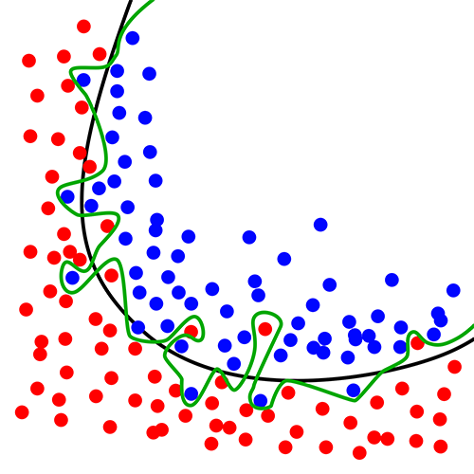
Overfitting ☹
Overfitting occurs when a statistical
model describes random error or noise instead of underlying relationship
If hypothesis space has many dimensions (many attributes) we may find meaningless regularity in data irrelevant to true distinguishing features
  Students with an m in first name, born in July, & whose SSN digits sum to a prime number get better grades in AI
If we have too little training data, even a reasonable hypothesis space can overfit

Slide 45
Avoiding Overfitting
Remove obviously irrelevant features
  E.g., remove ‘year observed’, ‘month observed’, ‘day observed’, ‘observer name’from the attributes used
Get more training data
Pruning lower nodes in a decision tree
  E.g., if gain of best attribute at a node is below a threshold, stop and make this node a leaf rather than generating children nodes

Slide 46
Pruning decision trees
Pruning a decision tree is done by replacing a whole subtree by a leaf node
Replacement takes place if the expected error rate in the subtree is greater than in the single leaf, e.g.,
  Training: 1 training red success and 2 training blue failures
  Test: 3 red failures and one blue success
  Consider replacing this subtree by a single Failure node.
After replacement, only 2 errors instead of 4
Training
Test
Pruned
Color
Color
FAILURE
red
blue
red
blue
2 success
4 failure
1 success
0 failure
0 success
2 failures
1 success
3 failure
1 success
1 failure

Slide 47
Converting decision trees to rules
Easy to get rules from decision tree: write rule for each path from the root to leaf
Rule’s left-hand side built from the label of the nodes & labels of arcs
Resulting rules set can be simplified:
  Let LHS be the rule’s left hand side (condition part)
  LHS’ obtained from LHS by eliminating some conditions
  Replace LHS by LHS' in this rule if the subsets of the training set satisfying LHS and LHS' are equal
  A rule may be eliminated by using meta-conditions such as “if no other rule applies”

Slide 48
Summary: decision tree learning
Widely used learning methods in practice for problems with relatively few features
Strengths
  Fast and easy to implement
  Simple model: translate to a set of rules
  Useful: empirically valid in many commercial products
  Robust: handles noisy data
  Explainable: easy for people to understand
Weaknesses
  Large decision trees may be hard to understand
  Requires fixed-length feature vectors
  Non-incremental, adding one new feature requires rebuilding entire tree

