Slide 1
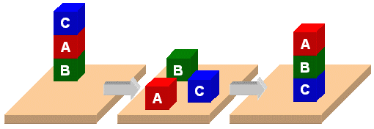
PDDL
Planning Domain Description Language

Slide 2
PDDL
Planning Domain Description Language
Based on STRIPS with various extensions
First defined by Drew McDermott (Yale) et al.
  Classic spec: PDDL 1.2; good reference guide
Used in biennial International Planning Competition (IPC) series (1998-2022)
Many planners use it as a standard input
Latest version is 3.1 and newer variants exist

Slide 3
PDDL is still widely used
After 22+ years, PDDL is still used in many planning systems and domains as a standard for input and output
It’s representation was updated, e.g. adding
  fluents (facts that change over time)
  preferences (aka soft constraints)
New variants support multiple agents, ontologies, and more
It still retains is traditional Lisp syntax

Slide 4
PDDL Representation
Task specified via two files: domain file and problem file
  Both use a logic-oriented notation with Lisp syntax
Domain file defines a domain via requirements, predicates, constants, and actions
  Used for many different problem files
Problem file: defines problem by describing its domain, specific objects, initial state and goal state
Planner: domain + problem ➔ a plan

Slide 5

Blocks Word
Domain File
(define (domain BW)
(:requirements :strips)
(:constants red green blue yellow small large)
(:predicates (on ?x ?y) (on-table ?x) (color ?x ?y) … (clear ?x))
(:action pick-up
:parameters (?obj1)
:precondition (and (clear ?obj1) (on-table ?obj1)
(arm-empty))
:effect (and (not (on-table ?obj1))
(not (clear ?obj1))
(not (arm-empty))
(holding ?obj1)))
… more actions ...)

Slide 6
Blocks Word
Problem File
(define (problem 00)
(:domain BW)
(:objects A B C)
(:init (arm-empty)
(ontable A)
(on B A)
(on C B)
(clear C))
(:goal (and (on A B)
(on B C)
(ontable C)))
C
A
B
B
A
C

Slide 7
Blocks Word
Problem File
(define (problem 00)
(:domain BW)
(:objects A B C)
(:init (arm-empty)
(on B A)
(on C B)
(clear C))
(:goal (and (on A B)
(on B C))))
C
A
B
B
A
C
Begin plan
1 (unstack c b)
2 (put-down c)
3 (unstack b a)
4 (stack b c)
5 (pick-up a)
6 (stack a b)
End plan

Slide 8
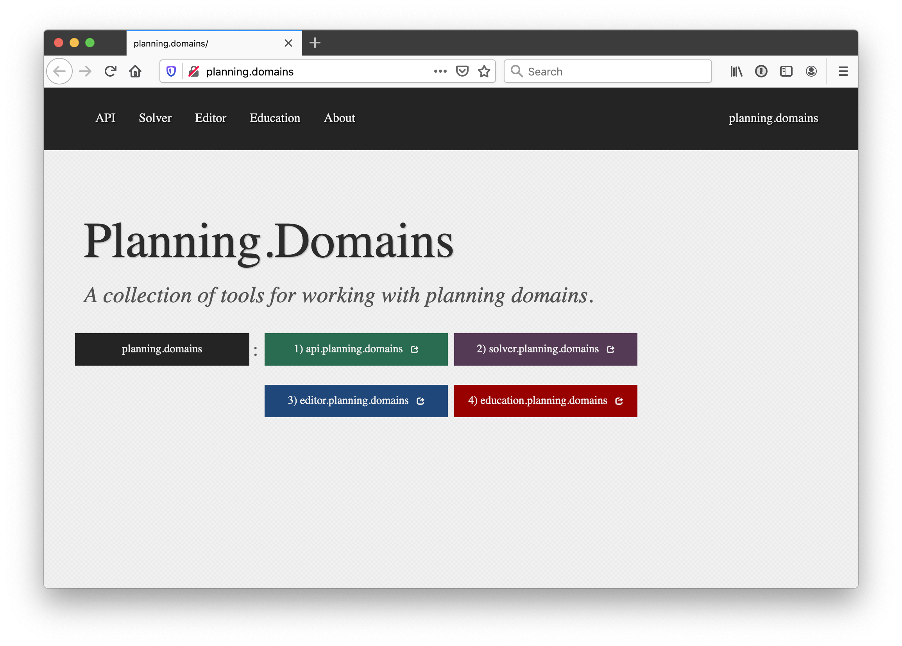
https://planning.domains/

Slide 9
Planning.domains
Open source environment for providing planning services using PDDL (GitHub)
Default planner is ff (aka, fastForward)
  very successful forward-chaining heuristic search planner producing sequential plans
  Can be configured to work with other planners
Use interactively or call via web-based API
We’ve used it for to extend blocks world domain in homework

