Slide 1
Planning 1
13.1
Chapter 11.1-11.3
Some material adopted from notes by
Andreas Geyer-Schulz and Chuck Dyer

Slide 2
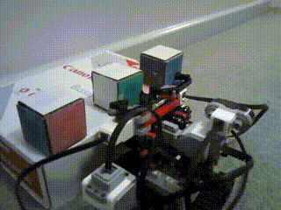
Planning is the art and practice of thinking before acting
— Patrik Haslum

Slide 3
Classic Planning
Find sequence of actions to reach a goal in a discrete, deterministic, static, fully-observable environment
State space search and logical
reasoning could be used
But classic planning developed custom representations & algorithms to do it more effectively
The approach uses a knowledge base and reasoning about the state
of the world and possible actions
We’ll look first at doing this in the
simple blocks world
robot arm
A
C
B
Initial State
A
B
C
Goal State

Slide 4
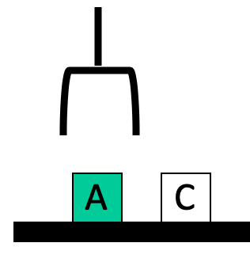
Blocks world
The blocks world is a “micro-world” with
a table, a set of blocks, and a robot hand
Some constraints for a simple model:
  Only one block can be on another block
  Any number of blocks can be on the table
  The hand can only hold one block

Slide 5
Blocks world
Typical representation uses a logic
notation to represent the state of the world:
  ontable(a) ontable(c)
  clear(a) clear(c)
  handempty
And possible actions with their preconditions and effects:
  Pickup Putdown
  Stack Unstack

Slide 6
Typical BW planning problem
Initial state:
  clear(a)
  clear(b)
  clear(c)
  ontable(a)
  ontable(b)
  ontable(c)
  handempty
Goal:
  on(b,c)
  on(a,b)
  ontable(c)
A
C
B
A
B
C

Slide 7
Typical BW planning problem
Logical assertions
describing initial &
final states
Sequence of robot actions
Initial state:
  clear(a)
  clear(b)
  clear(c)
  ontable(a)
  ontable(b)
  ontable(c)
  handempty
Goal state:
  on(b,c)
  on(a,b)
  ontable(c)
Plan:
  pickup(b)
  stack(b,c)
  pickup(a)
  stack(a,b)
A
C
B
A
B
C

Slide 8
Planning problem
Find sequence of actions to achieve goal state when executed from initial state given
  set of possible primitive actions, including their preconditions and effects
  initial state description
  goal state description
Compute plan as a sequence of actions that, when executed in initial state, achieves goal state
States specified as a KB , i.e. conjunction of conditions
  e.g., ontable(a) ∧ on(b, a)

Slide 9
Planning vs. problem solving
Problem solving methods solve similar problems
Planning is more powerful and efficient because of the representations and methods used
States, goals, and actions are decomposed into sets of sentences (usually in first-order logic)
Search often proceeds through plan space rather than state space (though there are also state-space planners)
Sub-goals can be planned independently, reducing the complexity of the planning problem

Slide 10
Typical simplifying assumptions
Atomic time: Each action is indivisible
No concurrent actions: but actions need not be ordered w.r.t. each other in the plan
Deterministic actions: action results completely determined — no uncertainty in their effects
Agent is the sole cause of change in the world
Agent is omniscient with complete knowledge of the state of the world
Closed world assumption: everything known to be true included in state description; anything not listed is false
Real AI planning systems can relax many of these

Slide 11
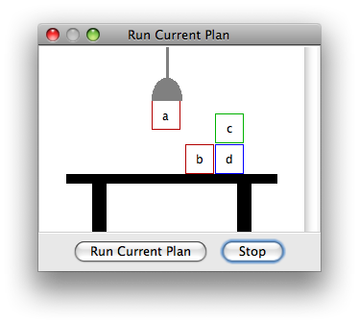
Simple Blocks world
The blocks world consists of a table, a set of blocks and a robot hand
Some domain constraints:
  Only one block can be on another block
  Any number of blocks can be on
  the table
  The hand can only hold one block
Typical representation:
  ontable(b) ontable(d)
  on(c,d) holding(a)
  clear(b) clear(c)
Meant to be a simple model!

Slide 12
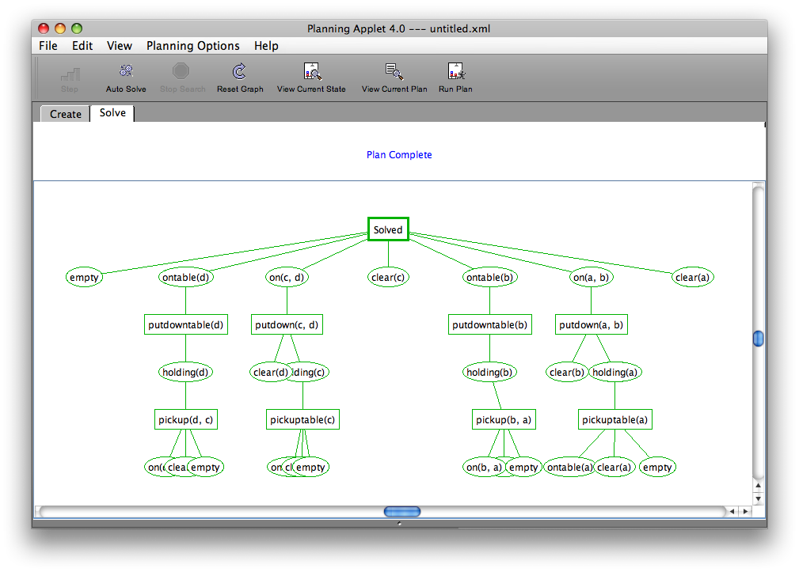

Slide 13
Typical BW planning problem
Simple approach:
find a way to achieve each goal in order
Initial state:
  clear(a)
  clear(b)
  clear(c)
  ontable(a)
  ontable(b)
  ontable(c)
  handempty
Goal:
  on(b,c)
  on(a,b)
  ontable(c)
A
C
B
A
B
C

Slide 14
Typical BW planning problem
Simple approach:
find a way to achieve each goal in order
Initial state:
  clear(a)
  clear(b)
  clear(c)
  ontable(a)
  ontable(b)
  ontable(c)
  handempty
Goal:
  on(b,c)
  on(a,b)
  ontable(c)
A
C
B
A plan:
  pickup(b)
  stack(b,c)
  pickup(a)
  stack(a,b)
A
B
C

Slide 15
Another BW planning problem
Simple approach:
find a way to achieve each goal in order
Initial state:
  clear(a)
  clear(b)
  clear(c)
  ontable(a)
  ontable(b)
  ontable(c)
  handempty
Goal:
  on(a,b)
  on(b,c)
  ontable(c)
A
C
B
A
B
C
Note: Goals in a different order!

Slide 16
Another BW planning problem
Initial state:
  clear(a)
  clear(b)
  clear(c)
  ontable(a)
  ontable(b)
  ontable(c)
  handempty
Goal:
  on(a,b)
  on(b,c)
  ontable(c)
A plan:
  pickup(a)
stack(a,b)
unstack(a,b)
putdown(a)
pickup(b)
stack(b,c)
pickup(a)
stack(a,b)
A
C
B
A
B
C
Note: Goals in a different order!

Slide 17
Yet Another BW planning problem
Plan:
  unstack(c,b)
  putdown(c)
  unstack(b,a)
  putdown(b)
  pickup(a)
  stack(a,b)
  unstack(a,b)
  putdown(a)
  pickup(b)
  stack(b,c)
  pickup(a)
  stack(a,b)
Initial state:
  clear(c)
  ontable(a)
  on(b,a)
  on(c,b)
  handempty
Goal:
  on(a,b)
  on(b,c)
  ontable(c)
C
B
A
A
B
C
Note: not very efficient!

Slide 18
Major approaches
Planning as search
GPS / STRIPS
Situation calculus
Partial order planning
Hierarchical decomposition (HTN planning)
Forward planning with heuristics
Planning with constraints (SATplan, Graphplan)
Reactive planning

Slide 19


History: Shakey the robot
First general-purpose mobile robot to be able to reason about its own actions
Shakey the Robot: 1st Robot to Embody Artificial Intelli-gence (2017, 6 min.)
Shakey: Experiments in Robot Planning and Learning (1972, 24 min)

Slide 20
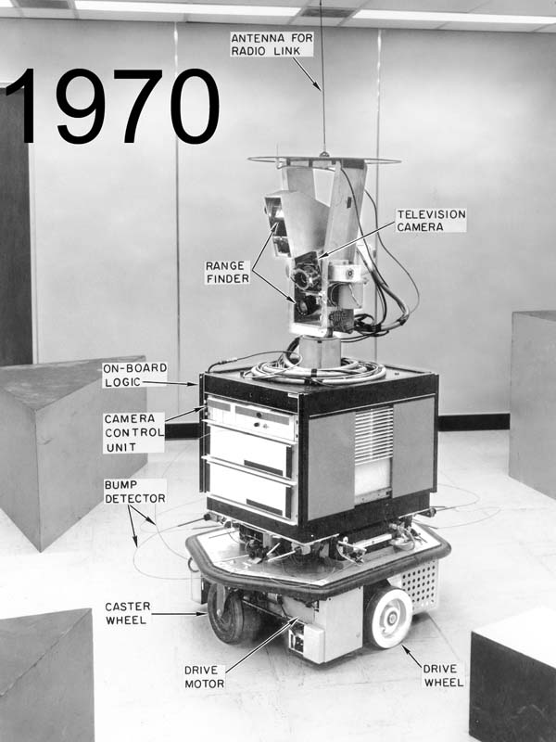
Strips planning representation
Classic approach first used in the STRIPS
(Stanford Research Institute Problem Solver) planner
A State is a conjunction of ground literals
  at(Home) ∧ ¬have(Milk) ∧ ¬have(bananas) ...
Goals are conjunctions of literals, but may have
variables, assumed to be existentially quantified
  at(?x) ∧ have(Milk) ∧ have(bananas) ...
Need not fully specify state
  Non-specified conditions either don’t-care or assumed false
  Represent many cases in small storage
  May only represent changes in state rather than entire situation
Unlike theorem prover, not seeking whether goal is true, but is there a sequence of actions to attain it
Shakey the robot

Slide 21
Blocks World Operators
Classic basic operations for the Blocks World
  stack(X,Y): put block X on block Y
  unstack(X,Y): remove block X from block Y
  pickup(X): pickup block X
  putdown(X): put block X on the table
Each represented by
  list of preconditions
  list of new facts to be added (add-effects)
  list of facts to be removed (delete-effects)
  optionally, set of (simple) variable constraints

Slide 22
Blocks World Stack Action
stack(X,Y):
preconditions(stack(X,Y), [holding(X), clear(Y)])
deletes(stack(X,Y), [holding(X), clear(Y)]).
adds(stack(X,Y), [handempty, on(X,Y), clear(X)])
constraints(stack(X,Y), [X≠Y, Y≠table, X≠table])

Slide 23
STRIPS planning
STRIPS maintains two additional data structures:
  State List - all currently true predicates
  Goal Stack - push down stack of goals to be solved, with current goal on top
If current goal not satisfied by present state, find action that adds it and push action and its preconditions (subgoals) on stack
When a current goal is satisfied, POP from stack
When an action is on top stack, record its application on plan sequence and use its add and delete lists to update current state

Slide 24
Typical BW planning problem
Initial state:
  clear(a)
  clear(b)
  clear(c)
  ontable(a)
  ontable(b)
  ontable(c)
  handempty
Goal:
  on(b,c)
  on(a,b)
  ontable(c)
A plan:
  pickup(b)
  stack(b,c)
  pickup(a)
  stack(a,b)
A
C
B
A
B
😃
C

Slide 25
Another BW planning problem
Initial state:
  clear(a)
  clear(b)
  clear(c)
  ontable(a)
  ontable(b)
  ontable(c)
  handempty
Goal:
  on(a,b)
  on(b,c)
  ontable(c)
A plan:
  pickup(a)
stack(a,b)
unstack(a,b)
putdown(a)
pickup(b)
stack(b,c)
pickup(a)
stack(a,b)
A
C
B
A
B
C
😐

Slide 26
Yet Another BW planning problem
😐
Plan:
  unstack(c,b)
  putdown(c)
  unstack(b,a)
  putdown(b)
  pickup(b)
  stack(b,a)
  unstack(b,a)
  putdown(b)
  pickup(a)
  stack(a,b)
  unstack(a,b)
  putdown(a)
  pickup(b)
  stack(b,c)
  pickup(a)
  stack(a,b)
Initial state:
  clear(c)
  ontable(a)
  on(b,a)
  on(c,b)
  handempty
Goal:
  on(a,b)
  on(b,c)
  ontable(c)
C
B
A
A
B
C

Slide 27
Yet Another BW planning problem
Initial state:
  ontable(a)
  ontable(b)
  clear(a)
  clear(b)
  handempty
Goal:
  on(a,b)
  on(b,a)
Plan:
  ??
A
B
😡

Slide 28
Goal interaction
Simple planning algorithms assume independent sub-goals
  Solve each separately and concatenate the solutions
Sussman Anomaly: an example of goal interaction problem:
  Solving on(A,B) first (via unstack(C,A),stack(A,B)) is undone when solving 2nd goal on(B,C) (via unstack(A,B), stack(B,C))
  Solving on(B,C) first will be undone when solving on(A,B)
Classic STRIPS couldn’t handle this, although minor modifications can get it to do simple cases
A
C
B
A
B
C
Initial state
Goal state

Slide 29
Fin

