Slide 1
A Glimpse of Game Theory 08
Notes:
1

Slide 2
Games and Game Theory
Much effort to develop computer programs for artificial games like chess or poker commonly played for entertainment
Larger issue: account for, model, and predict how agents (human or artificial) interact with other agents
Game theory accounts for mixture of cooperative and competitive behavior
Applies to zero-sum and non-zero-sum games

Slide 3
Basic Ideas of Game Theory
Game theory studies how strategic interactions among rational players produce outcomes with respect to players’ preferences
Preferences represented as utilities (numbers)
Outcomes might not have been intended
Provides a general theory of strategic behavior
Generally depicted in mathematical form
Plays important role in economics, decision theory and multi-agent systems
Notes:
2

Slide 4

Zero Sum Games
Zero-sum: participant’s gain/loss exactly balanced by losses/gains of the other participants
Total gains of participants minus total losses = 0
Poker is zero sum game: money won = money lost
Commercial trade not a zero-sum game
If country with an excess of bananas trades with another for their excess of apples, both may benefit
Non-zero-sum games more complex to analyze
More non-zero-sum games as world becomes more complex, specialized, and interdependent

Slide 5
Rules, Strategies, Payoffs & Equilibrium
Situations are treated as “games”:
Rules of game: who can do what, and when they can do it
Player's strategy: plan for actions in each possible situation in the game
Player's payoff: amount that player wins or loses in a particular situation in a game
Player has a dominant strategy if her best strategy doesn’t depend on what others do
Notes:
3

Slide 6
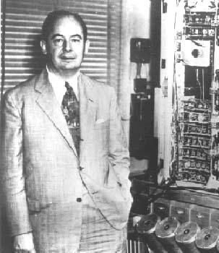
Game Theory Roots
Defined by John von Neumann & Oskar Morgenstern
von Neumann, J., and Morgenstern, O., (1947). The Theory of Games and Economic Behavior.
Provides powerful model & practical tools to model interactions among sets of autonomous agents
Used to model strategic policies (e.g., arms race among countries)

Slide 7

Nash Equilibrium
Occurs when each player's strategy is optimal given strategies of other players
It means that no player benefits by unilaterally changing strategy, while others stay fixed
Like a local maximum in hill climbing
Every finite game has at least one Nash equilibrium in either pure or mixed strategies (proved by John Nash)
J. F. Nash. 1950. Equilibrium Points in n-person Games. Proc. National Academy of Science, 36
Nash won 1994 Nobel Prize in economics for this work
Read A Beautiful Mind by Sylvia Nasar (1998) and/or see the 2001 film. Both excellent.
Notes:
5
When John Nash wrote "Non Cooperative Games," his Ph. D. dissertation at Princeton in 1950, the text of his thesis (read it online) was brief. It ran only 26 pages.

Slide 8

Prisoner's Dilemma
Famous example from game theory
Strategies must be undertaken without full knowledge of what other players will do
Players adopt dominant strategies, but they don't necessarily lead to the best outcome
Rational behavior leads to a situation where everyone is worse off!
Will the two prisoners cooperate to minimize total loss of liberty or will one of them, trusting the other to cooperate, betray him so as to go free?
Notes:
6

Slide 9

Bonnie and Clyde
Bonnie and Clyde are arrested and charged with crimes. They’re questioned separately, unable to communicate. They know how it works:
If both proclaim mutual innocence (cooperating), they will be found guilty anyway and get three-year sentences for robbery
If one confesses (defecting) and the other doesn’t (cooperating), the confessor is rewarded with a light, one-year sentence and the other gets a severe eight-year sentence
If both confess (defecting), then the judge sentences both to a moderate four years in prison
What should Bonnie do? What should Clyde do?

Slide 10
The payoff matrix
Recall: both must decide what to do independently, without knowing what the other chose

Slide 11
Bonnie’s Decision Tree
There are two cases to consider
If Clyde Confesses
If Clyde Does Not Confess
Bonnie
Bonnie
Confess
Not Confess
Confess
Not Confess
4 Years in
8 Years in
1 Year in
3 Years in
Prison
Prison
Prison
Prison
Best
Strategy
Best
Strategy
Bonnie’s Dominant strategy is to confess (defect) because no matter what Clyde does, she is better off confessing
Notes:
8

Slide 12
So what?
Clyde’s reasoning is the same
They both get 4-year sentences
They could have both had 3-year sentences
But it seems we should always defect and never cooperate
No wonder Economics has been called the dismal science

Slide 13
Some PD examples
There are lots of examples of the Prisoner’s Dilemma situations in the real world
It makes it difficult for “players” to avoid the bad outcome of both defecting
Cheating on a cartel
Trade wars between countries
Arms races between countries
Advertising
Communal coffee pot
Class team project
Notes:
9

Slide 14
Cheating on a Cartel
Cartel: association of firms with purpose of maintaining prices at a high level and restricting competition
Cartel members' possible strategies range from abiding by their agreement to cheating
i.e., can charge the cartel price or a lower one
Cheating firms can increase profits
The best strategy is charging the low price
Notes:
10

Slide 15
Trade Wars Between Countries
Free trade benefits both trading countries
Tariffs can benefit one trading country
Imposing tariffs can be a dominant strategy and establish a Nash equilibrium even though it may be inefficient
Notes:
10

Slide 16
Advertising
Advertising is expensive
All firms advertising tends to equalize the effects
Everyone would gain if no one advertised
But firms increase their advertising to gain advantage
Which makes their competition do the same
It’s an arms race
Notes:
10

Slide 17

Games Without Dominant Strategies
In some games, players have no dominant strategy
Player's strategy depends on others’ strategies
If player's best strategy depends on another’s strategy, she has no dominant strategy
Notes:
19

Slide 18
Ma’s Decision Tree
If Pa Confesses
If Pa Doesn’t Confess
Ma
Ma
Confess
Not Confess
Not Confess
Confess
6 Years in
4 Years in
Prison
Prison
8 Years in
5 Years in
Best
Prison
Prison
Strategy
Best
Strategy
Ma has no explicit dominant strategy, but there is a best one since Pa does have a dominant strategy (What is it?)
Notes:
21
Pa confesses

Slide 19
Pa’s Decision Tree
If Ma Confesses
If Ma Does Not Confess
Pa
Pa
Confess
Not Confess
Not Confess
Confess
1 Years in
2 Years in
Prison
Prison
3 Years in
0 Years in
Best
Prison
Prison
Strategy
Best
Strategy
Pa does have a dominant strategy: confess
So Ma’s best strategy is to confess
Notes:
21
Pa confesses

Slide 20
Some games have no simple solution
Neither player has a dominant strategy. There is no non-cooperative solution
Player B
1
2
1, -1
-1, 1
1
Player A
-1, 1
1, -1
2
Best strategy for each is to randomly choose 1 or 2

Slide 21
Repeated Games
A repeated game is a game that the same players play more than once
Repeated games differ from one-shot games since a player’s current actions can depend on the past behavior of other players
Cooperation is encouraged
Notes:
41

Slide 22
Payoff matrix for the generic two-person dilemma game
(A’s payoff, B’s payoff)
where C: cooperate
And D: defect
Player B
cooperate
defect
(CC,CC) reward for mutual cooperation
(CD,DC) sucker’s payoff and temptation to defect
cooperate
Player A
(DC,CD)
temptation to defect and sucker’s payoff
(DD,DD) punishment for mutual defection
defect

Slide 23

Payoffs
Four payoffs are involved
CC: Both players cooperate
CD: You cooperate, other defects (sucker’s payoff)
DC: You defect, other cooperates (temptation to defect)
DD: Both players defect
Assigning values induces an ordering, with 24 (4!) possibilities; 3 lead to “dilemma” games
Prisoner’s dilemma: DC > CC > DD > CD
Chicken: DC > CC > CD > DD
Stag Hunt: CC > DC > DD > CD

Slide 24

Chicken
DC > CC > CD > DD
Rebel without a cause scenario
Two cars race toward one another
Drivers choose to serve or not
Cooperation: swerving
Defecting: not swerving
Optimal move: do exactly the opposite of the other player

Slide 25

Stag Hunt
CC > DC > DD > CD
Two players on a stag hunt
Hard task requiring coordina-tion but with big shared payoff
Hare seen, do you defect and chase it?
Cooperate: keep after the stag
Defect: switch to chasing hare
Optimal play: do exactly what the other player(s) do

Slide 26

Prisoner’s dilemma
DC > CC > DD > CD
Optimal play: always defect
Two rational players will always defect.
Thus, (naïve) individual rationality subverts their common good

Slide 27
More examples of the PD in real life
Communal coffeepot
Cooperate by making new pot of coffee if you take last cup
Defect by taking last cup and not making new pot, depending on the next coffee seeker to do it
DC > CC > DD > CD
Class team project
Cooperate by doing your part well and on time
Defect by slacking, hoping other team members will come through and sharing benefits of good grade
(Arguable) DC > CC > DD > CD

Slide 28
Iterated Prisoner’s Dilemma
Game theory: rational players should always defect when engaged in a PD situation
In real situations, people don’t always do this
Why not? Possible explanations:
People aren’t rational
Morality
Social pressure
Fear of consequences
Evolution of species-favoring genes
Which make sense? How can we formalize?

Slide 29
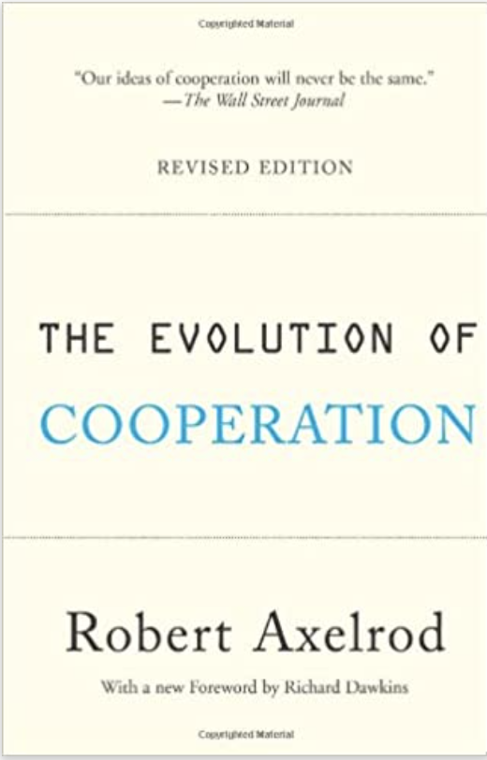
Iterated Prisoner’s Dilemma
Key idea: We often play more than one “game” with a given player
Players have knowledge of past games, including their choices and other players’ choices
Choice when playing against a player can be based on whether she’s cooperated in past
Simulation first done by Robert Axelrod where programs played in a round-robin tournament (DC=5;CC=3;DD=1;CD=0)
The simplest program won!

Slide 30
Some possible strategies
Always defect
Always cooperate
Randomly choose
Pavlovian (win-stay, lose-switch)
Start always cooperate, switch to always defect when punished by other’s defection, switch back & forth on every punishment
Tit-for-tat (TFT)
Be nice, but punish defections: Start cooperating and, after that always do what other player did on previous round
Joss
Sneaky TFT that defects 10% of the time
In an idealized (noise free) environment, TFT is both a very simple and very good strategy

Slide 31
Characteristics of Robust Strategies
Axelrod analyzed entries and identified characteristics
Nice: never defects first
Provocable: respond to defection by promptly defecting. Prompt response important; slow to anger a poor strategy; some programs tried even harder to take advantage
Forgiving: respond to single defections by defecting forever worked poorly. Better to respond to TIT with 0.9 TAT; might dampen echoes & prevent feuds
Clear: Clarity an important feature. With TFT you know what to expect and what will/won’t work. With too much randomness or bizarre strategies in program, competing programs cannot analyze and began to always defect.

Slide 32
Implications of Robust Strategies
Succeed not by "beating" others, but by allowing both to do well. TFT never "wins" a single turn! It can't. It can never do better than tie (all C).
You do well by motivating cooperative behavior from others … the provocability part
Envy is counterproductive. Doesn’t pay to get upset if someone does a few points better than you in a single encounter. To do well, others must also do well, e.g., business & its suppliers.

Slide 33
Implications of Robust Strategies
Need not be smart to do well. TFT models cooperative relations with bacteria and hosts.
Cosmic threats and promises aren’t necessary, though they may be helpful
Central authority unnecessary, though it may be helpful
Optimum strategy depends on environment. TFT not best program in all cases; too unforgiving of JOSS & too lenient with RANDOM

Slide 34

Emergence
Process where larger entities, patterns, and regularities arise via interactions among smaller or simpler entities that themselves don’t exhibit such properties
E.g.: Shape and behavior of a flock of birds or school of fish
Might cooperation be an emergent property?

Slide 35
Required for emergent cooperation
A non-zero-sum situation
Players equal in power; no discrimination or status differences
Repeated encounters with others you can recognize
Garages depending on repeat business versus those on busy highways. Being unlikely to ever see someone again => a non-iterated dilemma.
Low temptation payoff
If defecting makes you a billionaire, you're likely to do it. "Every person has a price"

Slide 36
Ecological model
Assume ecological system supporting N players
Players gain or loose points on each round
After a round, worst players die, best multiply
Environmental noise models that agent makes errors in following a strategy or misinterpret another’s choice
A simple way of modeling this is described in The Computational Beauty of Nature

Slide 37
Evolutionary stable strategies
Strategies do better or worse against other strategies
Successful strategies should work well in a variety of environments
E.g.: ALL-C works well in a mono-culture of ALL-Cs but not in a mixed environment
Successful strategies can “fight off mutations”
E.g.: ALL-D mono-culture is very resistant to invasions by any cooperating strategies
E.g.: TFT can be “invaded” by ALL-C

Slide 38
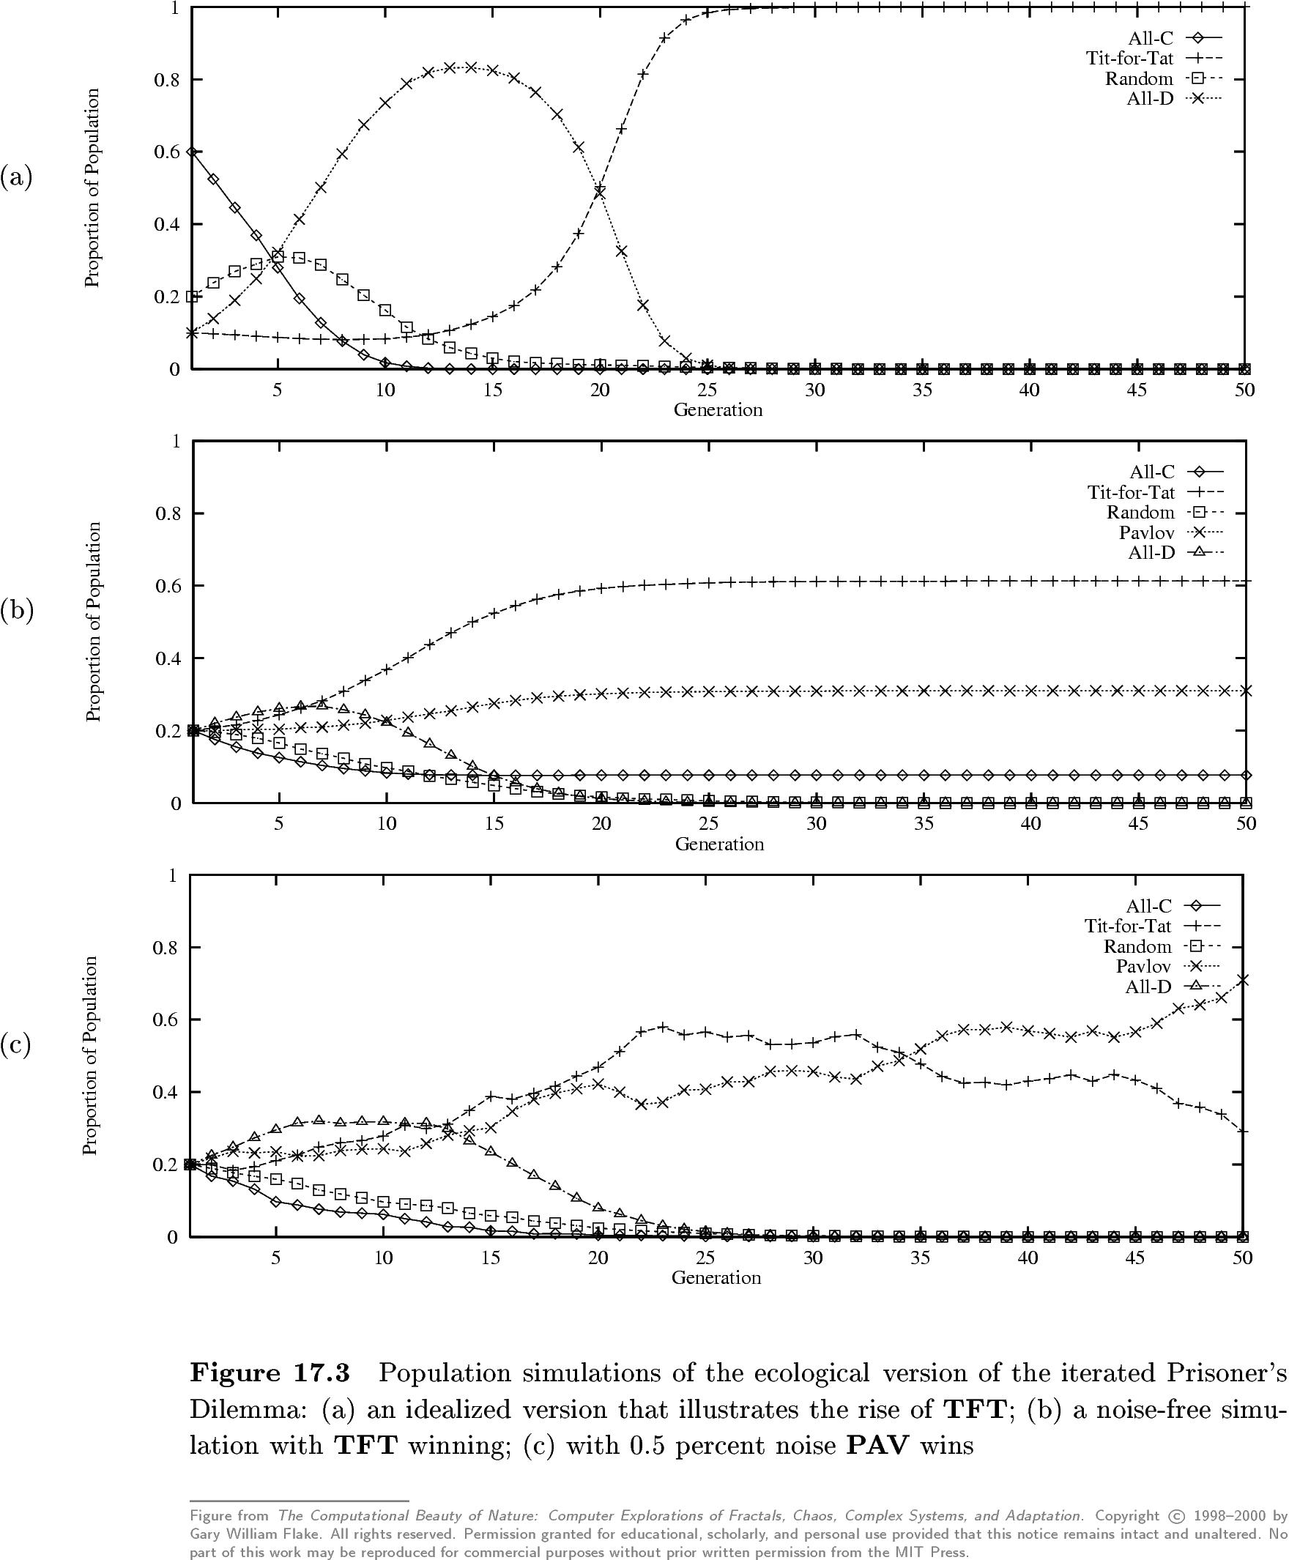
Population simulation
TFT wins
A noise free version with TFT winning
0.5% noise lets Pavlov win

Slide 39
If you are interested…
Axelrod Python
https://github.com/Axelrod-Python
Explore strategies for the Prisoners dilemma game
Over 100 strategies from the literature and some original ones
Run round robin tournaments with a variety of options
Population dynamics
Easy to install
pip install axelrod
Also includes notebooks

Slide 40
20th anniversary IPD competition (2004)
New Tack Wins Prisoner's Dilemma
Coordinating Team Players within a Noisy Iterated Prisoner’s Dilemma Tournament
U. Southhampton bot team won using covert channel to let Bots on the team recognize each other
The 60 bots
Executed series of moves that signaled their‘tribe’
Defect if other known to be outside tribe, coordin-ate if in tribe
Coordination was not just cooperation, but master/slave : defect/cooperate

Slide 41
Game Theory Relevance
Game theory is important in more complex ”games”
E.g.: multiplayer, non-zero-sum, complicated payoffs
Repeated games add complexity to balance cooperation and competition
Used in multi-agent systems and where agents form teams with humans

Slide 42
For more information
Prisoner's Dilemma: John von Neumann, Game Theory, and the Puzzle of the Bomb, William Poundstone, Anchor Books, Doubleday, 1993.
The Origins of Virtue: Human Instincts and the Evolution of Cooperation, Matt Ridley, Penguin, 1998.
Games of Life : Explorations in Ecology, Evolution and Behaviour, Karl Sigmund, 1995.
Nowak, M.A., R.M. May and K. Sigmund (1995). The Arithmetic of Mutual Help. Scientific American, 272(6).
Robert Axelrod, The Evolution of Cooperation, Basic Books, 1984.
The Computational Beauty of Nature: Computer Explorations of Fractals, Chaos, Complex Systems, and Adaptation, Gary William Flake, MIT Press, 2000.
New Tack Wins Prisoner's Dilemma, By Wendy M. Grossman, Wired News, October 2004.

Slide 43
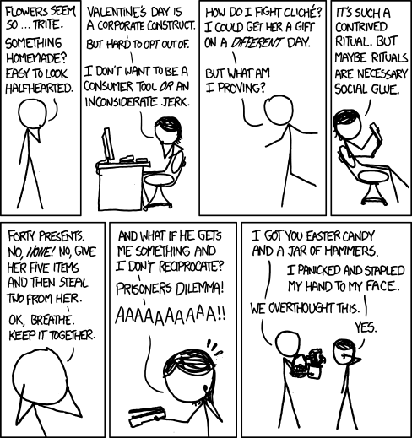
The worst resolution to the Valentine Prisoner’s Dilemma when YOU decide not to give your partner a present, but your PARTNER decides to testify against you in the armed robbery case.

