Slide 1
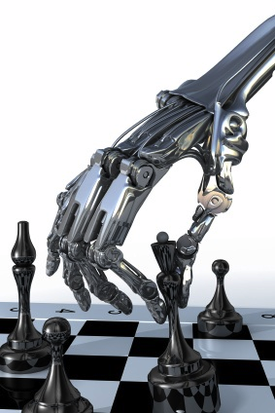
Adversarial Search
(aka Games)
Chapter 5
Some material adopted from notes by Charles R. Dyer, U of Wisconsin-Madison

Slide 2
Overview
Game playing
  State of the art and resources
  Framework
Game trees
  Minimax
  Alpha-beta pruning
  Adding randomness

Slide 3
Why study games?
Interesting, hard problems requiring minimal “initial structure”
Clear criteria for success
Study problems involving {hostile, adversarial, competing, cooperating} agents and uncertainty of interacting with the natural world
People have used them to assess their intelligence
Fun, good, easy to understand, PR potential
Games often define very large search spaces, e.g.
  chess 35¹⁰⁰ nodes in search tree, 10⁴⁰ legal states

Slide 4
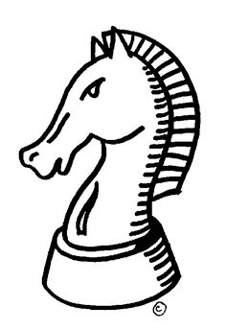
Computer chess history
1948: Norbert Wiener describes how chess program can work using minimax search with an evaluation function
1950: Claude Shannon publishes Programming a
Computer for Playing Chess
1951: Alan Turing develops on paper 1st program capable of playing full chess games (Turochamp)
1958: first program plays full game on IBM 704 (loses)
1962: Kotok & McCarthy (MIT) first program to play credibly
1967: Greenblatt’s Mac Hack Six (MIT) defeats a person in regular tournament play
1997: IBM’s Deep Blue beats world champ Gary Kasparov

Slide 5
State of the art
1979 Backgammon: BKG (CMU) tops world champ
1994 Checkers: Chinook is the world champion
1997 Chess: IBM Deep Blue beat Gary Kasparov
2007 Checkers: solved (it’s a draw)
2016 Go: AlphaGo beat champion Lee Sedol
2017 Poker: CMU’s Libratus won $1.5M from top poker players in a casino challenge
20?? Bridge: Expert bridge programs exist, but no world champions yet

Slide 6
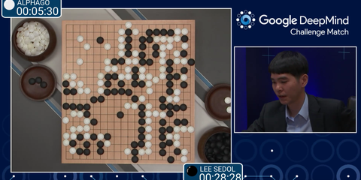
AlphaGo - The Movie
Highly recommended 2017 award-winning
documentary, free on YouTube

Slide 7
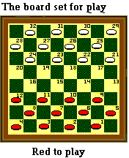

Chinook
Chinook is the World Man-Machine Checkers Champion, developed by researchers at the University of Alberta
It earned this title by competing in human tournaments, winning the right to play for the (human) world championship, and eventually defeating the best players in the world
Play Chinook online
One Jump Ahead: Challenging Human Supremacy in Checkers, Jonathan Schaeffer, 1998
See Checkers Is Solved, J. Schaeffer, et al., Science, v317, n5844, pp1518-22, AAAS, 2007.

Slide 8
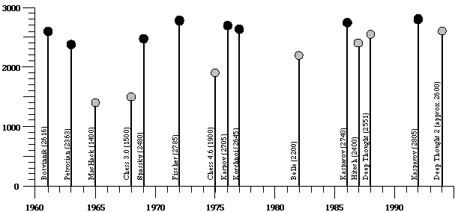
Ratings of human & computer chess champions

Slide 9
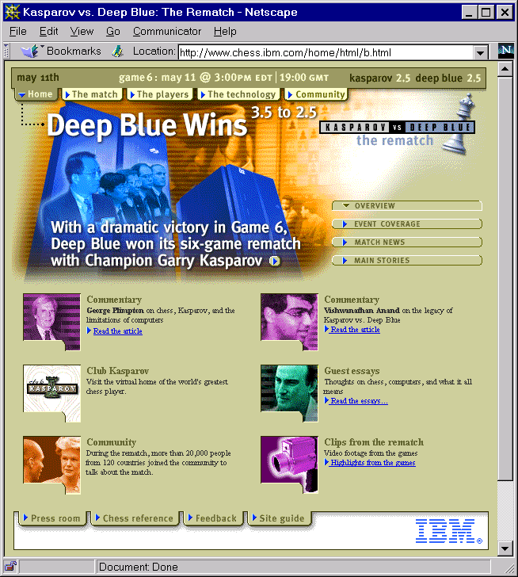
1997

Slide 10
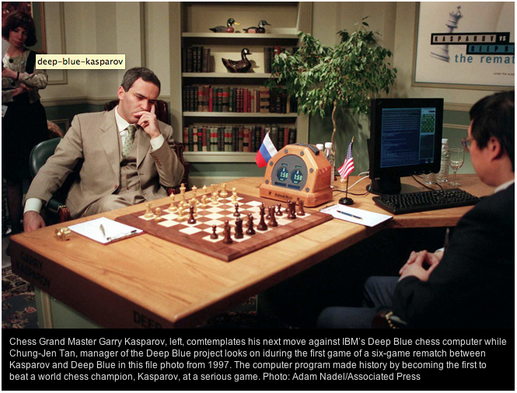
1997

Slide 11
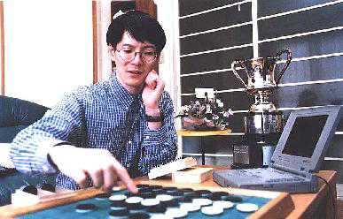
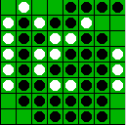
Othello: Murakami vs. Logistello
open sourced
Takeshi Murakami
World Othello Champion
1997: The Logistello software crushed Murakami, 6 to 0
Humans can not win against it
Othello, with 10²⁸ states, is still not solved
1997

Slide 12
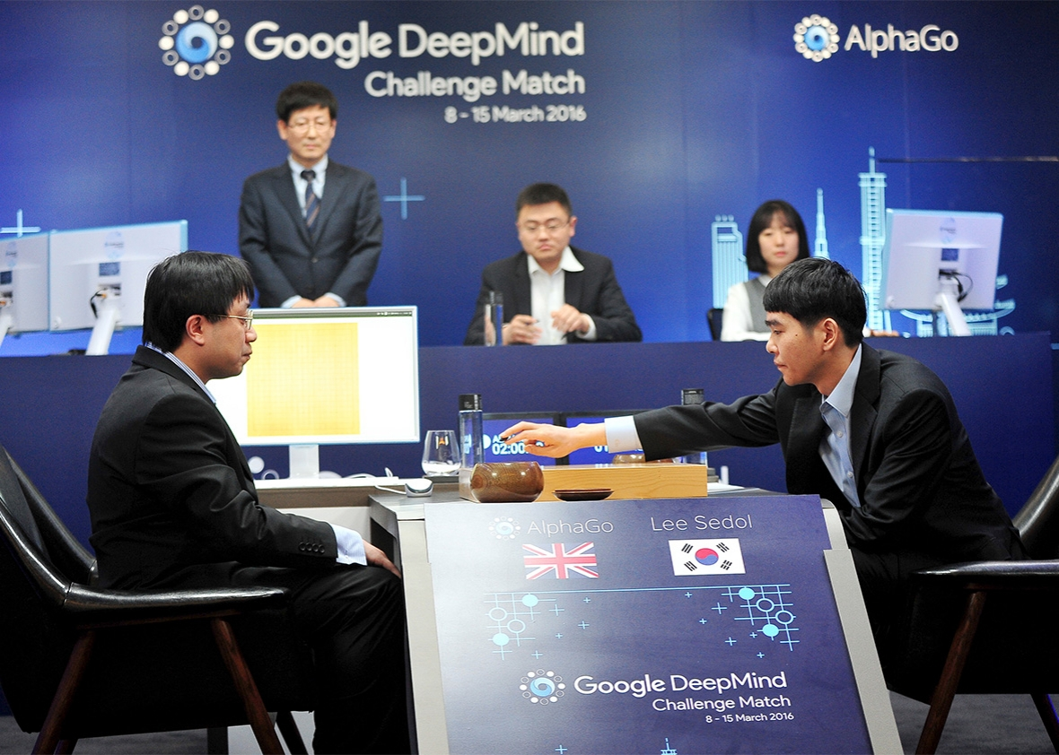
2016

Slide 13

2017

Slide 14
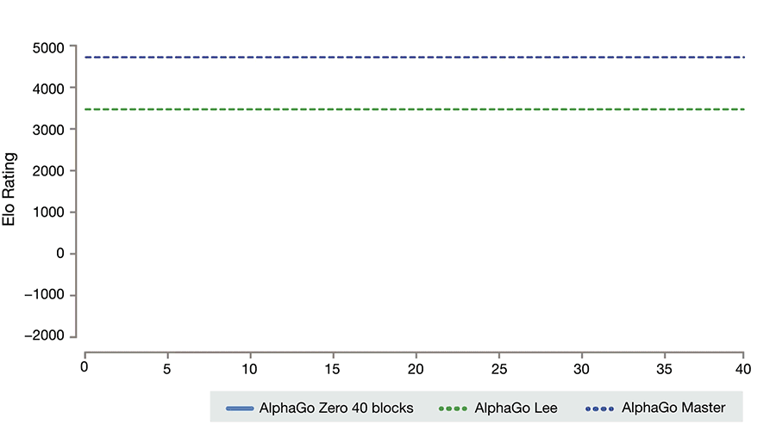
AlphaGo Zero learns on its Own
AlphaGo Zero was not trained on human games, but used reinforcement learning while playing against itself

Slide 15
How can we do it?

Slide 16
Classical vs. Machine Learning approaches
We’ll look first at the classical approach used from the 1940s to 2010
Then at newer statistical approaches, of which AlphaGo is an example
And reinforcement learning, used by Facebook’s ReBel for Texas Hold’em
These all share some techniques

Slide 17
Typical simple case for a game
2-person game
Players alternate moves
Zero-sum: one player’s loss is the other’s gain
Perfect information: both players have access to complete information about state of game. No information hidden from either player.
No chance (e.g., using dice, shuffled cards) involved
Examples: Tic-Tac-Toe, Checkers, Chess, Go, Nim, Othello
But not: Bridge, Solitaire, Backgammon, Poker, Rock-Paper-Scissors, ...

Slide 18
Can we use …
Uninformed search?
Heuristic search?
Local search?
Constraint based search?
None of these model the fact that we have an adversary …

Slide 19
How to play a game, v1
A way to play such a game is to:
  Consider all the legal moves you can make
  Compute new position resulting from each move
  Evaluate each to determine which is best for you
  Make that move
  Wait for your opponent to move and repeat
Key problems are:
  Representing the “board” (i.e., game state)
  Generating all legal next boards
  Evaluating a position

Slide 20
Evaluation function
Evaluation function or static evaluator used to evaluate the “goodness” of a game position
  Contrast with heuristic search, where evaluation function estimates cost from start node to goal passing through given node
Zero-sum assumption permits single function to describe goodness of board for both players
  f(n) >> 0: position n good for me; bad for you
  f(n) << 0: position n bad for me; good for you
  f(n) near 0: position n is a neutral position
  f(n) = +infinity: win for me
  f(n) = -infinity: win for you
Static: snapshot in time

Slide 21
Evaluation function examples
For Tic-Tac-Toe
  f(n) = [# my open 3lengths] - [# your open 3lengths]
  Where a 3length is complete row, column or diagonal that has no opponent marks
Alan Turing’s function for chess
  f(n) = w(n)/b(n) where w(n) = sum of point value of white’s pieces and b(n) = sum of black’s
  Traditional piece values: pawn:1; knight:3; bishop:3; rook:5; queen:9

Slide 22
Evaluation function examples
Most evaluation functions specified as a weighted sum of positive features
  f(n) = w₁*feat₁(n) + w₂*feat₂(n) + ... + w_{n}*feat_{k}(n)
Typical chess features: piece count, piece values, piece placement, squares controlled, …
IBM’s chess program Deep Blue (circa 1996) had >8K features in its evaluation function!
We can learn weights from choices made by expert players in real games (lots of data!)

Slide 23
But, that’s not how people play
People also use look ahead, i.e.
  enumerate actions, consider opponent’s possible responses, REPEAT
Producing a complete game tree only possible for simple games
  What is a complete game tree?
So, generate a partial game tree for some number of plys
  Move = each player takes a turn
  Ply = one player’s turn
What do we do with the game tree?

Slide 24
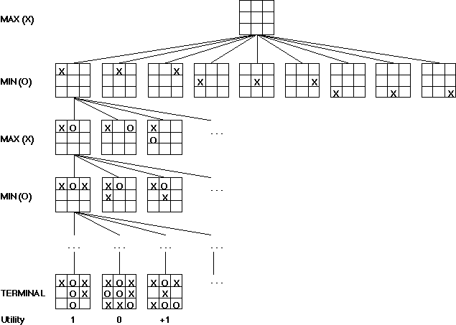
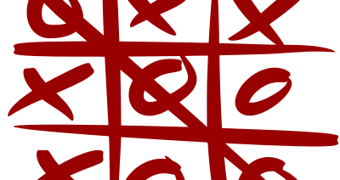
We can easily generate a complete game tree for Tic-Tac-Toe
Taking board symmetries into account, there are 138 terminal positions
91 wins for X, 44 for O and 3 draws

Slide 25
Game trees
Problem spaces for typical games are trees
Root node is current board configuration; player must decide best single move to make next
Static evaluator function rates board position f(board):real, often >0 for me; <0 for opponent
Arcs represent possible legal moves for a player
If my turn to move, then root is labeled a "MAX" node; otherwise it’s a "MIN" node
Each tree level’s nodes are all MAX or all MIN; nodes at level i are of opposite kind from those at level i+1

Slide 26
Game Tree for Tic-Tac-Toe
MAX nodes
MAX’s play →
MIN nodes
MIN’s play →
Here, symmetries are used to reduce branching factor
Terminal state
(win for MAX) →

Slide 27
Minimax procedure
Create MAX node with current board configuration
Expand nodes to some depth (a.k.a. plys) of lookahead in game
Apply evaluation function at each leaf node
Back up values for each non-leaf node until value is computed for the root node
  At MIN nodes: value is minimum of children’s values
  At MAX nodes: value is maximum of children’s values
Choose move to child node whose backed-up value determined value at root

Slide 28
Minimax theorem
Intuition: assume your opponent is at least as smart as you and play accordingly
  If she’s not, you can only do better!
Von Neumann, J: Zur Theorie der Gesellschafts-spiele Math. Annalen. 100 (1928) 295-320
  For every 2-person, 0-sum game with finite strategies, there is a value V and a mixed strategy for each player, such that (a) given player 2's strategy, best payoff possible for player 1 is V, and (b) given player 1's strategy, best payoff possible for player 2 is –V.
You can think of this as:
  Minimizing your maximum possible loss
  Maximizing your minimum possible gain

Slide 29
Minimax Algorithm
2
2
1
2
1
2
7
1
8
2
7
1
8
2
7
1
8
This is the move
selected by minimax
2
Static evaluator value
2
1
MAX
MIN
2
7
1
8

Slide 30
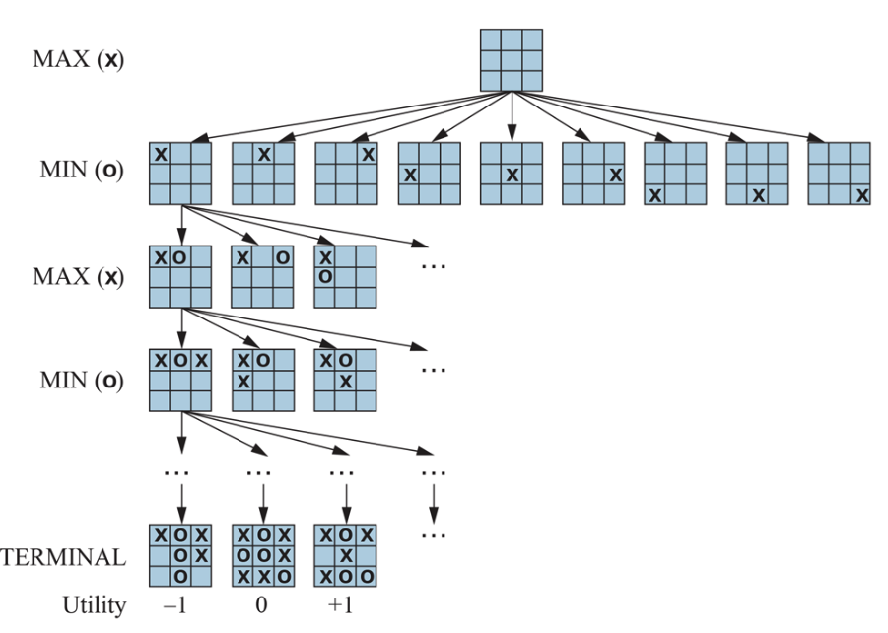
Partial Game Tree for Tic-Tac-Toe
f(n)=+1 if position win for X
f(n)=-1 if position win for O
f(n)=0 if position a draw
Partial game tree for tic-tac-toe. Top node is the initial state, and max moves first, placing an X in an empty square. Only part of the tree shown, giving alternating moves by min (O) and max (X), until we reach terminal states, which are assigned utilities {-1,0,+1} for {loose, draw, win}

Slide 31
Why backed-up values?
Why not just use a good static evaluator metric on immediate children
Intuition: if metric is good, doing look ahead and backing up values with Minimax should be better
Non-leaf node N’s backed-up value is value of best state MAX can reach at depth h if MIN plays well
  “plays well”: same criterion as MAX applies to itself
If e is good, then backed-up value is better estimate of STATE(N) goodness than e(STATE(N))
Use lookahead horizon h because time to choose a move is typically limited

Slide 32
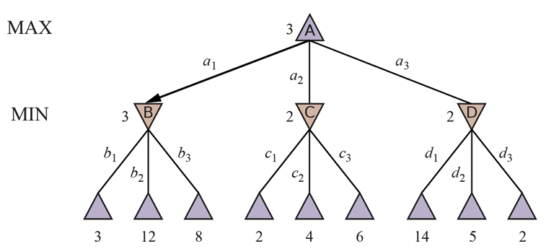
Minimax Tree Again
MAX node
value computed
by minimax
MIN node
f values:
Two-ply game tree. △ nodes are “max nodes,” in which it is max’s turn to move, and ▽ nodes are “min nodes.” The terminal nodes show utility values for max; the other nodes are labeled with their minimax values. max’s best move at root is a1 because it leads to state with the highest minimax value. min’s best reply is b1 since it leads to the state with the lowest minimax value.

Slide 33
Is that all there is to simple games?

Slide 34
Alpha-beta pruning
Improve performance of the minimax algorithm through alpha-beta pruning
“If you have an idea that is surely bad, don't take the time to see how truly awful it is” -Pat Winston (MIT)
MAX
?
We don’t need to compute the value at this node
No matter what it is, it can’t affect value of the root node
MIN
2
?
MAX
2
7
1
?

Slide 35
Alpha-beta pruning
Improve performance of the minimax algorithm through alpha-beta pruning
“If you have an idea that is surely bad, don't take the time to see how truly awful it is” -Pat Winston (MIT)
We don’t need to compute the value at this node
No matter what it is, it can’t affect value of the root node
Compute upper (α) & lower (β) bounds on final mini-max values as we go to identify such cases
MAX
α:2
MIN
β:2
β:1
MAX
2
7
1
?

Slide 36
Alpha-beta pruning
α:2
β:2
β:1
Traverse tree in depth-first order
At MAX node n, alpha(n) = max
value found so far
  Alpha values start at -∞ and only increase
At MIN node n, beta(n) = min value found so far
  Beta values start at +∞ and only decrease
Beta cutoff: stop search below MAX node N (i.e., don’t examine more descendants) if alpha(N) >= beta(i) for some MIN node ancestor i of N
Alpha cutoff: stop search below MIN node N if beta(N)<=alpha(i) for a MAX node ancestor i of N
2
7
1
?

Slide 37
Alpha-beta pruning
α:2
β:2
β:1
Traverse tree in depth-first order
At MAX node n, alpha(n) = max
value found so far
  Alpha values start at -∞ and only increase
At MIN node n, beta(n) = min value found so far
  Beta values start at +∞ and only decrease
Beta cutoff: stop search below MAX node N (i.e., don’t examine more descendants) if alpha(N) >= beta(i) for some MIN node ancestor i of N
Alpha cutoff: stop search below MIN node N if beta(N)<=alpha(i) for a MAX node ancestor i of N
2
7
1
?

Slide 38
Alpha-Beta Tic-Tac-Toe Example

Slide 39
Alpha-Beta Tic-Tac-Toe Example
β: 2
F = X’s open lines –
O’s open lines
Beta value of a MIN
node is upper bound on
final backed-up value;
it can never increase
2

Slide 40
Alpha-Beta Tic-Tac-Toe Example
β: 1
Beta value of a MIN
node is upper bound on
final backed-up value;
it can never increase
2
1

Slide 41
Alpha-Beta Tic-Tac-Toe Example
α: 1
β: 1
Alpha value of MAX
node is lower bound on
final backed-up value;
it can never decrease
2
1

Slide 42
Alpha-Beta Tic-Tac-Toe Example
α: 1
β = 1
β: -1
2
1
-1

Slide 43
Alpha-Beta Tic-Tac-Toe Example
α = 1
β = 1
β = -1
2
1
-1
Discontinue search below a MIN node whose beta value ≤ alpha value of one of its MAX ancestors

Slide 44
Another alpha-beta example
MAX
α=3
β=1
prune!
MIN
β=3
β=2
prune!
3
12
8
2
14
1

Slide 45
Alpha-Beta Tic-Tac-Toe Example 2
0
5
-3
3
3
-3
0
2
-2
3
5
2
5
-5
0
1
5
1
-3
0
-5
5
-3
3
2

Slide 46
0
0
5
-3
3
3
-3
0
2
-2
3
5
2
5
-5
0
1
5
1
-3
0
-5
5
-3
3
2

Slide 47
0
0
0
5
-3
3
3
-3
0
2
-2
3
5
2
5
-5
0
1
5
1
-3
0
-5
5
-3
3
2

Slide 48
0
0
-3
0
5
-3
3
3
-3
0
2
-2
3
5
2
5
-5
0
1
5
1
-3
0
-5
5
-3
3
2

Slide 49
0
0
-3
0
5
-3
3
3
-3
0
2
-2
3
5
2
5
-5
0
1
5
1
-3
0
-5
5
-3
3
2

Slide 50
0
0
0
-3
0
5
-3
3
3
-3
0
2
-2
3
5
2
5
-5
0
1
5
1
-3
0
-5
5
-3
3
2

Slide 51
0
0
3
0
-3
3
0
5
-3
3
3
-3
0
2
-2
3
5
2
5
-5
0
1
5
1
-3
0
-5
5
-3
3
2

Slide 52
0
0
3
0
-3
3
0
5
-3
3
3
-3
0
2
-2
3
5
2
5
-5
0
1
5
1
-3
0
-5
5
-3
3
2

Slide 53
0
0
0
0
3
0
-3
3
0
5
-3
3
3
-3
0
2
-2
3
5
2
5
-5
0
1
5
1
-3
0
-5
5
-3
3
2

Slide 54
0
0
0
0
3
0
-3
3
5
0
5
-3
3
3
-3
0
2
-2
3
5
2
5
-5
0
1
5
1
-3
0
-5
5
-3
3
2

Slide 55
0
0
0
0
3
2
0
-3
3
2
0
5
-3
3
3
-3
0
2
-2
3
5
2
5
-5
0
1
5
1
-3
0
-5
5
-3
3
2

Slide 56
0
0
0
0
3
2
0
-3
3
2
0
5
-3
3
3
-3
0
2
-2
3
5
2
5
-5
0
1
5
1
-3
0
-5
5
-3
3
2

Slide 57
0
0
2
0
2
0
3
2
0
-3
3
2
0
5
-3
3
3
-3
0
2
-2
3
5
2
5
-5
0
1
5
1
-3
0
-5
5
-3
3
2

Slide 58
0
0
2
0
2
0
3
2
0
-3
3
2
0
5
-3
3
3
-3
0
2
-2
3
5
2
5
-5
0
1
5
1
-3
0
-5
5
-3
3
2

Slide 59
0
0
0
2
0
2
0
3
2
0
-3
3
2
0
5
-3
3
3
-3
0
2
-2
3
5
2
5
-5
0
1
5
1
-3
0
-5
5
-3
3
2

Slide 60
0
0
0
2
0
2
0
3
2
0
-3
3
2
5
0
5
-3
3
3
-3
0
2
-2
3
5
2
5
-5
0
1
5
1
-3
0
-5
5
-3
3
2

Slide 61
0
0
0
2
0
2
0
3
2
1
0
-3
3
2
1
0
5
-3
3
3
-3
0
2
-2
3
5
2
5
-5
0
1
5
1
-3
0
-5
5
-3
3
2

Slide 62
0
0
0
2
0
2
0
3
2
1
0
-3
3
2
1
-3
0
5
-3
3
3
-3
0
2
-2
3
5
2
5
-5
0
1
5
1
-3
0
-5
5
-3
3
2

Slide 63
0
0
0
2
0
2
0
3
2
1
0
-3
3
2
1
-3
0
5
-3
3
3
-3
0
2
-2
3
5
2
5
-5
0
1
5
1
-3
0
-5
5
-3
3
2

Slide 64
0
0
0
2
1
0
2
1
0
3
2
1
0
-3
3
2
1
-3
0
5
-3
3
3
-3
0
2
-2
3
5
2
5
-5
0
1
5
1
-3
0
-5
5
-3
3
2

Slide 65
0
0
0
2
1
0
2
1
0
3
2
1
0
-3
3
2
1
-3
-5
0
5
-3
3
3
-3
0
2
-2
3
5
2
5
-5
0
1
5
1
-3
0
-5
5
-3
3
2

Slide 66
0
0
0
2
1
0
2
1
0
3
2
1
0
-3
3
2
1
-3
-5
0
5
-3
3
3
-3
0
2
-2
3
5
2
5
-5
0
1
5
1
-3
0
-5
5
-3
3
2

Slide 67
0
0
0
2
1
0
2
1
-5
0
3
2
1
-5
0
-3
3
2
1
-3
-5
0
5
-3
3
3
-3
0
2
-2
3
5
2
5
-5
0
1
5
1
-3
0
-5
5
-3
3
2

Slide 68
0
0
0
2
1
0
2
1
-5
0
3
2
1
-5
0
-3
3
2
1
-3
-5
0
5
-3
3
3
-3
0
2
-2
3
5
2
5
-5
0
1
5
1
-3
0
-5
5
-3
3
2

Slide 69
1
0
1
0
2
1
0
2
1
-5
0
3
2
1
-5
0
-3
3
2
1
-3
-5
0
5
-3
3
3
-3
0
2
-2
3
5
2
5
-5
0
1
5
1
-3
0
-5
5
-3
3
2

Slide 70
1
0
1
0
2
1
2
0
2
1
-5
2
0
3
2
1
-5
2
0
-3
3
2
1
-3
-5
2
0
5
-3
3
3
-3
0
2
-2
3
5
2
5
-5
0
1
5
1
-3
0
-5
5
-3
3
2

Slide 71
With alpha-beta we avoided computing a static evaluation metric for 14 of the 25 leaf nodes
1
0
1
0
2
1
2
0
2
1
-5
2
0
3
2
1
-5
2
0
-3
3
2
1
-3
-5
2
0
5
-3
3
3
-3
0
2
-2
3
5
2
5
-5
0
1
5
1
-3
0
-5
5
-3
3
2

Slide 72
Alpha-beta algorithm
function MAX-VALUE (state, α, β)
;; α = best MAX so far; β = best MIN
if TERMINAL-TEST (state) then return UTILITY(state)
v := -∞
for each s in SUCCESSORS (state) do
v := MAX (v, MIN-VALUE (s, α, β))
if v >= β then return v
α := MAX (α, v)
end
return v
function MIN-VALUE (state, α, β)
if TERMINAL-TEST (state) then return UTILITY(state)
v := ∞
for each s in SUCCESSORS (state) do
v := MIN (v, MAX-VALUE (s, α, β))
if v <= α then return v
β := MIN (β, v)
end
return v

Slide 73
Effectiveness of alpha-beta
Alpha-beta guaranteed to compute same value for root node as minimax, but with less computation
Worst case: no pruning, examine b^{d} leaf nodes, where nodes have b children & d-ply search is done
Best case: examine only (2b)^{d/2} leaf nodes
  You can search twice as deep as minimax!
  Occurs if each player’s best move is 1st alternative
In Deep Blue, alpha-beta pruning reduced effective branching factor from ~35 to ~6

Slide 74
Many other improvements
Adaptive horizon + iterative deepening
Extended search: retain k>1 best paths (not just 1) and extend tree at greater depth below their leaf nodes to help dealing with “horizon effect”
Singular extension: If move is obviously better than others in node at horizon h, expand it
Use transposition tables to deal with repeated states

Slide 75
Simple Games Summary
Simple 2-player, zero-sum, deterministic, perfect information games are popular and let us explore adversarial search
Use a static evaluator and look ahead to choose move
Computing static evaluator uses most computing
Minimax makes best choice for next move
Alpha-beta gives same answer, but often with much less work

