Slide 1

CMSC 671
Introduction to
Artificial Intelligence
Course Overview
Fall 2021

Slide 2
Today’s Class
Course overview
Introduction
  Brief history of AI
  What is AI? (and why is it so interesting?)
  What’s the state of AI now?

Slide 3
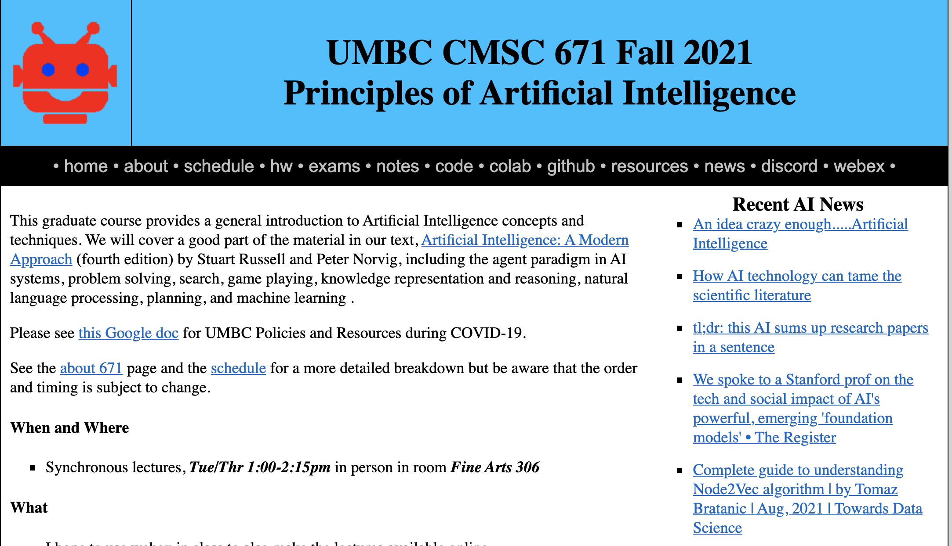
https://bit.ly/671f21

Slide 4
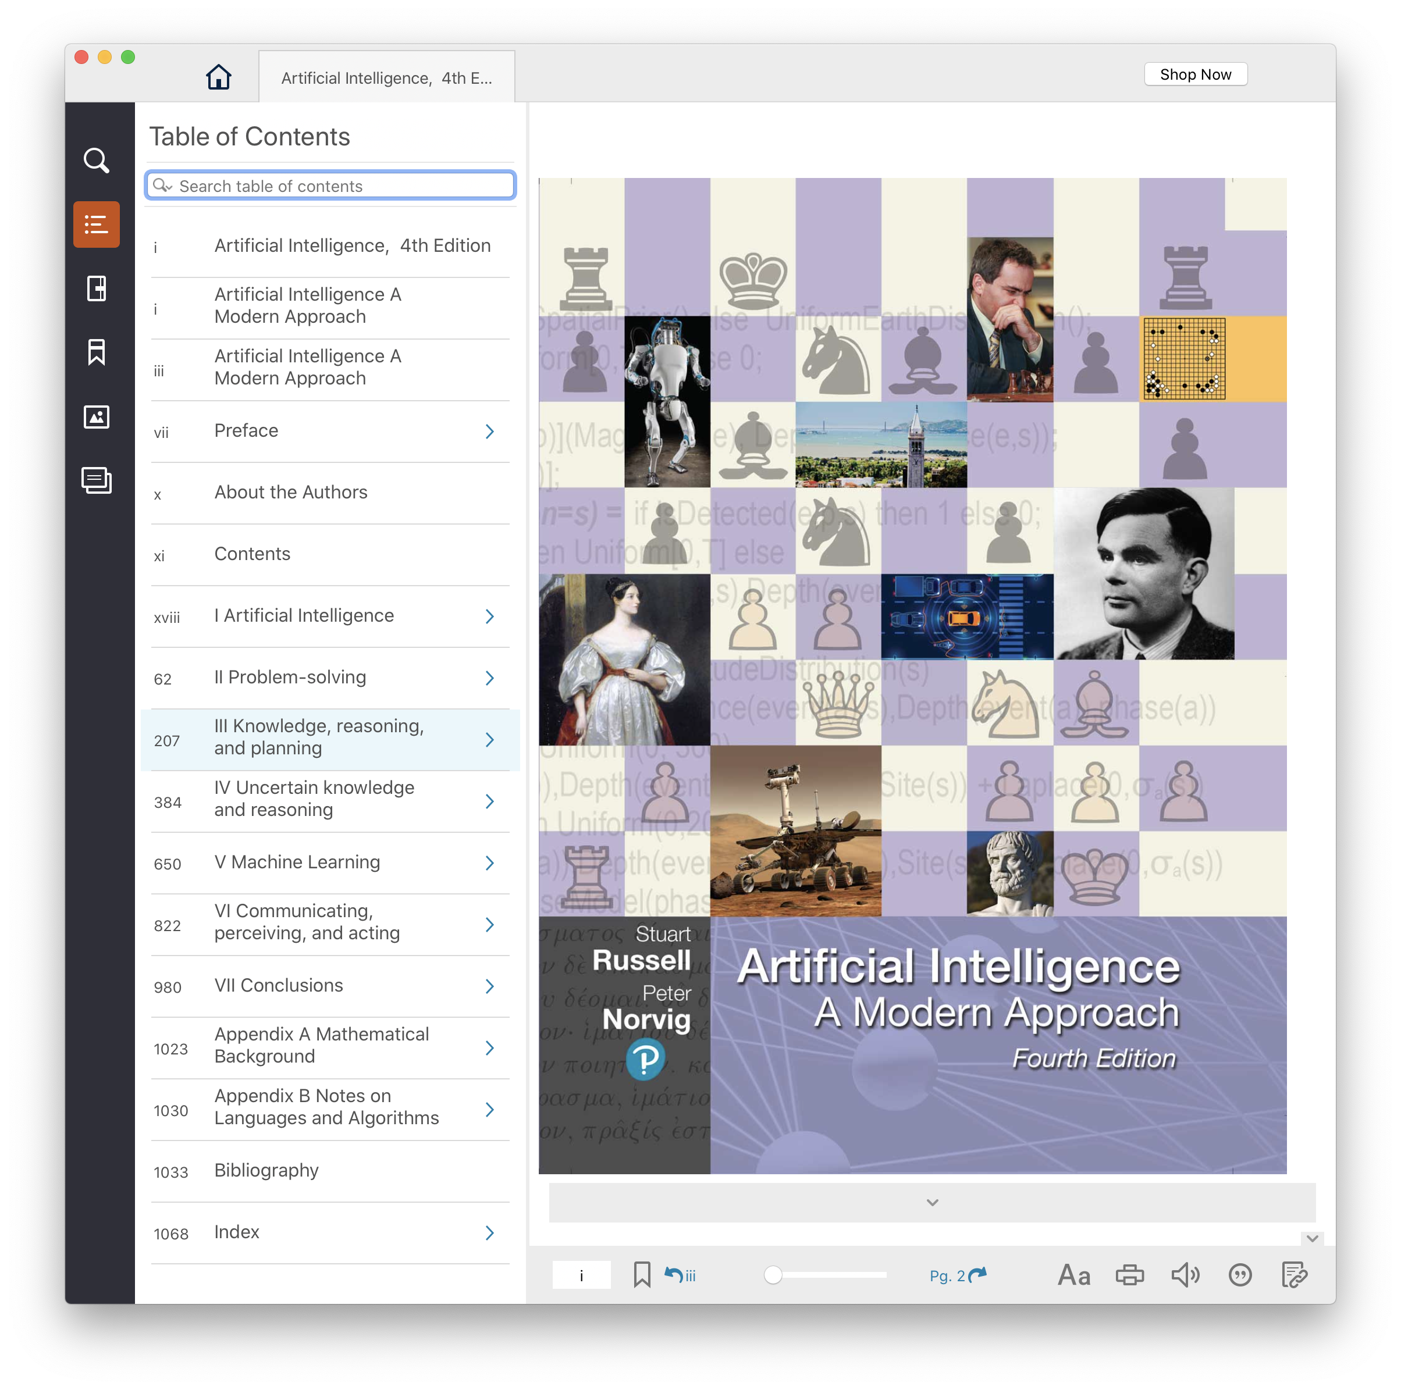
Text, CMI
4th edition of AIMA (2020) has lots of new material since the 2009 3rd edition
UMBC CMI program charges
$35 for a digital version, $160
on Amazon for hardcopy
Access on Blackboard or down- load epub to computer/phone
Opt-out of CMI via Blackboard

Slide 5
Homework and grading policies
Six to eight short homework assignments (mix of written and programming)
  One-time extensions of up to a week may be granted if requested in advance
  Last-minute requests for extensions probably will not be granted
Do the reading before each class!

Slide 6
Programming
Programming assignments in Python
  We’ll use Python 3 in the notes and examples
We’ll use GitHub to share code, Jupyter notebooks and for HW submission
Some assignments may require other systems
  E.g., C5 decision tree learning system, Weka Machine learning environments

Slide 7
Exams and Quizes
We may have periodic short quizzes (0-10%)
  On Blackboard every other week or so, mostly to motivate you to keep up with the reading and classes
Midterm exam (15-20%)
  In person or on Blackboard, October 10?
Final exam (25-30%)
  In person or on Blackboard, December 15?
  Comprehensive with an emphasis on last half of material (e.g., 30/70 split)
Homework (45-50%)

Slide 8
Instructor availability
Professor Finin, finin@umbc.edu
  Office hours: TBD on Webex and/or in person
Ask general questions to Discord first
  We’ll try to respond within 24 hours
TA: Jinglong Sun, jsun2@umbc.edu
Grader: TBD
If needed, we may try holding help session on Discord

