Slide 1

Notes
notes

Slide 2
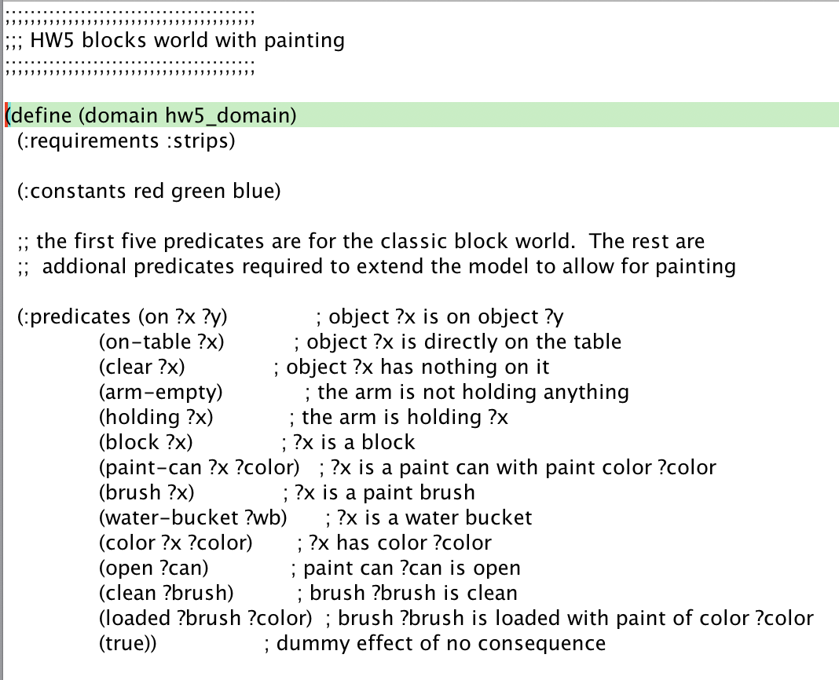
hw5
Shortest plan?
How long is too long?
Finding shortest plan?
Why different lengths?
~(clean ?b) ⬄ (loaded ?b ?c)
(loaded ?b ?c1) ^ (loaded ?b ?c2) => (c1 = c2)
Don’t think you can say this in simple PDDL
Must define relevant actions to enforce it
Can then assume it in preconditions
May be possible in current PDDL spec. or successor ADL

Slide 3


