Slide 1
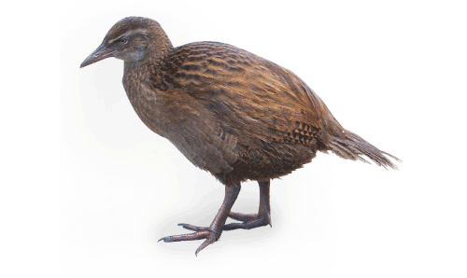
Decision Trees in
AIMA, WEKA, and SCIKIT-LEARN
14_2_dt_examples

Slide 2
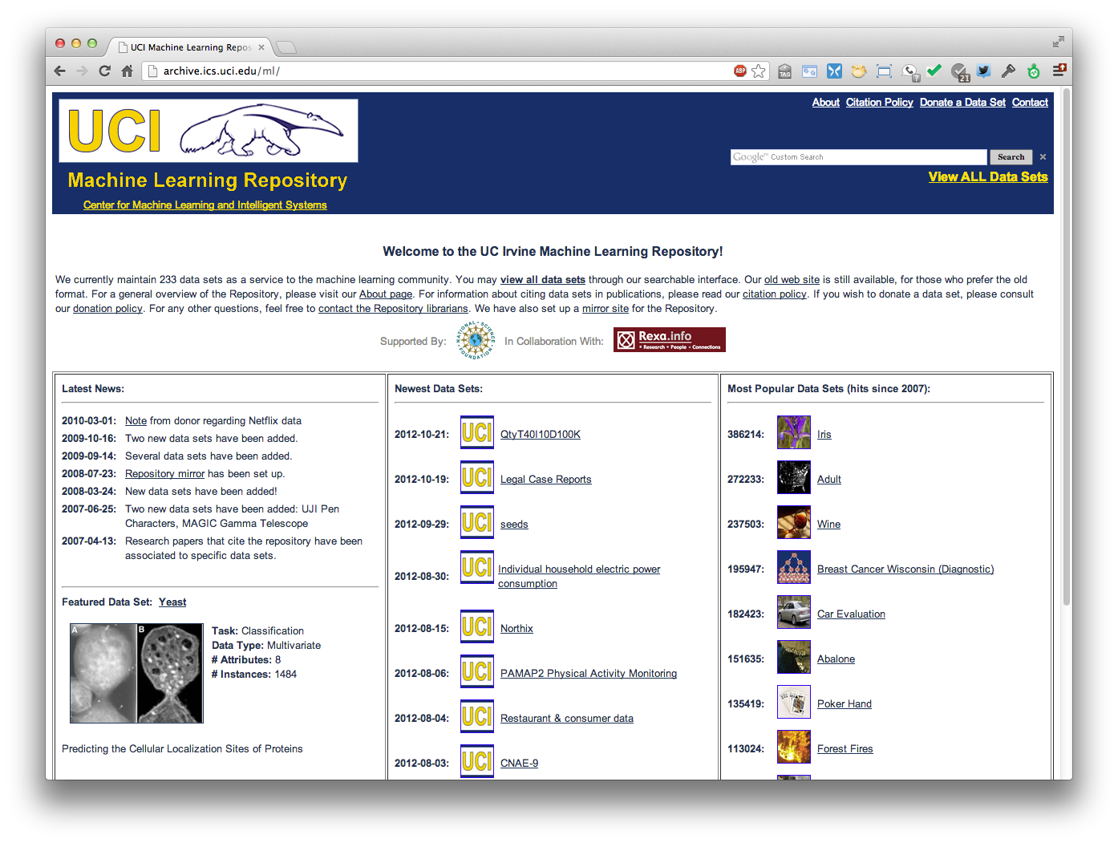
http://archive.ics.uci.edu/ml
Est. 1987!
370 data sets
Notes:
The UCI Machine Learning Repository maintains 370 (as of 2017-05-01) data sets as a service to the machine learning community.
The archive was created as an ftp archive in 1987 by David Aha and fellow graduate students at UC Irvine.

Slide 3
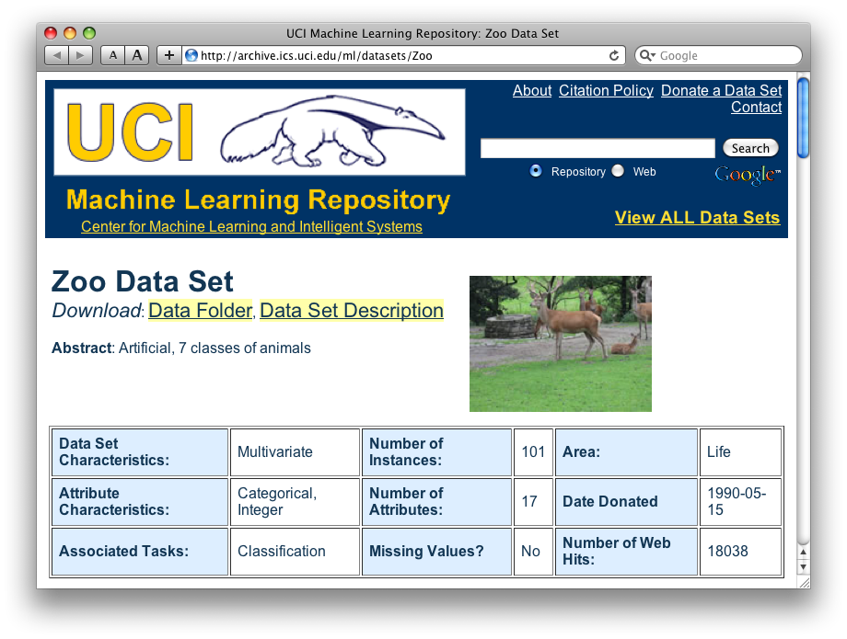
http://archive.ics.uci.edu/ml/datasets/Zoo

Slide 4
Zoo training data
animal name: string
hair: Boolean
feathers: Boolean
eggs: Boolean
milk: Boolean
airborne: Boolean
aquatic: Boolean
predator: Boolean
toothed: Boolean
backbone: Boolean
breathes: Boolean
venomous: Boolean
fins: Boolean
legs: {0,2,4,5,6,8}
tail: Boolean
domestic: Boolean
catsize: Boolean
type: {mammal, fish, bird, shellfish, insect, reptile, amphibian}
category
label
101 Instances
aardvark,1,0,0,1,0,0,1,1,1,1,0,0,4,0,0,1,mammal
antelope,1,0,0,1,0,0,0,1,1,1,0,0,4,1,0,1,mammal
bass,0,0,1,0,0,1,1,1,1,0,0,1,0,1,0,0,fish
bear,1,0,0,1,0,0,1,1,1,1,0,0,4,0,0,1,mammal
boar,1,0,0,1,0,0,1,1,1,1,0,0,4,1,0,1,mammal
buffalo,1,0,0,1,0,0,0,1,1,1,0,0,4,1,0,1,mammal
calf,1,0,0,1,0,0,0,1,1,1,0,0,4,1,1,1,mammal
carp,0,0,1,0,0,1,0,1,1,0,0,1,0,1,1,0,fish
catfish,0,0,1,0,0,1,1,1,1,0,0,1,0,1,0,0,fish
cavy,1,0,0,1,0,0,0,1,1,1,0,0,4,0,1,0,mammal
cheetah,1,0,0,1,0,0,1,1,1,1,0,0,4,1,0,1,mammal
chicken,0,1,1,0,1,0,0,0,1,1,0,0,2,1,1,0,bird
chub,0,0,1,0,0,1,1,1,1,0,0,1,0,1,0,0,fish
clam,0,0,1,0,0,0,1,0,0,0,0,0,0,0,0,0,shellfish
crab,0,0,1,0,0,1,1,0,0,0,0,0,4,0,0,0,shellfish
…

Slide 5
Zoo example
aima-python> python
>>> from learning import *
>>> zoo
<DataSet(zoo): 101 examples, 18 attributes>
>>> dt = DecisionTreeLearner()
>>> dt.train(zoo)
>>> dt.predict(['shark',0,0,1,0,0,1,1,1,1,0,0,1,0,1,0,0]) #eggs=1
'fish'
>>> dt.predict(['shark',0,0,0,0,0,1,1,1,1,0,0,1,0,1,0,0]) #eggs=0
'mammal’
Notes:
Sharks bear their young alive

Slide 6
Zoo example
>> dt.dt
DecisionTree(13, 'legs', {0: DecisionTree(12, 'fins', {0: DecisionTree(8, 'toothed', {0: 'shellfish', 1: 'reptile'}), 1: DecisionTree(3, 'eggs', {0: 'mammal', 1: 'fish'})}), 2: DecisionTree(1, 'hair', {0: 'bird', 1: 'mammal'}), 4: DecisionTree(1, 'hair', {0: DecisionTree(6, 'aquatic', {0: 'reptile', 1: DecisionTree(8, 'toothed', {0: 'shellfish', 1: 'amphibian'})}), 1: 'mammal'}), 5: 'shellfish', 6: DecisionTree(6, 'aquatic', {0: 'insect', 1: 'shellfish'}), 8: 'shellfish'})

Slide 7
Zoo example
>>> dt.dt.display()
Test legs
legs = 0 ==> Test fins
fins = 0 ==> Test toothed
toothed = 0 ==> RESULT = shellfish
toothed = 1 ==> RESULT = reptile
fins = 1 ==> Test eggs
eggs = 0 ==> RESULT = mammal
eggs = 1 ==> RESULT = fish
legs = 2 ==> Test hair
hair = 0 ==> RESULT = bird
hair = 1 ==> RESULT = mammal
legs = 4 ==> Test hair
hair = 0 ==> Test aquatic
aquatic = 0 ==> RESULT = reptile
aquatic = 1 ==> Test toothed
toothed = 0 ==> RESULT = shellfish
toothed = 1 ==> RESULT = amphibian
hair = 1 ==> RESULT = mammal
legs = 5 ==> RESULT = shellfish
legs = 6 ==> Test aquatic
aquatic = 0 ==> RESULT = insect
aquatic = 1 ==> RESULT = shellfish
legs = 8 ==> RESULT = shellfish

Slide 8
8
legs
shellfish
0
2
4
5
6
fins
hair
shellfish
aquatic
0
0
insect
1
0
1
eggs
tooth
shellfish
aquatic
0
1
0
1
hair
1
mammal
shellfish
1
0
tooth
0
fish
reptile
mammal
1
0
bird
shellfish
reptile
reptile

Slide 9
Zoo example
>>> dt.dt.display()
Test legs
legs = 0 ==> Test fins
fins = 0 ==> Test toothed
toothed = 0 ==> RESULT = shellfish
toothed = 1 ==> RESULT = reptile
fins = 1 ==> Test milk
milk = 0 ==> RESULT = fish
milk = 1 ==> RESULT = mammal
legs = 2 ==> Test hair
hair = 0 ==> RESULT = bird
hair = 1 ==> RESULT = mammal
legs = 4 ==> Test hair
hair = 0 ==> Test aquatic
aquatic = 0 ==> RESULT = reptile
aquatic = 1 ==> Test toothed
toothed = 0 ==> RESULT = shellfish
toothed = 1 ==> RESULT = amphibian
hair = 1 ==> RESULT = mammal
legs = 5 ==> RESULT = shellfish
legs = 6 ==> Test aquatic
aquatic = 0 ==> RESULT = insect
aquatic = 1 ==> RESULT = shellfish
legs = 8 ==> RESULT = shellfish
After adding the shark example to the training data & retraining

Slide 10

Weka
Open-source Java machine learning tool
http://www.cs.waikato.ac.nz/ml/weka/
Implements many classifiers & ML algorithms
Uses common data representation format; easy to try different ML algorithms and compare results
  Comprehensive set of data pre-processing tools and evaluation methods
Three modes of operation: GUI, command line, Java API

Slide 11
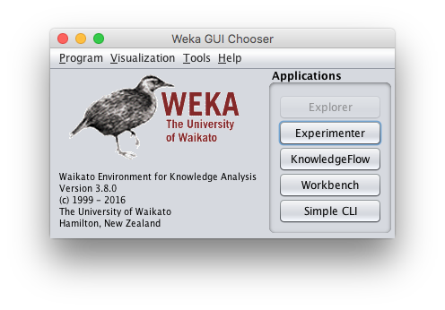
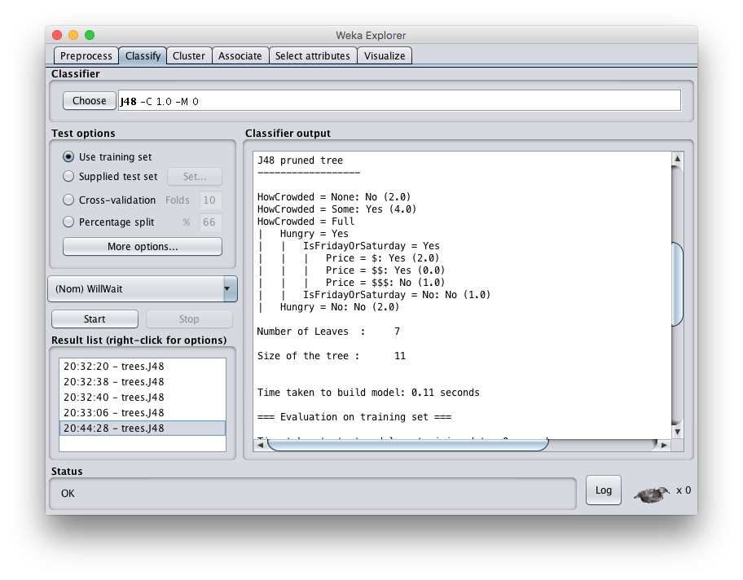

Slide 12
Common .arff* data format
% Simplified data for predicting heart disease with just six variables
% Comments begin with a % allowed at the top
@relation heart-disease-simplified
@attribute age numeric
@attribute sex { female, male }
@attribute chest_pain_type { typ_angina, asympt, non_anginal, atyp_angina}
@attribute cholesterol numeric
@attribute exercise_induced_angina {no, yes}
@attribute class {present, not_present}
@data
63,male,typ_angina,233,no,not_present
67,male,asympt,286,yes,present
67,male,asympt,229,yes,present
38,female,non_anginal,?,no,not_present
...
age is a numeric attribute
sex is a nominal attribute
class is target variable
Training data
*ARFF = Attribute-Relation File Format

Slide 13
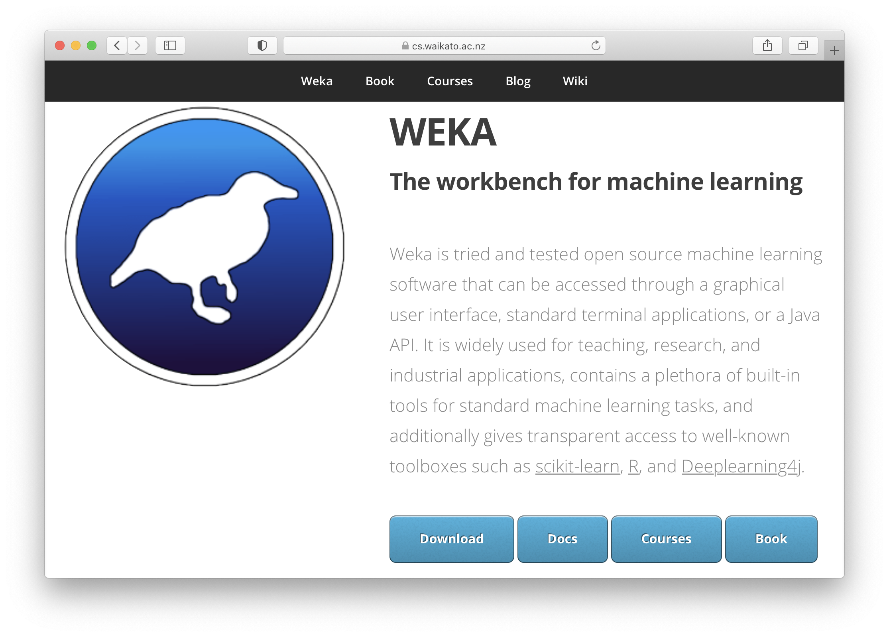
Weka demo
https://cs.waikato.ac.nz/ml/weka/

Slide 14
Install Weka
Download and install Weka
cd to your weka directory
Invoke the GUI interface or call components from the command line
  You may want to set environment variables (e.g., CLASSPATH) or aliases (e.g., weka)

Slide 15
Getting your data ready
Our class code repo’s ML directory has several data files for the restaurant example
  restaurant.csv: original data in simple text format
  restaurant.arff: data put in Weka’s arff format
  restaurant_test.arff: more data for test/evaluation
  restaurant_predict.arff: new data we want predictions for using a saved model
#1 is the raw training data we’re given
We’ll train and save a model with #2
Test it with #3
Predict target on new data with #4

Slide 16
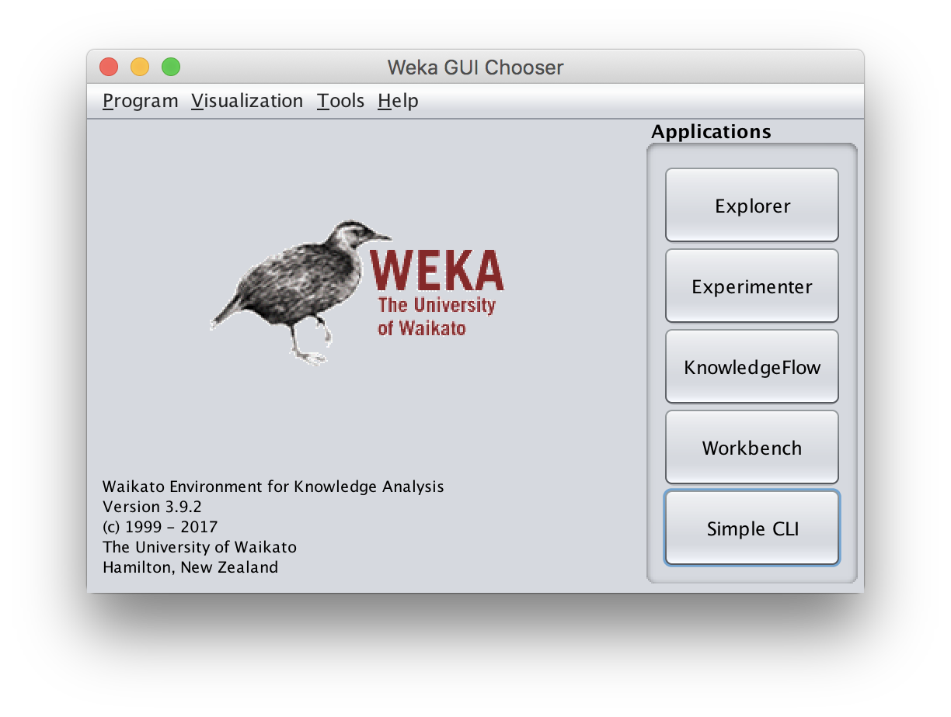
Open Weka app
cd /Applications/weka
java -jar weka.jar
Apps optimized for different tasks
Start with Explorer

Slide 17
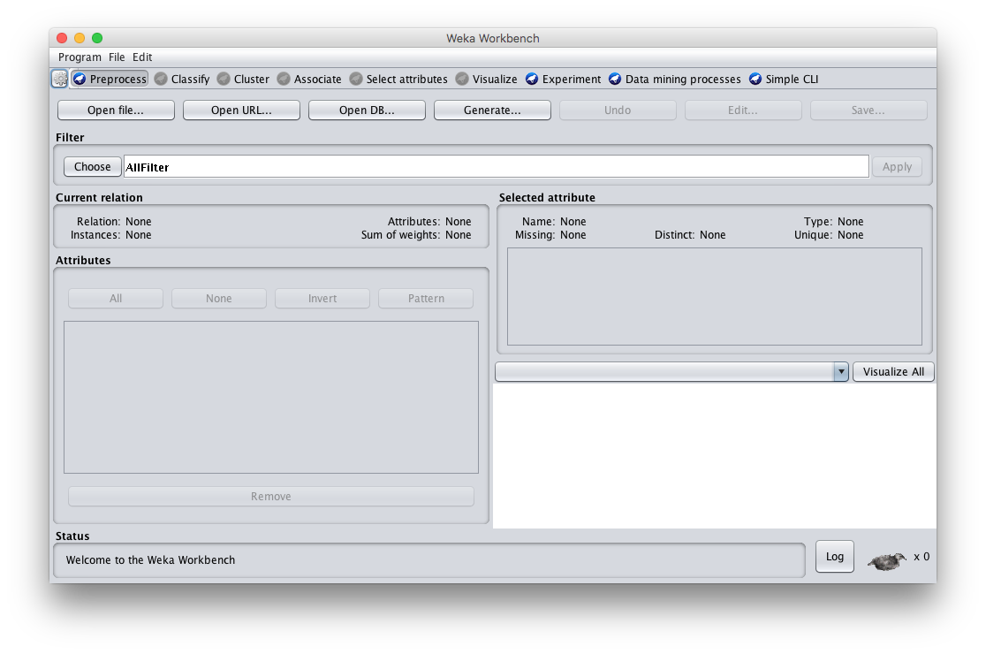
Explorer Interface

Slide 18
Starts with Data Preprocessing; open file to load data

Slide 19
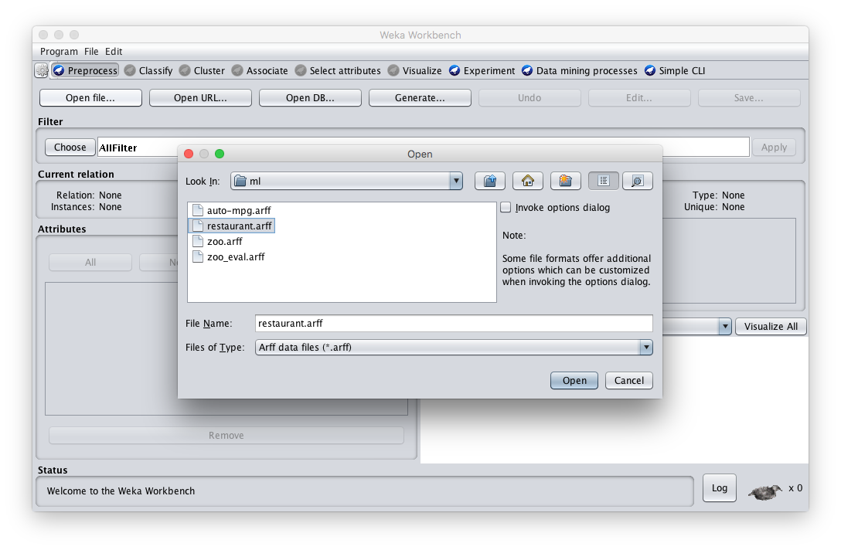
Load restaurant.arff training data

Slide 20
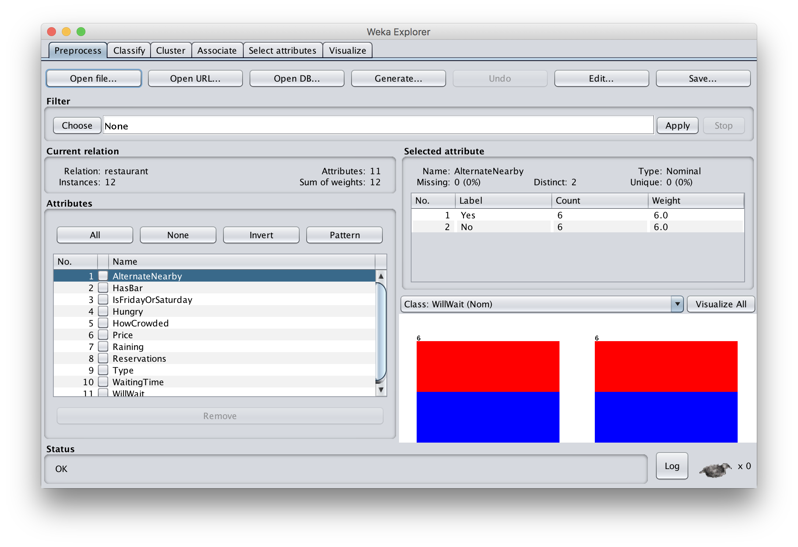
We can inspect/remove features

Slide 21
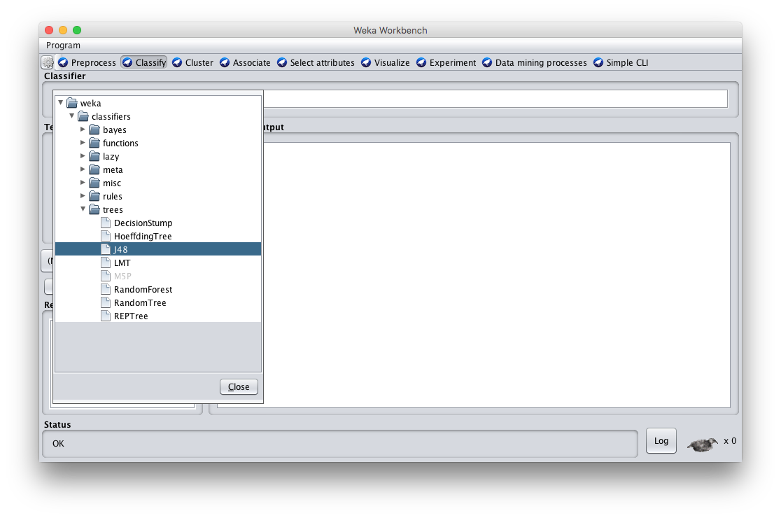
Select: classify > choose > trees > J48

Slide 22
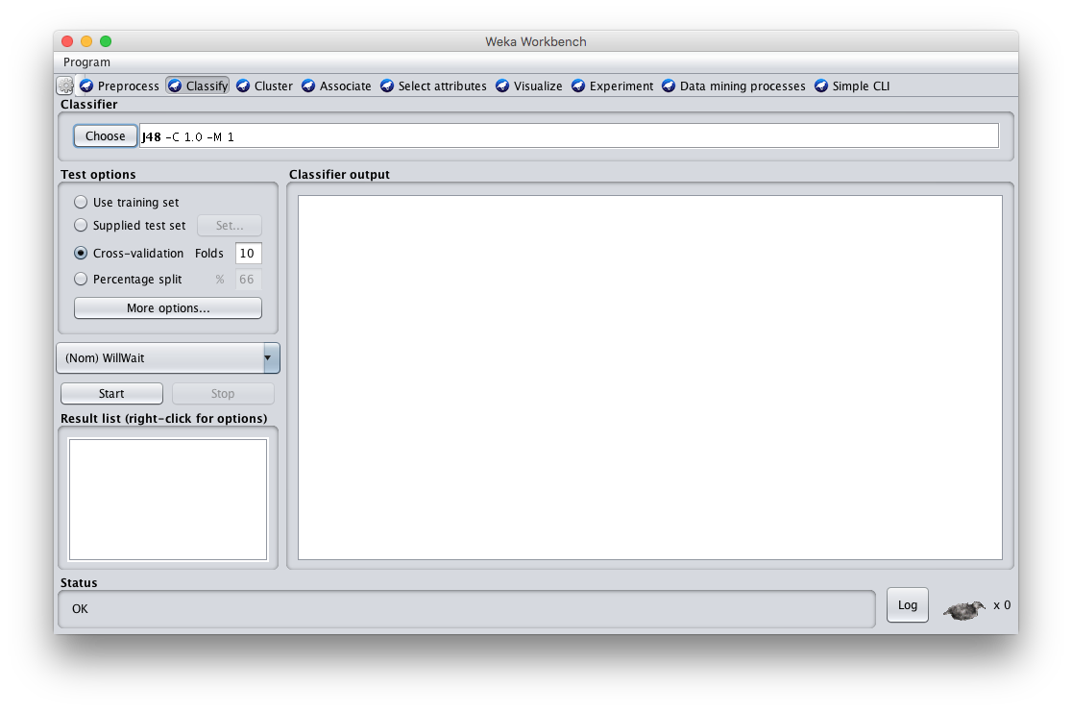
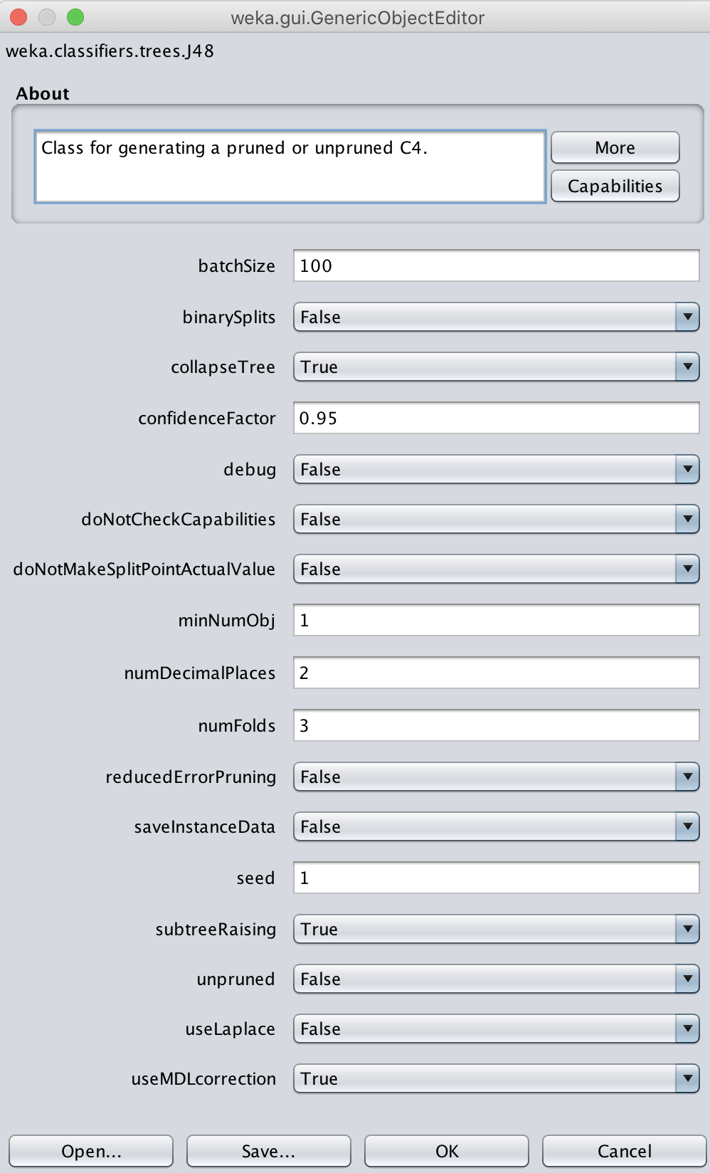
Adjust parameters

Slide 23
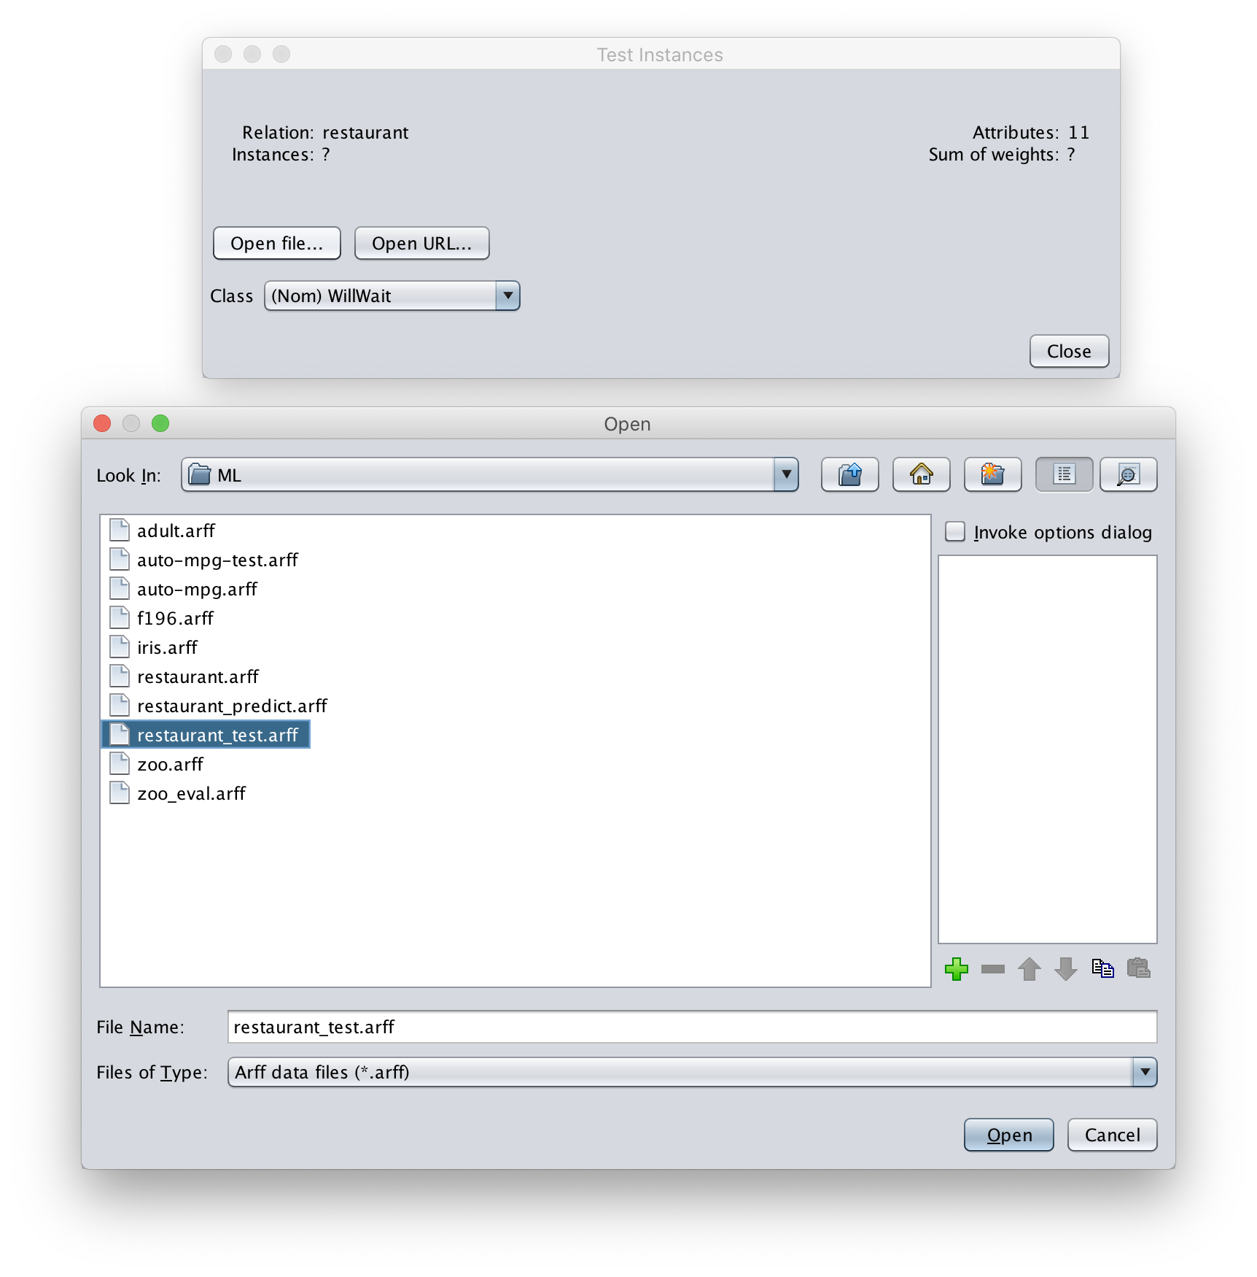
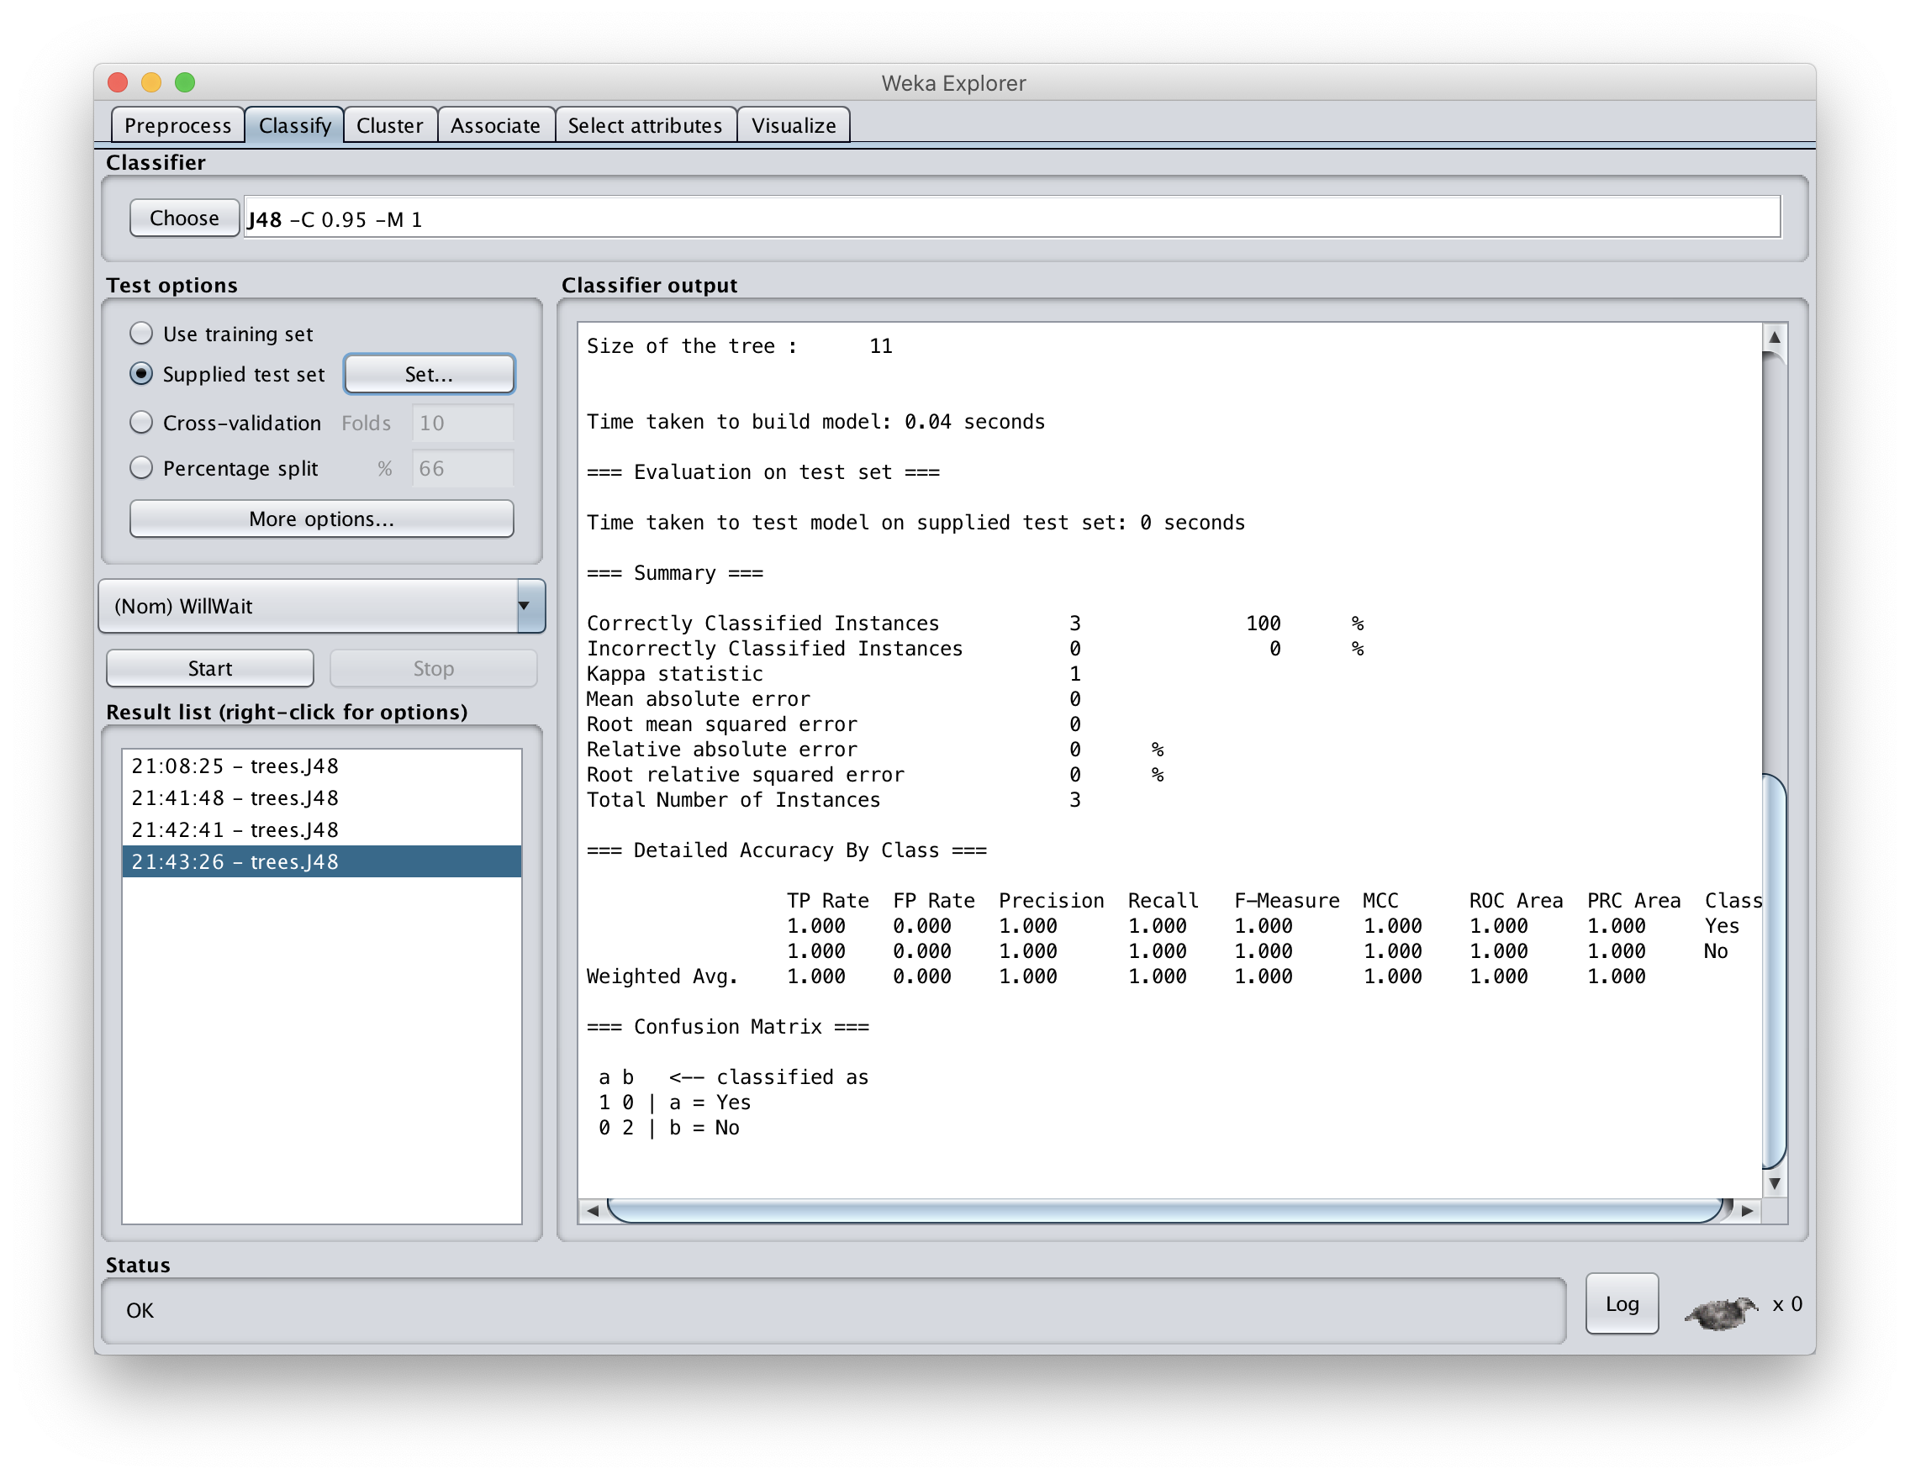
Select the testing procedure

Slide 24
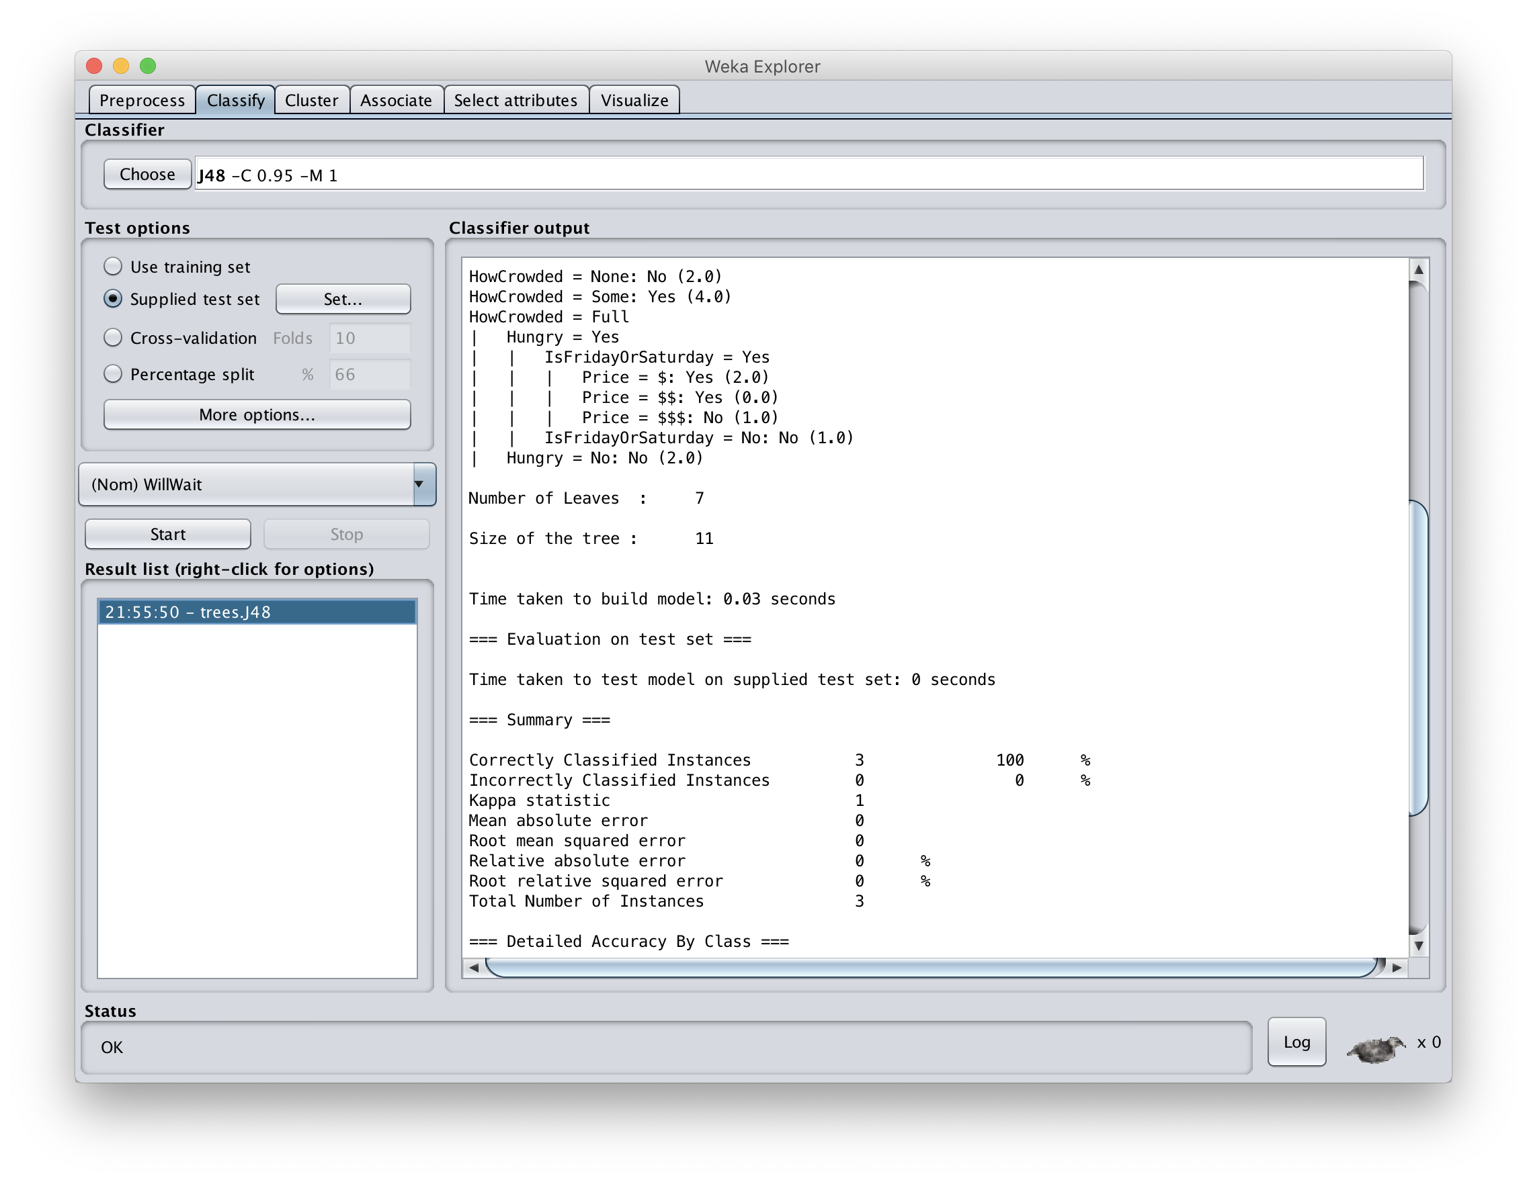
See training results

Slide 25
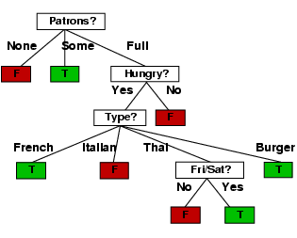
Compare results
HowCrowded = None: No (2.0)
HowCrowded = Some: Yes (4.0)
HowCrowded = Full
| Hungry = Yes
| | IsFridayOrSaturday = Yes
| | | Price = $: Yes (2.0)
| | | Price = $$: Yes (0.0)
| | | Price = $$$: No (1.0)
| | IsFridayOrSaturday = No: No (1.0)
| Hungry = No: No (2.0)
J48 pruned tree: nodes:11; leaves:7, max depth:4
ID3 tree: nodes:12; leaves:8, max depth:4
The two decision trees are equally good

Slide 26
scikit-learn
Popular open source ML and data analysis tools for Python
Built on NumPy, SciPy, and matplotlib for efficiency
However decision tree tools are a weak area
  E.g., data features must be numeric, so working with restaurant example requires conversion
  Perhaps because DTs not used for large problems
We’ll look at using it to learn a DT for the classic iris flower dataset

Slide 27
50 samples from each of three species of Iris (setosa, virginica, versicolor) with four data features: length and width of the sepals and petals in centimeters

Slide 28
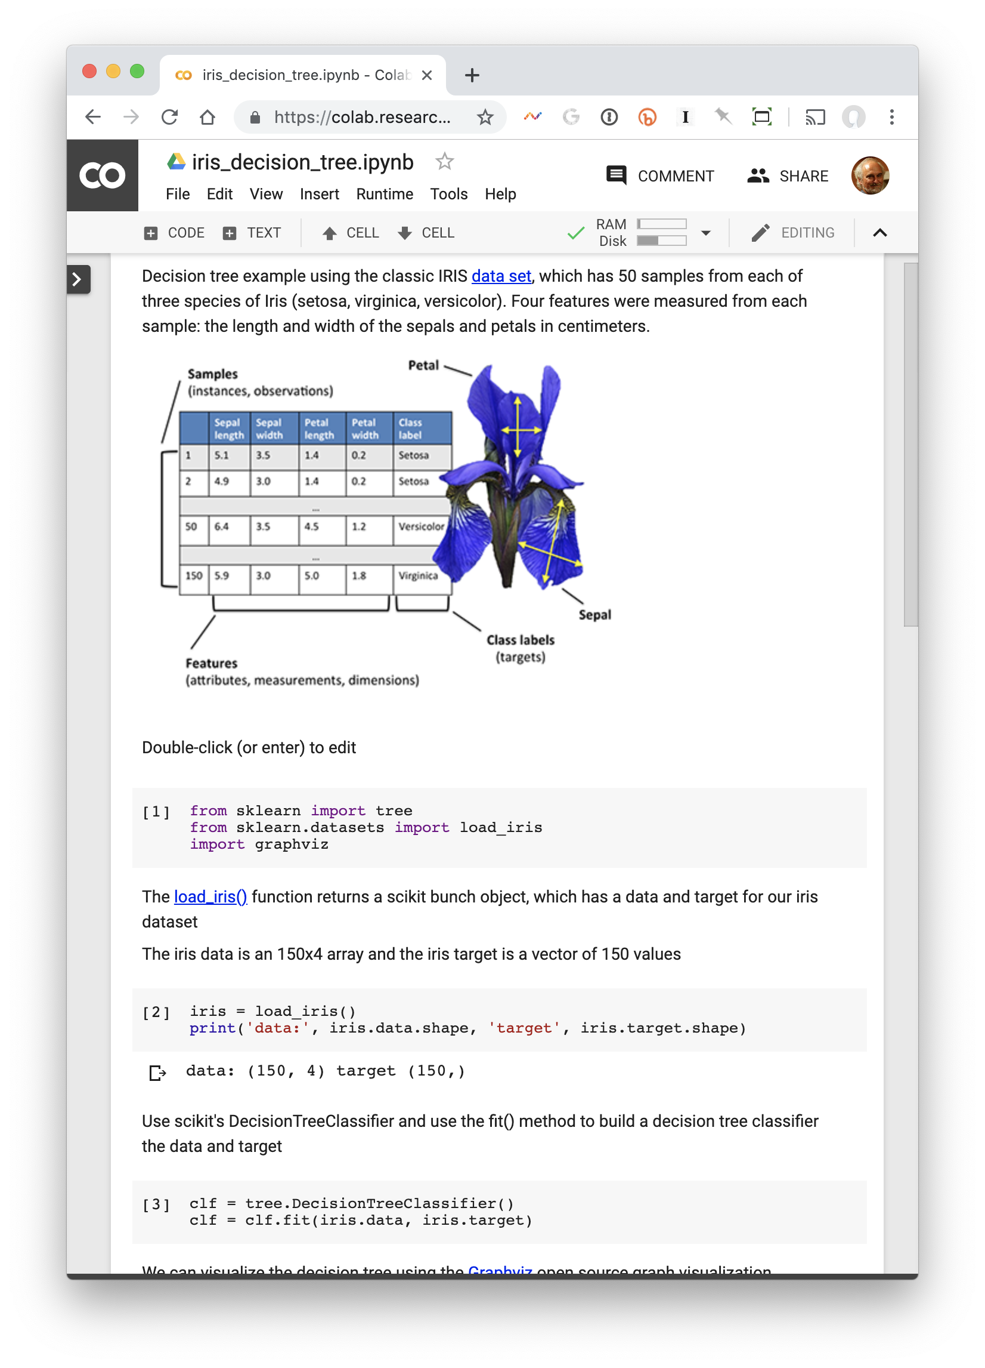
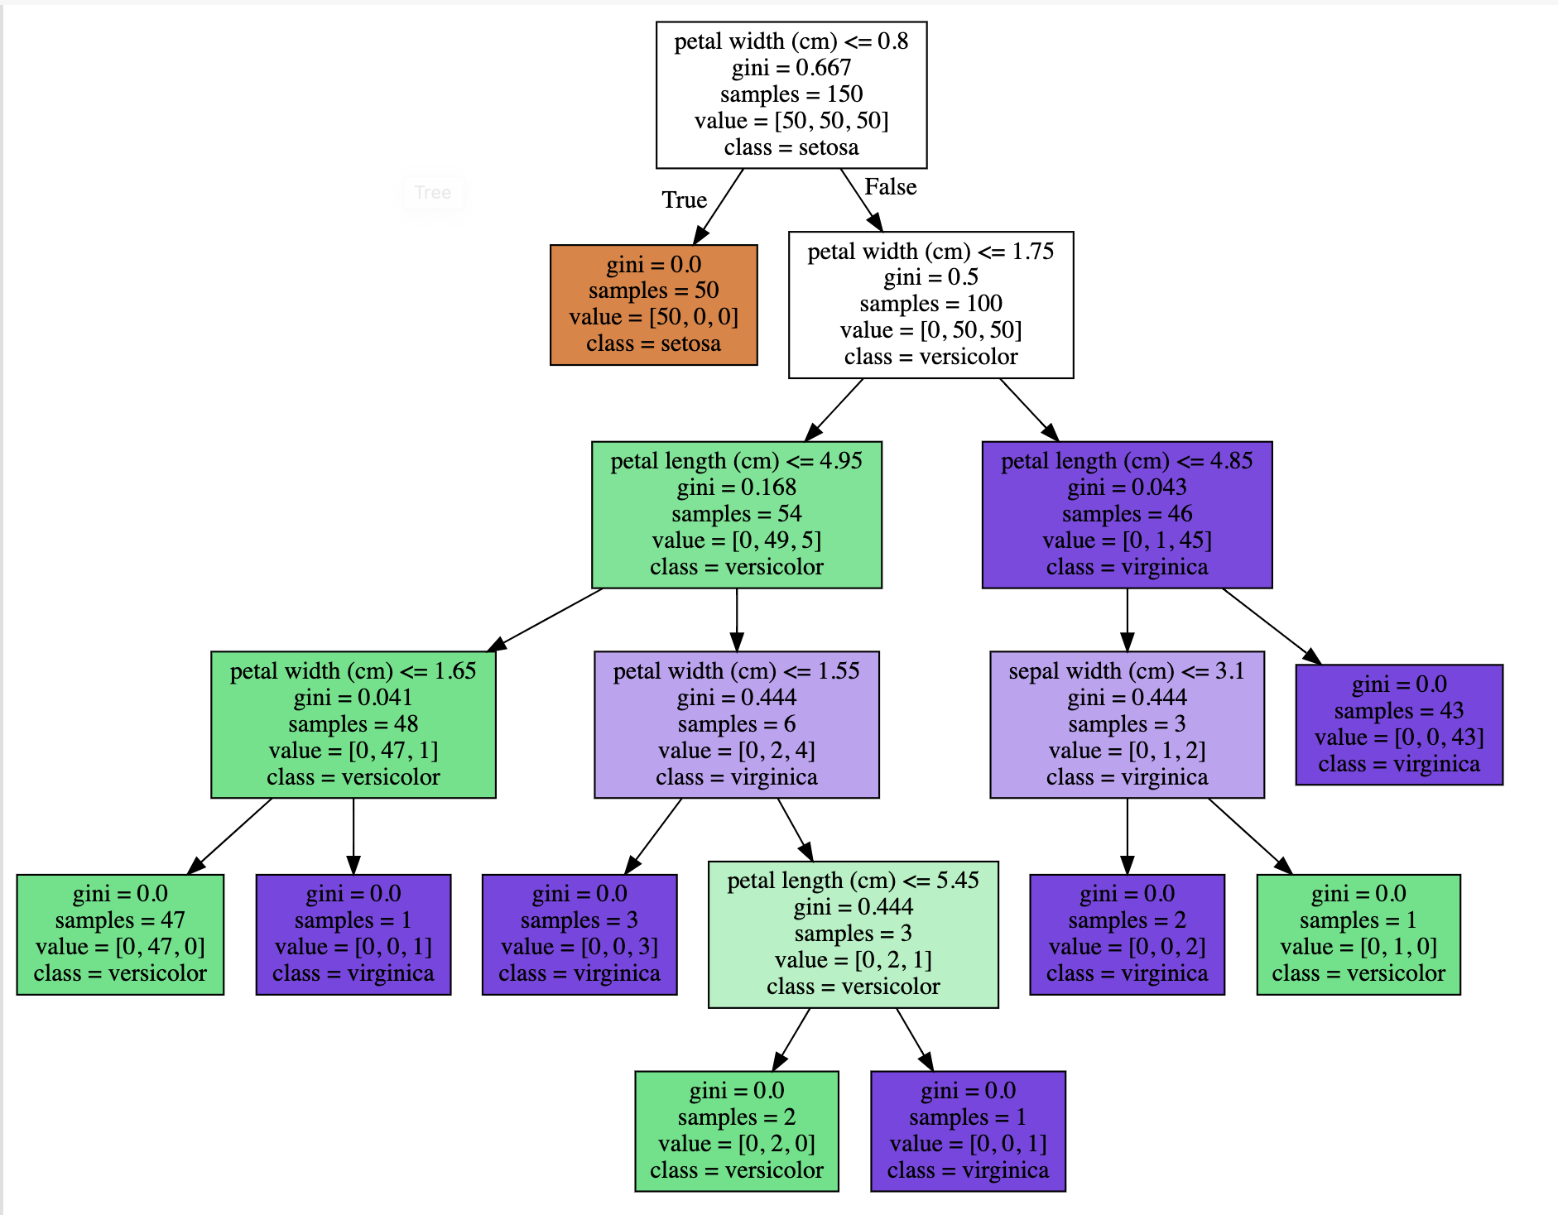
Scikit DT
from sklearn import tree, datasets
import graphviz, pickle
iris = datasets.load_iris()
clf = tree.DecisionTreeClassifier()
clf = clf.fit(iris.data, iris.target)
pickle.dump(clf, open(‘iris.p’, ‘wb’))
tree.export_graphviz(clf, out_file=“iris.pdf”)
http://bit.ly/iris671

Slide 29

Weka vs. scikit-learn vs. …
Weka: good for experimenting with many ML algorithms
  Other tools are more efficient & scalable
Scikit-learn: popular and efficient suite of open-source machine-learning tools in Python
  Uses NumPy, SciPy, matplotlib for efficiency
  Preloaded into Google’s Colaboratory
Custom apps for a specific ML algorithm are often preferred for speed or features

