Slide 1
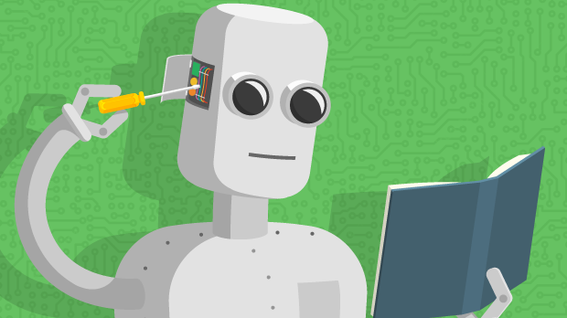
Machine Learning overview
Chapter 19
14.1

Slide 2
What we will cover
Some popular ML problems and algorithms
  Take CMSC 478/678 Machine Leaning for more
  Use online resources & experiment on your own
Focus on when/how to use techniques and only touch on how/why they work
Basic ML methodology and evaluation
Use various platform for examples & demos (e.g., scikit-learn, Weka, TensorFlow, PyTorch)
  Great for exploration and learning

Slide 3
What is learning?
Learning denotes changes in a system that ... enable a system to do the same task more efficiently the next time – Herbert Simon
Learning is constructing or modifying representations of what is being experienced
– Ryszard Michalski
Learning is making useful changes in our minds – Marvin Minsky

Slide 4
Why study learning?
Discover new things or structure previously unknown
  Examples: data mining, scientific discovery
Fill in skeletal or incomplete specifications in a domain
  Large, complex systems can’t be completely built by hand & require dynamic updating to incorporate new info.
  Learning new characteristics expands the domain or expertise and lessens the “brittleness” of the system
Acquire models automatically directly from data rather than by manual programming
Build agents that can adapt to users, other agents, and their environment
Understand and improve efficiency of human learning

Slide 5
AI and Learning Today
50s&60s: neural network learning popular
  Marvin Minsky did neural networks for his dissertation
Mid 60s: replaced by paradigm of manually encoding & using symbolic knowledge
  Cf. Perceptrons, Minsky & Papert book showed limitations of perceptron model of neural networks
90s: more data & processing power drove interest in statistical machine learning techniques & data mining
Now: machine learning techniques & big data play biggest driver in almost all successful AI systems
  … and neural networks are the current favorite approach
seeAlso: Timeline of machine learning

Slide 6
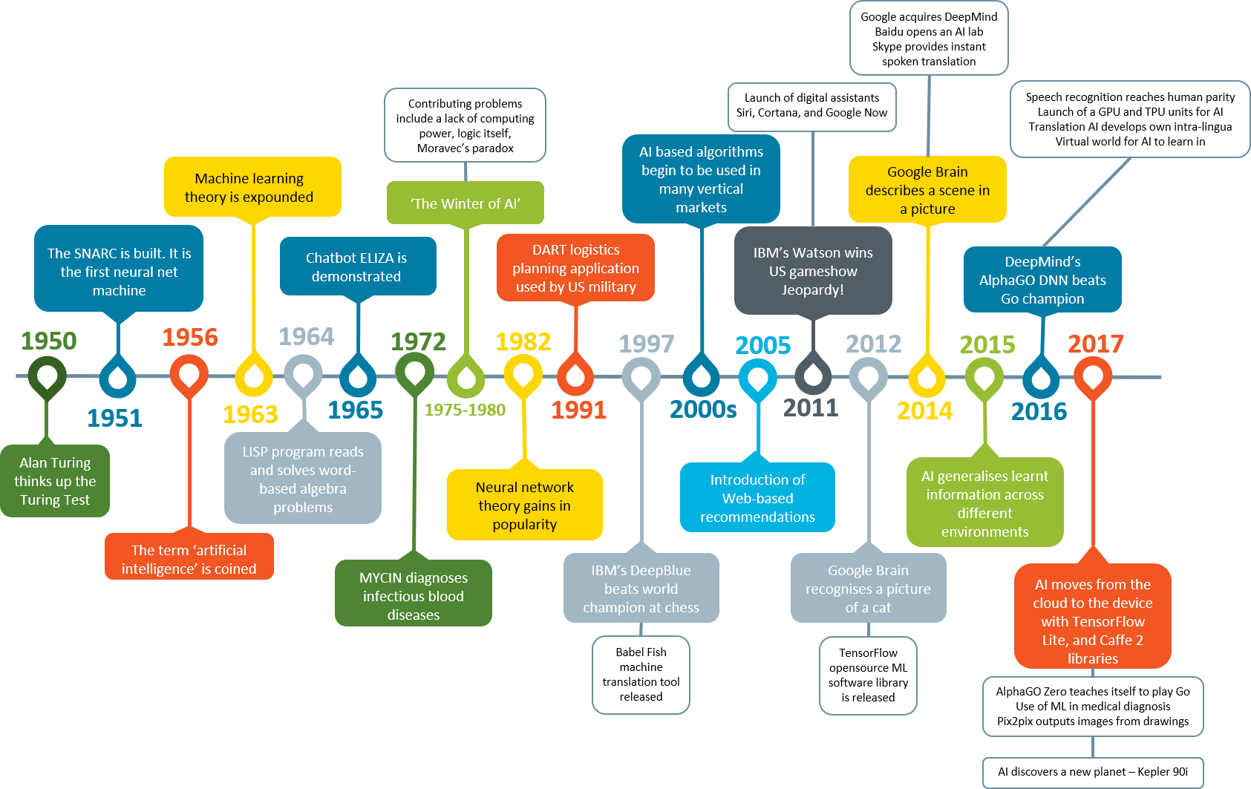

Slide 7
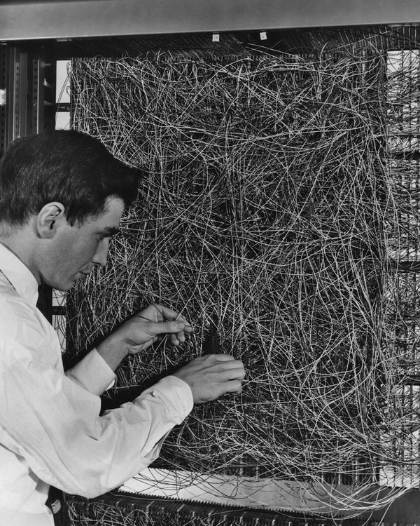
Neural Networks 1960
A man adjusting the random wiring network between the light sensors and association unit of scientist Frank Rosen-blatt's Perceptron, or MARK 1 computer, at the Cornell Aeronautical Laboratory, Buffalo, New York, circa 1960. The machine is designed to use a type of artificial neural network, known as a perceptron.

Slide 8
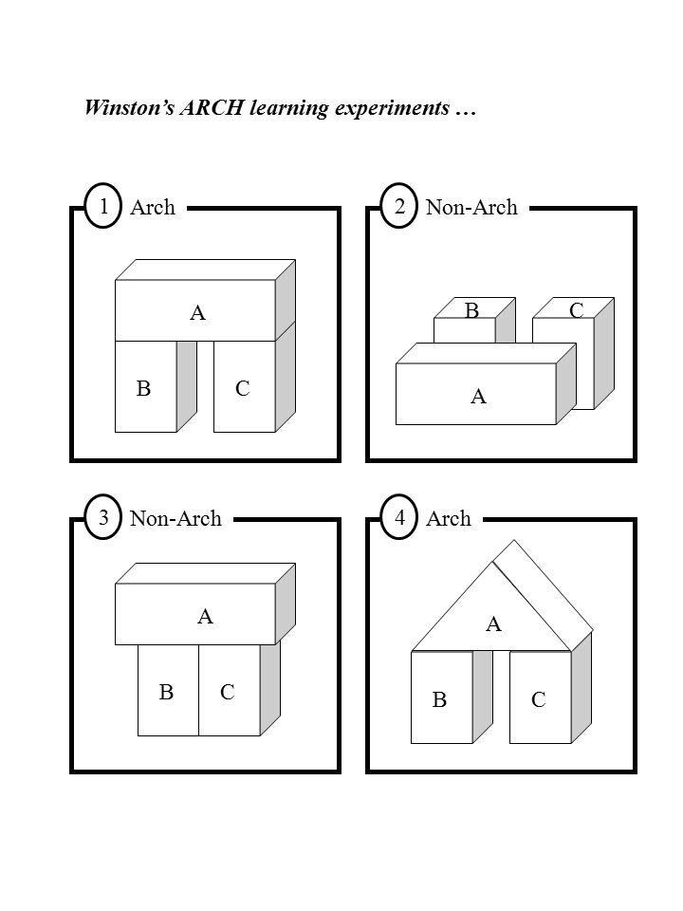
AI Learning in the 1970s
Marvin Minsky
Fist we need to understand how to program machines to be intelligent in some way, then we can take on the task of getting the to learn how to do it.

Slide 9
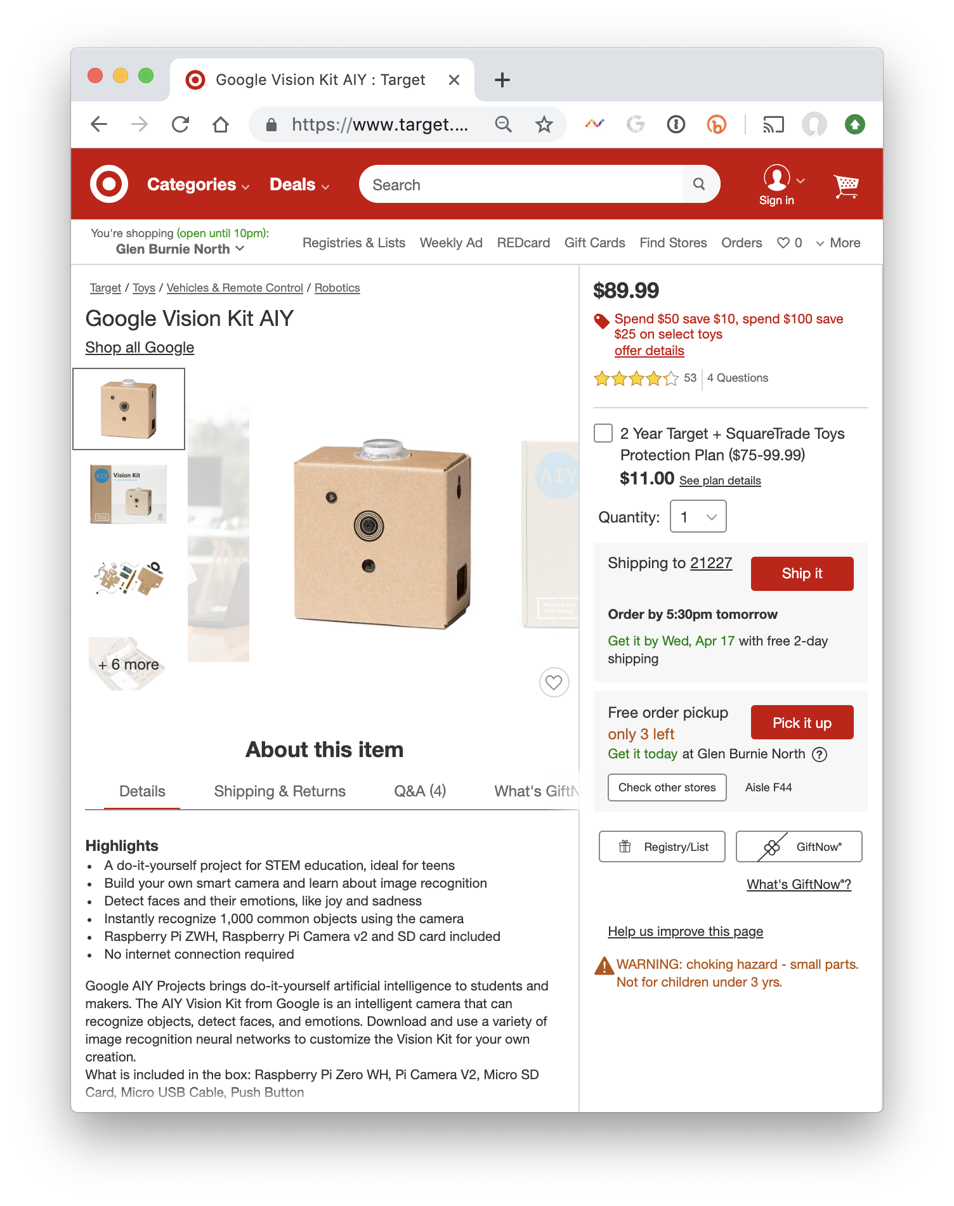
Neural Networks 2018
Google’s AIY Vision Kit ($89.99 at Target) is an intelligent camera that can recognize objects, detect faces and emotions. Download and use a variety of image recognition neural networks to customize the Vision Kit for your own creation. Included in the box: Raspberry Pi Zero WH, Pi Camera V2, Micro SD Card, Micro USB Cable, Push Button.
Currently $59.00 on Amazon

Slide 10
Machine Learning Successes
Games: chess, go, poker
Text sentiment analysis
Email spam detection
Recommender systems (e.g., Netflix, Amazon)
Machine translation
Speech understanding
SIRI, Alexa, Google Assistant, …
Autonomous vehicles
Individual face recognition
Understanding digital images
Credit card fraud detection
Showing annoying ads

Slide 11
The Big Idea and Terminology
Given some data, learn a model of how the world works that lets you predict new data
Training Set: Data from which you learn initially
Model: What you learn; a “model” of how inputs are associated with outputs
Test set: New data you test your model against
Corpus: A body of text data (pl.: corpora)
Representation: The computational expression of data

Slide 12
Major Machine learning paradigms (1)
Rote: 1-1 mapping from inputs to stored representation, learning by memorization, association-based storage & retrieval
Induction: Use specific examples to reach general conclusions
Clustering: Unsupervised discovery of natural groups in data

Slide 13
Major Machine learning paradigms (2)
Analogy: Find correspondence between different representations
Discovery: Unsupervised, specific goal not given
Genetic algorithms: Evolutionary search techniques, based on survival of the fittest
Reinforcement: Feedback (positive or negative reward) given at the end of a sequence of steps
Deep learning: artificial neural networks with representation learning for ML tasks

Slide 14
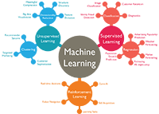
Types of learning problems
Supervised: learn from training examples
  Regression:
  Classification: Decision Trees, SVM
Unsupervised: learn w/o training examples
  Clustering
  Dimensionality reduction
  Word embeddings
Reinforcement learning: improve performance using feedback from actions taken
Lots more we won’t cover
  Hidden Markov models, Learning to rank, Semi-supervised learning, Active learning, …

Slide 15
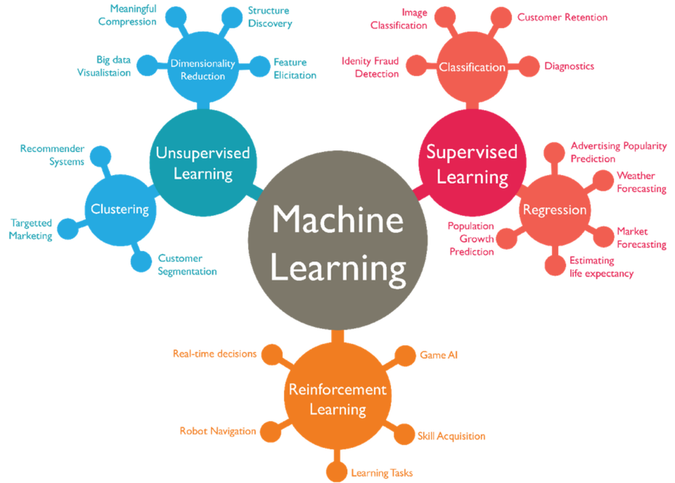

Slide 16
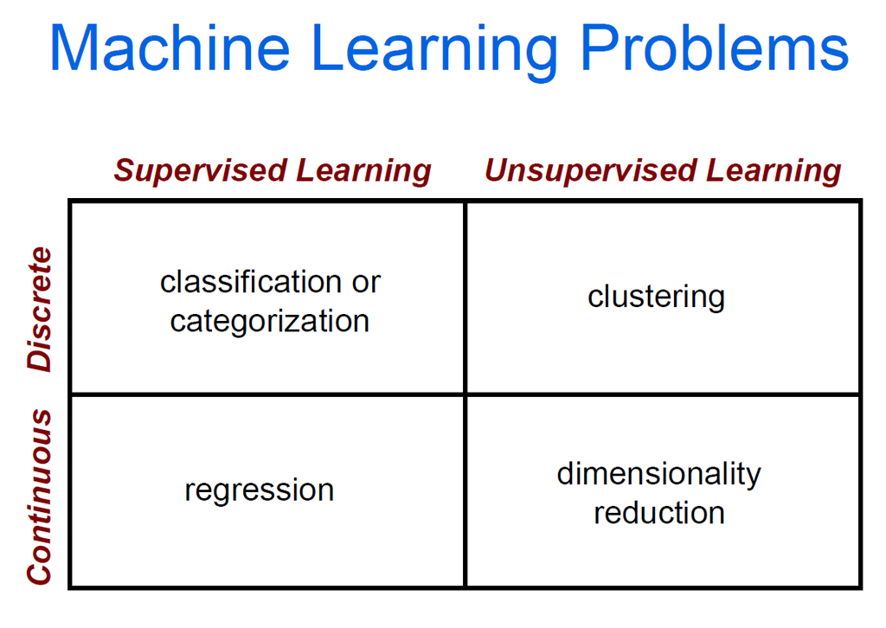

Slide 17
Supervised learning
Given training examples of inputs & corresponding outputs, produce “correct” outputs for new inputs
Two important scenarios:
  Classification: outputs typically labels (goodRisk, badRisk); learn decision boundary to separate classes
  Regression: aka curve fitting or function approxima-tion; Learn a continuous input-output mapping from examples, e.g., for a zip code, predict house sale price given its square footage

Slide 18
Unsupervised Learning
Given only unlabeled data as input, learn some sort of structure, e.g.:
Clustering: group Facebook friends based on similarity of post texts and friends
Embeddings: Find sets of words whose meanings are related (e.g., doctor, hospital)
Topic modeling: Induce N topics and words most common in documents about each

Slide 19
Inductive Learning Framework
Raw input data from sensors or a database preprocessed to obtain feature vector, X, of relevant features for classifying examples
Each X is a list of (attribute, value) pairs
n attributes (a.k.a. features): fixed, positive, and finite
Features have fixed, finite number # of possible values
  Or continuous within some well-defined space, e.g., “age”
Each example is a point in an n-dimensional feature space
  X = [Person:Sue, EyeColor:Brown, Age:Young, Sex:Female]
  X = [Cheese:f, Sauce:t, Bread:t]
  X = [Texture:Fuzzy, Ears:Pointy, Purrs:Yes, Legs:4]

Slide 20
Inductive Learning as Search
Instance space, I, is set of all possible examples
  Defines language for the training and test instances
  Usually each instance i ∈ I is a feature vector
  Features are also sometimes called attributes or variables
I: V₁ × V₂ × … × V_{k}, i = (v₁, v₂, …, v_{k})
Class variable C gives an instance’s class (to be predicted)

Slide 21
Inductive Learning as Search
C gives an instance’s class
Model space M defines the possible classifiers
  M: I → C, M = {m₁, … m_{n}} (possibly infinite)
  Model space is sometimes defined using same features as instance space (not always)
Training data lets us search for a good (consistent, complete, simple) hypothesis in the model space
The learned model is a classifier

Slide 22
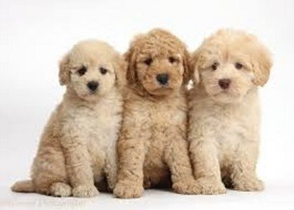



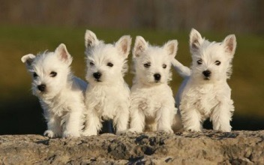







Inductive Learning Pipeline
Puppy classifier
Training data
Training
Classifier (trained model)

Slide 23
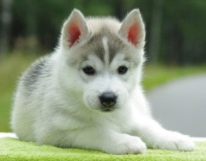
Inductive Learning Pipeline
Puppy classifier
Training data
Test data
Classifier (trained model)
Test
Label:
+

Slide 24
Inductive Learning Pipeline
Puppy classifier
Training data
Training
Test data
Classifier (trained model)
Test
Label:
+

Slide 25
Inductive Learning Pipeline
Puppy classifier
Training data, X
Training
Text-ure | Ears | Legs | Class
Fuzzy | Round | 4 | +
Slimy | Missing | 8 | -
Fuzzy | Pointy | 4 | -
Fuzzy | Round | 4 | +
Fuzzy | Pointy | 4 | +
…
Test data
Classifier (trained model)
x₁ = <Fuzzy, Pointy, 4>
Test
Label:
+

Slide 26
Model Spaces
Decision trees
  Partition the instance space I into axis-parallel regions
  Labeled with class value
Nearest-neighbor classifiers
  Partition the instance space I into regions defined by centroid instances (or cluster of k instances)
Bayesian networks
  Probabilistic dependencies of class on attributes
  Naïve Bayes: special case of BNs where class → each attribute

Slide 27
More Model Spaces
Neural networks
  Nonlinear feed-forward functions of attribute values
Support vector machines
  Find a separating plane in a high-dimensional feature space
Associative rules (feature values → class)
First-order logical rules

Slide 28
Machine Learning
ML’s significance in AI has gone up and down over the last 75 years
  Today it’s very important for AI and data science
Driving ML are three trends:
  Cheaper and more powerful computing systems
  Open-source ML tools (e.g., scikit-learn, TensorFlow)
  Availability of large amounts of data
Understanding ML concepts and tools allow many to use them with success

