Slide 1

CMSC 671
Principles of
Artificial Intelligence
Course Overview
Fall 2020

Slide 2
Today’s Class
Course overview
Introduction
  Brief history of AI
  What is AI? (and why is it so interesting?)
  What’s the state of AI now?

Slide 3
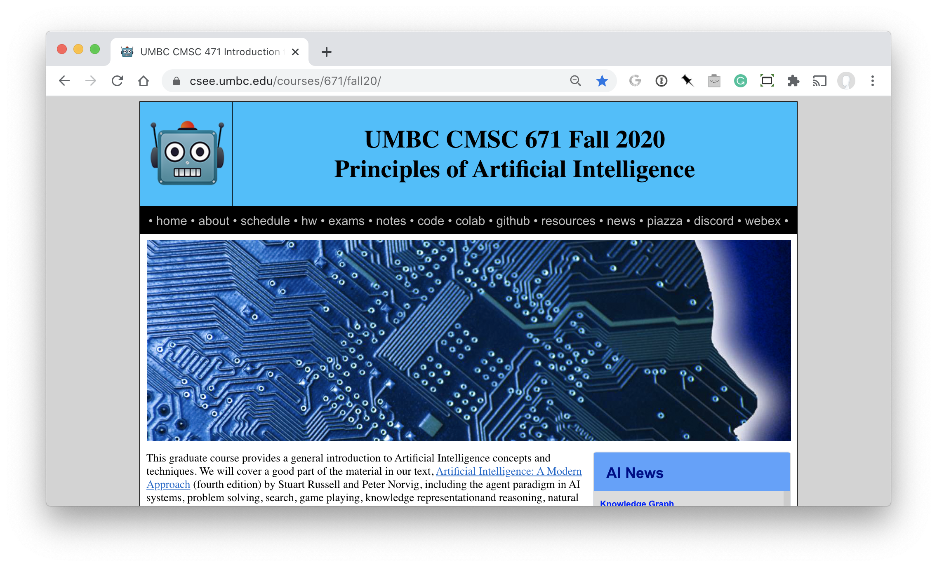
http://bit.ly/671F20

Slide 4
Homework and grading policies
Six to eight short homework assignments (mix of written and programming)
  One-time extensions of up to a week may be granted if requested in advance
  Last-minute requests for extensions probably will not be granted
Do the reading before each class!

Slide 5
Programming
Programming assignments in Python
  We’ll use Python 3 in the notes and examples
We’ll use GitHub to share code, Jupyter notebooks and for HW submission
Some assignments may require other systems
  E.g., C5 decision tree learning system, Weka Machine learning environments

Slide 6
Exams and Quizes
Periodic short quizzes (10%)
  On Blackboard every other week or so
Midterm exam (15%)
  On Blackboard, October 10
Final exam (25%)
  On Blackboard, December 15
  Comprehensive with an emphasis on last half of material (e.g., 30/70 split)

Slide 7
Instructor availability
Professor Finin, finin@umbc.edu
  Office hours: Tue/Fri 9-10 on Webex
Direct general questions to Piazza first
  We’ll try to respond within 24 hours
TA: Tiantian Xie, xtiant1@umbc.edu
Grader: Pratik Pradeep Jogdand, pratikj1@umbc.edu
If needed, we may try holding help session on Discord

