Slide 1
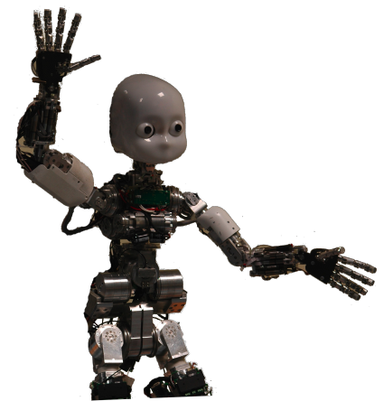
Machine Learning: Decision Trees
Chapter 18.1-18.3
Some material adopted from notes by Chuck Dyer

Slide 2
Learning decision trees
Goal: Build a decision tree to classify examples as positive or negative instances of a concept using supervised learning from a training set
A decision tree is a tree where
each non-leaf node has associated with it an attribute (feature)
each leaf node has associated with it a classification (+ or -)
each arc has associated with it one of the possible values of the attribute at the node from which the arc is directed
Generalization: allow for >2 classes
e.g., for stocks, classify into {sell, hold, buy}
Color
green
red
blue
Size
+
Shape
big
small
square
round
-
+
Size
+
big
small
-
+

Slide 3
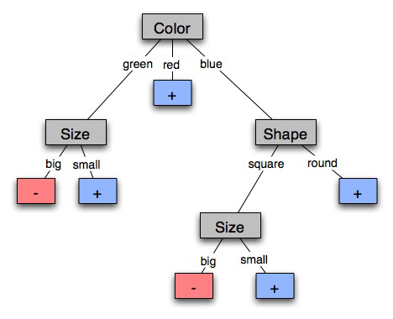
A decision tree-induced partition
The red groups are + examples, blue -
+: big green shapes
-: big, blue squares

Slide 4
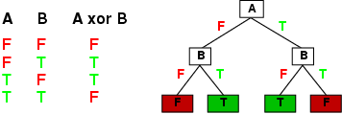
Expressiveness of Decision Trees
Can express any function of the input attributes, e.g.
For Boolean functions, truth table row → path to leaf:
Trivially, there’s a consistent decision tree for any training set with one path to leaf for each example (unless f nondeterministic in x), but it probably won't generalize to new examples
We prefer to find more compact decision trees

Slide 5
Inductive learning and bias
Suppose that we want to learn a function f(x) = y and we are given some sample (x,y) pairs, as in figure (a)
There are several hypotheses we could make about this function, e.g.: (b), (c) and (d)
A preference for one over the others reveals the bias of our learning technique, e.g.:
prefer piece-wise functions
prefer a smooth function
prefer a simple function and treat outliers as noise

Slide 6
Preference bias: Occam’s Razor
AKA Occam’s Razor, Law of Economy, or Law of Parsimony
Principle stated by William of Ockham (1285-1347)
“non sunt multiplicanda entia praeter necessitatem”
entities are not to be multiplied beyond necessity
The simplest consistent explanation is the best
Therefore, the smallest decision tree that correctly classifies all of the training examples is best
Finding the provably smallest decision tree is NP-hard, so instead of constructing the absolute smallest tree consistent with the training examples, construct one that is pretty small

Slide 7
Hypothesis spaces
How many distinct decision trees with n Boolean attributes?
= number of Boolean functions
= number of distinct truth tables with 2^{n} rows = 2^{2n}
e.g., with 6 Boolean attributes, 18,446,744,073,709,551,616 trees
How many conjunctive hypotheses (e.g., Hungry ∧ ¬Rain)?
Each attribute can be in (positive), in (negative), or out
3^{n} distinct conjunctive hypotheses
e.g., with 6 Boolean attributes, 729 trees
A more expressive hypothesis space
increases chance that target function can be expressed
increases number of hypotheses consistent with training set
⇒ may get worse predictions in practice

Slide 8
R&N’s restaurant domain
Develop decision tree for decision patron makes when deciding whether or not to wait for a table
Two classes: wait, leave
Ten attributes: Alternative available? Bar in restaurant? Is it Friday? Are we hungry? How full is the restaurant? How expensive? Is it raining? Do we have reservation? What type of restaurant is it? Estimated waiting time?
Training set of 12 examples
~ 7000 possible cases

Slide 9
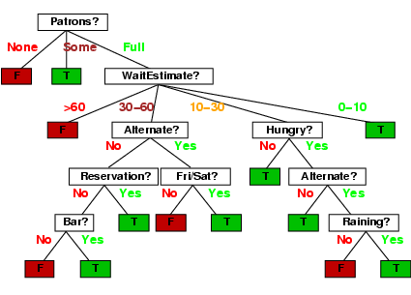
A decision tree from introspection

Slide 10
Attribute-based representations
Examples described by attribute values (Boolean, discrete, continuous), e.g., situations where I will/won't wait for a table
Classification of examples is positive (T) or negative (F)
Serves as a training set

Slide 11
ID3/C4.5 Algorithm
A greedy algorithm for decision tree construction developed by Ross Quinlan circa 1987
Top-down construction of tree by recursively selec-ting “best attribute” to use at the current node in tree
Once attribute is selected for current node, generate child nodes, one for each possible value of attribute
Partition examples using possible values of attribute, and assign these subsets of the examples to appropriate child node
Repeat for each child node until all examples associated with a node are either all positive or all negative

Slide 12
Choosing the best attribute
Key problem: choosing which attribute to split a given set of examples
Some possibilities:
Random: Select any attribute at random
Least-Values: Choose attribute with smallest number of possible values
Most-Values: Choose attribute with largest number of possible values
Max-Gain: Choose the attribute that has largest expected information gain–i.e., attribute that results in smallest expected size of subtrees rooted at its children
The ID3 algorithm uses the Max-Gain method of selecting the best attribute

Slide 13
Choosing an attribute
Idea: good attribute splits examples into subsets that are (ideally) all positive or all negative
Which is better: Patrons? or Type?

Slide 14
Restaurant example
Random: Patrons or Wait-time; Least-values: Patrons; Most-values: Type; Max-gain: ???
French
Y
N
Y
N
Type variable
Italian
Thai
N
Y
N
Y
N
Y
N
Y
Burger
Empty
Some
Full
Patrons variable

Slide 15
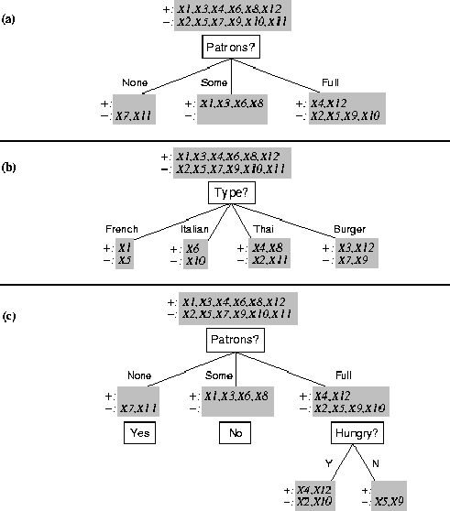
Splitting examples by testing attributes

Slide 16
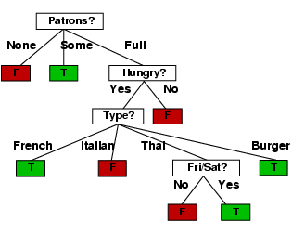
ID3-induced decision tree

Slide 17
Compare the two Decision Trees

Slide 18
Information theory 101
Information theory sprang almost fully formed from the seminal work of Claude E. Shannon at Bell Labs
A Mathematical Theory of Communication, Bell System Technical Journal, 1948.
Intuitions
Common words (a, the, dog) shorter than less common ones (parlimentarian, foreshadowing)
Morse code: common (probable) letters have shorter encodings
Information measured in minimum number of bits needed to store or send some information
The measure of data (information entropy) is the average number of bits needed to storage or send

Slide 19
Information theory 101
Information is measured in bits
Information conveyed by message depends on its probability
For n equally probable possible messages, each has prob. 1/n
Information conveyed by message is -log(p) = log(n)
e.g., with 16 messages, then log(16) = 4 and we need 4 bits to identify/send each message
Given probability distribution for n messages P = (p₁,p₂…p_{n}), the information conveyed by distribution (aka entropy of P) is:
I(P) = -(p₁*log(p₁) + p₂*log(p₂) + .. + p_{n}*log(p_{n}))
probability of msg 2
info in msg 2

Slide 20
Information theory II
Information conveyed by distribution (aka entropy of P):
I(P) = -(p₁*log(p₁) + p₂*log(p₂) + .. + p_{n}*log(p_{n}))
Examples:
If P is (0.5, 0.5) then I(P) = .5*1 + 0.5*1 = 1
If P is (0.67, 0.33) then I(P) = -(2/3*log(2/3) + 1/3*log(1/3)) = 0.92
If P is (1, 0) then I(P) = 1*1 + 0*log(0) = 0
The more uniform the probability distribution, the greater its information: more information is conveyed by a message telling you which event actually occurred
Entropy is the average number of bits/message needed to represent a stream of messages

Slide 21
Example: Huffman code
In 1952 MIT student David Huffman devised, in course of doing a homework assignment, an elegant coding scheme which is optimal in the case where all symbols’ probabilities are integral powers of 1/2.
A Huffman code can be built in the following manner:
Rank symbols in order of probability of occurrence
Successively combine two symbols of the lowest probability to form a new composite symbol; eventually we will build a binary tree where each node is the probability of all nodes beneath it
Trace a path to each leaf, noticing direction at each node

Slide 22
Huffman code example
M P
A .125
B .125
C .25
D .5
1
0
1
.5
.5
D
0
1
.25
If we use this code to many messages (A,B,C or D) with this probability distribution, then, over time, the average bits/message should approach 1.75
.25
C
0
1
.125
.125
A
B

Slide 23
Information for classification
If a set T of records is partitioned into disjoint exhaustive classes (C₁,C₂,..,C_{k}) on the basis of the value of the class attribute, then information needed to identify class of an element of T is:
Info(T) = I(P)
where P is the probability distribution of partition (C₁,C₂,..,C_{k}):
P = (|C₁|/|T|, |C₂|/|T|, ..., |C_{k}|/|T|)
C₁
C₂
C₃
C₁
C₃
C₂
Low information
High information

Slide 24
Information for classification II
If we partition T wrt attribute X into sets {T₁,T₂, ..,T_{n}}, the information needed to identify class of an element of T becomes the weighted average of the information needed to identify the class of an element of T_{i}, i.e. the weighted average of Info(T_{i}):
Info(X,T) = Σ|T_{i}|/|T| * Info(T_{i})
C₁
C₃
C₁
C₃
C₂
C₂
High information
Low information

Slide 25
Information gain
Gain(X,T) = Info(T) - Info(X,T) is difference between
info needed to identify element of T and
info needed to identify element of T after value of attribute X known
This is the gain in information due to attribute X
Use to rank attributes and build DT where each node uses attribute with greatest gain of those not yet considered (in path from root)
The intent of this ordering is to Create small DTs to minimize questions

Slide 26
Computing Information Gain
I(T) = ?
I (Pat, T) = ?
I (Type, T) = ?
French
Y
N
Italian
Y
N
Thai
N
Y
N
Y
Burger
N
Y
N
Y
Empty
Some
Full
Gain (Pat, T) = ?
Gain (Type, T) = ?

Slide 27
Computing information gain
I(T) = - (.5 log .5 + .5 log .5) = .5 + .5 = 1
I (Pat, T) = 2/12 (0) + 4/12 (0) + 6/12 (- (4/6 log 4/6 + 2/6 log 2/6)) = 1/2 (2/3*.6 + 1/3*1.6) = .47
I (Type, T) = 2/12 (1) + 2/12 (1) + 4/12 (1) + 4/12 (1) = 1
French
Y
N
Italian
Y
N
Thai
N
Y
N
Y
Burger
N
Y
N
Y
Empty
Some
Full
Gain (Pat, T) = 1 - .47 = .53
Gain (Type, T) = 1 – 1 = 0

Slide 28
The ID3 algorithm builds a decision tree, given a set of non-categorical attributes C1, C2, .., Cn, the class attribute C, and a training set T of records
function ID3(R:input attributes, C:class attribute, S:training set) returns decision tree;
If S is empty, return single node with value Failure;
If every example in S has same value for C, return single node with that value;
If R is empty, then return a single node with most frequent of the values of C found in examples S; # causes errors -- improperly classified record
Let D be attribute with largest Gain(D,S) among R;
Let {dj| j=1,2, .., m} be values of attribute D;
Let {Sj| j=1,2, .., m} be subsets of S consisting of records with value dj for attribute D;
Return tree with root labeled D and arcs labeled d1..dm going to the trees ID3(R-{D},C,S1). . . ID3(R-{D},C,Sm);

Slide 29
How well does it work?
Many case studies have shown that decision trees are at least as accurate as human experts.
A study for diagnosing breast cancer had humans correctly classifying the examples 65% of the time; the decision tree classified 72% correct
British Petroleum designed a decision tree for gas-oil separation for offshore oil platforms that replaced an earlier rule-based expert system
Cessna designed an airplane flight controller using 90,000 examples and 20 attributes per example

Slide 30
Extensions of ID3
Using gain ratios
Real-valued data
Noisy data and overfitting
Generation of rules
Setting parameters
Cross-validation for experimental validation of performance
C4.5 is an extension of ID3 that accounts for unavailable values, continuous attribute value ranges, pruning of decision trees, rule derivation, and so on

Slide 31
Using gain ratios
The information gain criterion favors attributes that have a large number of values
If we have an attribute D that has a distinct value for each record, then Info(D,T) is 0, thus Gain(D,T) is maximal
To compensate for this Quinlan suggests using the following ratio instead of Gain:
GainRatio(D,T) = Gain(D,T) / SplitInfo(D,T)
SplitInfo(D,T) is the information due to the split of T on the basis of value of categorical attribute D
SplitInfo(D,T) = I(|T1|/|T|, |T2|/|T|, .., |Tm|/|T|)
where {T1, T2, .. Tm} is the partition of T induced by value of D

Slide 32
Computing gain ratio
French
Y
N
I(T) = 1
I (Pat, T) = .47
I (Type, T) = 1
Italian
Y
N
Thai
N
Y
N
Y
Gain (Pat, T) =.53
Gain (Type, T) = 0
Burger
N
Y
N
Y
Empty
Some
Full
SplitInfo (Pat, T) = - (1/6 log 1/6 + 1/3 log 1/3 + 1/2 log 1/2) = 1/6*2.6 + 1/3*1.6 + 1/2*1 = 1.47
SplitInfo (Type, T) = 1/6 log 1/6 + 1/6 log 1/6 + 1/3 log 1/3 + 1/3 log 1/3 = 1/6*2.6 + 1/6*2.6 + 1/3*1.6 + 1/3*1.6 = 1.93
GainRatio (Pat, T) = Gain (Pat, T) / SplitInfo(Pat, T) = .53 / 1.47 = .36
GainRatio (Type, T) = Gain (Type, T) / SplitInfo (Type, T) = 0 / 1.93 = 0

Slide 33
Real-valued data
Select set of thresholds defining intervals
Each becomes a discrete value of attribute
Use some simple heuristics, e.g. always divide into quartiles
Use domain knowledge…
divide age into infant (0-2), toddler (3-5), school-aged (5-8)
Or treat this as another learning problem:
Try different ways to discretize the continuous variable; see which yield better results w.r.t. some metric
E.g., try midpoint between every pair of values

Slide 34
Noisy data
Many kinds of “noise” can occur in the examples:
Two examples have same attribute/value pairs, but different classifications
Some values of attributes are incorrect because of errors in the data acquisition process or the preprocessing phase
The classification is wrong (e.g., + instead of -) because of some error
Some attributes are irrelevant to the decision-making process, e.g., color of a die is irrelevant to its outcome

Slide 35
Overfitting
Irrelevant attributes, can result in overfitting the training example data
If hypothesis space has many dimensions (large number of attributes), we may find meaningless regularity in the data that is irrelevant to the true, important, distinguishing features
If we have too little training data, even a reasonable hypothesis space will ‘overfit’

Slide 36
Overfitting
Fix by by removing irrelevant features
E.g., remove ‘year observed’, ‘month observed’, ‘day observed’, ‘observer name’ from feature vector
Fix by getting more training data
Fix by pruning lower nodes in the decision tree
E.g., if gain of the best attribute at a node is below a threshold, stop and make this node a leaf rather than generating children nodes

Slide 37
Pruning decision trees
Pruning of the decision tree is done by replacing a whole subtree by a leaf node
The replacement takes place if a decision rule establishes that the expected error rate in the subtree is greater than in the single leaf. E.g.,
Training: one training red success and two training blue failures
Test: three red failures and one blue success
Consider replacing this subtree by a single Failure node.
After replacement we will have only two errors instead of five:
Training
Test
Pruned
Color
Color
FAILURE
red
blue
red
blue
2 success
4 failure
1 success
0 failure
0 success
2 failures
1 success
3 failure
1 success
1 failure

Slide 38
Converting decision trees to rules
It is easy to derive rules from a decision tree: write a rule for each path from the root to a leaf
In that rule the left-hand side is built from the label of the nodes and the labels of the arcs
The resulting rules set can be simplified:
Let LHS be the left hand side of a rule
LHS’ obtained from LHS by eliminating some conditions
Replace LHS by LHS' in this rule if the subsets of the training set satisfying LHS and LHS' are equal
A rule may be eliminated by using meta-conditions such as “if no other rule applies”

Slide 39
http://archive.ics.uci.edu/ml
233 data sets

Slide 40
http://archive.ics.uci.edu/ml/datasets/Zoo

Slide 41
Zoo data
animal name: string
hair: Boolean
feathers: Boolean
eggs: Boolean
milk: Boolean
airborne: Boolean
aquatic: Boolean
predator: Boolean
toothed: Boolean
backbone: Boolean
breathes: Boolean
venomous: Boolean
fins: Boolean
legs: {0,2,4,5,6,8}
tail: Boolean
domestic: Boolean
catsize: Boolean
type: {mammal, fish, bird, shellfish, insect, reptile, amphibian}
101 examples
aardvark,1,0,0,1,0,0,1,1,1,1,0,0,4,0,0,1,mammal
antelope,1,0,0,1,0,0,0,1,1,1,0,0,4,1,0,1,mammal
bass,0,0,1,0,0,1,1,1,1,0,0,1,0,1,0,0,fish
bear,1,0,0,1,0,0,1,1,1,1,0,0,4,0,0,1,mammal
boar,1,0,0,1,0,0,1,1,1,1,0,0,4,1,0,1,mammal
buffalo,1,0,0,1,0,0,0,1,1,1,0,0,4,1,0,1,mammal
calf,1,0,0,1,0,0,0,1,1,1,0,0,4,1,1,1,mammal
carp,0,0,1,0,0,1,0,1,1,0,0,1,0,1,1,0,fish
catfish,0,0,1,0,0,1,1,1,1,0,0,1,0,1,0,0,fish
cavy,1,0,0,1,0,0,0,1,1,1,0,0,4,0,1,0,mammal
cheetah,1,0,0,1,0,0,1,1,1,1,0,0,4,1,0,1,mammal
chicken,0,1,1,0,1,0,0,0,1,1,0,0,2,1,1,0,bird
chub,0,0,1,0,0,1,1,1,1,0,0,1,0,1,0,0,fish
clam,0,0,1,0,0,0,1,0,0,0,0,0,0,0,0,0,shellfish
crab,0,0,1,0,0,1,1,0,0,0,0,0,4,0,0,0,shellfish
…

Slide 42
Zoo example
aima-python> python
>>> from learning import *
>>> zoo
<DataSet(zoo): 101 examples, 18 attributes>
>>> dt = DecisionTreeLearner()
>>> dt.train(zoo)
>>> dt.predict(['shark',0,0,1,0,0,1,1,1,1,0,0,1,0,1,0,0]) #eggs=1
'fish'
>>> dt.predict(['shark',0,0,0,0,0,1,1,1,1,0,0,1,0,1,0,0]) #eggs=0
'mammal’
Notes:
Sharks bear their young alive

Slide 43
Zoo example
>> dt.dt
DecisionTree(13, 'legs', {0: DecisionTree(12, 'fins', {0: DecisionTree(8, 'toothed', {0: 'shellfish', 1: 'reptile'}), 1: DecisionTree(3, 'eggs', {0: 'mammal', 1: 'fish'})}), 2: DecisionTree(1, 'hair', {0: 'bird', 1: 'mammal'}), 4: DecisionTree(1, 'hair', {0: DecisionTree(6, 'aquatic', {0: 'reptile', 1: DecisionTree(8, 'toothed', {0: 'shellfish', 1: 'amphibian'})}), 1: 'mammal'}), 5: 'shellfish', 6: DecisionTree(6, 'aquatic', {0: 'insect', 1: 'shellfish'}), 8: 'shellfish'})

Slide 44
Zoo example
>>> dt.dt.display()
Test legs
legs = 0 ==> Test fins
fins = 0 ==> Test toothed
toothed = 0 ==> RESULT = shellfish
toothed = 1 ==> RESULT = reptile
fins = 1 ==> Test eggs
eggs = 0 ==> RESULT = mammal
eggs = 1 ==> RESULT = fish
legs = 2 ==> Test hair
hair = 0 ==> RESULT = bird
hair = 1 ==> RESULT = mammal
legs = 4 ==> Test hair
hair = 0 ==> Test aquatic
aquatic = 0 ==> RESULT = reptile
aquatic = 1 ==> Test toothed
toothed = 0 ==> RESULT = shellfish
toothed = 1 ==> RESULT = amphibian
hair = 1 ==> RESULT = mammal
legs = 5 ==> RESULT = shellfish
legs = 6 ==> Test aquatic
aquatic = 0 ==> RESULT = insect
aquatic = 1 ==> RESULT = shellfish
legs = 8 ==> RESULT = shellfish

Slide 45
Zoo example
>>> dt.dt.display()
Test legs
legs = 0 ==> Test fins
fins = 0 ==> Test toothed
toothed = 0 ==> RESULT = shellfish
toothed = 1 ==> RESULT = reptile
fins = 1 ==> Test milk
milk = 0 ==> RESULT = fish
milk = 1 ==> RESULT = mammal
legs = 2 ==> Test hair
hair = 0 ==> RESULT = bird
hair = 1 ==> RESULT = mammal
legs = 4 ==> Test hair
hair = 0 ==> Test aquatic
aquatic = 0 ==> RESULT = reptile
aquatic = 1 ==> Test toothed
toothed = 0 ==> RESULT = shellfish
toothed = 1 ==> RESULT = amphibian
hair = 1 ==> RESULT = mammal
legs = 5 ==> RESULT = shellfish
legs = 6 ==> Test aquatic
aquatic = 0 ==> RESULT = insect
aquatic = 1 ==> RESULT = shellfish
legs = 8 ==> RESULT = shellfish
Add the shark example to the training set and retrain

Slide 46
Summary: Decision tree learning
Widely used learning methods in practice
Can out-perform human experts in many problems
Strengths include
Fast and simple to implement
Can convert result to a set of easily interpretable rules
Empirically valid in many commercial products
Handles noisy data
Weaknesses include
Univariate splits/partitioning using only one attribute at a time so limits types of possible trees
Large decision trees may be hard to understand
Requires fixed-length feature vectors
Non-incremental (i.e., batch method)

