Slide 1
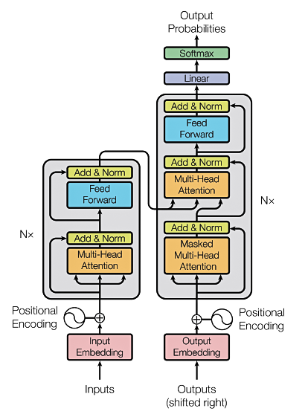
Transformers

Slide 2
Background (1)
The RNN and LSTM neural models were designed to process language and perform tasks like classification, summarization, translation, and sentiment detection
  RNN: Recurrent Neural Network
  LSTM: Long Short Term Memory
In both models, layers get the next input word and have access to some previous words, allowing it to use the word’s left context
They used word embeddings where each word was encoded as a vector of 100-300 real numbers representing its meaning

Slide 3
Background (2)
Transformers extend this to allow the network to process a word input knowing the words in both its left and right context
This provides a more powerful context model
Transformers add additional features, like attention, which identifies the important words in this context
And break the problem into two parts:
  An encoder (e.g., Bert)
  A decoder (e.g., GPT)

Slide 4
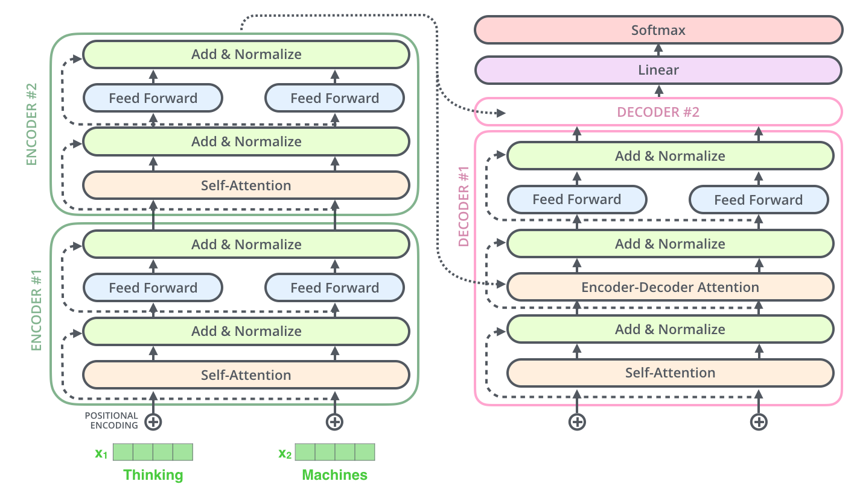
Transformer model
Encoder (e.g., BERT)
Decoder (e.g., GPT)

Slide 5
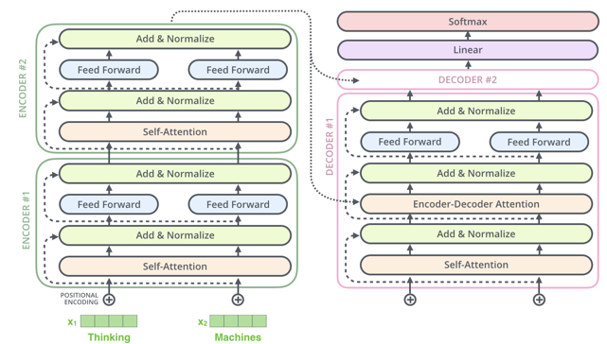
Transformers, GPT-2, and BERT
A transformer uses an encoder stack to
model input, and uses decoder stack to
model output (using input information from encoder side)
If we do not have input, we just want to model the “next word”, we can get rid of the encoder side of a transformer and output “next word” one by one. This gives us GPT
If we are only interested in training a language model for the input for some other tasks, then we do not need the decoder of the transformer, that gives us BERT

Slide 6
Training a Transformer
Transformers typically use semi-supervised learning with
  Unsupervised pretraining over a very large dataset of general text
  Followed by supervised fine-tuning over a focused data set of inputs and outputs for a particular task
Tasks for pretraining and fine-tuning commonly include:
  language modeling
  next-sentence prediction (aka completion)
  question answering
  reading comprehension
  sentiment analysis
  paraphrasing

Slide 7
Pretrained models
Since training a model requires huge datasets of text and significan computation, researchers often use common pretrained models
Examples (circa December 2021) include
  Google’s BERT model
  Huggingface’s various Transformer models
  OpenAI’s and GPT-3 models

Slide 8
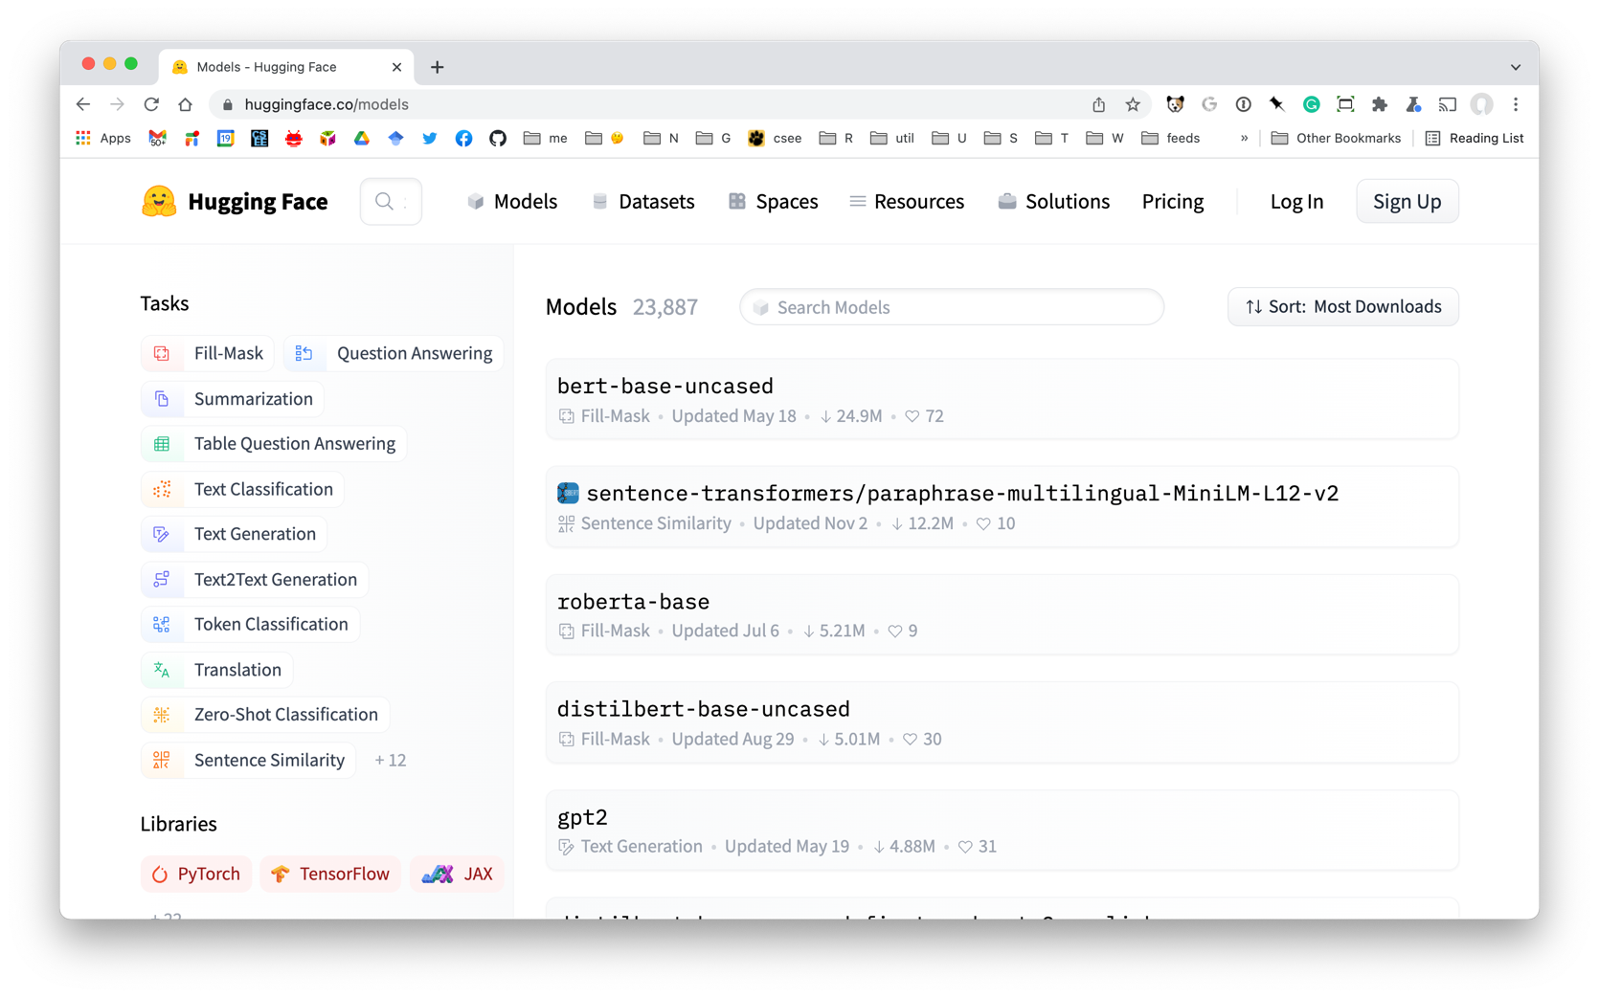
Hugggingface Models

Slide 9
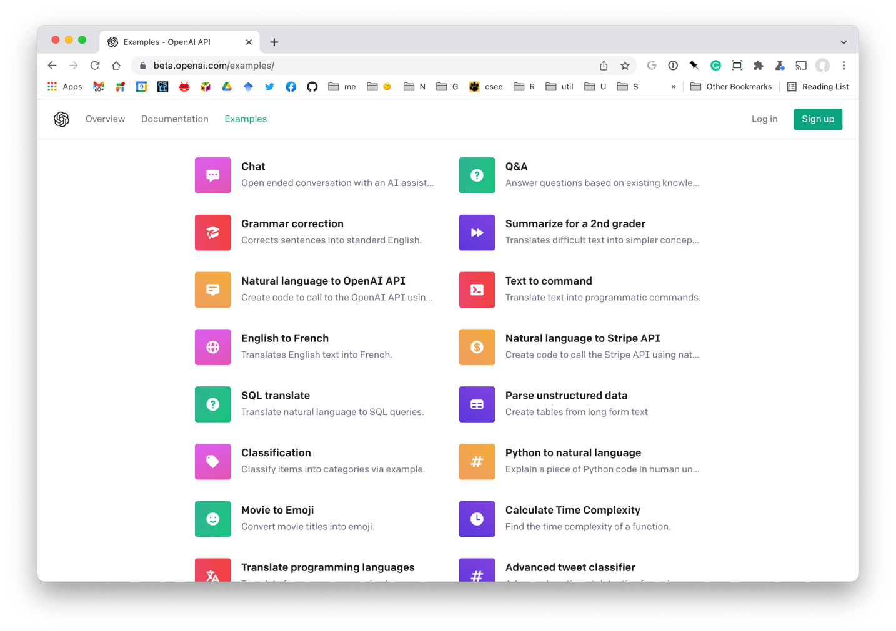
OpenAI Application Examples

Slide 10
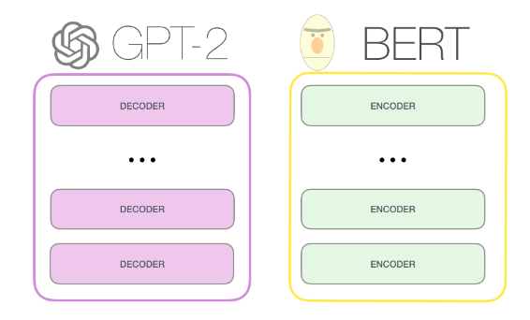
03
GPT-2, BERT

Slide 11
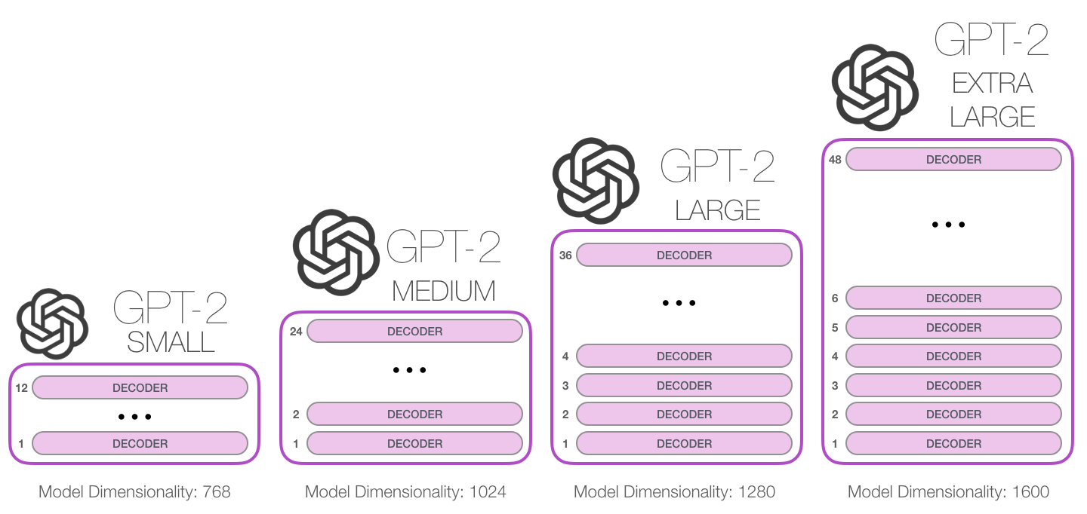
GPT released June 2018
GPT-2 released Nov. 2019 with 1.5B parameters
GPT-3 released in 2020 with 175B parameters
03
117M parameters
345M
762M
1542M

