Slide 1
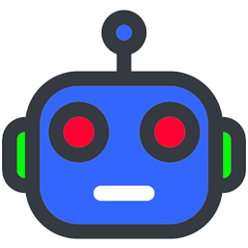
CMSC 471 Introduction to Artificial Intelligence Course Overview
Spring 2022

Slide 2
Today’s Class
Course overview
Introduction
Brief history of AI
What is AI? (and why is it so interesting?)
What’s the state of AI now?

Slide 3
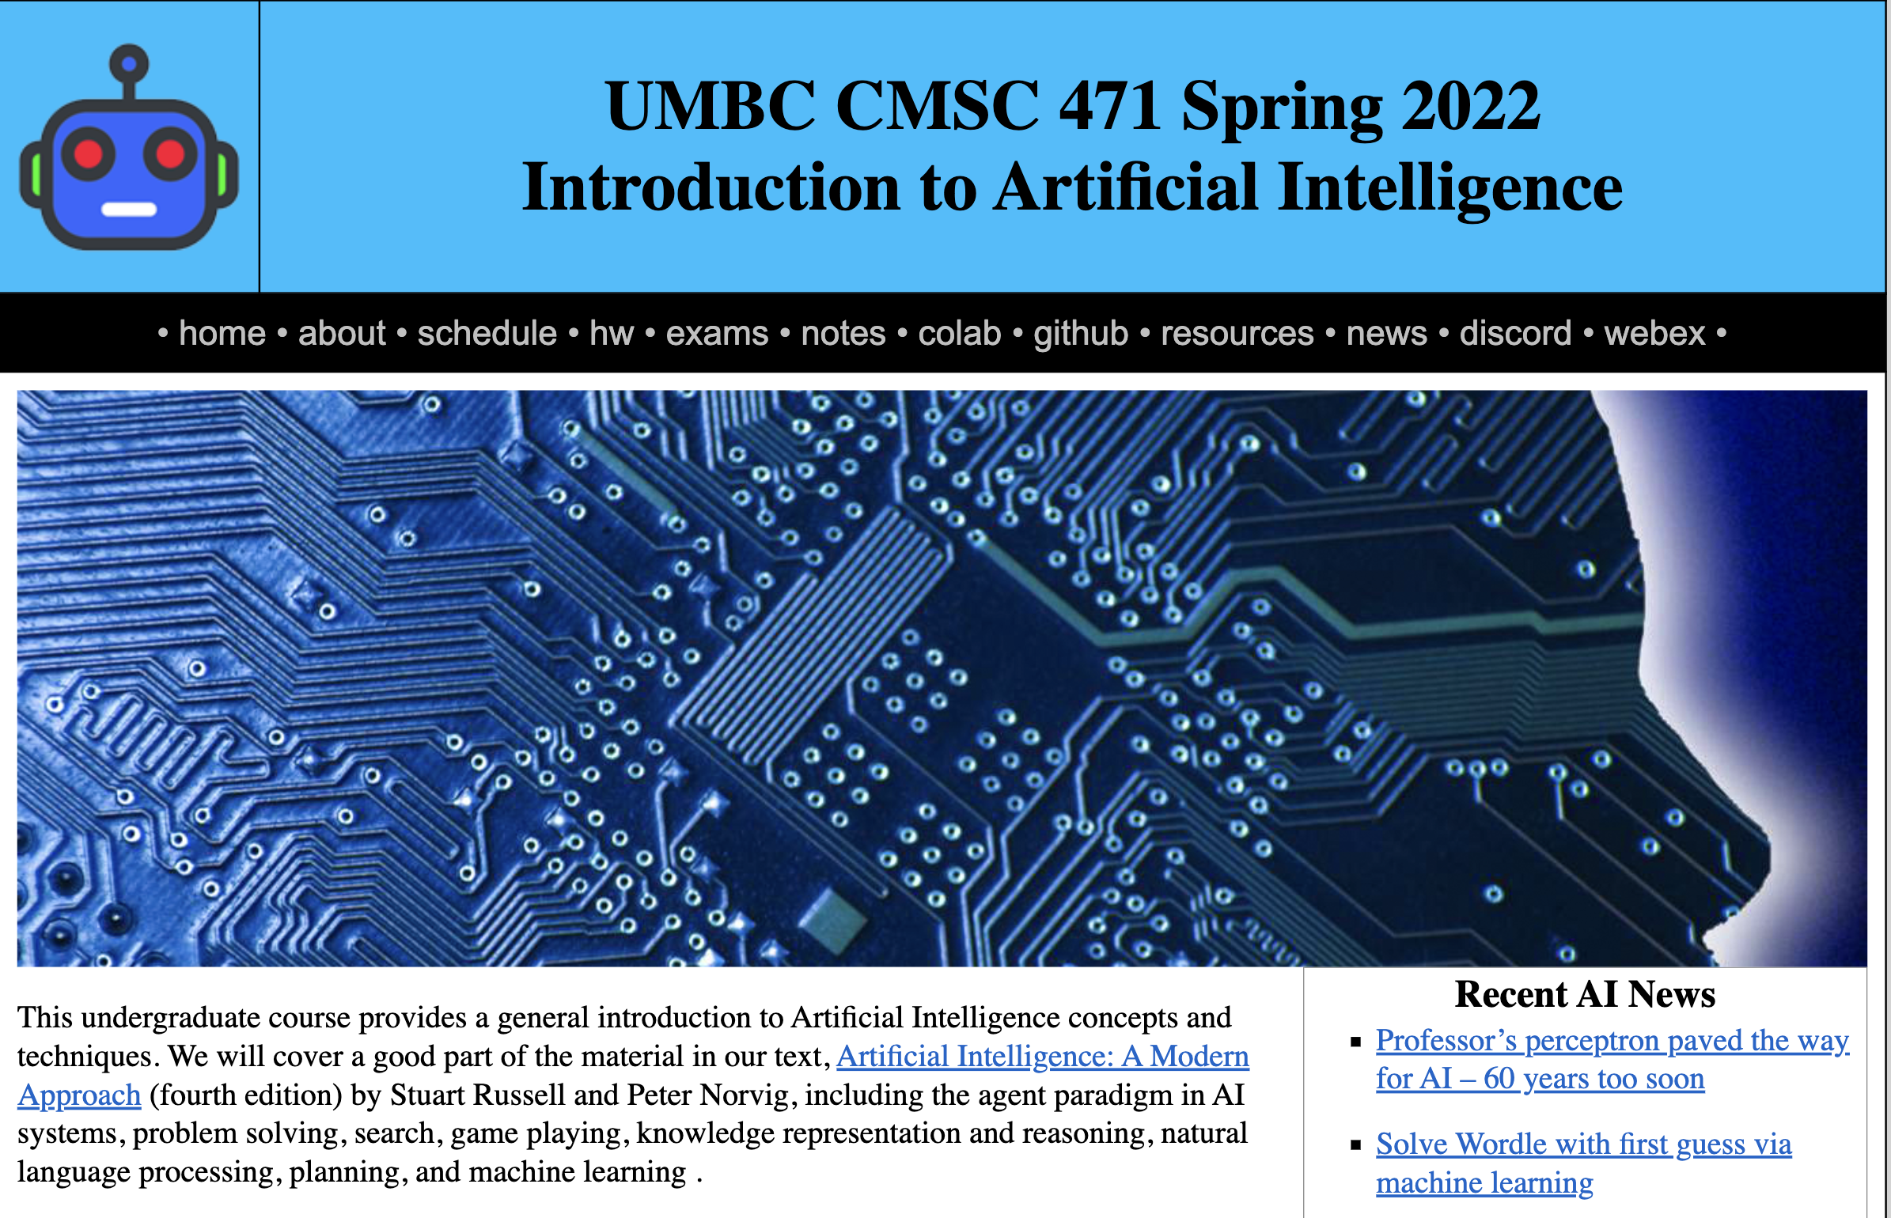
https://bit.ly/471s22

Slide 4
Text, CMI
4th edition of AIMA (2020) has lots of new material since the 2009 3rd edition
UMBC CMI program charges
$35 for a digital version, $160 on Amazon for hardcopy
Access on Blackboard or down- load to computer/phone
Opt-out of CMI via Blackboard

Slide 5
Homework and grading policies
~Six short homework assignments (mix of written and programming)
One-time extensions of up to a week may be granted if requested in advance
Last-minute requests for extensions probably will not be granted
Do the reading before each class!

Slide 6
Programming
Programming assignments in Python
We’ll use Python 3 in the notes and examples
We’ll use GitHub to share code, Jupyter notebooks, and for HW submission
You’ll need to install some Python packages
Some assignments may require other systems
E.g., C5 decision tree software, Weka Machine learning environments

Slide 7
Exams and Quizes
We may have periodic short quizzes (0-10%)
On Blackboard every other week or so, mostly to motivate you to keep up with the reading and classes
Midterm exam (15-20%)
In person or on Blackboard, March 17?
Final exam (25-30%)
In person or on Blackboard, mid-May
Comprehensive with an emphasis on last half of material (e.g., 30/70 split)
Homework (45-50%)

Slide 8
Instructor availability
Professor Tim Finin, finin@umbc.edu
Office hour: Wed 10-11 on Webex and/or in person by arrangement (329 ITE)
Ask general questions on Discord first
We’ll try to respond within 24 hours
TA: Prajna Bhandary, prajnab1@umbc.edu, ITE334
If needed, we may try holding help session on Discord

