Slide 1
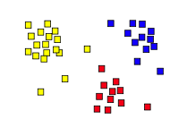
Unsupervised Learning: Clustering
14.6
Some material adapted from slides by Andrew Moore, CMU

Slide 2
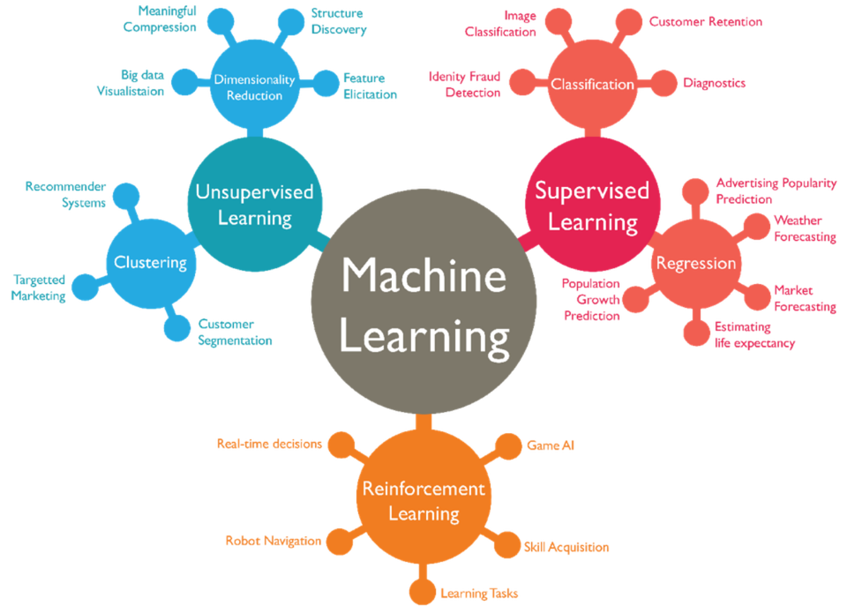

Slide 3
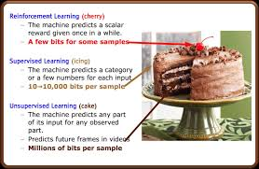
Yann LeCun on Unsupervised Learning
“Most of human and animal learning is unsupervised learning. If
intelligence was a cake, unsupervised learning would be the cake,
supervised learning would be the icing on the cake, and reinforcement learning would be the cherry on the cake. … We know how to make the icing and the cherry, but we don't know how to make the cake. We need to solve the unsupervised learning problem before we can even think of getting to true AI.”*
--
* Yann LeCun (Head of Facebook AI, NYU CS Prof.) on AlphaGo’s success and AI, 2016

Slide 4
Unsupervised Learning
Supervised learning used labeled data pairs (x, y) to learn a function f : X→y
What if we don’t have labels?
No labels = unsupervised learning
Only some points are labeled = semi-supervised learning
  Getting labels is expensive, so we only get a few
Clustering is the unsupervised grouping of data points based on similarity
It can be used for knowledge discovery

Slide 5
Clustering algorithms
Many clustering algorithms
Clustering typically done using a distance measure defined between instances or points
Distance defined by instance feature space, so it works with numeric features
  Requires encoding of categorial values; may benefit from normalization
We’ll look at three popular approaches
  Centroid-based clustering
  Hierarchical clustering
  DBSCAN

Slide 6
Clustering Data
Given a collection of points (x,y), group them into one or more clusters based on their distance from one another
How many clusters are there?
How can we find them

Slide 7
(1) K-Means Clustering
Randomly choose k cluster center locations, aka centroids
Loop until convergence
  assign a point to cluster of closest centroid
  re-estimate cluster centroids based on its data assigned
Convergence: no point is re-assigned to a different cluster
k = 5

Slide 8
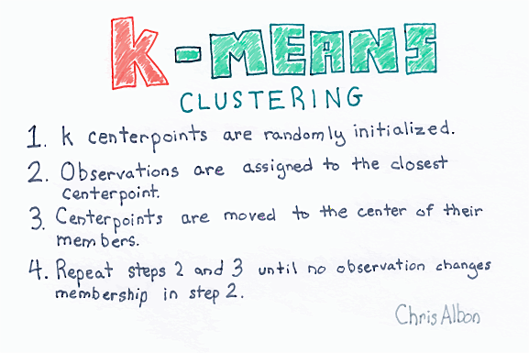

Slide 9
distance, centroids
Distance between points (X₀,Y₀,Z₀) and (X₁,Y₁,Z₁) is just sqrt((X₀- X₁)² + (Y₀- Y₁)² + (Z₀- Z₁)²)
In numpy
  >>> import numpy as np
  >>> p1 = np.array([0,-2,0,1]) ; p2 = np.array([0,1,2,1]))
  >>> np.linalg.norm(p1 - p2)
  3.605551275463989
Computing centroid of set of points easy
  >>> points = np.array([[1,2,3], [2,1,1], [3,1,0]]) # 3D points
  >>> centroid = np.mean(points, axis=0) # mean across columns
  >>> centroid
  array([2.0, 1.33, 1.33])

Slide 10
(1) K-Means Clustering
Randomly choose k cluster center locations, aka centroids
Loop until convergence
  assign a point to cluster of the closest centroid
  re-estimate cluster centroids based on its data assigned
Convergence: no point is assigned to a different cluster
k = 5

Slide 11
K-Means Clustering
K-Means ( k , data )
Randomly choose k cluster center locations (centroids)
Loop until convergence
  Assign each point to the cluster of the closest centroid.
  Re-estimate the cluster centroids based on the data assigned to each
Convergence: no point is assigned to a different cluster
veroni diagram: add lines for regions of points closest to each centroid

Slide 12
K-Means Clustering
K-Means ( k , data )
Randomly choose k cluster center locations (centroids)
Loop until convergence
  Assign each point to the cluster of the closest centroid
  Re-estimate the cluster centroids based on the data assigned to each
Convergence: no point is assigned to a different cluster

Slide 13
K-Means Clustering
K-Means ( k , data )
Randomly choose k cluster center locations (centroids)
Loop until convergence
  Assign each point to the cluster of the closest centroid
  Re-estimate the cluster centroids based on the data assigned to each
Convergence: no point is assigned to a different cluster

Slide 14
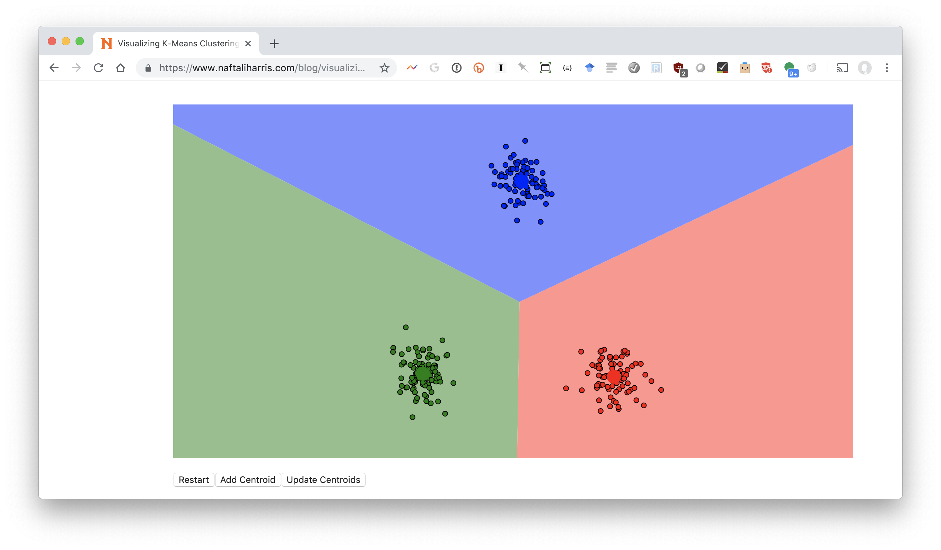
Visualizing k-means: http://bit.ly/471kmean

Slide 15
Clustering the Iris Data
Let’s try using unsupervised clustering on the Iris Data

Slide 16
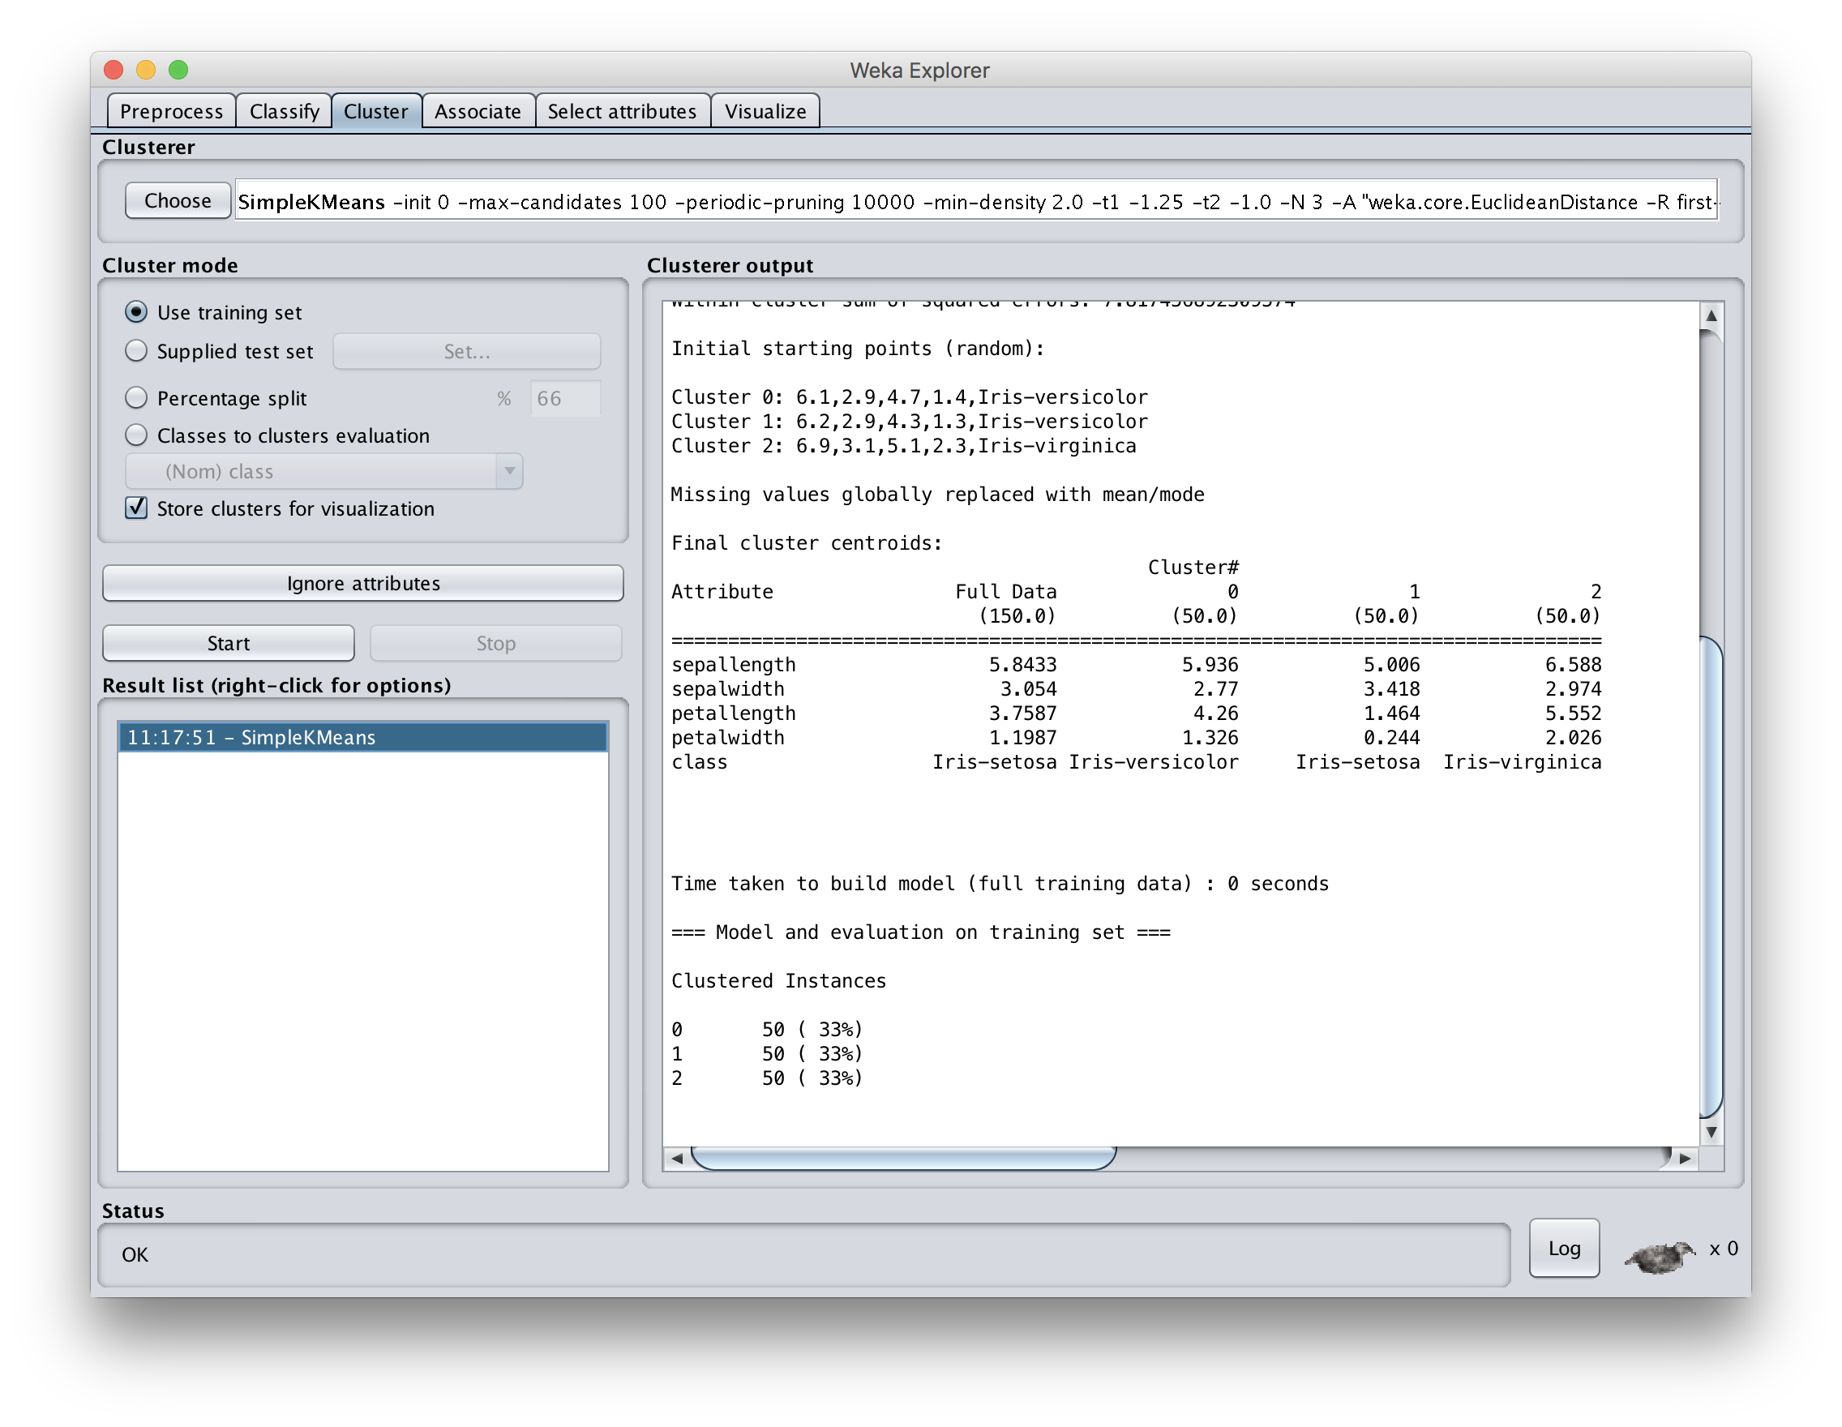
Notes:
We get perfect results, but we forgot to remove the ground truth nominal attribute! Select “Classes to cluster evaluation” to identify that class.

Slide 17
Getting results that are too good is usually a red flag
Perfect results, but we forgot to remove ground truth nominal attribute! Select “Classes to cluster evaluation” to identify that class.
Notes:
We get perfect results, but we forgot to remove the ground truth nominal attribute! Select “Classes to cluster evaluation” to identify that class.

Slide 18
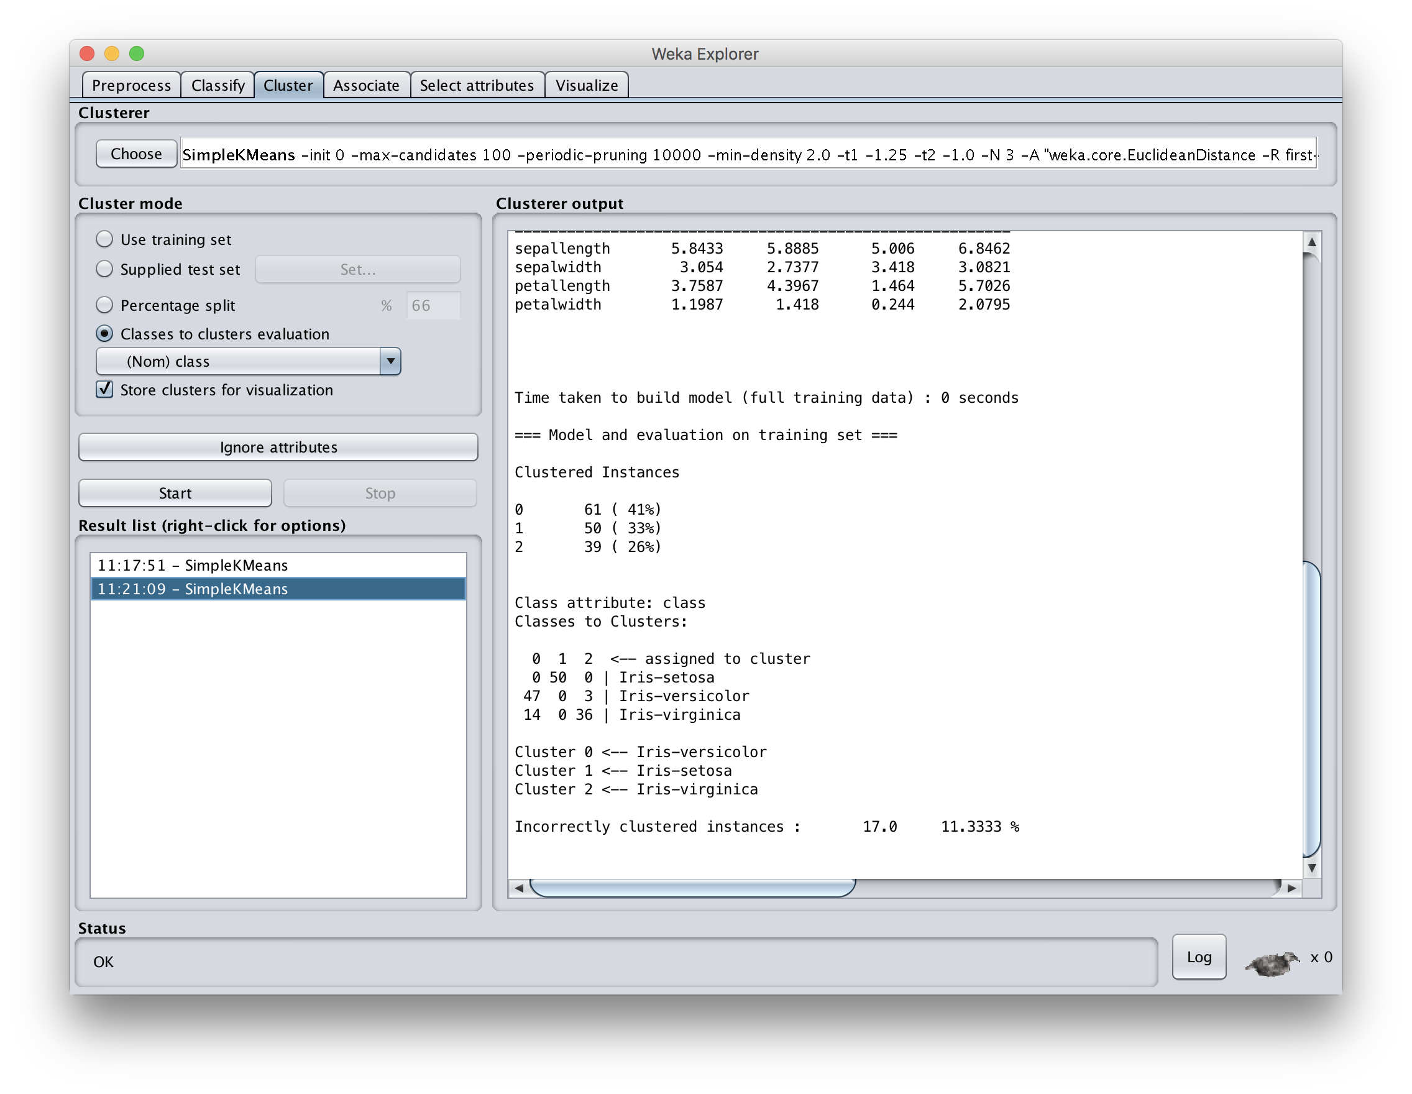

Slide 19
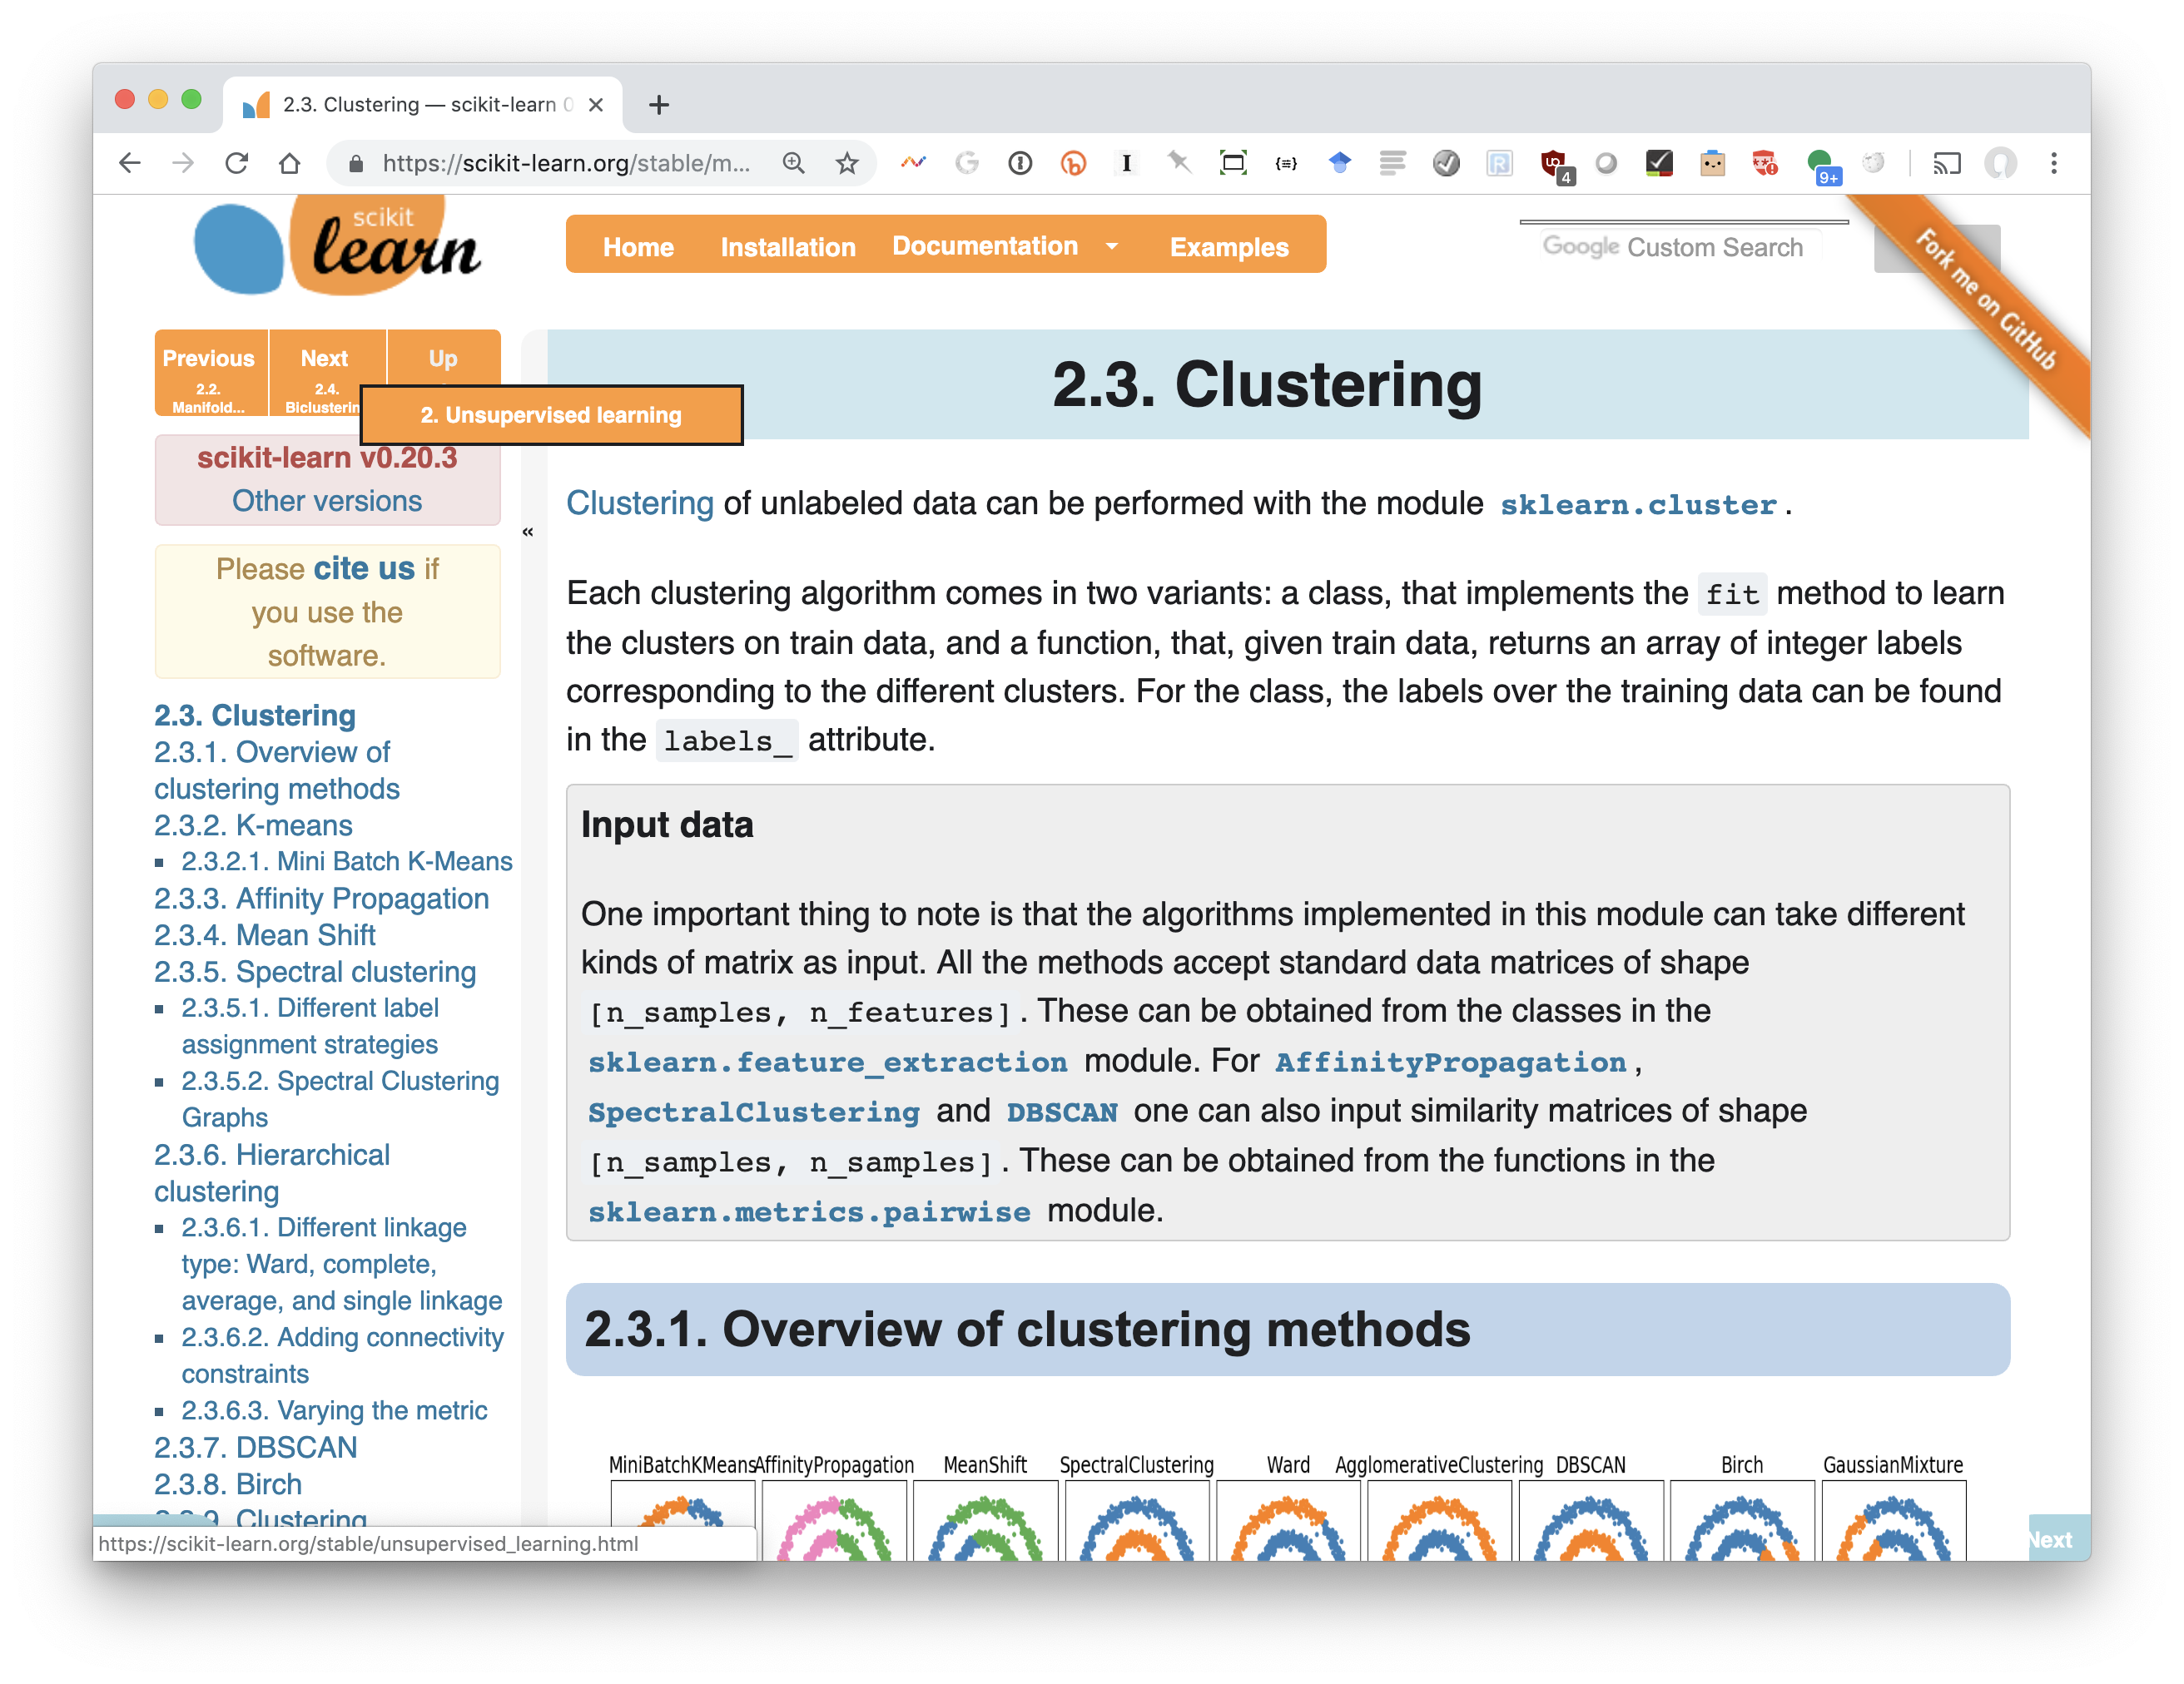
Scikit-learn clustering

Slide 20
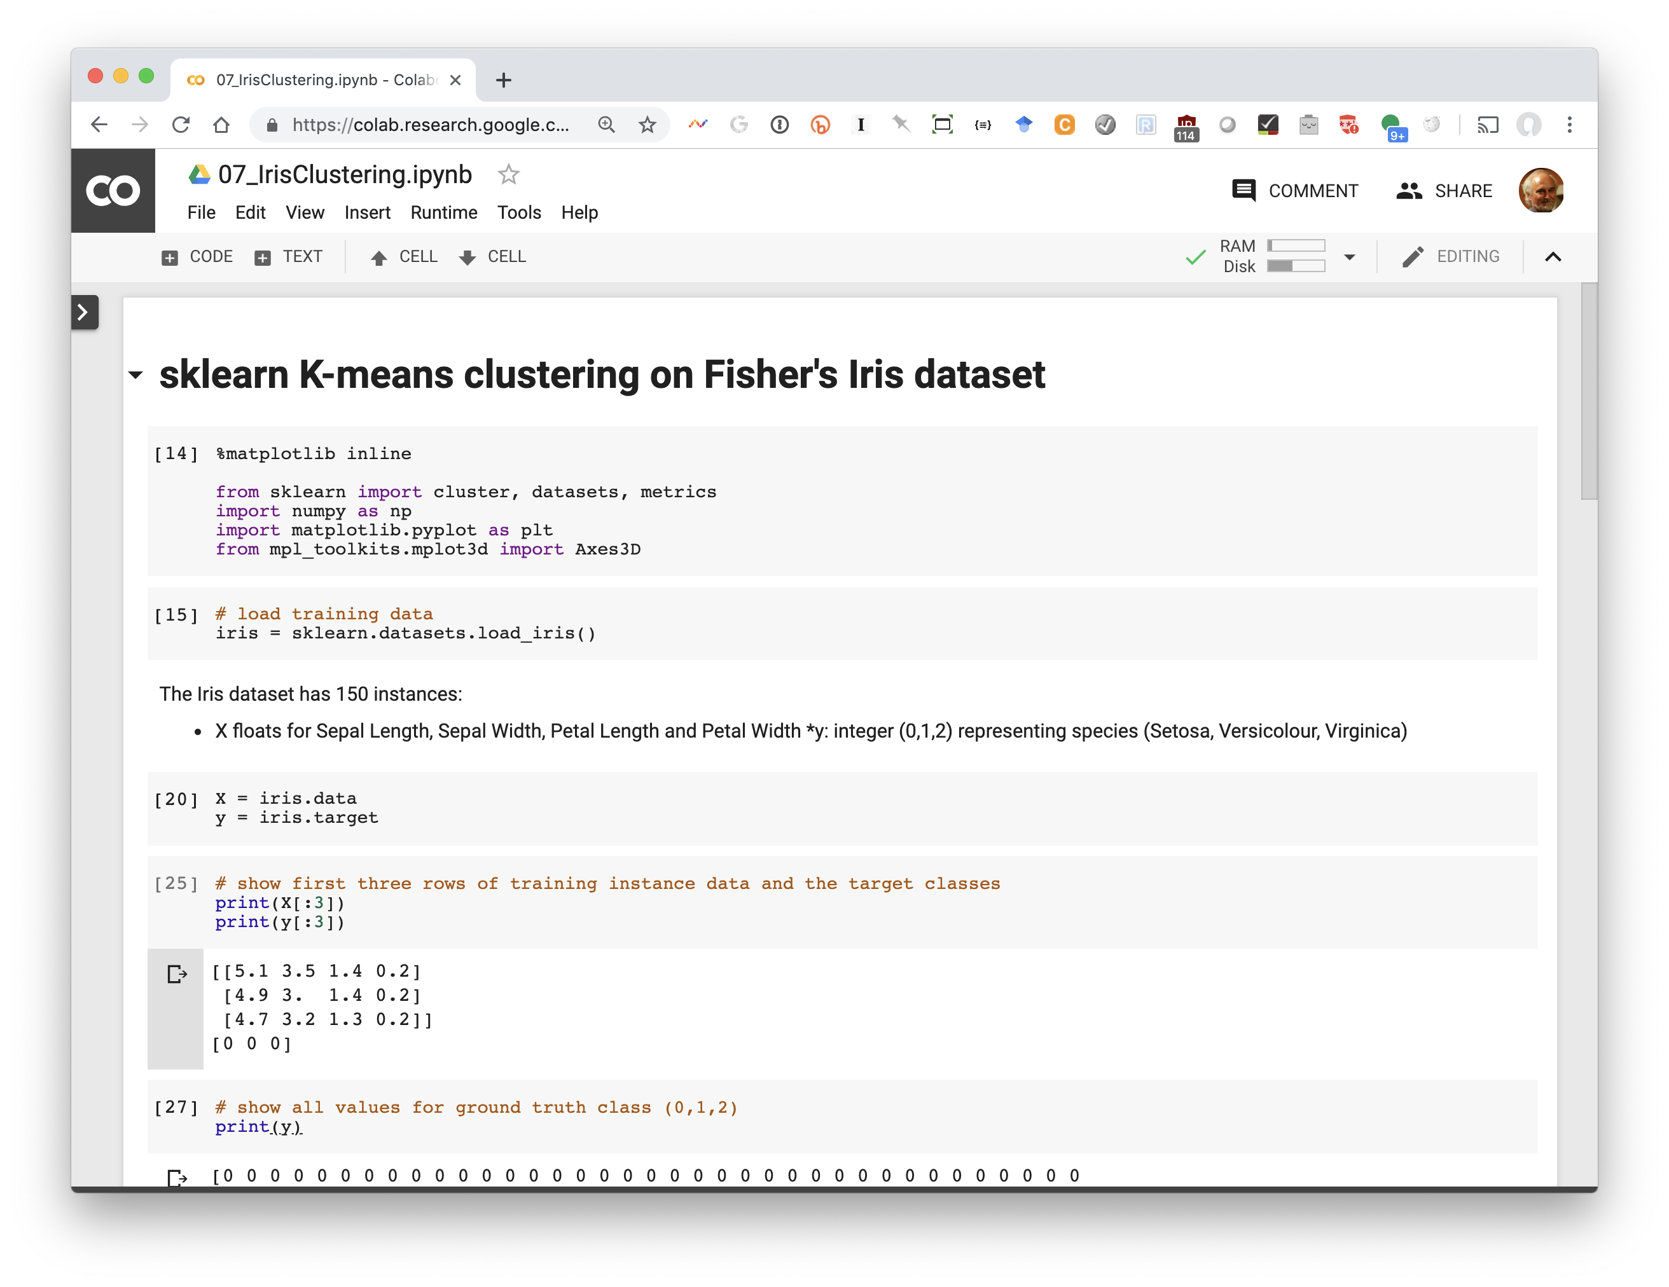

Slide 21
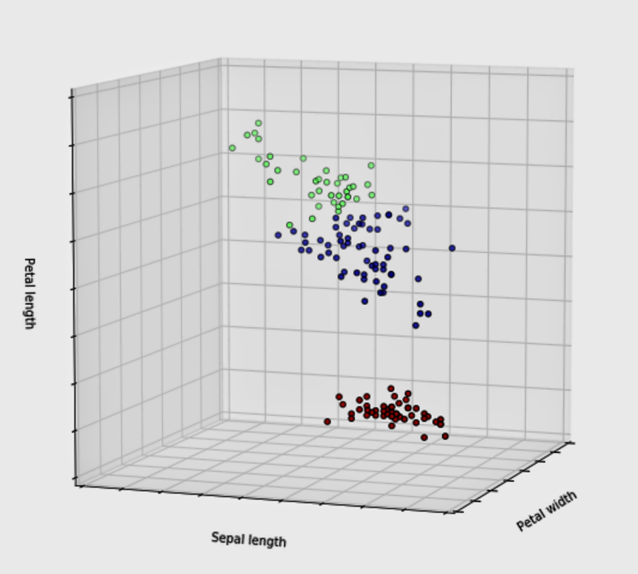

Slide 22
Problems with K-Means
Only works for numeric data (typically reals)
Very sensitive to the initial points
  fix: Do many runs, each with different initial centroids
  fix: Seed centroids with non-random method, e.g., farthest-first sampling
Sensitive to outliers
  E.g.: find three
  fix: identify and remove outliers
Must manually choose k
  Learn optimal k using some performance measure

Slide 23
Problems with K-Means
How do you tell it which clustering you want?
Constrained clustering technique provides hints
Same-cluster constraint
(must-link)
Different-cluster constraint
(cannot-link)

Slide 24
(2) Hierarchical clustering
Agglomerative
  Bottom-up approach: elements start as individual clusters & clusters are merged as one moves up the hierarchy
Divisive
  Top-down approach: elements start as a single cluster & clusters are split as one moves down the hierarchy

Slide 25
Hierarchical Clustering
Recursive partitioning/merging of a data set
1−clustering
5
2−clustering
1
3−clustering
4
2
4−clustering
3
5−clustering
1 2 3 4 5

Slide 26
Dendogram
  Tree structure representing all data partitionings
  Constructed as clustering proceeds
Nine items

Slide 27
Dendogram
  Tree structure representing all data partitionings
  Constructed as clustering proceeds
  Get a K-clustering by looking at connected components at any given level
  Often binary dendograms, but n-ary ones easy to get with minor algorithm changes
Four clusters

Slide 28
Dendogram
  Tree structure representing all data partitionings
  Constructed as clustering proceeds
  Get a K-clustering by looking at connected components at any given level
  Often binary dendograms, but n-ary ones easy to get with minor algorithm changes
Two clusters

Slide 29
Hierarchical clustering advantages
Need not specify number of clusters
Good for data visualization
  See how data points interact at many levels
  Can view data at multiple granularity levels
  Understand how all points interact
Specifies all of the K clusterings/partitions

Slide 30
Divisive hierarchical clustering
Top-down technique to find best partitioning of data, generally exponential in time
Common approach:
  Let C be a set of clusters
  Initialize C to be a one-clustering of data
  While there exists a cluster c in C
    remove c from C
    partition c into 2 clusters (c₁ and c₂ ) using a flat clustering algorithm (e.g., k-means with k=2)
    Add to c₁ and c₂ C

Slide 31
Divisive clustering

Slide 32
Divisive clustering
start with one cluster

Slide 33
Divisive clustering
use flat clustering to
split into two clusters (e.g., using K-means with k=2)

Slide 34
Divisive clustering

Slide 35
Divisive clustering
split using flat clustering, e.g., K-means

Slide 36
Divisive clustering
split using flat clustering
split using flat clustering, e.g., K-means

Slide 37
Divisive clustering
Stop when clusters reach some constraint

Slide 38
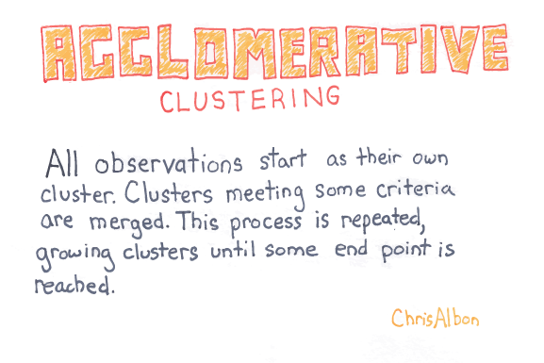

Slide 39
Hierarchical Agglomerative Clustering
Let C be a set of clusters
Initialize C to all points/docs as separate clusters
While C contains more than one cluster
  find c₁ and c₂ in C that are closest together
  remove c₁ and c₂ from C
  merge c₁ and c₂ and add resulting cluster to C
Merging history forms a binary tree or hierarchy
Q: How to measure distance between clusters?

Slide 40
Distance between clusters
Single-link: Similarity of the most similar (single-link)
Weka: linkType=SINGLE

Slide 41
Distance between clusters
Complete-link: Similarity of the “furthest” points, the least similar
Weka: linkType=COMPLETE

Slide 42
Distance between clusters
Centroid: Clusters whose centroids (centers of gravity) are the most similar
Weka: linkType=CENTROID

Slide 43
Distance between clusters
Average-link: Average similarity between all pairs of elements
Weka: linkType=AVERAGE

Slide 44
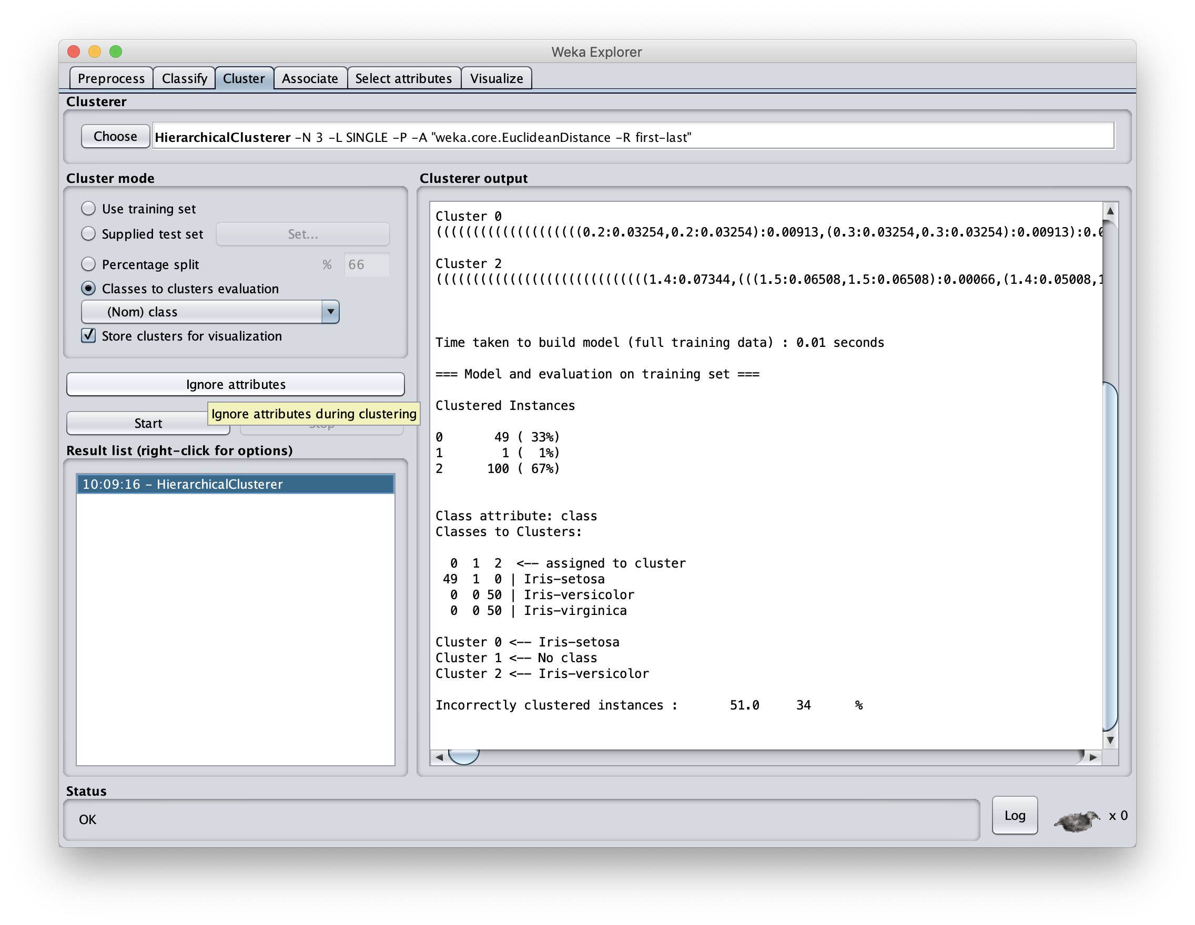
Defaut SINGLE cluster distance gives poor results here

Slide 45
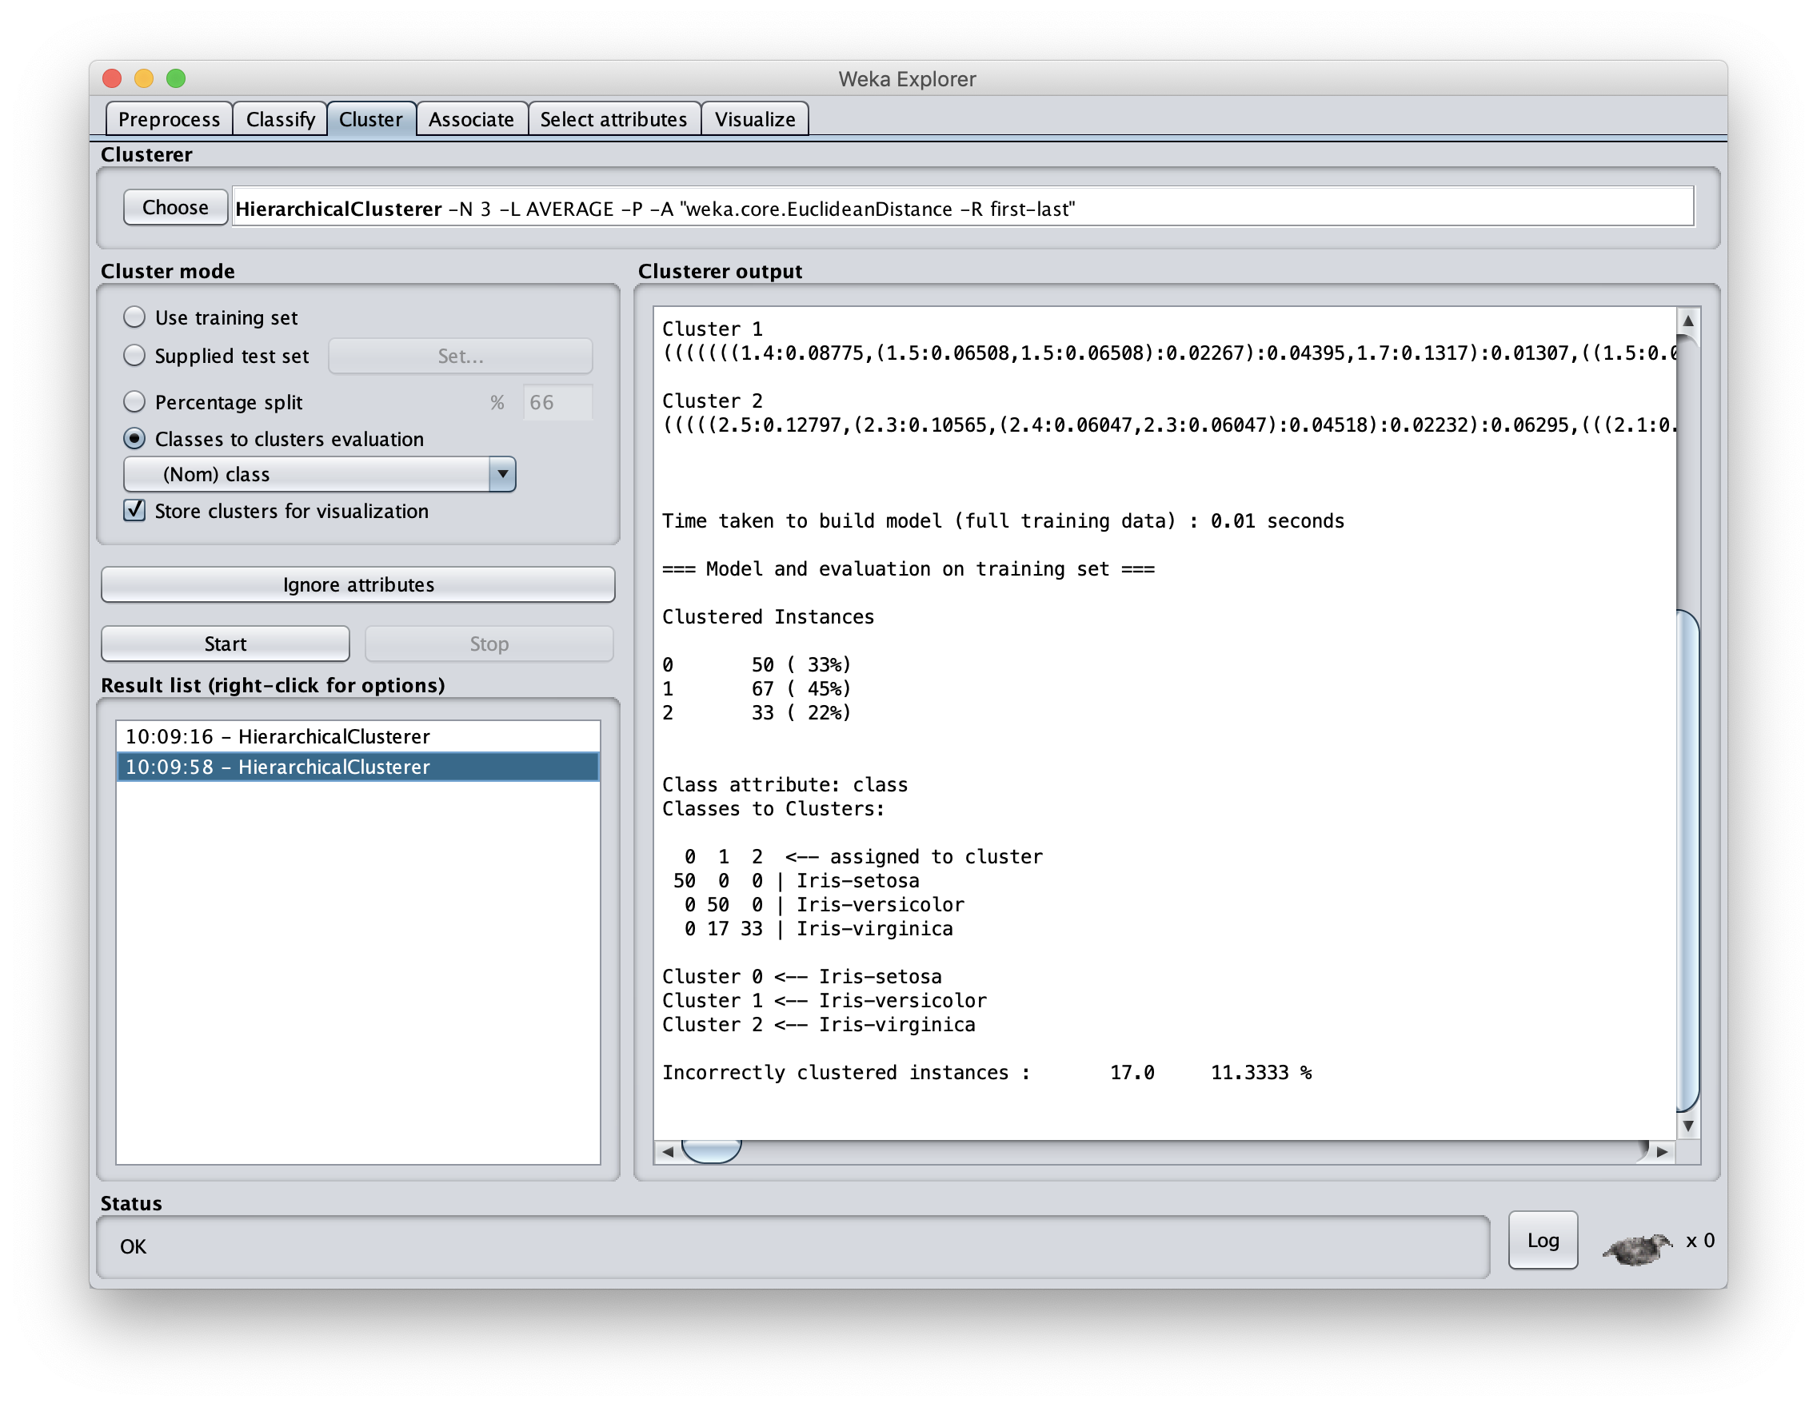
Using AVERAGE cluster distance measure improves results

Slide 46

Knowing when to stop
General issue is knowing when to stop merging/splitting a cluster
We may have a problem specific desired range of clusters (e.g., 3-6)
There are some general metrics for assessing quality of a cluster
There are also domain specific heuristics for cluster quality

Slide 47
(3) DBSCAN Algorithm
Density-Based Spatial Clustering of Applica-tions with Noise
It clusters close points based on a distance and a minimum number of points
  Key parameters: eps=maximum distance between two points; minPoints= minimal cluster size
Marks as outliers points in low-density regions
Needn’t specify number of clusters expected
Fast

Slide 48
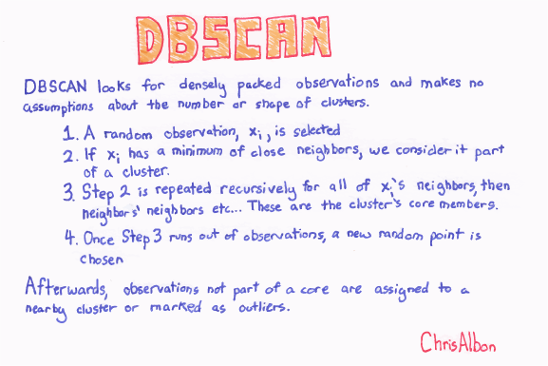

Slide 49
Comparing Clustering algorithms
Scikit Learn — Plot Cluster Comparison

Slide 50
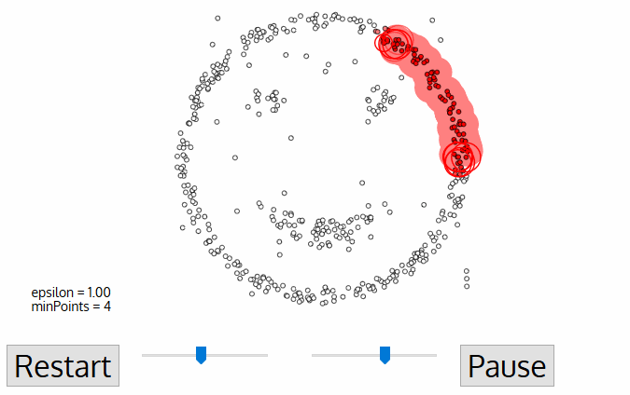
DBSCAN Example
This gif (in ppt) shows how DBSCAN grows four clusters and identifies the remaining points as outliers

Slide 51
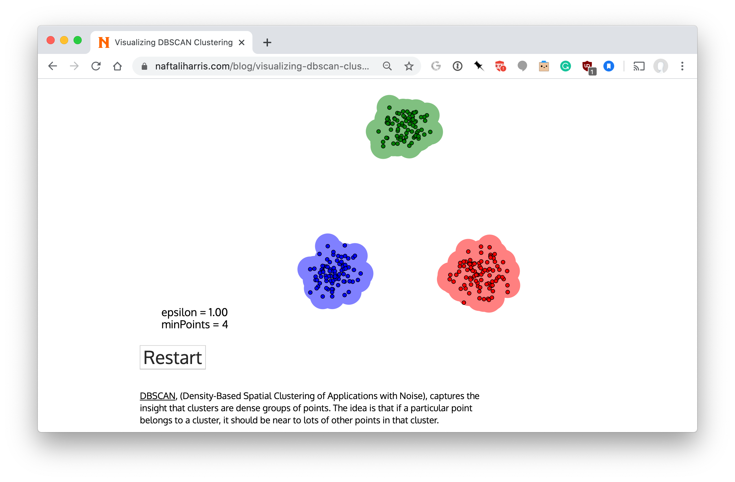
Visualizing DBSCAN https://bit.ly/471dbscan

Slide 52
Clustering Summary
Clustering is useful and effective for many tasks
K-means clustering is one of the simplest and fastest techniques but
  Requires knowing how many clusters is right
  Doesn’t handle outliers well
Hierarchical clustering is slower but more general, but needs a metric on knowing when to stop
There are many other clustering options

