Slide 1
Support Vector Machines
Some slides borrowed from Andrew Moore’s slides on SVMs. His repository is here: http://www.cs.cmu.edu/~awm/tutorials .

Slide 2
Support Vector Machines
Very popular ML technique
Became popular in the late 90s (Vapnik 1995; 1998)
Invented in the late 70s (Vapnik, 1979)
Controls complexity and overfitting, so works well on a wide range of practical problems
Can handle high dimensional vector spaces, which makes feature selection less critical
Very fast and memory efficient implementa-tions, e.g., svm_light
Not always best solution, especially for problems with small vector spaces

Slide 3
Linear Classifiers
α
x
f
y^{est}
f(x,w,b) = sign(w. x - b)
denotes +1
denotes -1
How would you classify this data?

Slide 4
Linear Classifiers
α
x
f
y^{est}
f(x,w,b) = sign(w. x - b)
denotes +1
denotes -1
How would you classify this data?

Slide 5
Linear Classifiers
α
x
f
y^{est}
f(x,w,b) = sign(w. x - b)
denotes +1
denotes -1
How would you classify this data?
Notes:
q

Slide 6
Linear Classifiers
α
x
f
y^{est}
f(x,w,b) = sign(w. x - b)
denotes +1
denotes -1
How would you classify this data?

Slide 7
Linear Classifiers
α
x
f
y^{est}
f(x,w,b) = sign(w. x - b)
denotes +1
denotes -1
Any of these would be fine..
..but which is best?

Slide 8
Classifier Margin
α
x
f
y^{est}
f(x,w,b) = sign(w. x - b)
denotes +1
denotes -1
A linear classifier’s margin is width that boundary could be increased by before hitting a datapoint

Slide 9
Maximum Margin
α
x
f
y^{est}
f(x,w,b) = sign(w. x - b)
denotes +1
denotes -1
Maximum margin linear classifier is the linear classifier with the, um, maximum margin
The simplest kind of SVM, called an LSVM
Linea SVM

Slide 10
Maximum Margin
α
x
f
y^{est}
f(x,w,b) = sign(w. x - b)
denotes +1
denotes -1
Maximum margin linear classifier is the linear classifier with the, um, maximum margin
The simplest kind of SVM, called an LSVM
Support Vectors are the datapoints that margin pushes up against
Linea SVM

Slide 11
Why Maximum Margin?
Intuitively this feels safest
Small errors in boundary location unlikely to cause misclassification
LOOCV is easy since model is immune to removal of non-support-vector datapoints
There’s some theory (using VC dimension) that is related to (but not the same as) the proposition that this is a good thing
Empirically it works very very well
f(x,w,b) = sign(w. x - b)
denotes +1
denotes -1
The maximum margin linear classifier is the linear classifier with the, um, maximum margin.
This is the simplest kind of SVM (Called an LSVM)
Support Vectors are those datapoints that the margin pushes up against
LOOCV = leave one out cross validation

Slide 12
Specifying a line and margin
Plus-Plane
Classifier Boundary
“Predict Class = +1” zone
Minus-Plane
“Predict Class = -1” zone
How do we represent this mathematically?
…in m input dimensions?

Slide 13
Specifying a line and margin
Plus-Plane
Classifier Boundary
“Predict Class = +1” zone
Minus-Plane
wx+b=1
“Predict Class = -1” zone
wx+b=0
wx+b=-1
Plus-plane = { x : w . x + b = +1 }
Minus-plane = { x : w . x + b = -1 }
Classify as.. | +1 | if | w . x + b >= 1
 | -1 | if | w . x + b <= -1
 | Universe explodes | if | -1 < w . x + b < 1

Slide 14
Learning the Maximum Margin Classifier
x⁺
M = Margin Width =
“Predict Class = +1” zone
x⁻
wx+b=1
“Predict Class = -1” zone
wx+b=0
wx+b=-1
Given a guess of w and b we can
Compute whether all data points in the correct half-planes
Compute the width of the margin
Write a program to search the space of ws and bs to find widest margin matching all the datapoints.
How? -- Gradient descent? Simulated Annealing? Matrix Inversion? EM? Newton’s Method?

Slide 15
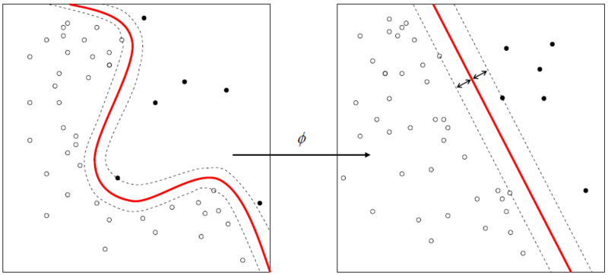
Learning SVMs
Trick #1: Find points that would be closest to optimal separating plane (“support vectors”) and work directly from those instances
Trick #2: Represent as a quadratic optimization problem, and use quadratic programming techniques
Trick #3 (“kernel trick”):
Instead of using raw features, represent data in a high-dimensional feature space constructed from a set of basis functions (e.g., polynomial and Gaussian combinations of the base features)
Find separating plane/SVM in that space
Voila: A nonlinear classifier!

Slide 16
Soft margin classification
What if data from two classes not linearly separable?
Allow a fat decision margin to make a few mistakes
Some points, outliers or noisy examples, are inside or on wrong side of the margin
Each outlier incurs a cost based on distance to hyperplane

Slide 17
Kernel trick
What if data from two classes not linearly separable?
Project data onto a higher dimensional space where it becomes linearly separable
Many SVMs can take an argument, a kernel, that does the transformation of the data
Deciding what kernel function to use is done through eperimentation

Slide 18
SVM Performance
Can handle very large features spaces (e.g., 100K features)
Relatively fast
Anecdotally they work very, very well indeed
Example: They are among the best-known classifier on a well-studied hand-written-character recognition benchmark

Slide 19
Binary vs. multi classification (1)
SVMs can only do binary classification
Two approaches to multi classification: OVA and OVO
OVA or one-vs-all: turns n-way classification into n binary classification tasks:
E.g., for zoo problem, do mammal vs. not-mammal, fish vs. not-fish, … bird vs. not-bird, …
Pick one that results in the highest score (e.g., widest margin)

Slide 20
Binary vs. multi classification (2)
OVO for n classes builds N*(N-1)/2 one-vs-one classifiers
Mammal vs. fish, mammal vs. reptile, etc…
Choose the on that wins the most 1x1 pairings

