Slide 1
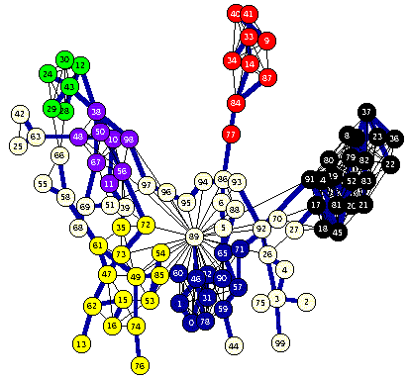
CSP in Python

Slide 2
Overview
Python_constraint is a good package for solving CSP problems in Python
Installing it
Using it
Examples
Magic Squares
Map coloring
Sudoku puzzles
HW?: Battleships

Slide 3
Installation
On your own computer
pip install python-constraint
sudo pip install python-constraint
Install locally on gl
pip3 install –user python-constraints
Install locally on UMBC Jupyter hub server by executing this once in a notebook
!pip install –user python-constraints
Clone source from github
https://github.com/python-constraint

Slide 4
Simple Example
>>> from constraint import *
>>> p = Problem()
>>> p.addVariable("a", [1,2,3])
>>> p.addVariable("b", [4,5,6])
>>> p.getSolutions()
[{'a': 3, 'b': 6}, {'a': 3, 'b': 5}, {'a': 3, 'b': 4},
{'a': 2, 'b': 6}, {'a': 2, 'b': 5}, {'a': 2, 'b': 4},
{'a': 1, 'b': 6}, {'a': 1, 'b': 5}, {'a': 1, 'b': 4}]
>>> p.addConstraint(lambda x,y: 2*x == y, (’a', ’b'))
>>> p.getSolutions()
[{'a': 3, 'b': 6}, {'a': 2, 'b': 4}]

Slide 5
Simple Example
variable name
>>> from constraint import *
>>> p = Problem()
>>> p.addVariable("a", [1,2,3])
>>> p.addVariable("b", [4,5,6])
>>> p.getSolutions()
[{'a': 3, 'b': 6}, {'a': 3, 'b': 5}, {'a': 3, 'b': 4},
{'a': 2, 'b': 6}, {'a': 2, 'b': 5}, {'a': 2, 'b': 4},
{'a': 1, 'b': 6}, {'a': 1, 'b': 5}, {'a': 1, 'b': 4}]
>>> p.addConstraint(lambda x,y: 2*x==y, (’a’,’b'))
>>> p.getSolutions()
[{'a': 3, 'b': 6}, {'a': 2, 'b': 4}]
domain
two variables
constraint function

Slide 6
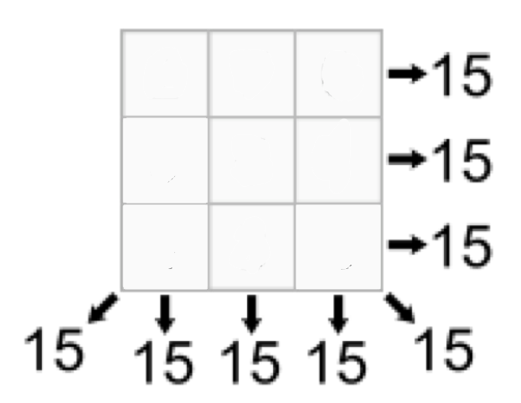
Magic Square
An NxN array of integers where all rows, columns and diagonals sum to the same number
Given N (e.g., 3) and the magic sum (e.g., 15) find the cell values
What are the
Variables & their domains
Constraints

Slide 7
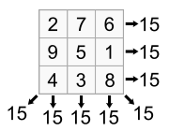
Magic Square
An NxN array on integers where all rows, columns and diagonals sum to the same number
Given N (e.g., 3) and the magic sum (e.g., 15) find the cell values
What are the
Variables & their domains
Constraints

Slide 8
3x3 Magic Square
numbers as variables: 0..8
domain of each is 1..10
from constraint import *
p = Problem()
p.addVariables(range(9), range(1,10))
p.addConstraint(AllDifferentConstraint(), range(9))
p.addConstraint(ExactSumConstraint(15), [0,4,8])
p.addConstraint(ExactSumConstraint(15), [2,4,6])
for row in range(3):
p.addConstraint(ExactSumConstraint(15),
[row*3+i for i in range(3)])
for col in range(3):
p.addConstraint(ExactSumConstraint(15),
[col+3*i for i in range(3)])
built-in constraint functions
variables involved with constraint

Slide 9
3x3 Magic Square
sols = p.getSolutions()
print sols
for s in sols:
print
for row in range(3):
for col in range(3):
print s[row*3+col],
print

Slide 10
3x3 Magic Square
> python ms3.py
[{0:6,1:7,2:2,…8:4}, {0:6,1:…}, …]
6 7 2
1 5 9
8 3 4
6 1 8
7 5 3
2 9 4
… six more solutions …

Slide 11
Constraints
FunctionConstraint(f, v)
Arguments:
F: a function of N (N>0) arguments
V: a list of N variables
Function can be defined & referenced by name or defined locally via lambda expressions
p.addConstraint(lambda x,y:x==2*y,[11,22])
def dblfn(x,y): return x == 2*y P.addConstraint(dblfn, [11,22])

Slide 12
Constraints
Constraints on a set of variables:
AllDifferentConstraint()
AllEqualConstraint()
MaxSumConstraint()
ExactSumConstraint()
MinSumConstraint()
Example:
p.addConstraint(ExactSumConstraint(100),[11,…19])
p.addConstraint(AllDifferentConstraint(),[11,…19])

Slide 13
Constraints
Constraints on a set of possible values
InSetConstraint()
NotInSetConstraint()
SomeInSetConstraint()
SomeNotInSetConstraint()

Slide 14
Map Coloring
def color(map, colors=['red','green','blue']):
(vars, adjoins) = parse_map(map)
p = Problem()
p.addVariables(vars, colors)
for (v1, v2) in adjoins:
p.addConstraint(lambda x,y: x!=y, [v1, v2])
solution = p.getSolution()
if solution:
for v in vars:
print "%s:%s " % (v, solution[v]),
print
else:
print 'No solution found :-(’
austrailia = "SA:WA NT Q NSW V; NT:WA Q; NSW: Q V; T:"

Slide 15
Map Coloring
australia = 'SA:WA NT Q NSW V; NT:WA Q; NSW: Q V; T:’
def parse_map(neighbors):
adjoins = []
regions = set()
specs = [spec.split(':') for spec in neighbors.split(';')]
for (A, Aneighbors) in specs:
A = A.strip();
regions.add(A)
for B in Aneighbors.split():
regions.add(B)
adjoins.append([A,B])
return (list(regions), adjoins)

Slide 16
Sudoku
def sudoku(initValue):
p = Problem()
# Define a variable for each cell: 11,12,13...21,22,23...98,99
for i in range(1, 10) :
p.addVariables(range(i*10+1, i*10+10), range(1, 10))
# Each row has different values
for i in range(1, 10) :
p.addConstraint(AllDifferentConstraint(), range(i*10+1, i*10+10))
# Each colum has different values
for i in range(1, 10) :
p.addConstraint(AllDifferentConstraint(), range(10+i, 100+i, 10))
# Each 3x3 box has different values
p.addConstraint(AllDifferentConstraint(), [11,12,13,21,22,23,31,32,33])
p.addConstraint(AllDifferentConstraint(), [41,42,43,51,52,53,61,62,63])
p.addConstraint(AllDifferentConstraint(), [71,72,73,81,82,83,91,92,93])
p.addConstraint(AllDifferentConstraint(), [14,15,16,24,25,26,34,35,36])
p.addConstraint(AllDifferentConstraint(), [44,45,46,54,55,56,64,65,66])
p.addConstraint(AllDifferentConstraint(), [74,75,76,84,85,86,94,95,96])
p.addConstraint(AllDifferentConstraint(), [17,18,19,27,28,29,37,38,39])
p.addConstraint(AllDifferentConstraint(), [47,48,49,57,58,59,67,68,69])
p.addConstraint(AllDifferentConstraint(), [77,78,79,87,88,89,97,98,99])
# add unary constraints for cells with initial non-zero values
for i in range(1, 10) :
for j in range(1, 10):
value = initValue[i-1][j-1]
if value: p.addConstraint(lambda var, val=value: var == val, (i*10+j,))
return p.getSolution()

Slide 17
Sudoku Input
easy = [[0,9,0,7,0,0,8,6,0],
[0,3,1,0,0,5,0,2,0],
[8,0,6,0,0,0,0,0,0],
[0,0,7,0,5,0,0,0,6],
[0,0,0,3,0,7,0,0,0],
[5,0,0,0,1,0,7,0,0],
[0,0,0,0,0,0,1,0,9],
[0,2,0,6,0,0,0,5,0],
[0,5,4,0,0,8,0,7,0]]

Slide 18
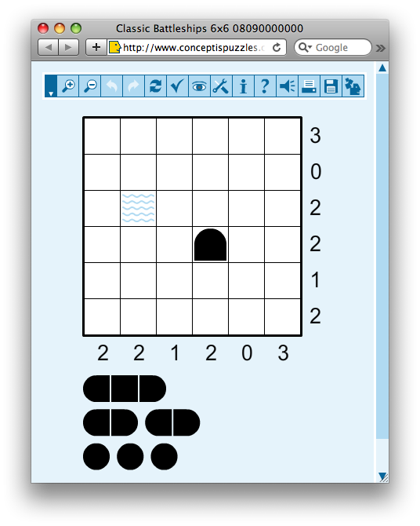
Battleship Puzzle
NxN grid
Each cell occupied by water or part of a ship
Given
Ships of varying lengths
Row and column sums of number of ship cells
Hints for some cells
What are
variables and domains
constraints

Slide 19
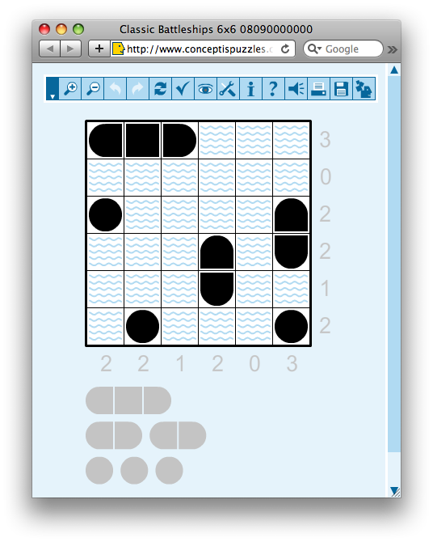
Battleship Puzzle
NxN grid
Each cell occupied by water or part of a ship
Given
Ships of varying lengths
Row and column sums of number of ship cells
Hints for some cells
What are
variables and domains
constraints

Slide 20
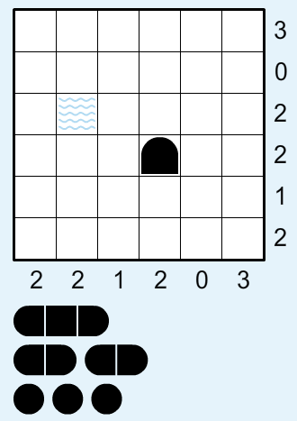
Battleship puzzle
Resources
http://www.conceptispuzzles.com/
http://wikipedia.org/wiki/Battleship_(puzzle)
Barbara M. Smith, Constraint Programming Models for Solitaire Battleships, 2006
http://bit.ly/cspBs

Slide 21
A HW Problem ?
Write a CSP program to solve 6x6 battleships with 3 subs, 2 destroyers and 1 carrier
Given row and column sums and several hints
Hints: for a location, specify one of {water, top, bottom, left, right, middle, circle}

