Slide 1
Uninformed Search
Chapter 3
Some material adopted from notes by Charles R. Dyer, University of Wisconsin-Madison

Slide 2
Today’s topics
Goal-based agents
Representing states and actions
Example problems
Generic state-space search algorithm
Specific algorithms
Breadth-first search
Depth-first search
Uniform cost search
Depth-first iterative deepening
Example problems revisited

Slide 3
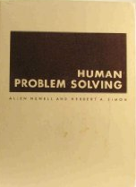
Big Idea
Allen Newell and Herb Simon developed the problem space principle as an AI approach in the late 60s/early 70s
"The rational activity in which people engage to solve a problem can be described in terms of (1) a set of states of knowledge, (2) operators for changing one state into another, (3) constraints on applying operators and (4) control knowledge for deciding which operator to apply next."
Newell A & Simon H A. Human problem solving. Englewood Cliffs, NJ: Prentice-Hall. 1972.

Slide 4
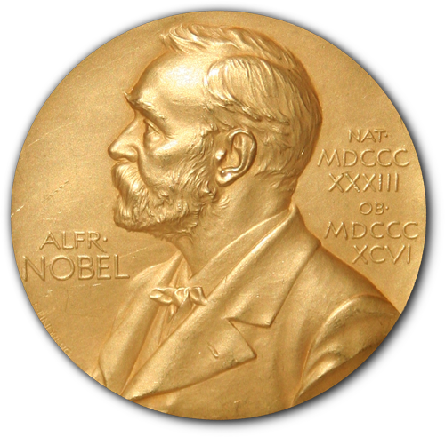
BTW
Herb Simon was a polymath who contributed to economics, cognitive science, management, computer science and many other fields
He was awarded a Nobel Prize in 1978 “for his pioneering research into the decision-making process within economic organizations”
He is the only computer scientist to have won a Nobel Prize

Slide 5
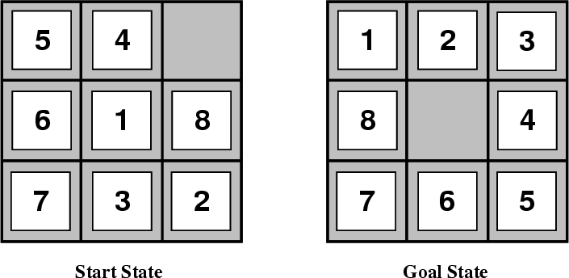
Example: 8-Puzzle
Given an initial configuration of 8 numbered tiles on a 3x3 board, move the tiles in such a way so as to produce a desired goal configuration of the tiles.

Slide 6
Simpler: 3-Puzzle
3
1
2
2
1
3

Slide 7
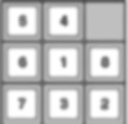
Building goal-based agents
We must answer the following questions
How do we represent the state of the “world”?
What is the goal and how can we recognize it
What are the possible actions?
What relevant information do we encoded to describe the state and available transitions, and solve the problem?
initial state
goal state

Slide 8
What is the goal to be achieved?
Can describe a situation we want to achieve, a set of properties that we want to hold, etc.
Requires defining a goal test, so we know what it means to have achieved/satisfied goal
A hard question, rarely tackled in AI; usually assume system designer or user specifies goal
Psychologists and motivational speakers stress importance of establishing clear goals as a first step towards solving a problem
What are your goals???

Slide 9
What are the actions?
Characterize primitive actions for making changes in the world to achieve a goal
Deterministic world: no uncertainty in an action’s effects (simple model)
Given action and description of current world state, action completely specifies
Whether action can be applied to the current world (i.e., is it applicable and legal?) and
What state results after action is performed in the current world (i.e., no need for history information to compute the next state)

Slide 10
Representing actions
Actions can be considered as discrete events that occur at an instant of time, e.g.:
If “In class” and perform action “go home,” then next state is “at home.” There’s no time where you’re neither in class nor at home (i.e., in the state of “going home”)
Number of actions/operators depends on the representation used in describing a state
8-puzzle: specify 4 possible moves for each of the 8 tiles, resulting in a total of 4*8=32 operators
Or, we could specify four moves for “blank” square and we only need 4 operators
Representational shift can simplify a problem!

Slide 11
Representing states
What information is necessary to describe all relevant aspects to solving the goal?
Size of a problem usually described in terms of possible number of states
Tic-Tac-Toe has about 3⁹ states (19,683≈2*10⁴)
Checkers has about 10⁴⁰ states
Rubik’s Cube has about 10¹⁹ states
Chess has about 10¹²⁰ states in a typical game
Go has 2*10¹⁷⁰
Theorem provers may deal with an infinite space
State space size ≈ solution difficulty

Slide 12
Representing states
State space size ≈ solution difficulty
Our estimates were loose upper bounds
How many legal states does tic-tac-toe really have?

Slide 13
Representing states
Our estimates were loose upper bounds
How many possible, legal states does tic-tac-toe really have?
Simple upper bound: nine board cells, each of which can be empty, O or X, so 3⁹
Only 593 states after eliminating
impossible states
Rotations and reflections
X
X
X
X

Slide 14
Closed World Assumption
We will generally use the Closed World Assumption
All necessary information about problem domain is available in each percept so each state is a complete description of the world
I.e., no incomplete information at any point in time

Slide 15
Some example problems
Toy problems and micro-worlds
8-Puzzle
Missionaries and Cannibals
Cryptarithmetic
Remove 5 Sticks
Water Jug Problem
Real-world problems

Slide 16
8-Puzzle
Given an initial configuration of 8 numbered tiles on a 3x3 board, move the tiles in such a way so as to produce a desired goal configuration of the tiles.
What are the states, goal test, actions?

Slide 17
8 puzzle
State: 3x3 array of the tiles on the board
Actions: Move blank square left, right, up or down
More efficient encoding than one with 4 possible moves for each of 8 distinct tiles
Initial State: A given board configuration
Goal: A given board configuration

Slide 18
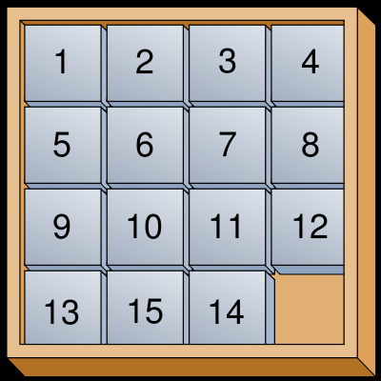
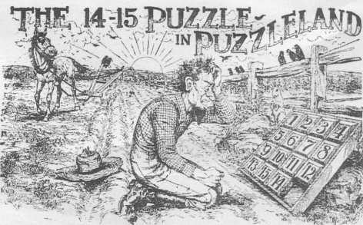
15 puzzle
Popularized, but not invented by, Sam Loyd
In late 1800s he offered $1000 to all who could find a solution
He sold many puzzles
Its states form two disjoint spaces
There was no path to the solution from his initial state!

Slide 19
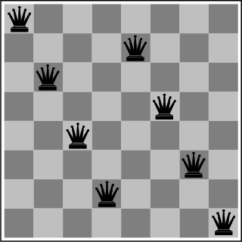
The 8-Queens Puzzle
Place eight queens on a chessboard such that no queen attacks any other
We can generalize the problem to a NxN chessboard
What are the states, goal test, actions?

Slide 20
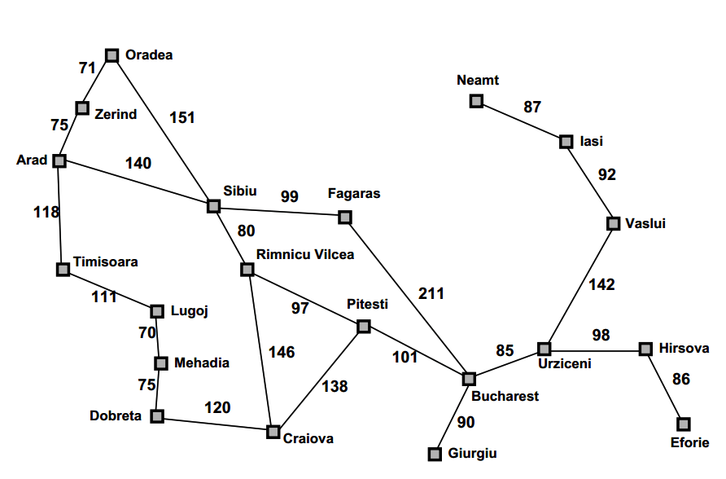
Route Planning
Find a route from Arad to Bucharest
A simplified map of major roads in Romania used in our text

Slide 21
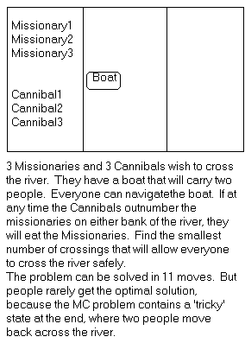
Missionaries and Cannibals
There are 3 missionaries, 3 canni-bals, and 1 boat that can carry up to two people on one side of a river
Goal: Move all the missionaries and cannibals across the river
Constraint: Missionaries can’t be out-numbered by cannibals on either side of river, or else the missionaries are killed
State: configuration of missionaries and cannibals and boat on each side of river
Operators: Move boat containing some set of occupants across the river (in either direction) to the other side
What are the states, goal test, actions?

Slide 22
Missionaries and Cannibals Solution
Near side Far side
0 Initial setup: MMMCCC B -
1 Two cannibals cross over: MMMC B CC
2 One comes back: MMMCC B C
3 Two cannibals go over again: MMM B CCC
4 One comes back: MMMC B CC
5 Two missionaries cross: MC B MMCC
6 A missionary & cannibal return: MMCC B MC
7 Two missionaries cross again: CC B MMMC
8 A cannibal returns: CCC B MMM
9 Two cannibals cross: C B MMMCC
10 One returns: CC B MMMC
11 And brings over the third: - B MMMCCC

Slide 23
Cryptarithmetic
Find an assignment of digits (0..9) to letters so that a given arithmetic expression is true. Examples: SEND + MORE = MONEY and
FORTY Solution: 29786
+ TEN 850
+ TEN 850
----- -----
SIXTY 31486
F=2, O=9, R=7, etc.
The solution is NOT a sequence of actions that transforms the initial state into the goal state
Solution is a node with an assignment of digits to each of the distinct letters in the given problem
What are the states, goal test, actions?

Slide 24
Remove 5 Sticks
Given this configuration of sticks, remove exactly five sticks so that the remaining ones form exactly three squares
Other tasks:
Remove 4 sticks and leave 4 squares
Remove 3 sticks and leave 4 squares
Remove 4 sticks and leave 3 squares

Slide 25
Some more real-world problems
Route finding
Touring (traveling salesman)
Logistics
VLSI layout
Robot navigation
Theorem proving
Learning

Slide 26
Knowledge representation issues
What’s in a state?
Is boat color relevant to solving the M&C problem? Is sunspot activity relevant to predicting the stock market? This a hard problem that’s usually left to a person.
The right level of abstraction to describe the world
Too fine-grained and we’ll “miss the forest for the trees.” Too coarse-grained and we’ll miss critical details for solving the problem.
Number of states depends on the representation and abstraction level. E.g., for Remove-5-Sticks
Represent individual sticks, there are 17-choose-5 possible ways of removing 5 sticks
Represent the “squares” defined by 4 sticks, there are 6 squares initially and we must remove 3 squares, so only 6-choose-3 ways of removing 3 squares

Slide 27
Example: Water Jug Problem
Two jugs J1 and J2 with capacity C1 and C2
Initially J1 has W1 water and J2 has W2 water
e.g.: a full 5 gallon jug and an empty 2 gallon jug
Possible actions:
Pour from jug X to jug Y until X empty or Y full
Empty jug X onto the floor
Goal: J1 has G1 water and J2 G2
G1 or G0 can be -1 to represent any amount
E.g.: initially full jugs with capacities 3 and 1 liters, goal is to have 1 liter in each

Slide 28
So…
How can we represent the states?
What an initial state
How do we recognize a goal state
What are the actions; how can we tell which ones can be performed in a given state; what is the resulting state
How do we search for a solution from an initial state given a goal state
What is a solution? The goal state achieved or a path to it?

Slide 29
Search in a state space
Basic idea:
Create representation of initial state
Try all possible actions & connect states that result
Recursively apply process to the new states until we find a solution or dead ends
We need to keep track of the connections between states and might use a
Tree data structure or
Graph data structure
A graph structure is best in general…

Slide 30
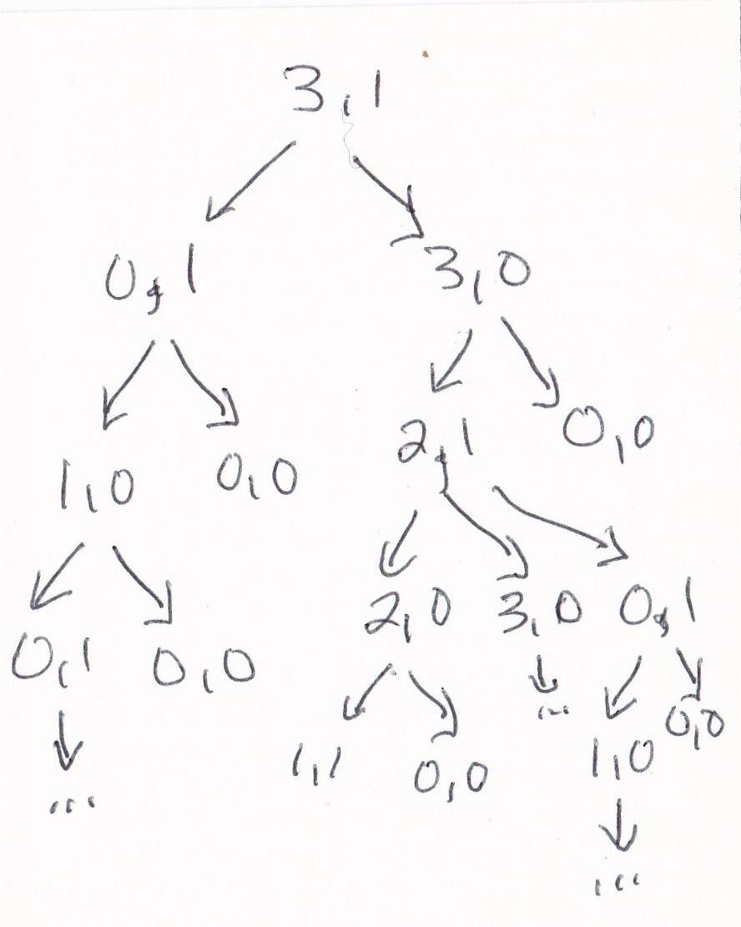
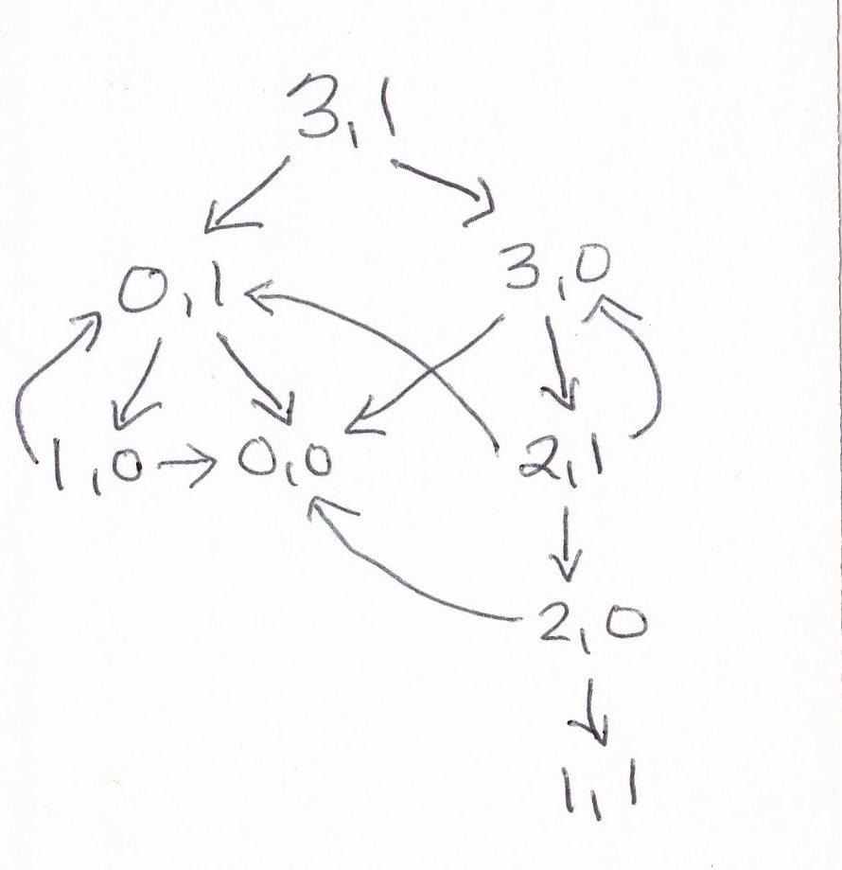
Search in a state space
Consider a water jug problem with a 3-liter and 1-liter jug, an initial state of (3,1) and a goal stage of (1,1)
Tree model of space
Graph model of space
graph model avoids redundancy and loops and is usually preferred

Slide 31
Formalizing search in a state space
A state space is a graph (V, E) where V is a set of nodes and E is a set of arcs, and each arc is directed from a node to another node
Nodes are data structures with a state des-cription and other info, e.g., node’s parent, name of action that generated it from parent, etc.
Arcs are instances of actions. When opera-tor is applied to state at its source node, then resulting state is arc’s destination node

Slide 32
Formalizing search in a state space
Each arc has fixed, positive cost associated with it corresponding to the operator cost
Simple case: all costs are 1
Each node has a set of successor nodes corresponding to all legal actions that can be applied at node’s state
Expanding a node = generating its successor nodes and adding them and their associated arcs to the graph
One or more nodes are marked as start nodes
A goal test predicate is applied to a state to determine if its associated node is a goal node

Slide 33
Example: Water Jug Problem
Two jugs J1 and J2 with capacity C1 and C2
Initially J1 has W1 water and J2 has W2 water
e.g.: a full 5 gallon jug and an empty 2 gallon jug
Possible actions:
Pour from jug X to jug Y until X empty or Y full
Empty jug X onto the floor
Goal: J1 has G1 water and J2 G2
G1 or G0 can be -1 to represent any amount

Slide 34
Example: Water Jug Problem
Given full 5 gallon jug and an empty 2 gallon jug, goal is to fill 2 gallon jug with exactly one gallon
State representation?
General state?
Initial state?
Goal state?
Possible actions?
Condition?
Resulting state?
Action table
Name | Cond. | Transition | Effect
Empty5 |  | (x,y)→(0,y) | Empty 5G jug
Empty2 |  | (x,y)→(x,0) | Empty 2G jug
2to5 | x ≤ 3 | (x,2)→(x+2,0) | Pour 2G into 5G
5to2 | x ≥ 2 | (x,0)→(x-2,2) | Pour 5G into 2G
5to2part | y < 2 | (1,y)→(0,y+1) | Pour partial 5G into 2G

Slide 35
Example: Water Jug Problem
Given full 5 gallon jug and an empty 2 gallon jug, goal is to fill 2 gallon jug with exactly one gallon
State = (x,y), where x is water in jug 1 and y is water in jug 2
Initial State = (5,0)
Goal State = (-1,1), where -1 means any amount
Action table
Name | Cond. | Transition | Effect
dump1 | x>0 | (x,y)→(0,y) | Empty Jug 1
dump2 | y>0 | (x,y)→(x,0) | Empty Jug 2
pour_1_2 | x>0 & y<C2 | (x,y)→(x-D,y+D) D = min(x,C2-y) | Pour from Jug 1 to Jug 2
pour_2_1 | y>0 & X<C1 | (x,y)→(x+D,y-D) D = min(y,C1-x) | Pour from Jug 2 to Jug 1

Slide 36
Water jug state space
5, 2
5, 1
5, 0
Empty5
4, 2
4, 1
4, 0
Empty2
3, 2
3, 1
3, 0
2to5
2, 2
2, 1
2, 0
5to2
1, 2
1, 1
1, 0
5to2part
0, 2
0, 1
0, 0

Slide 37
Water jug solution
5, 2
5, 1
5, 0
4, 2
4, 1
4, 0
3, 2
3, 1
3, 0
2, 2
2, 1
2, 0
1, 2
1, 1
1, 0
0, 2
0, 1
0, 0

Slide 38
Class Exercise
Representing a 2x2 Sudoku puzzle as a search space
Fill in the grid so that every row, every column, and every 2x2 box contains the digits 1 through 4
What are the states?
What are the actions?
What are the constraints on actions?
What is the description of the goal state?
 | 3
 |  |  | 1
3
 |  | 2

Slide 39
Formalizing search (3)
Solution: sequence of actions associated with a path from a start node to a goal node
Solution cost: sum of the arc costs on the solution path
If all arcs have same (unit) cost, then solution cost is just the length of solution (number of steps / state transitions)
Algorithms generally require that arc costs cannot be negative (why?)

Slide 40
Formalizing search (4)
State-space search: searching through state space for solution by making explicit a sufficient portion of an implicit state-space graph to find a goal node
Can’t materializing whole space for large problems
Initially V={S}, where S is the start node, E={}
On expanding S, its successor nodes are generated and added to V and associated arcs added to E
Process continues until a goal node is found
Nodes represent a partial solution path (+ cost of partial solution path) from S to the node
From a node there may be many possible paths (and thus solutions) with this partial path as a prefix

Slide 41
State-space search algorithm
;; problem describes the start state, operators, goal test, and operator costs
;; queueing-function is a comparator function that ranks two states
;; general-search returns either a goal node or failure
function general-search (problem, QUEUEING-FUNCTION)
nodes = MAKE-QUEUE(MAKE-NODE(problem.INITIAL-STATE))
loop
if EMPTY(nodes) then return "failure"
node = REMOVE-FRONT(nodes)
if problem.GOAL-TEST(node.STATE) succeeds
then return node
nodes = QUEUEING-FUNCTION(nodes, EXPAND(node,
problem.OPERATORS))
end
;; Note: The goal test is NOT done when nodes are generated
;; Note: This algorithm does not detect loops

Slide 42
Key procedures to be defined
EXPAND
Generate all successor nodes of a given node, adding them to the graph
GOAL-TEST
Test if state satisfies all goal conditions
QUEUEING-FUNCTION
Used to maintain a ranked list of nodes that are candidates for expansion

Slide 43
Bookkeeping
Typical node data structure includes:
State at this node
Parent node(s)
Action(s) applied to get to this node
Depth of this node (# of actions on shortest known path from initial state)
Cost of path (sum of action costs on best path from initialstate)

Slide 44
Some issues
Search process constructs a search tree/graph, where
root is initial state and
leaf nodes are nodes
not yet expanded (i.e., in list “nodes”) or
having no successors (i.e., they’re deadends because no operators were applicable and yet they are not goals)
Search tree may be infinite due to loops; even graph may be infinite for some problems
Solution is a path or a node, depending on problem.
E.g., in cryptarithmetic return a node; in 8-puzzle, a path
Changing definition of the QUEUEING-FUNCTION leads to different search strategies

Slide 45
Uninformed vs. informed search
Uninformed search strategies (blind search)
Use no information about likely “direction” of goal node(s)
Methods: breadth-first, depth-first, depth-limited, uniform-cost, depth-first iterative deepening, bidirectional
Informed search strategies (heuristic search)
Use information about domain to (try to) (usually) head in the general direction of goal node(s)
Methods: hill climbing, best-first, greedy search, beam search, algorithm A, algorithm A*
Notes:
Heuristic = “rule of athumb”

Slide 46
Evaluating search strategies
Completeness
Guarantees finding a solution whenever one exists
Time complexity (worst or average case)
Usually measured by number of nodes expanded
Space complexity
Usually measured by maximum size of graph/tree during the search
Optimality/Admissibility
If a solution is found, is it guaranteed to be an optimal one, i.e., one with minimum cost

Slide 47
Example of uninformed search strategies
S
3
8
1
A
B
C
3
15
7
20
5
D
E
G
Consider this search space where S is the start node and G is the goal. Numbers are arc costs.

Slide 48
Classic uninformed search methods
The four classic uninformed search methods
Breadth first search (BFS)
Depth first search (DFS)
Uniform cost search (generalization of BFS)
Iterative deepening (blend of DFS and BFS)
To which we can add another technique
Bi-directional search (hack on BFS)

Slide 49
Breadth-First Search
Enqueue nodes in FIFO (first-in, first-out) order
Complete
Optimal (i.e., admissible) finds shorted path, which is optimal if all operators have same cost
Exponential time and space complexity, O(b^{d}), where d is depth of solution and b is branching factor (i.e., # of children)
Takes a long time to find solutions with large number of steps because must look at all shorter length possibilities first

Slide 50
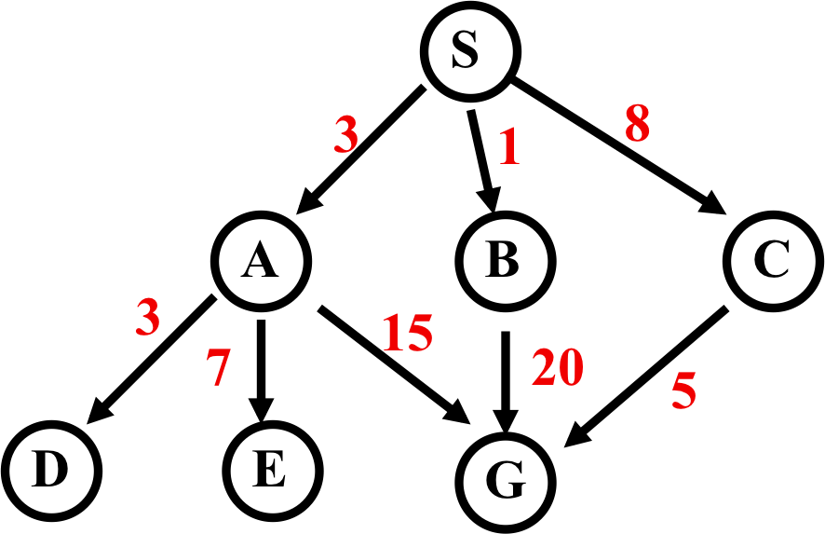
Breadth-First Search
weighted arcs
Expanded node Nodes list (aka Fringe)
{ S⁰ }
S⁰ { A³ B¹ C⁸ }
A³ { B¹ C⁸ D⁶ E¹⁰ G¹⁸ }
B¹ { C⁸ D⁶ E¹⁰ G¹⁸ G²¹ }
C⁸ { D⁶ E¹⁰ G¹⁸ G²¹ G¹³ }
D⁶ { E¹⁰ G¹⁸ G²¹ G¹³ }
E¹⁰ { G¹⁸ G²¹ G¹³ }
G¹⁸ { G²¹ G¹³ }
Note: we typically don’t check for goal until we expand node Solution path found is S A G , cost 18
Number of nodes expanded (including goal node) = 7
Notation
G¹⁸
G is node; 18 is cost of shortest known path from start node S

Slide 51
Breadth-First Search
Long time to find solutions with many steps: we must look at all shorter length possibilities first
Complete search tree of depth d where non-leaf nodes have b children has 1 + b + b² + ... + b^{d} = (b^{(d+1)} - 1)/(b-1) nodes = 0(b^{d})
Tree of depth 12 with branching 10 has more than a trillion nodes
If BFS expands 1000 nodes/sec and nodes uses 100 bytes, then it may take 35 years to run and uses 111 terabytes of memory!

Slide 52
Depth-First (DFS)
Enqueue nodes on nodes in LIFO (last-in, first-out) order, i.e., use stack data structure to order nodes
May not terminate w/o depth bound, i.e., ending search below fixed depth D (depth-limited search)
Not complete (with or w/o cycle detection, with or w/o a cutoff depth)
Exponential time, O(b^{d}), but linear space, O(bd)
Can find long solutions quickly if lucky (and short solutions slowly if unlucky!)
On reaching deadend, can only back up one level at a time even if problem occurs because of a bad choice at top of tree

Slide 53
Depth-First Search
Expanded node Nodes list
{ S⁰ }
S⁰ { A³ B¹ C⁸ }
A³ { D⁶ E¹⁰ G¹⁸ B¹ C⁸ }
D⁶ { E¹⁰ G¹⁸ B¹ C⁸ }
E¹⁰ { G¹⁸ B¹ C⁸ }
G¹⁸ { B¹ C⁸ }
Solution path found is S A G, cost 18
Number of nodes expanded (including goal node) = 5

Slide 54
Uniform-Cost Search (UCS)
Enqueue nodes by path cost. i.e., let g(n) = cost of path from start to current node n. Sort nodes by increasing value of g(n).
Also called Dijkstra’s Algorithm, similar to Branch and Bound Algorithm from operations research
Complete (*)
Optimal/Admissible (*)
Depends on goal test being applied when node is removed from nodes list, not when its parent node is expanded & node first generated
Exponential time and space complexity, O(b^{d})

Slide 55
Uniform-Cost Search
Expanded node Nodes list
{ S⁰ }
S⁰ { B¹ A³ C⁸ }
B¹ { A³ C⁸ G²¹ }
A³ { D⁶ C⁸ E¹⁰ G¹⁸ G²¹ }
D⁶ { C⁸ E¹⁰ G¹⁸ G²¹ }
C⁸ { E¹⁰ G¹³ G¹⁸ G²¹ }
E¹⁰ { G¹³ G¹⁸ G²¹ }
G¹³ { G¹⁸ G²¹ }
Solution path found is S C G, cost 13
Number of nodes expanded (including goal node) = 7

Slide 56
Depth-First Iterative Deepening (DFID)
Do DFS to depth 0, then (if no solution) DFS to depth 1, etc.
Usually used with a tree search
Complete
Optimal/Admissible if all operators have unit cost, else finds shortest solution (like BFS)
Time complexity a bit worse than BFS or DFS
Nodes near top of search tree generated many times, but since almost all nodes are near tree bottom, worst case time complexity still exponential, O(b^{d})

Slide 57
Depth-First Iterative Deepening (DFID)
If branching factor is b and solution is at depth d, then nodes at depth d are generated once, nodes at depth d-1 are generated twice, etc.
Hence b^{d} + 2b^{(d-1)} + ... + db <= b^{d} / (1 - 1/b)² = O(b^{d}).
If b=4, worst case is 1.78 * 4^{d}, i.e., 78% more nodes searched than exist at depth d (in worst case)
Linear space complexity, O(bd), like DFS
Has advantages of BFS (completeness) and DFS (i.e., limited space, finds longer paths quickly)
Preferred for large state spaces where solution depth is unknown

Slide 58
How they perform
Depth-First Search:
4 Expanded nodes: S A D E G
Solution found: S A G (cost 18)
Breadth-First Search:
7 Expanded nodes: S A B C D E G
Solution found: S A G (cost 18)
Uniform-Cost Search:
7 Expanded nodes: S A D B C E G
Solution found: S C G (cost 13)
Only uninformed search that worries about costs
Iterative-Deepening Search:
10 nodes expanded: S S A B C S A D E G
Solution found: S A G (cost 18)

Slide 59
Searching Backward from Goal
Usually a successor function is reversible
i.e., can generate a node’s predecessors in graph
If we know a single goal (rather than a goal’s properties), we could search backward to the initial state
It might be more efficient
Depends on whether the graph fans in or out

Slide 60
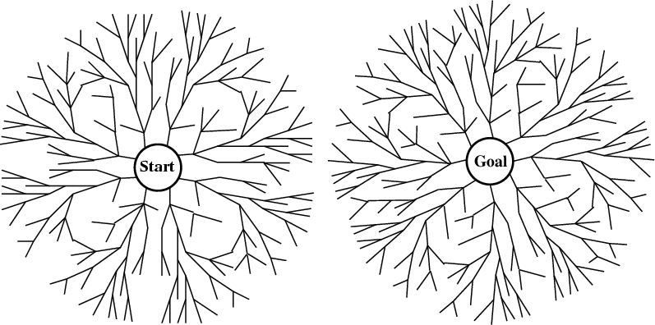
Bi-directional search
Alternate searching from the start state toward the goal and from the goal state toward the start
Stop when the frontiers intersect
Works well only when there are unique start & goal states
Requires ability to generate “predecessor” states
Can (sometimes) lead to finding a solution more quickly

Slide 61
Comparing Search Strategies

Slide 62
Some simple improvements
In increasing order of effectiveness w.r.t. reducing state space size and with increasing computational costs:
1. Never return to state you just came from
2. Never create paths with cycles in them
3. Never generate a state that was ever created before
Net effect depends on frequency of loops in state space

Slide 63
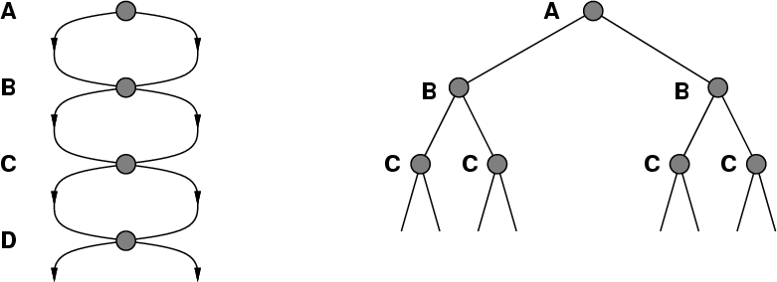
A State Space that Generates an Exponentially Growing Search Space

Slide 64
Holy Grail Search
Expanded node Nodes list
{ S⁰ }
S⁰ {C⁸ A³ B¹ }
C⁸ { G¹³ A³ B¹ }
G¹³ { A³ B¹ }
Solution path found is S C G, cost 13 (optimal)
Number of nodes expanded (including goal node) = 3 (as few as possible!)
If only we knew where we were headed…

