Slide 1
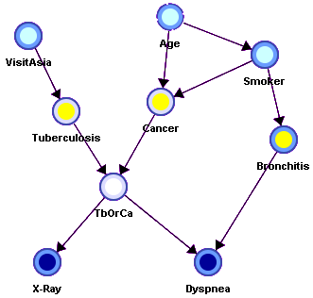
Reasoning with Bayesian Belief Networks

Slide 2
Overview
Bayesian Belief Networks (BBNs) can reason with networks of propositions and associated probabilities
Useful for many AI problems
Diagnosis
Expert systems
Planning
Learning

Slide 3
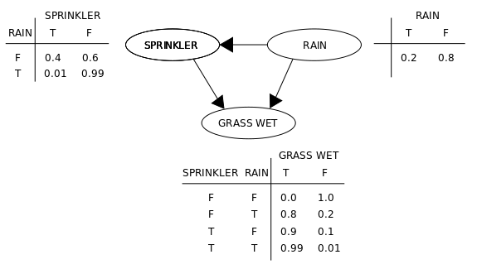
BBN Definition
AKA Bayesian Network, Bayes Net
A graphical model (as a DAG) of probabilistic relationships among a set of random variables
Links represent direct influence of one variable on another
source

Slide 4
Recall Bayes Rule
Note symmetry: can compute probability of a hypothesis given its evidence as well as probability of evidence given hypothesis

Slide 5
Simple Bayesian Network
Smoking
Cancer
P(
S=no)
0.80
P(
S=light)
0.15
P(
S=heavy)
0.05
Smoking=
no
light
heavy
P(
C=none)
0.96
0.88
0.60
P(
C=benign)
0.03
0.08
0.25
P(
C=malig)
0.01
0.04
0.15

Slide 6
More Complex Bayesian Network
Age
Gender
Exposure
to Toxics
Smoking
Cancer
Serum
Calcium
Lung
Tumor

Slide 7
More Complex Bayesian Network
Nodes
represent
variables
Age
Gender
Exposure
to Toxics
Smoking
Does gender cause smoking?
Influence might be a more appropriate term
Links represent
“causal” relations
Cancer
Serum
Calcium
Lung
Tumor

Slide 8
More Complex Bayesian Network
predispositions
Age
Gender
Exposure
to Toxics
Smoking
Cancer
Serum
Calcium
Lung
Tumor

Slide 9
More Complex Bayesian Network
Age
Gender
Exposure
to Toxics
Smoking
condition
Cancer
Serum
Calcium
Lung
Tumor

Slide 10
More Complex Bayesian Network
Age
Gender
Exposure
to Toxics
Smoking
Cancer
observable symptoms
Serum
Calcium
Lung
Tumor

Slide 11
Independence
Age and Gender are
independent.
Age
Gender
P(A,G) = P(G) * P(A)
P(A |G) = P(A)
P(G |A) = P(G)
P(A,G) = P(G|A) P(A) = P(G)P(A)
P(A,G) = P(A|G) P(G) = P(A)P(G)

Slide 12
Conditional Independence
Cancer is independent of Age and Gender given Smoking
Age
Gender
Smoking
P(C | A,G,S) = P(C | S)
Cancer

Slide 13
Conditional Independence: Naïve Bayes
Serum Calcium and Lung Tumor are dependent
Cancer
Serum Calcium is indepen-dent of Lung Tumor, given Cancer
Serum
Calcium
Lung
Tumor
P(L | SC,C) = P(L|C)
P(SC | L,C) = P(SC|C)
Naïve Bayes assumption: evidence (e.g., symptoms) independent given disease; easy to combine evidence
Notes:
Serum calcium is a blood test to measure the amount of calcium in the blood
Elevated levels of calcium in the blood is associated with some cancers.

Slide 14
Explaining Away
Exposure to Toxics and Smoking are independent
Exposure
to Toxics
Smoking
Exposure to Toxics is dependent on Smoking, given Cancer
Cancer
P(E=heavy | C=malignant) > P(E=heavy | C=malignant, S=heavy)
Explaining away: reasoning pattern where confirma-tion of one cause reduces need to invoke alternatives
Essence of Occam’s Razor (prefer hypothesis with fewest assumptions)
Relies on independence of causes
Notes:
Occam’s Razor : among competing hypotheses, the one with the fewest assumptions should be selected

Slide 15
Conditional Independence
A variable (node) is conditionally independent of its non-descendants given its parents
Age
Gender
Non-Descendants
Exposure
to Toxics
Smoking
Parents
Cancer is independent of Age and Gender given Exposure to Toxics and Smoking.
Cancer
Serum
Calcium
Lung
Tumor
Descendants

Slide 16
Another non-descendant
A variable is conditionally independent of its non-descendants given its parents
Age
Gender
Exposure
to Toxics
Smoking
Diet
Cancer
Cancer is independent of Diet given Exposure to Toxics and Smoking
Serum
Calcium
Lung
Tumor

Slide 17
BBN Construction
The knowledge acquisition process for a BBN involves three steps
KA1: Choosing appropriate variables
KA2: Deciding on the network structure
KA3: Obtaining data for the conditional probability tables

Slide 18
KA1: Choosing variables
Variable values can be integers, reals or enumerations
Variable should have collectively exhaustive, mutually exclusive values
Error Occurred
No Error
They should be values, not probabilities
Risk of Smoking
Smoking

Slide 19
Heuristic: Knowable in Principle
Example of good variables
Weather: {Sunny, Cloudy, Rain, Snow}
Gasoline: Cents per gallon {0,1,2…}
Temperature: { ≥ 100°F , < 100°F}
User needs help on Excel Charts: {Yes, No}
User’s personality: {dominant, submissive}

Slide 20
KA2: Structuring
Age
Gender
Network structure corresponding
to “causality” is usually good.
Exposure
to Toxic
Smoking
Cancer
Genetic
Damage
Initially this uses the designer’s
knowledge but can be checked with data
Lung
Tumor

Slide 21
KA3: The Numbers
For each variable we have a table of probability of its value for values of its parents
For variables w/o parents, we have prior probabilities
Smoking
Cancer
 | smoking
cancer | no | light | heavy
none | 0.96 | 0.88 | 0.60
benign | 0.03 | 0.08 | 0.25
malignant | 0.01 | 0.04 | 0.15
smoking priors
no | 0.80
light | 0.15
heavy | 0.05

Slide 22
KA3: The numbers
Second decimal usually doesn’t matter
Relative probabilities are important
Zeros and ones are often enough
Order of magnitude is typical: 10⁻⁹ vs 10⁻⁶
Sensitivity analysis can be used to decide accuracy needed

Slide 23
Three kinds of reasoning
BBNs support three main kinds of reasoning:
Predicting conditions given predispositions
Diagnosing conditions given symptoms (and predisposing)
Explaining a condition by one or more predispositions
To which we can add a fourth:
Deciding on an action based on probabilities of the conditions

Slide 24
Predictive Inference
Age
Gender
How likely are elderly males
to get malignant cancer?
Exposure
to Toxics
Smoking
Cancer
P(C=malignant | Age>60, Gender=male)
Serum
Calcium
Lung
Tumor

Slide 25
Predictive and diagnostic combined
Age
Gender
How likely is an elderly male patient with high Serum Calcium to have malignant cancer?
Exposure
to Toxics
Smoking
Cancer
P(C=malignant | Age>60,
Gender= male, Serum Calcium = high)
Serum
Calcium
Lung
Tumor

Slide 26
Explaining away
Age
Gender
If we see a lung tumor, the probability of heavy smoking and of exposure to toxics both go up
Exposure
to Toxics
Smoking
Smoking
Cancer
If we then observe heavy smoking, the probability of exposure to toxics goes back down
Serum
Calcium
Lung
Tumor

Slide 27
Decision making
A decision is a medical domain might be a choice of treatment (e.g., radiation or chemotherapy)
Decisions should be made to maximize expected utility
View decision making in terms of
Beliefs/Uncertainties
Alternatives/Decisions
Objectives/Utilities

Slide 28
A Decision Problem
Should I have my party inside or outside?
dry
Regret
in
wet
Relieved
dry
Perfect!
out
wet
Disaster

Slide 29
Value Function
A numerical score over all possible states allows a BBN to be used to make decisions

Slide 30
Two software tools
Netica: Windows app for working with Bayes-ian belief networks and influence diagrams
A commercial product, free for small networks
Includes graphical editor, compiler, inference engine, etc.
Hugin: free demo version for linux, mac, windows
Samiam: Java system for modeling and reasoning with Bayesian networks
Includes a GUI and reasoning engine

Slide 31
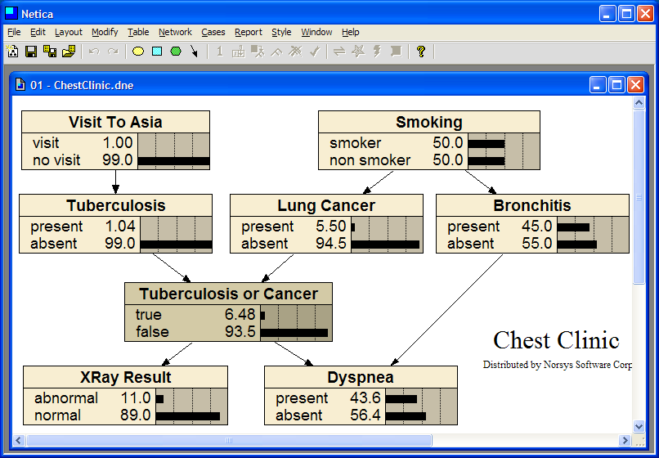
Notes:
Dyspnea is medical term for difficult or labored breathing.

Slide 32
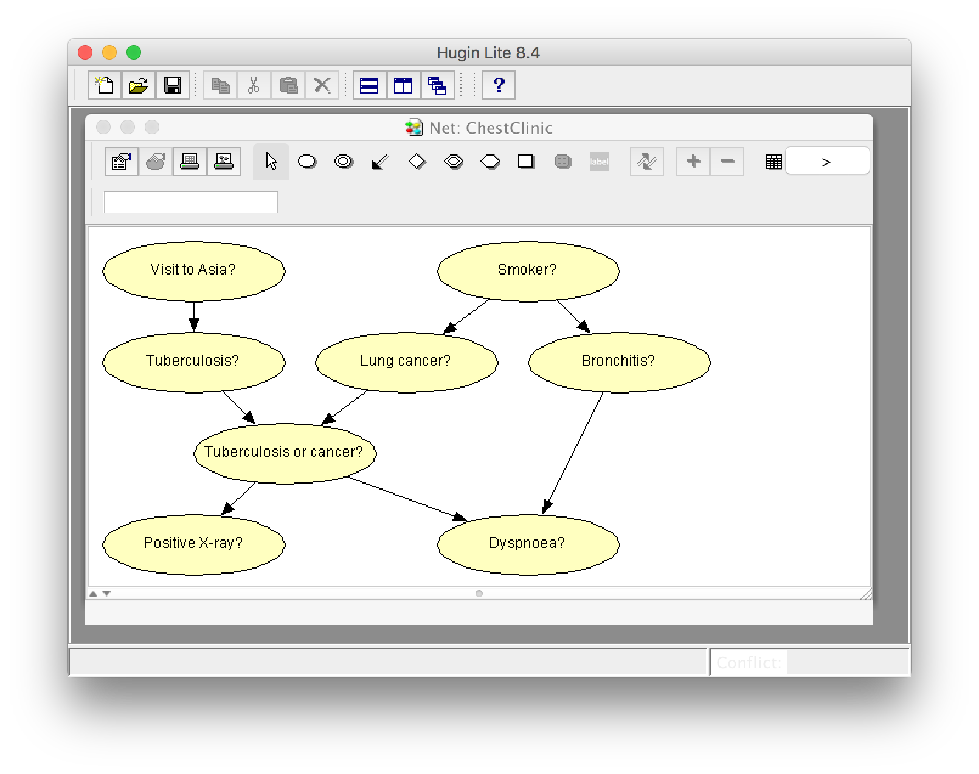
Same BBN model in Hugin app
Notes:
Dyspnoea is also a medical term for difficult or labored breathing.

Slide 33
Predispositions or causes

Slide 34
Conditions or diseases

Slide 35
Functional Node

Slide 36
Symptoms or effects
Dyspnea is shortness of breath

Slide 37
Decision Making with BBNs
Today’s weather forecast might be either sunny, cloudy or rainy
Should you take an umbrella when you leave?
Your decision depends only on the forecast
The forecast “depends on” the actual weather
Your satisfaction depends on your decision and the weather
Assign a utility to each of four situations: (rain|no rain) x (umbrella, no umbrella)

Slide 38
Decision Making with BBNs
Extend BBN framework to include two new kinds of nodes: decision and utility
Decision node computes the expected utility of a decision given its parent(s) (e.g., forecast) and a valuation
Utility node computes utility value given its parents, e.g. a decision and weather
Assign utility to each situations: (rain|no rain) x (umbrella, no umbrella)
Utility value assigned to each is probably subjective

Slide 39
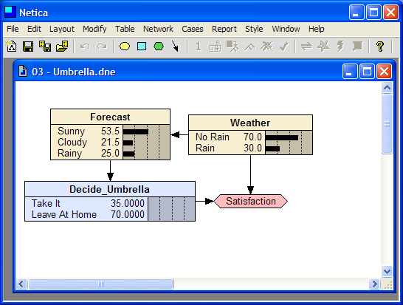

Slide 40
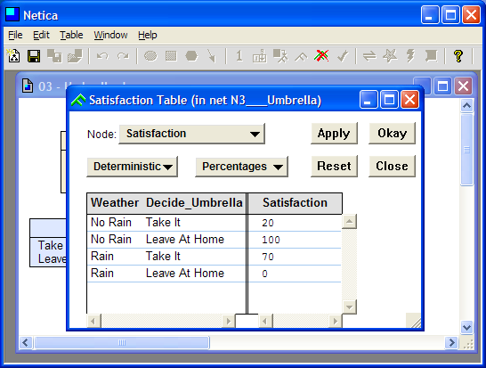

Slide 41
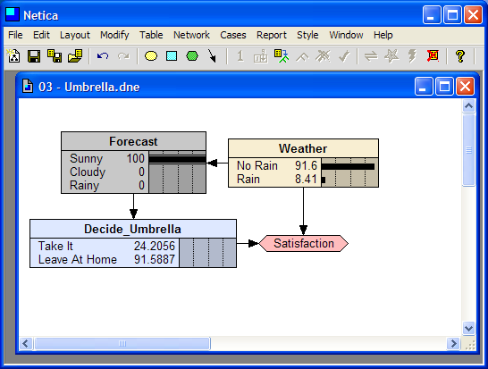

Slide 42
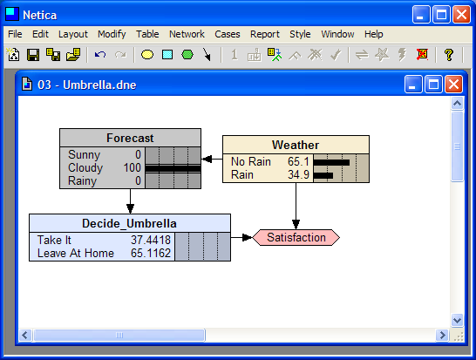

Slide 43
