Slide 1
Logical Inference 2 Rule-based reasoning
Chapter 9
Some material adopted from notes by Andreas Geyer-Schulz,, Chuck Dyer, and Mary Getoor

Slide 2
Automated inference for FOL
Automated inference for FOL is harder than PL
Variables can potentially take on an infinite number of possible values from their domains
Hence there are potentially an infinite number of ways to apply the Universal Elimination rule
Godel's Completeness Theorem says that FOL entailment is only semi-decidable
If a sentence is true given a set of axioms, there is a procedure that will determine this
If the sentence is false, there’s no guarantee a proce-dure will ever determine this — it may never halt

Slide 3
Generalized Modus Ponens
Modus Ponens
P, P=>Q |= Q
Generalized Modus Ponens (GMP) extends this to rules in FOL
Combines And-Introduction, Universal-Elimina-tion, and Modus Ponens, e.g.
from P(c) and Q(c) and ∀x P(x)∧Q(x) → R(x) derive R(c)
Must deal with
more than one condition on left side of rule
variables

Slide 4
Generalized Modus Ponens
General case: Given
atomic sentences P₁, P₂, ..., P_{N}
implication sentence (Q₁ ∧ Q₂ ∧ ... ∧ Q_{N}) → R
Q₁, ..., Q_{N} and R are atomic sentences
substitution subst(θ, P_{i}) = subst(θ, Q_{i}) for i=1,...,N
Derive new sentence: subst(θ, R)
Substitutions
subst(θ, α) denotes the result of applying a set of substitutions defined by θ to the sentence α
A substitution list θ = {v₁/t₁, v₂/t₂, ..., v_{n}/t_{n}} means to replace all occurrences of variable symbol v_{i} by term t_{i}
Substitutions made in left-to-right order in the list
subst({x/Cheese, y/Mickey}, eats(y,x)) = eats(Mickey, Cheese)

Slide 5
Our rules are Horn clauses
A Horn clause is a sentence of the form:
P₁(x) ∧ P₂(x) ∧ ... ∧ P_{n}(x) → Q(x)
where
≥ 0 P_{i}s and 0 or 1 Q
P_{i}s and Q are positive (i.e., non-negated) literals
Equivalently: P₁(x) ∨ P₂(x) … ∨ P_{n}(x) where the P_{i} are all atomic and at most one is positive
Prolog is based on Horn clauses
Horn clauses represent a subset of the set of sentences representable in FOL

Slide 6
Horn clauses II
Special cases
Typical rule: P₁ ∧ P₂ ∧ … P_{n} → Q
Constraint: P₁ ∧ P₂ ∧ … P_{n} → false
A fact: true → Q
These are not Horn clauses:
dead(x) ∨ alive(x)
married(x, y) → loves(x, y) ∨ hates(x, y)
¬likes(john, mary)
¬likes(x, y) → hates(x, y)
Can’t assert or conclude disjunctions, no negation
No wonder reasoning over Horn clauses is easier

Slide 7
Horn clauses III
Where are the quantifiers?
Variables in conclusion are universally quantified
Variables only in premises are existentially quantified
Examples:
parent(P,X) → isParent(P) ∀P ∃X parent(P,X) → isParent(P)
parent(P1, X) ∧ parent(X, P2) → grandParent(P1, P2) ∀P1,P2 ∃X parent(P1,X) ∧ parent(X, P2) → grandParent(P1, P2)
Prolog: grandParent(P1,P2) :- parent(P1,X), parent(X,P2)

Slide 8
Forward & Backward Reasoning
We usually talk about two reasoning strategies: forward and backward ‘chaining’
Both are equally powerful
You can also have a mixed strategy

Slide 9
Forward chaining
Proofs start with the given axioms/premises in KB, deriving new sentences using GMP until the goal/query sentence is derived
This defines a forward-chaining inference procedure because it moves “forward” from the KB to the goal [eventually]
Inference using GMP is sound and complete for KBs containing only Horn clauses

Slide 10
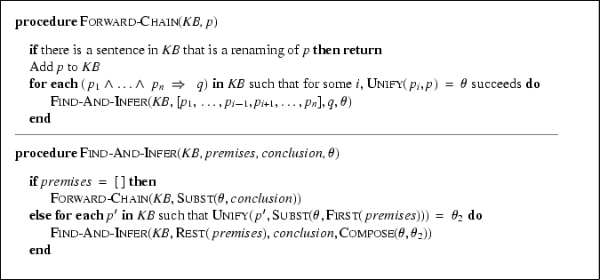
Forward chaining algorithm

Slide 11
Forward chaining example
KB:
allergies(X) → sneeze(X)
cat(Y) ∧ allergicToCats(X) → allergies(X)
cat(felix)
allergicToCats(mary)
Goal:
sneeze(mary)

Slide 12
Backward chaining
Backward-chaining deduction using GMP is also complete for KBs containing only Horn clauses
Proofs start with the goal query, find rules with that conclusion, and then prove each of the antecedents in the implication
Keep going until you reach premises
Avoid loops: check if new subgoal is already on the goal stack
Avoid repeated work: check if new subgoal
Has already been proved true
Has already failed

Slide 13
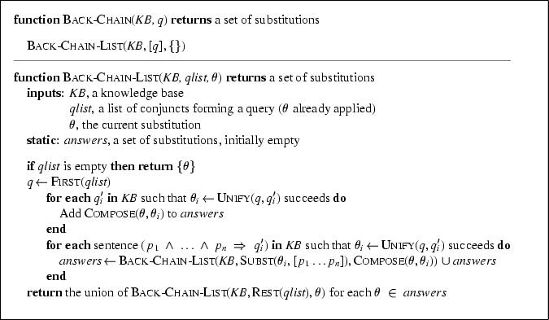
Backward chaining algorithm

Slide 14
Backward chaining example
KB:
allergies(X) → sneeze(X)
cat(Y) ∧ allergicToCats(X) → allergies(X)
cat(felix)
allergicToCats(mary)
Goal:
sneeze(mary)

Slide 15
Forward vs. backward chaining
Forward chaining is data-driven
Automatic, unconscious processing, e.g., object recognition, routine decisions
May do lots of work that is irrelevant to the goal
Efficient when you want to compute all conclusions
Backward chaining is goal-driven, better for problem-solving and query answering
Where are my keys? How do I get to my next class?
Complexity of BC can be much less than linear in the size of the KB
Efficient when you want one or a few decisions
Good where the underlying facts are changing

Slide 16
Mixed strategy
Many practical reasoning systems do both forward and backward chaining
The way you encode a rule determines how it is used, as in
% this is a forward chaining rule
spouse(X,Y) => spouse(Y,X).
% this is a backward chaining rule
wife(X,Y) <= spouse(X,Y), female(X).
Given a model of the rules you have and the kind of reason you need to do, it’s possible to decide which to encode as FC and which as BC rules.

Slide 17
Completeness of GMP
GMP (using forward or backward chaining) is complete for KBs that contain only Horn clauses
not complete for simple KBs with non-Horn clauses
What is entailed by the following sentences:
(∀x) P(x) → Q(x)
(∀x) ¬P(x) → R(x)
(∀x) Q(x) → S(x)
(∀x) R(x) → S(x)

Slide 18
Completeness of GMP
The following entail that S(A) is true:
(∀x) P(x) → Q(x)
(∀x) ¬P(x) → R(x)
(∀x) Q(x) → S(x)
(∀x) R(x) → S(x)
If we want to conclude S(A), with GMP we cannot, since the second one is not a Horn clause
It is equivalent to P(x) ∨ R(x)

Slide 19
How about in Prolog?
Try encoding this in Prolog
q(X) :- p(X).
r(X) :- neg(p(X)).
s(X) :- q(X).
s(X) :- r(X).
We should not use \+ or not (in SWI) for negation since it means “negation as failure”
Prolog explores possible proofs independently
It can’t take a larger view and realize that one branch must be true since p(x) ∨ ~p(x) is always true
(∀x) P(x) → Q(x)
(∀x) ¬P(x) → R(x)
(∀x) Q(x) → S(x)
(∀x) R(x) → S(x)

