Slide 1
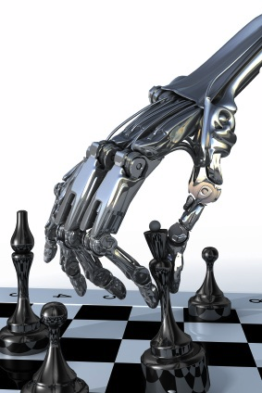
Adversarial Search Aka Games
Chapter 6
Some material adopted from notes by Charles R. Dyer, University of Wisconsin-Madison

Slide 2
Overview
Game playing
State of the art and resources
Framework
Game trees
Minimax
Alpha-beta pruning
Adding randomness

Slide 3
Why study games?
Interesting, hard problems that require minimal “initial structure”
Clear criteria for success
A way to study problems involving {hostile, adversarial, competing} agents and the uncertainty of interacting with the natural world
People have used them to asses their intelligence
Fun, good, easy to understand, PR potential
Games often define very large search spaces
chess 35¹⁰⁰ nodes in search tree, 10⁴⁰ legal states

Slide 4
State of the art
Chess:
Deep Blue beat Gary Kasparov in 1997
Garry Kasparav vs. Deep Junior (Feb 2003): tie!
Kasparov vs. X3D Fritz (November 2003): tie!
Checkers: Chinook is the world champion
Checkers: has been solved exactly – it’s a draw!
Go: Computers starting to achieve expert level
Bridge: Expert computer players exist, but no world champions yet
Poker: Poki regularly beats human experts
Check out the U. Alberta Games Group

Slide 5
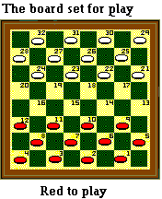
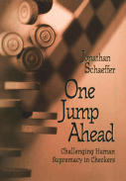
Chinook
Chinook is the World Man-Machine Checkers Champion, developed by researchers at the University of Alberta
It earned this title by competing in human tournaments, winning the right to play for the (human) world championship, and eventually defeating the best players in the world
Play Chinook online
One Jump Ahead: Challenging Human Supremacy in Checkers, Jonathan Schaeffer, 1998
See Checkers Is Solved, J. Schaeffer, et al., Science, v317, n5844, pp1518-22, AAAS, 2007.

Slide 6
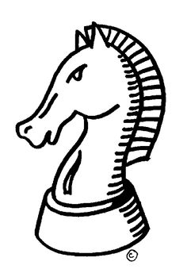
Chess early days
1948: Norbert Wiener’s Cybernetics describes how a chess program could be developed using a depth-limited minimax search with an evaluation function
1950: Claude Shannon publishes Programming a Computer for Playing Chess
1951: Alan Turing develops on paper the first program capable of playing a full game of chess
1962: Kotok and McCarthy (MIT) develop first program to play credibly
1967: Mac Hack Six, by Richard Greenblatt et al. (MIT) defeats a person in regular tournament play

Slide 7
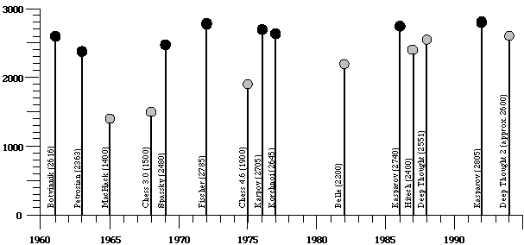
Ratings of human & computer chess champions

Slide 8
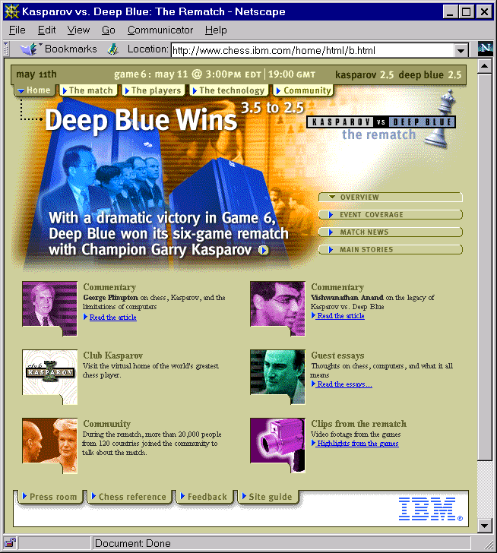
1997

Slide 9
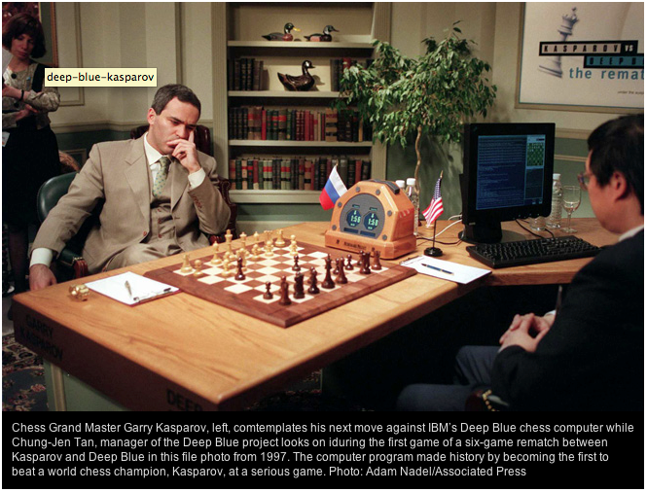
1997

Slide 10
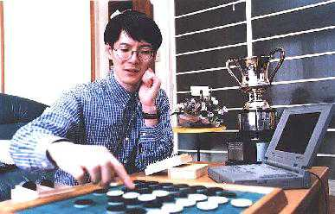
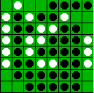
Othello: Murakami vs. Logistello
open sourced
Takeshi Murakami
World Othello Champion
1997: The Logistello software crushed Murakami, 6 to 0
Humans can not win against it
Othello, with 10²⁸ states, is still not solved

Slide 11
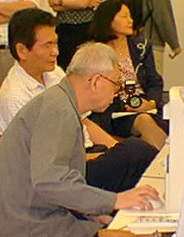
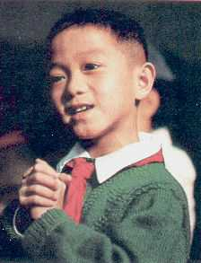
Go: Goemate vs. a young player
Name: Chen Zhixing
Profession: Retired
Computer skills:
self-taught programmer
Author of Goemate (arguably the best Go program available today)
Gave Goemate a 9 stone
handicap and still easily
beat the program,
thereby winning $15,000
Jonathan Schaeffer

Slide 12
Go: Goemate vs. ??
Name: Chen Zhixing
Profession: Retired
Computer skills:
self-taught programmer
Author of Goemate (arguably the strongest Go programs)
Go has too high a branching factor for existing search techniques
Current and future software must rely on huge databases and pattern-recognition techniques
Gave Goemate a 9 stone
handicap and still easily
beat the program,
thereby winning $15,000
Jonathan Schaeffer

Slide 13
How can we do it?

Slide 14
Typical simple case for a game
2-person game
Players alternate moves
Zero-sum: one player’s loss is the other’s gain
Perfect information: both players have access to complete information about state of game. No information hidden from either player.
No chance (e.g., using dice) involved
Examples: Tic-Tac-Toe, Checkers, Chess, Go, Nim, Othello
But not: Bridge, Solitaire, Backgammon, Poker, Rock-Paper-Scissors, ...

Slide 15
Can we use …
Uninformed search?
Heuristic search?
Local search?
Constraint based search?

Slide 16
How to play a game
A way to play such a game is to:
Consider all the legal moves you can make
Compute new position resulting from each move
Evaluate each to determine which is best
Make that move
Wait for your opponent to move and repeat
Key problems are:
Representing the “board” (i.e., game state)
Generating all legal next boards
Evaluating a position

Slide 17
Evaluation function
Evaluation function or static evaluator used to evaluate the “goodness” of a game position
Contrast with heuristic search where evaluation function is non-negative estimate of cost from start node to goal passing through given node
Zero-sum assumption permits single function to describe goodness of board for both players
f(n) >> 0: position n good for me; bad for you
f(n) << 0: position n bad for me; good for you
f(n) near 0: position n is a neutral position
f(n) = +infinity: win for me
f(n) = -infinity: win for you

Slide 18
Evaluation function examples
For Tic-Tac-Toe
f(n) = [# my open 3lengths] - [# your open 3lengths]
Where 3length is complete row, column, or diagonal
Alan Turing’s function for chess
f(n) = w(n)/b(n) where w(n) = sum of the point value of white’s pieces and b(n) = sum of black’s
Traditional piece values are -- Pawn:1; Knight, bishop: 3; Rook: 5; Queen: 9

Slide 19
Evaluation function examples
Most evaluation functions specified as a weighted sum of positive features
f(n) = w₁*feat₁(n) + w₂*feat₂(n) + ... + w_{n}*feat_{k}(n)
Example features for chess are piece count, piece values, piece placement, squares controlled, etc.
IBM’s chess program Deep Blue had >8K features in its evaluation function

Slide 20
That’s not how people play
People use look ahead
i.e., enumerate actions, consider opponent’s possible responses, REPEAT
Producing a complete game tree is only possible for simple games
So, generate a partial game tree for some number of plys
Move = each player takes a turn
Ply = one player’s turn
What do we do with the game tree?

Slide 21
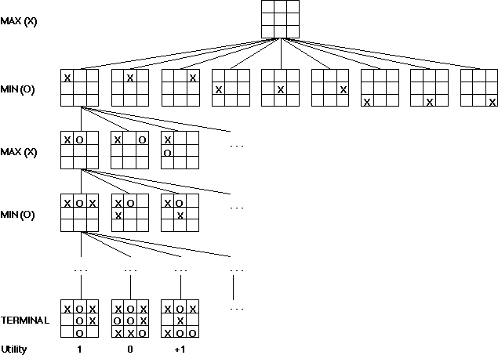
We can easily imagine generating a complete game tree for Tic-Tac-Toe
Taking board symmet-ries into account, there are 138 terminal positions
91 wins for X, 44 for O and 3 draws

Slide 22
Game trees
Problem spaces for typical games are trees
Root node is current board configuration; player must decide best single move to make next
Static evaluator function rates board position f(board):real, >0 for me; <0 for opponent
Arcs represent possible legal moves for a player
If my turn to move, then root is labeled a "MAX" node; otherwise it’s a "MIN" node
Each tree level’s nodes are all MAX or all MIN; nodes at level i are of opposite kind from those at level i+1

Slide 23
Game Tree for Tic-Tac-Toe
MAX nodes
MAX’s play →
MIN nodes
MIN’s play →
Here, symmetries are used to reduce branching factor
Terminal state (win for MAX) →

Slide 24
Minimax procedure
Create MAX node with current board configuration
Expand nodes to some depth (a.k.a. ply) of lookahead in game
Apply evaluation function at each leaf node
Back up values for each non-leaf node until value is computed for the root node
At MIN nodes, backed-up value is minimum of values associated with its children.
At MAX nodes, backed-up value is maximum of values associated with its children.
Pick operator associated with child node whose backed-up value determined value at the root

Slide 25
Minimax theorem
Intuition: assume your opponent is at least as smart as you and play accordingly
If she’s not, you can only do better!
Von Neumann, J: Zur Theorie der Gesellschafts-spiele Math. Annalen. 100 (1928) 295-320
For every 2-person, 0-sum game with finite strategies, there is a value V and a mixed strategy for each player, such that (a) given player 2's strategy, the best payoff possible for player 1 is V, and (b) given player 1's strategy, the best payoff possible for player 2 is –V.
You can think of this as:
Minimizing your maximum possible loss
Maximizing your minimum possible gain

Slide 26
Minimax Algorithm
2
2
1
2
1
2
7
1
8
2
7
1
8
2
7
1
8
This is the move
selected by minimax
2
Static evaluator
value
2
1
MAX
MIN
2
7
1
8

Slide 27
Partial Game Tree for Tic-Tac-Toe
f(n)=+1 if position a win for X
f(n)=-1 if position a win for O
f(n)=0 if position a draw

Slide 28
Why use backed-up values?
Intuition: if evaluation function is good, doing look ahead and backing up values with Minimax should be better
Non-leaf node N’s backed-up value is value of best state that MAX can reach at depth h if MIN plays well
“well” : same criterion as MAX applies to itself
If e is good, then backed-up value is better estimate of STATE(N) goodness than e(STATE(N))
We use a lookup horizon h because time to compute a move is limited

Slide 29
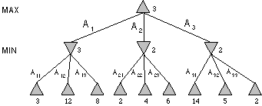
Minimax Tree
MAX node
MIN node
value computed
by minimax
f value

Slide 30
Is that all there is to simple games?

Slide 31
Alpha-beta pruning
Improve on performance of the minimax algorithm through alpha-beta pruning
“If you have an idea that is surely bad, don't take the time to see how truly awful it is” -- Pat Winston
MAX
>=2
We don’t need to compute the value at this node
No matter what it is, it can’t affect value of the root node
MIN
=2
<=1
MAX
2
7
1
?

Slide 32
Alpha-beta pruning
Traverse search tree in depth-first order
At MAX node n, alpha(n) = max value found so far
At MIN node n, beta(n) = min value found so far
Alpha values start at -∞ and only increase, while beta values start at +∞ and only decrease
Beta cutoff: Given MAX node n, cut off search below n (i.e., don’t examine any more of n’s children) if alpha(n) >= beta(i) for some MIN node ancestor i of n
Alpha cutoff: stop searching below MIN node n if beta(n) <= alpha(i) for some MAX node ancestor i of n

Slide 33
Alpha-Beta Tic-Tac-Toe Example

Slide 34
Alpha-Beta Tic-Tac-Toe Example
The beta value of a MIN
node is an upper bound on
the final backed-up value.
It can never increase
β = 2
2

Slide 35
Alpha-Beta Tic-Tac-Toe Example
The beta value of a MIN
node is an upper bound on
the final backed-up value.
It can never increase
β = 1
2
1

Slide 36
Alpha-Beta Tic-Tac-Toe Example
α = 1
The alpha value of a MAX
node is a lower bound on
the final backed-up value.
It can never decrease
β = 1
2
1

Slide 37
Alpha-Beta Tic-Tac-Toe Example
α = 1
β = 1
β = -1
2
1
-1

Slide 38
Alpha-Beta Tic-Tac-Toe Example
α = 1
β = 1
β = -1
Search can be discontinued below
any MIN node whose beta value is
less than or equal to the alpha value
of one of its MAX ancestors
2
1
-1

Slide 39
Alpha-beta general example
MAX
3
MIN
3
2 - prune
14
1 - prune
3
12
8
2
14
1

Slide 40
Alpha-Beta Tic-Tac-Toe Example 2
0
5
-3
3
3
-3
0
2
-2
3
5
2
5
-5
0
1
5
1
-3
0
-5
5
-3
3
2

Slide 41
0
0
5
-3
3
3
-3
0
2
-2
3
5
2
5
-5
0
1
5
1
-3
0
-5
5
-3
3
2

Slide 42
0
0
0
5
-3
3
3
-3
0
2
-2
3
5
2
5
-5
0
1
5
1
-3
0
-5
5
-3
3
2

Slide 43
0
0
-3
0
5
-3
3
3
-3
0
2
-2
3
5
2
5
-5
0
1
5
1
-3
0
-5
5
-3
3
2

Slide 44
0
0
-3
0
5
-3
3
3
-3
0
2
-2
3
5
2
5
-5
0
1
5
1
-3
0
-5
5
-3
3
2

Slide 45
0
0
0
-3
0
5
-3
3
3
-3
0
2
-2
3
5
2
5
-5
0
1
5
1
-3
0
-5
5
-3
3
2

Slide 46
0
0
3
0
-3
3
0
5
-3
3
3
-3
0
2
-2
3
5
2
5
-5
0
1
5
1
-3
0
-5
5
-3
3
2

Slide 47
0
0
3
0
-3
3
0
5
-3
3
3
-3
0
2
-2
3
5
2
5
-5
0
1
5
1
-3
0
-5
5
-3
3
2

Slide 48
0
0
0
0
3
0
-3
3
0
5
-3
3
3
-3
0
2
-2
3
5
2
5
-5
0
1
5
1
-3
0
-5
5
-3
3
2

Slide 49
0
0
0
0
3
0
-3
3
5
0
5
-3
3
3
-3
0
2
-2
3
5
2
5
-5
0
1
5
1
-3
0
-5
5
-3
3
2

Slide 50
0
0
0
0
3
2
0
-3
3
2
0
5
-3
3
3
-3
0
2
-2
3
5
2
5
-5
0
1
5
1
-3
0
-5
5
-3
3
2

Slide 51
0
0
0
0
3
2
0
-3
3
2
0
5
-3
3
3
-3
0
2
-2
3
5
2
5
-5
0
1
5
1
-3
0
-5
5
-3
3
2

Slide 52
0
0
2
0
2
0
3
2
0
-3
3
2
0
5
-3
3
3
-3
0
2
-2
3
5
2
5
-5
0
1
5
1
-3
0
-5
5
-3
3
2

Slide 53
0
0
2
0
2
0
3
2
0
-3
3
2
0
5
-3
3
3
-3
0
2
-2
3
5
2
5
-5
0
1
5
1
-3
0
-5
5
-3
3
2

Slide 54
0
0
0
2
0
2
0
3
2
0
-3
3
2
0
5
-3
3
3
-3
0
2
-2
3
5
2
5
-5
0
1
5
1
-3
0
-5
5
-3
3
2

Slide 55
0
0
0
2
0
2
0
3
2
0
-3
3
2
5
0
5
-3
3
3
-3
0
2
-2
3
5
2
5
-5
0
1
5
1
-3
0
-5
5
-3
3
2

Slide 56
0
0
0
2
0
2
0
3
2
1
0
-3
3
2
1
0
5
-3
3
3
-3
0
2
-2
3
5
2
5
-5
0
1
5
1
-3
0
-5
5
-3
3
2

Slide 57
0
0
0
2
0
2
0
3
2
1
0
-3
3
2
1
-3
0
5
-3
3
3
-3
0
2
-2
3
5
2
5
-5
0
1
5
1
-3
0
-5
5
-3
3
2

Slide 58
0
0
0
2
0
2
0
3
2
1
0
-3
3
2
1
-3
0
5
-3
3
3
-3
0
2
-2
3
5
2
5
-5
0
1
5
1
-3
0
-5
5
-3
3
2

Slide 59
0
0
0
2
1
0
2
1
0
3
2
1
0
-3
3
2
1
-3
0
5
-3
3
3
-3
0
2
-2
3
5
2
5
-5
0
1
5
1
-3
0
-5
5
-3
3
2

Slide 60
0
0
0
2
1
0
2
1
0
3
2
1
0
-3
3
2
1
-3
-5
0
5
-3
3
3
-3
0
2
-2
3
5
2
5
-5
0
1
5
1
-3
0
-5
5
-3
3
2

Slide 61
0
0
0
2
1
0
2
1
0
3
2
1
0
-3
3
2
1
-3
-5
0
5
-3
3
3
-3
0
2
-2
3
5
2
5
-5
0
1
5
1
-3
0
-5
5
-3
3
2

Slide 62
0
0
0
2
1
0
2
1
-5
0
3
2
1
-5
0
-3
3
2
1
-3
-5
0
5
-3
3
3
-3
0
2
-2
3
5
2
5
-5
0
1
5
1
-3
0
-5
5
-3
3
2

Slide 63
0
0
0
2
1
0
2
1
-5
0
3
2
1
-5
0
-3
3
2
1
-3
-5
0
5
-3
3
3
-3
0
2
-2
3
5
2
5
-5
0
1
5
1
-3
0
-5
5
-3
3
2

Slide 64
1
0
1
0
2
1
0
2
1
-5
0
3
2
1
-5
0
-3
3
2
1
-3
-5
0
5
-3
3
3
-3
0
2
-2
3
5
2
5
-5
0
1
5
1
-3
0
-5
5
-3
3
2

Slide 65
1
0
1
0
2
1
2
0
2
1
-5
2
0
3
2
1
-5
2
0
-3
3
2
1
-3
-5
2
0
5
-3
3
3
-3
0
2
-2
3
5
2
5
-5
0
1
5
1
-3
0
-5
5
-3
3
2

Slide 66
1
0
1
0
2
1
2
0
2
1
-5
2
0
3
2
1
-5
2
0
-3
3
2
1
-3
-5
2
0
5
-3
3
3
-3
0
2
-2
3
5
2
5
-5
0
1
5
1
-3
0
-5
5
-3
3
2

Slide 67
Alpha-beta algorithm
function MAX-VALUE (state, α, β)
;; α = best MAX so far; β = best MIN
if TERMINAL-TEST (state) then return UTILITY(state)
v := -∞
for each s in SUCCESSORS (state) do
v := MAX (v, MIN-VALUE (s, α, β))
if v >= β then return v
α := MAX (α, v)
end
return v
function MIN-VALUE (state, α, β)
if TERMINAL-TEST (state) then return UTILITY(state)
v := ∞
for each s in SUCCESSORS (state) do
v := MIN (v, MAX-VALUE (s, α, β))
if v <= α then return v
β := MIN (β, v)
end
return v

Slide 68
Effectiveness of alpha-beta
Alpha-beta guaranteed to compute same value for root node as minimax, but with ≤ computation
Worst case: no pruning, examine b^{d} leaf nodes, where nodes have b children & d-ply search is done
Best case: examine only (2b)^{d/2} leaf nodes
You can search twice as deep as minimax!
Occurs if each player’s best move is 1st alternative
In Deep Blue’s alpha-beta pruning, average branching factor at node was ~6 instead of ~35!

Slide 69
Other Improvements
Adaptive horizon + iterative deepening
Extended search: retain k>1 best paths (not just one) extend tree at greater depth below their leaf nodes to help dealing with “horizon effect”
Singular extension: If move is obviously better than others in node at horizon h, expand it
Use transposition tables to deal with repeated states
Null-move search: assume player forfeits move; do a shallow analysis of tree; result must surely be worse than if player had moved. Can be used to recognize moves that should be explored fully.

